Slide 1
STUDIO-AFRIK 28 JULY 2024
Movie Datasets, 2010 - 2019
Analysis by: James Kamau

Slide 2
Overview
This project analysis dataset is from im.db & tn.movie_budgets.csv.
Both datasets contain information from 2010 - 2019 about movie production
The most equitable actions has to be taken to produce quality analysis for a start-up business like Studio-Afrik.

Slide 3
Business Understanding
Studio-Afrik aims to venture into film production but have no idea about this industry:
Type of problem to solve
Factors to consider
Types of Genre
Return of Investment in the industry

Slide 4
Data Understanding
Dataset Used
Im.db
tn.movie_budgets.csv
Measures Used
From 2010 up to 2019
Genre, , Aircraft Service

Slide 5
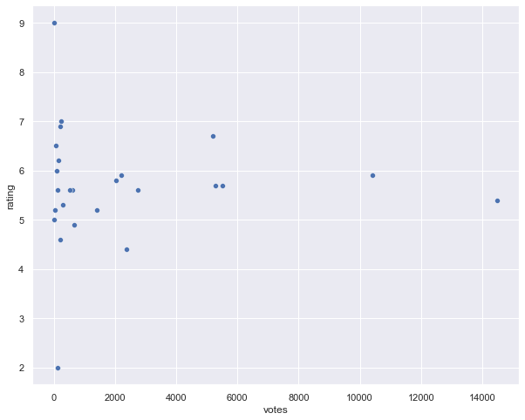
Genre ratings based on votes Ratings is not picked as observed but by comparing it to high number of votes.

Slide 6
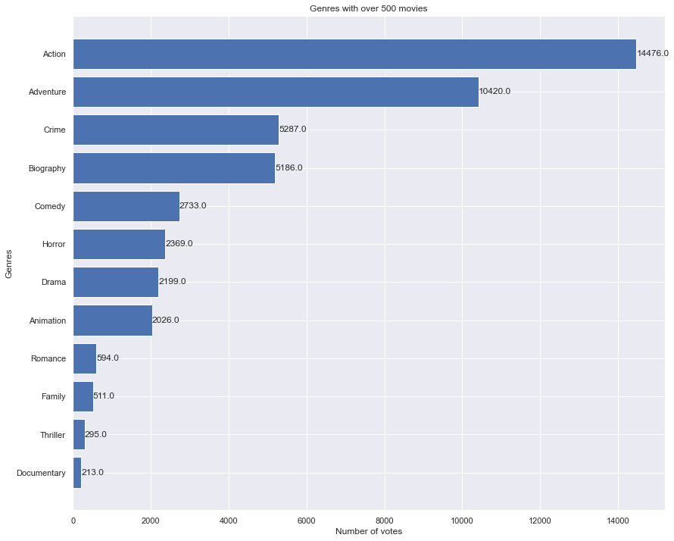
Genre with over 500 movies This will help in picking in relevant genres for filming.

Slide 7
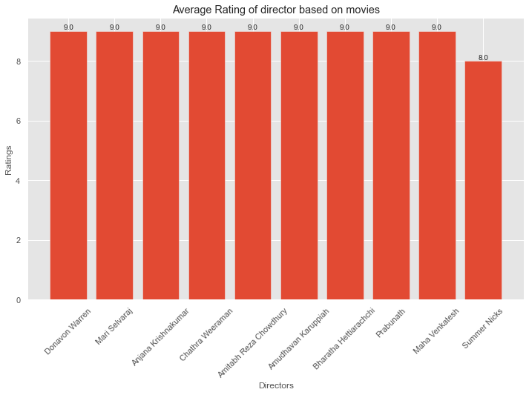
Directors to Hire This will help in production of movies with a higher rating.

Slide 8
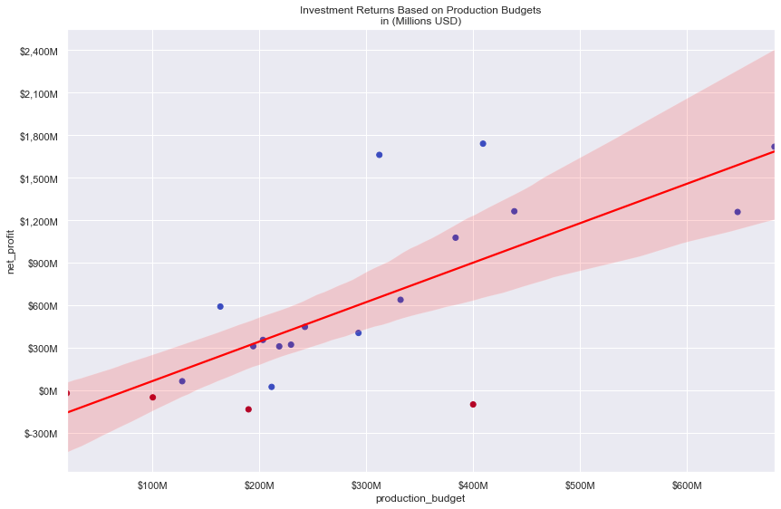
Return of Investments Investing well in production budget tends to gain high profit returns.

Slide 9
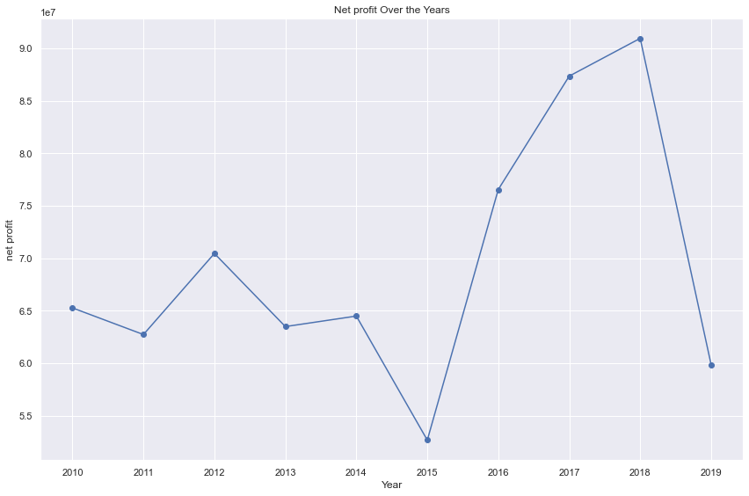
Yearly Return of Investments

Slide 10
Conclusion
Recommendation
Picking top rated genres with highest number of votes and over 500 movies.
Hire directors with a high average movie rating and votes are above average votes.
Invest in production budget to attain a high return in investments.

