Slide 1
Interaction Design and Development II: Requirements & Beyond
SPRING 2020
DR MARK FREEMAN

Slide 2
Week | Topic | Reading
1 | Introduction to HCI; Design Principles | Chapter 1
2 | User-Centred Design Process | Chapter 2 & 3 / Gould et al. (1987)
3 | User Interaction and Interfaces | Chapters 4, 5 & 6 / Shin et al. (2017)
4 | Interaction Design and Development I | Chapters 7 & 8
5 | Interaction Design and Development II | Chapters 9 & 10
6 | Interaction Design and Development III | Chapters 11 & 12
7 | Information Presentation and Design Patterns
8 | Usability Evaluation Methods I | Chapters 13 / Borsci et al. (2015)
9 | Usability Evaluation Methods II | Chapter 14, 15 & 16
10 | Accessibility and Special Issues in HCI | Online: WCAG2.0
11 | Models, Theories and Risks | MacKenzie (1992)
12 | Mixed Reality and Future HCI
13 | Subject Revision

Slide 3
This Week
Brief review of last week
Beyond Requirements for UI/UX
Scenarios and Personas
Style Guides
Card Sorts
Hierarchical Task Analysis (HTA)
Class Activities
Card Sort
HTA

Slide 4
Subject Description
The subject provides students with an understanding of Human Computer Interaction (HCI) principles and practices, and how to apply them in the context of developing usable interactive computer applications and systems. The subject also emphasises the importance of taking into account contextual, organisational, and social factors in the design of computer systems. Students will be taken through the analysis, design, development, and evaluation of user interfaces. They will acquire hands-on design skills through an interaction design project. The subject will cover topics including user-centred design, the development process, prototyping, usability testing, measuring and evaluating the user experience and accessibility.

Slide 5
Subject Learning Outcomes (SLOs)
On successful completion of this subject, students will be able to:
  Identify and describe HCI principles and design issues.
  Discuss and justify HCI solutions based on design principles.
  Demonstrate an understanding of the HCI design process.
  Acquire skills to design and implement user-centred design.
  Select and use suitable methods of measuring and evaluating the user experience.

Slide 6
Techniques for Data Gathering
Other systems / Processes (Market Analysis)
Business Documents
Observation
Interviews
Focus groups
Questionnaires
Use case analysis (for new systems being built)
Requests for {information, proposals, tenders, quotation}
Formal One-on-one
Brainstorming
Notes:
Focus will be on the top techniques

Slide 7
Quantitative and qualitative
Quantitative data
Qualitative data
Quantitative analysis
Qualitative analysis
expressed as numbers
difficult to measure sensibly as numbers, e.g. count number of words to measure dissatisfaction
numerical methods to ascertain size, magnitude, amount
expresses the nature of elements and is represented as themes, patterns, stories

Slide 8
Use Case Description
FOR DESCRIBING FUNCTIONAL REQUIREMENTS
Use Case Name:
Scenario:
Triggering Event:
Brief Description:
Actors:
Related Use Cases:
Stakeholders:
Pre-conditions:
Post-conditions:
Flow of Activities: | Actor | System
Exceptions:

Slide 9
Consider CRUD
Create
Update
Delete
Read

Slide 10
FRUPS+
A WAY OF CATEGORISING REQUIREMENTS
Functionality
Usability
Reliability
Performance
Security
+
Constrains, standards, physical, other systems, etc.

Slide 11
Remember: Importance of Involving Users
Management Expectation
Realistic expectations
No surprises, no disappointments
Timely training
Communication, but no hype
Ownership
Make the users active stakeholders
More likely to forgive or accept problems
Can make a big difference to acceptance and success of product

Slide 12
Degree of ‘user’ Involvement
DIFFERENT LEVELS FROM DIFFERENT ‘USERS’
Notes:
Member of the design team
Full time: constant input, but lose touch with users
Part time: patchy input, and very stressful
Short term: inconsistent across project life
Long term: consistent, but lose touch with users
Newsletters and other dissemination devices
Reach wider selection of users
Need communication both ways
User involvement after product is released
Combination of these approaches

Slide 13
Who are the users/stakeholders?
Not as obvious as you think:
  those who interact directly with the product
  those who manage direct users
  those who receive output from the product
  those who make the purchasing decision
  those who use competitor’s products
Three categories of a user (Eason, 1987):
  Primary: frequent hands-on
  Secondary: occasional or via someone else
  Tertiary: affected by its introduction, or will influence its purchase
www.id-book.com

Slide 14
What do we mean by the user’s ‘needs’?
ALSO CONSIDER WHEN CONDUCTING INTERVIEWS
Users rarely know what is possible
Sometimes users can’t tell you what they ‘need’ to help them achieve their goals – may tell you about their wants
Instead, look at existing tasks:
  their context
  what information do they require?
  who collaborates to achieve the task?
  why is the task achieved the way it is?

Slide 15
Establishing requirements
What do users want?
What do users ‘need’?
Notes:
Requirements need clarification, refinement, completion, re-scoping
Input: Requirements document from client (maybe)
Output: stable requirements
Why ‘establish’?
Requirements arise from understanding users’ needs
Requirements can be justified & related to data

Slide 16
Constantly Think: Alternative Solutions
USERS USUALLY KNOW WHAT CURRENTLY WORKS AND THINK THAT IS THE ONLY WAY
Your task is to come up with different designs and different concepts

Slide 17
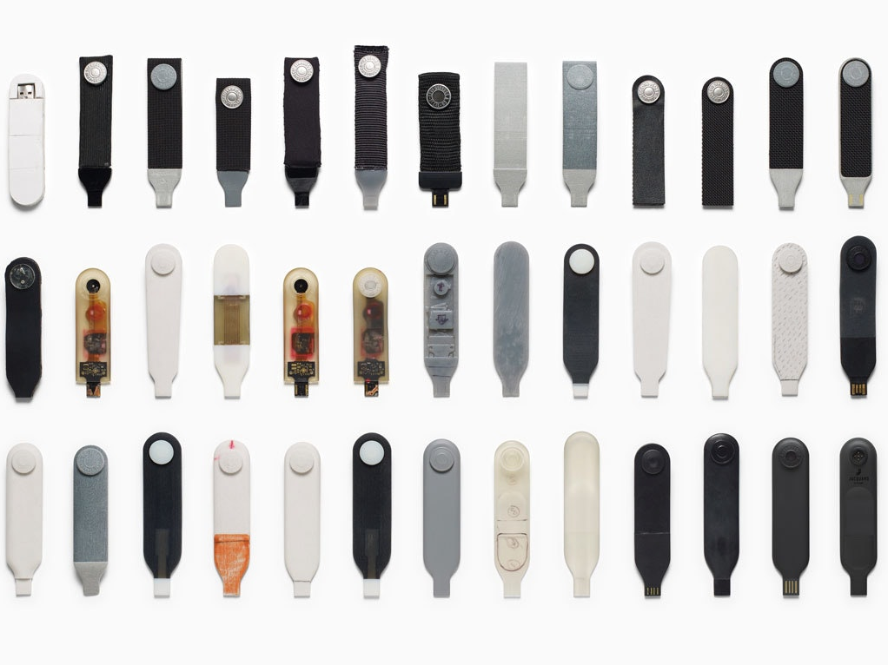

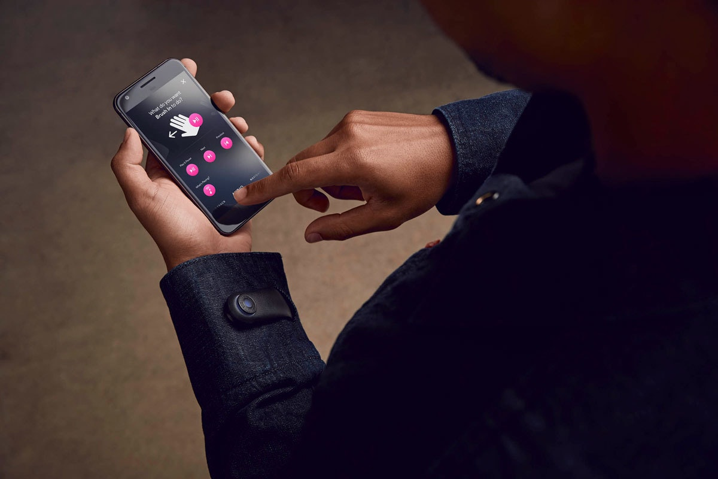
Levi’s Commuter Trucker Jacket with Jacquard by Google
Notes:
For details of the development and product see: https://www.ideo.com/case-study/designing-the-levis-commuter-trucker-jacket-with-jacquard-by-google

Slide 18
How to choose among alternatives
Evaluation with ‘users’, e.g. prototypes
Technical feasibility: some not possible
Quality thresholds: Usability goals lead to usability criteria set early on and check regularly
  Safety
  Utility
  Effectiveness
  efficiency
  learnability
  memorability

Slide 19
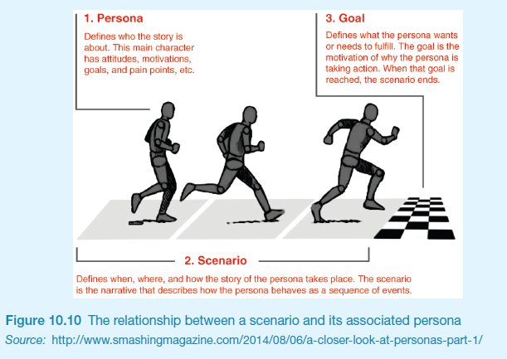
Scenarios and Personas

Slide 20
Scenarios
A story about the process of a user achieving an action or a goal
How a user would perform tasks in a planned system
Consider:
  User motivations
  Processes
Traditionally written, but can be in the form of a storyboard, flow diagram or journey map
Designed around typical users
Scenarios are linked to user personas

Slide 21
Personas
“Personas are fictional characters, which you create based upon your research in order to represent the different user types that might use your service, product, site, or brand in a similar way. “ (Dam and Siang, 2018)
Capture a set of user characteristics (user profile)
Fictional characters, but synthesised from real users
Should not be idealised
Bring them to life with a name, characteristics, goals, attitudes, personal background, expected system use
Develop a small set of personas with one primary

Slide 22
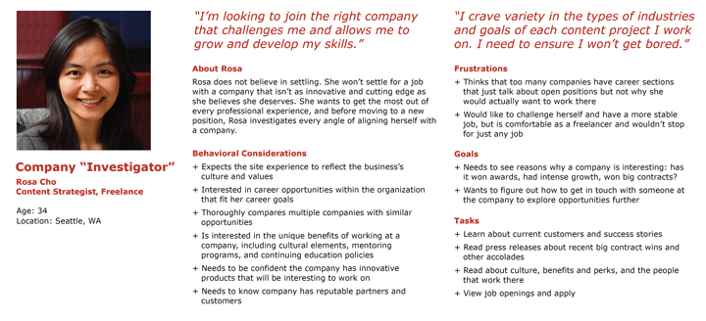
Example: NN/g
■
Watch
Notes:
Watch – link to a You Tube clip by NN/g

Slide 23
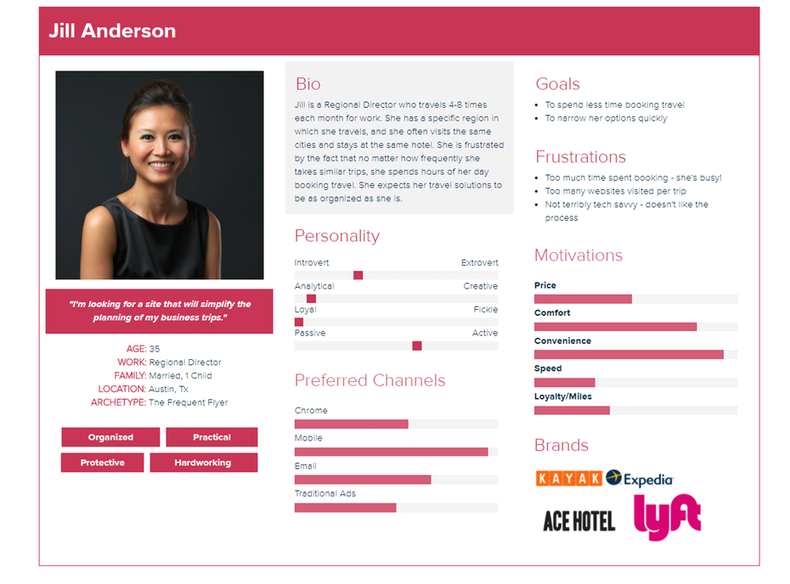
Example: Xtensio
Notes:
Tool – link to the website on how to create a persona.

Slide 24
Task descriptions
Scenarios
  an informal narrative story, simple, ‘natural’, personal, not generalisable
Use cases
  assume interaction with a system
  assume detailed understanding of the interaction
Essential use cases
  abstract away from the details
  does not have the same assumptions as use cases

Slide 25
Scenario for travel organizer
“The Thomson family enjoy outdoor activities and want to try their hand at sailing this year. There are four family members: Sky (10 years old), Eamonn (15 years old), Claire (35), and Will (40). One evening after dinner they decide to start exploring the possibilities. They all gather around the travel organizer and enter their initial set of requirements – a sailing trip for four novices in the Mediterranean. The console is designed so that all members of the family can interact easily and comfortably with it. The system’s initial suggestion is a flotilla, where several crews (with various levels of experience) sail together on separate boats. Sky and Eamonn aren’t very happy at the idea of going on vacation with a group of other people, even though the Thomsons would have their own boat. The travel organizer shows them descriptions of flotillas from other children their ages and they are all very positive, so eventually, everyone agrees to explore flotilla opportunities. Will confirms this recommendation and asks for detailed options. As it’s getting late, he asks for the details to be saved so everyone can consider them tomorrow. The travel organizer emails them a summary of the different options available.”

Slide 26
Using scenarios
Express proposed or imagined situations
Used throughout design in various ways
  as a basis for overall design
  scripts for user evaluation of prototypes
  concrete examples of tasks
  as a means of co-operation across
  professional boundaries
Plus and minus scenarios to explore extreme cases

Slide 27
Use case for travel organizer
The system displays options for investigating visa and vaccination requirements.
The user chooses the option to find out about visa requirements.
The system prompts user for the name of the destination country.
The user enters the country’s name.
The system checks that the country is valid.
The system prompts the user for her nationality.
The user enters her nationality.
The system checks the visa requirements of the entered country for a passport holder of her nationality.
The system displays the visa requirements.
The system displays the option to print out the visa requirements.
The user chooses to print the requirements.

Slide 28
Alternative courses for travel organizer
Some alternative courses:
6. If the country name is invalid:
6.1 The system displays an error message.
6.2 The system returns to step 3.
8. If the nationality is invalid:
8.1 The system displays an error message.
8.2 The system returns to step 6.
9. If no information about visa requirements is found:
9.1 The system displays a suitable message.
9.2 The system returns to step 1.

Slide 29
Different kinds of UI/UX requirements
CONSIDER WITH FURPS+
Functional:
  What the system should display to the user
Non-functional: security, response time...
Data:
  What kinds of data need to be collected/stored?
  How will they be stored (e.g. database)?
Environment or context of use:
  physical: dusty? noisy? vibration? light? heat? humidity? …. (e.g. ATM)
  social: sharing of files, of displays, in paper, across great distances, synchronous, privacy for client
  organisational: hierarchy, IT department’s attitude and remit, user support, communications structure and infrastructure, availability of training

Slide 30
Style Guides
“All good brands have a great style guide” (stribley, 2018)
NOTE: A style guide for your group project is needed – this should be attached as an appendix and followed in your document and designs

Slide 31
Style Guides (Branding Guidelines)
A document that catalogues:
  Colours
  Font types
  Logos
  Patterns
  Images
  Tone
For consistency in interface designs across an organisation or team

Slide 32
Some Examples

Discuss
UOW
  https://www.uow.edu.au/brand/
NSW Government
  https://communications.dpc.nsw.gov.au/branding/
Apple – App Store Promotion
  https://developer.apple.com/app-store/marketing/guidelines/
Lonely Planet
  http://rizzo.lonelyplanet.com/styleguide/design-elements/colours
Spotify
  https://developer.spotify.com/branding-guidelines/
Facebook
  https://en.facebookbrand.com/

Slide 33
Card Sorting
TYPICALLY CONDUCTED EARLY IN THE DESIGN PHASE OF A PROJECT FOR DEFINING A SYSTEMS ARCHITECTURE

Slide 34
Card Sorting
■
Watch
generate information about the associations and grouping of specific data items
Technology:
  Low-tech method using index cards or post-it notes
  High-tech method (e.g. OptimalWorkshop, uxSort or UserZoom)
Typically conducted as a:
  Series of individual exercises
  Concurrent activity in a small group
  Mixed approach (individual then group discussion - differences)
Open vs. Closed sorts
See:
  http://measuringuserexperience.com/CardSorting/index.htm
  https://www.interaction-design.org/literature/book/the-encyclopedia-of-human-computer-interaction-2nd-ed/card-sorting

Slide 35
Task Analysis
Notes:
Task descriptions are often used to envision new systems or devices
Task analysis is used mainly to investigate an existing situation
It is important not to focus on superficial activities
What are people trying to achieve?
Why are they trying to achieve it?
How are they going about it?
Many techniques, the most popular is Hierarchical Task Analysis (HTA)

Slide 36
Hierarchical Task Analysis
Involves breaking a task down into subtasks, then sub-sub-tasks and so on. These are grouped as plans which specify how the tasks might be performed in practice
HTA focuses on physical and observable actions, and includes looking at actions not related to software or an interaction device
Start with a user goal which is examined and the main tasks for achieving it are identified
Tasks are sub-divided into sub-tasks
More information: http://www.usabilitybok.org/task-analysis

Slide 37
Example Hierarchical Task Analysis
  0. In order to buy a DVD
  1. locate DVD
  2. add DVD to shopping basket
  3. enter payment details
  4. complete address
  5. confirm order
Plan 0: If regular user do 1-2-5.
If new user do 1-2-3-4-5.

Slide 38
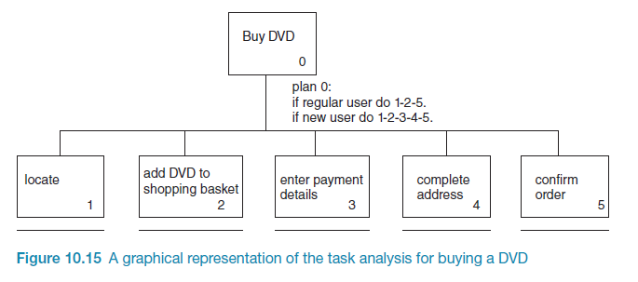
Example Hierarchical Task Analysis (GRAPHICAL)

Slide 39
HTA Example
http://www.uxmatters.com/mt/archives/2010/02/hierarchical-task-analysis.php

Slide 40
Activity 1: Card Sort
Current Students
University management
Degree Structures
Technology
Sport
Library
Research
Study Programmes
Admissions
Study at the university
Moodle
International programmes
Directory
Services
Research Institutes
Organisation chart
Alumni
Faculties
Technological resources
Webmail
Schools

Slide 41
Activity 2: HTA – Borrow a known book
0. To borrow a book from the library
  1. Go to the library
  2. Find the required book
    2.1 access library catalogue
    2.2 access the search screen
    2.3 enter search criteria
    2.4 identify required book
    2.5 note location
  3. Go to correct shelf and retrieve book
  4. Borrow book at self-check-out machine
plan 0: do 1-3-4.
If book isn’t on the expected shelf, do 2-3-4.
plan 2: do 2.1-2.4-2.5.
If book not identified do 2.2-2.3-2.4.
Notes:
Convert to graphical notation

Slide 42
Take Home Message…
When designing the UI/UX for a system you need to think beyond the traditional approaches to come up with creative solutions that meet the needs of multiple stakeholders

Slide 43
Additional Resources
Dam, R. & Siang, T. (2018) “Personas – A Simple Introduction” [Available: https://www.interaction-design.org/literature/article/personas-why-and-how-you-should-use-them]
Harley, A. (2015) “Personas Make Users Memorable for Product Team Members” [Available: https://www.nngroup.com/articles/persona/]
Gregersen, H. (2018) “Better Brainstorming”, Harvard Business Review, March-April.
IDEO (2017) “Designing the Levi’s Commuter Trucker Jacket with Jacquard by Google” [Available: https://www.ideo.com/case-study/designing-the-levis-commuter-trucker-jacket-with-jacquard-by-google]
Stribley, M. (2018) “50 meticulous style guides every startup should see before launching” [Available: https://www.canva.com/learn/50-meticulous-style-guides-every-startup-see-launching/]

Slide 44
Things
to think
about
Personas and Scenarios
Card Sorting
Hierarchical Task Analysis

Slide 45
Questions

