Slide 1
Interaction Design and Development III: Prototyping
SPRING 2020
DR MARK FREEMAN

Slide 2
Week | Topic | Reading
1 | Introduction to HCI; Design Principles | Chapter 1
2 | User-Centred Design Process | Chapter 2 & 3 / Gould et al. (1987)
3 | User Interaction and Interfaces | Chapters 4, 5 & 6 / Shin et al. (2017)
4 | Interaction Design and Development I | Chapters 7 & 8
5 | Interaction Design and Development II | Chapters 9 & 10
6 | Interaction Design and Development III | Chapters 11 & 12
7 | Information Presentation and Design Patterns
8 | Usability Evaluation Methods I | Chapters 13 / Borsci et al. (2015)
9 | Usability Evaluation Methods II | Chapter 14, 15 & 16
10 | Accessibility and Special Issues in HCI | Online: WCAG2.0
11 | Models, Theories and Risks | MacKenzie (1992)
12 | Mixed Reality and Future HCI
13 | Subject Revision

Slide 3
This Week
Review of last week
Lo-Fi prototyping
Wireframing
Storyboards
Hi-Fi prototyping

Slide 4
Subject Description
The subject provides students with an understanding of Human Computer Interaction (HCI) principles and practices, and how to apply them in the context of developing usable interactive computer applications and systems. The subject also emphasises the importance of taking into account contextual, organisational, and social factors in the design of computer systems. Students will be taken through the analysis, design, development, and evaluation of user interfaces. They will acquire hands-on design skills through an interaction design project. The subject will cover topics including user-centred design, the development process, prototyping, usability testing, measuring and evaluating the user experience and accessibility.

Slide 5
Subject Learning Outcomes (SLOs)
On successful completion of this subject, students will be able to:
  Identify and describe HCI principles and design issues.
  Discuss and justify HCI solutions based on design principles.
  Demonstrate an understanding of the HCI design process.
  Acquire skills to design and implement user-centred design.
  Select and use suitable methods of measuring and evaluating the user experience.

Slide 6
What did we discuss last week?

Slide 7
Information Architecture (IA)
Organising and structuring content of systems
Card Sort to involve users in the design of IA
Focus:
  Organisation, Structuring and labelling of content
  Allows an understanding for users to find information and compete the tasks on a system
https://www.usability.gov/what-and-why/information-architecture.html
http://www.uxbooth.com/articles/complete-beginners-guide-to-information-architecture/
https://uxplanet.org/information-architecture-basics-for-designers-b5d43df62e20

Slide 8
Information Architecture
“IA is a blueprint of the design structure which can be generated into wireframes and sitemaps of the project. UX designers use them as the basic materials so that they could plan navigation system.” (Tubik Studio, 2017)

Slide 9
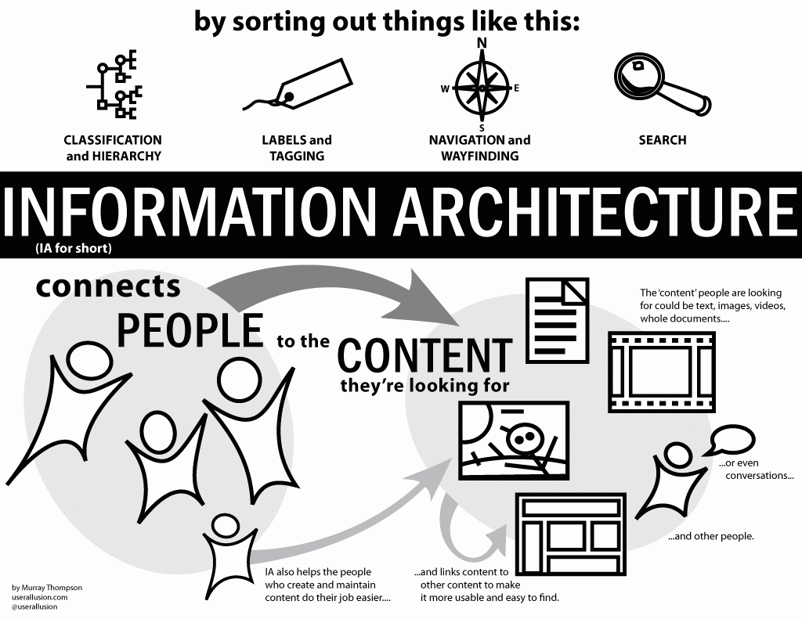

Slide 10
Chapter 11: Overview
DESIGN, PROTOTYPING and CONSTRUCTION
Prototyping
Conceptual design
Concrete design
Using scenarios
Generating prototypes
Construction

Slide 11
Prototyping
What is a prototype?
Why prototype?
Different kinds of prototyping
  Low fidelity (Lo-Fi)
  High fidelity (Hi-Fi)
Compromises in prototyping
  Vertical: provide a wide range of functions, but with little detail
  Horizontal: provide a lot of detail for only a few functions
Final product needs to be engineered

Slide 12
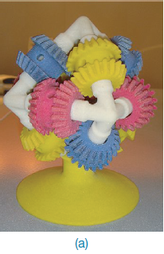
What is a prototype?
In other design fields a prototype is a small-scale model:
  a miniature car
  a miniature building or town
  the examples here come
  from a 3D printer
www.id-book.com

Slide 13
What is a prototype?
In interaction design it can be (among other things):
  a series of screen sketches
  a storyboard, i.e. a cartoon-like series of scenes
  a PowerPoint slide show
  a video simulating the use of a system
  a lump of wood (e.g. PalmPilot)
  a cardboard mock-up
  a piece of software with limited functionality written in the target language or in another language
www.id-book.com

Slide 14
Why prototype?
Evaluation and feedback are central to interaction design
Stakeholders can see, hold, interact with a prototype more easily than a document or a drawing
Team members can communicate effectively
You can test out ideas for yourself
It encourages reflection: very important aspect of design
Prototypes answer questions, and support designers in choosing between alternatives
www.id-book.com

Slide 15
What to prototype?
Technical issues
Work flow, task design
Screen layouts and information display
Difficult, controversial, critical areas
www.id-book.com

Slide 16
Conceptual design
Transform user requirements/needs into a conceptual model
A conceptual model is an outline of what people can do with a product and what concepts are needed to understand and interact with it
Mood board may be used to capture feel
Consider alternatives: prototyping helps

Slide 17
Concrete design
Many aspects to concrete design
  Colour, icons, buttons, interaction devices etc.
User characteristics and context
  Accessibility, cross-cultural design
Cultural website guidelines
  successful products “are … bundles of social solutions. Inventors succeed in a particular culture because they understand the values, institutional arrangements, and economic notions of that culture.”

Slide 18
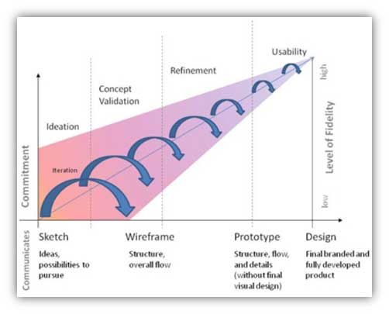
https://www.usability.gov/how-to-and-tools/methods/prototyping.html

Slide 19
Basic Process
Research
Lo-Fi Testing
Hi-Fi
Lo-Fi
Hi-Fi Testing
Delivery

Slide 20
Low-Fidelity

Slide 21
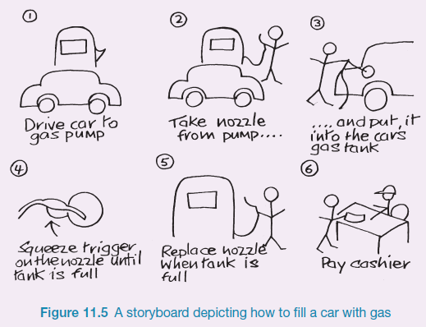
Sketching
Sketching is important to low-fidelity prototyping
Don’t be inhibited about drawing ability. Practice simple symbols

Slide 22
Wireframes
2D illustration of a page’s interface
Focus:
  Space allocation
  Functions
  Content sections
  Intended behaviours
Traditionally
  No styling
  No colour
  No graphics
Designed to develop relationships with a systems templates

Slide 23
The value of Wireframing
Identify the interfaces functionality
Identify a pages space allocation
Ensure consistency for particular elements in an interface
Links between a systems information architecture and its visual design

Slide 24
What elements do you want to be consistent?
Logo
Search
Headers
Menus
Footers
…

Slide 25
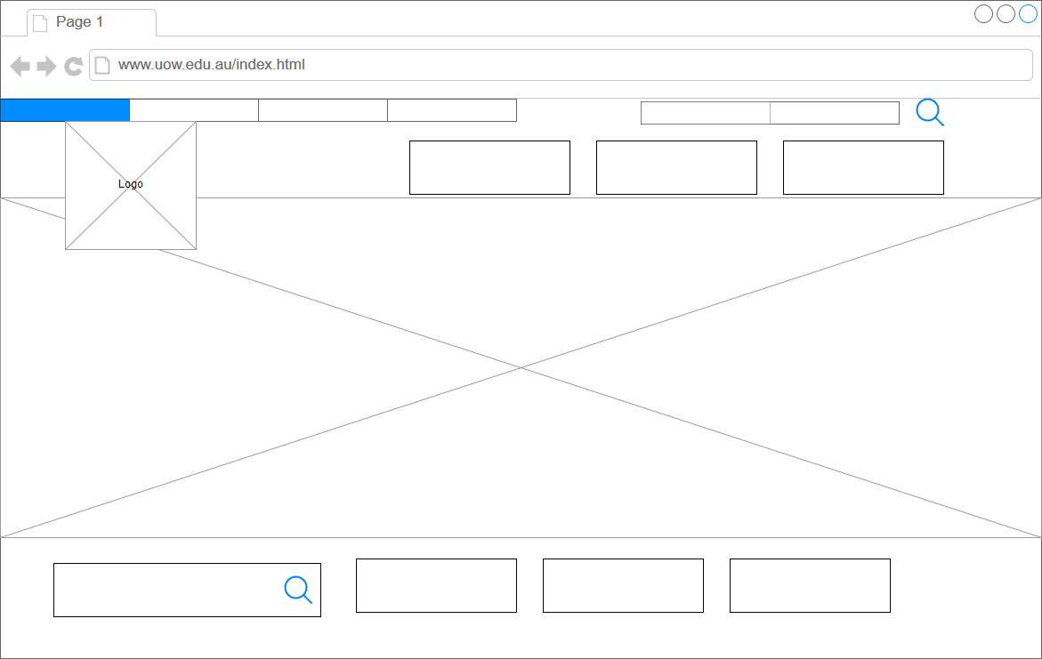
Basic Wireframe of Old UOW Homepage

Slide 26
Low-Fidelity Prototyping
Uses a medium which is unlike the final medium
  e.g. paper, cardboard
Examples:
  sketches of screens (wireframes), task sequences, etc.
  ‘post-it’ notes
  storyboards

Slide 27
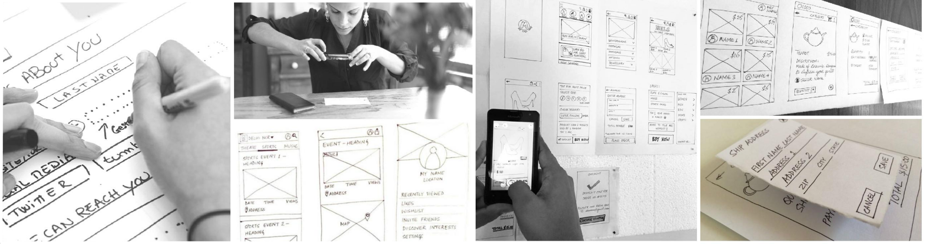
Ideas

Slide 28
Low-Fidelity – Advantages
Quick
  Does not take long to develop
Cheap
Easily changed
  Even during testing
Designers feel less attached to lo-fi prototypes
Stakeholders recognise that the work is not finished

Slide 29
Low-Fidelity – Disadvantages
Can be uncertainty during testing
  What is the design showing?
  How will the interaction work?
Requires imagination by the user
Limited interactivity to show complex elements
  Animations
  Transitions

Slide 30
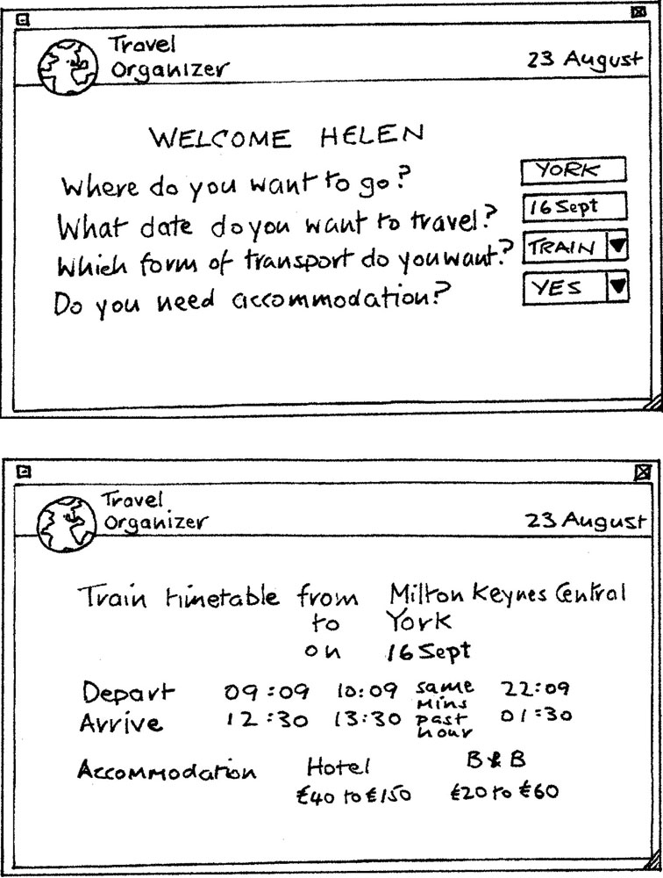
Card-based prototypes
  Each card represents
  one screen or part of screen

Slide 31
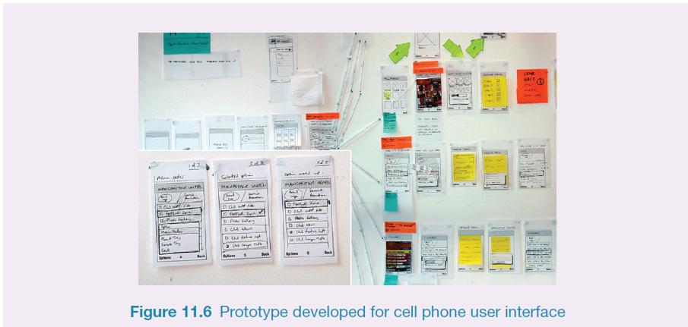
Generate card-based prototype from use case

Slide 32
Storyboards
Designed to illustrate the interaction between the user and the product
Drawings, sketches and pictures that tell a story
Creates meaning beyond a typical technical drawing (e.g. flowchart)
https://blogs.msdn.microsoft.com/crm/2006/11/02/using-storyboard-prototypes-in-your-design-process/
http://www.usabilitybok.org/storyboard
https://uxmag.com/articles/storyboarding-in-the-software-design-process

Slide 33
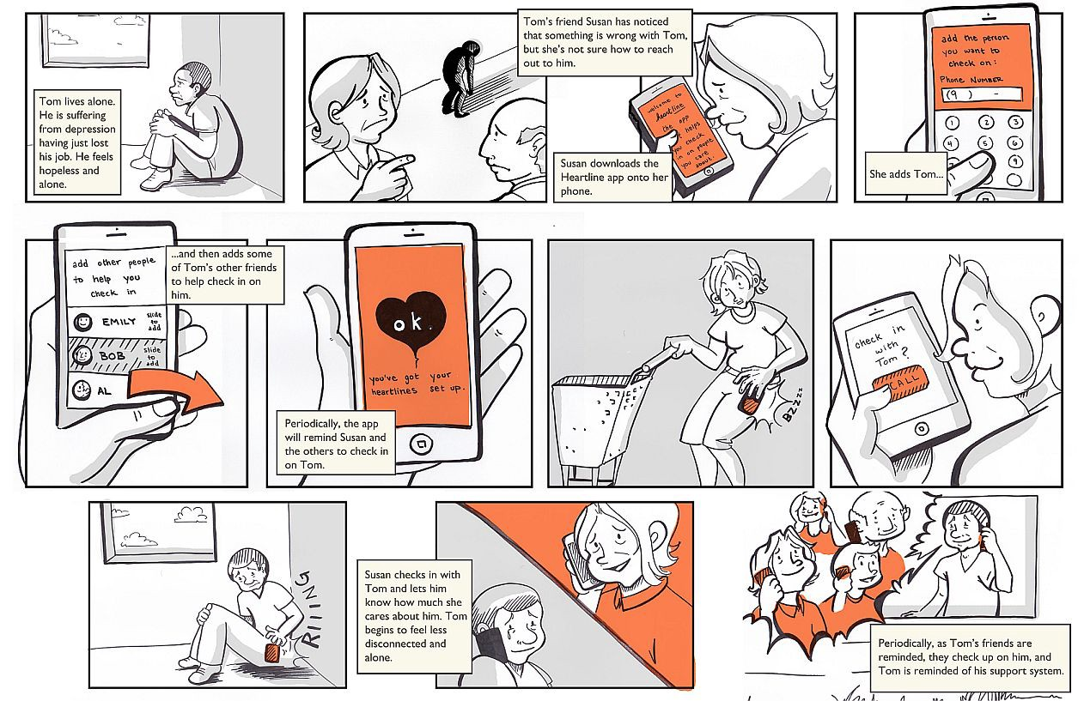
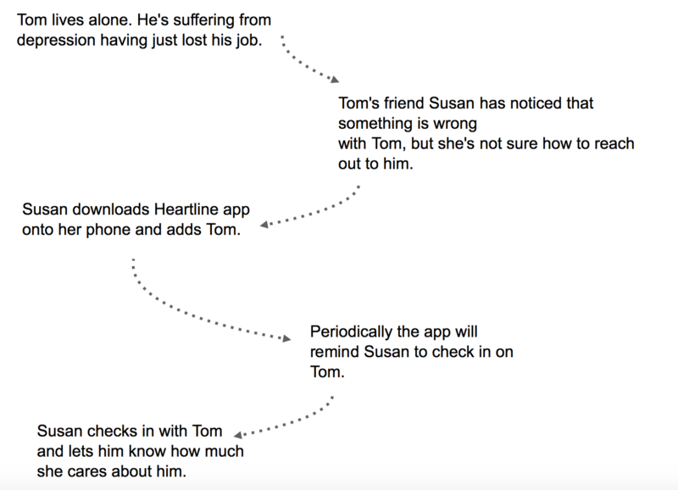
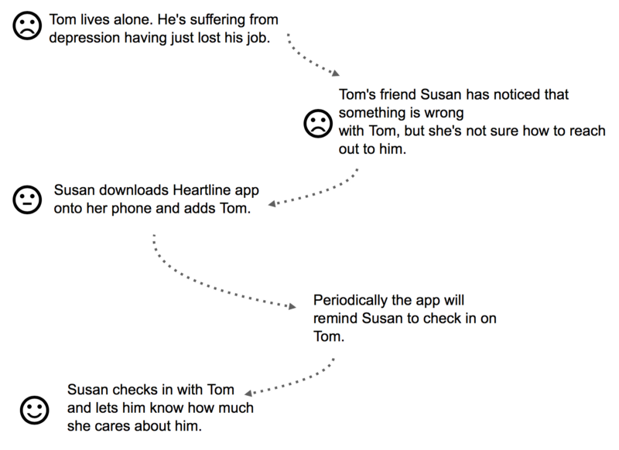
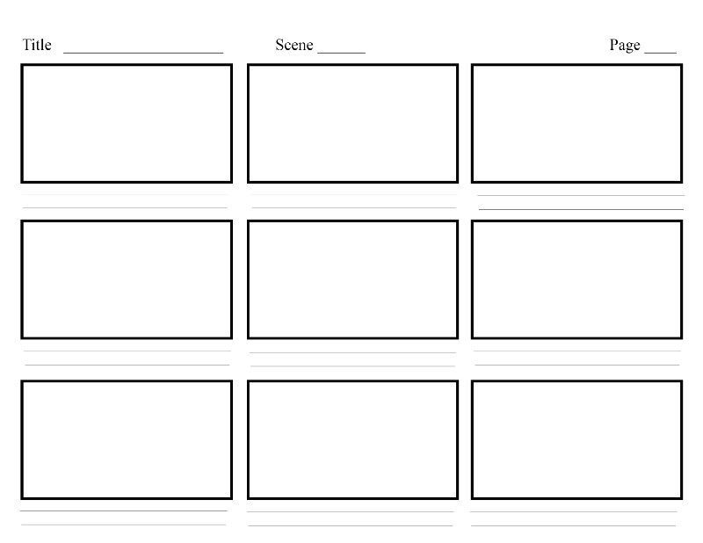
Storyboard - example
https://uxplanet.org/storyboarding-in-ux-design-b9d2e18e5fab

Slide 34
High-Fidelity

Slide 35
High-Fidelity Prototyping
Uses materials that you would expect to be in the final product
  Visual design
  Content
  Interactivity
Prototype looks more like the final system than a low-fidelity version
High-fidelity prototypes can be developed by integrating existing hardware and software components
Danger that users think they have a complete system!

Slide 36
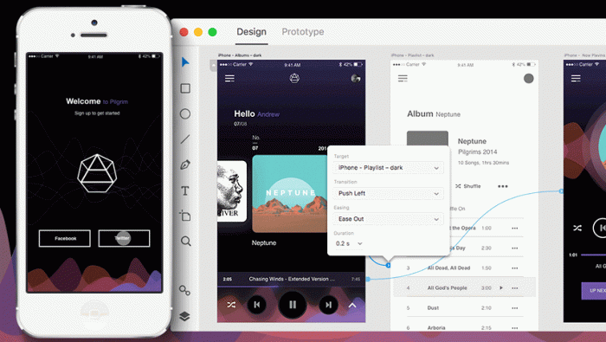
Adobe XD example

Slide 37
High-Fidelity – Advantages
Can show complete functionality
Fully interactive
  Can test workflow
User-driven
Clearly defines navigational scheme
Use for exploration and testing
Look and feel of the final product
Serves as a living specification
Marketing and sales tool

Slide 38
High-Fidelity – Disadvantages
Cost of ‘development’
More resource intensive to develop
Time consuming to create
Inefficient for proof-of-concept designs
Not effective for requirements gathering

Slide 39
Using scenarios
Express proposed or imagined situations
Used throughout design in various ways
  as a basis for overall design
  scripts for user evaluation of prototypes
  concrete examples of tasks
  as a means of co-operation across
  professional boundaries
Plus and minus scenarios to explore extreme cases

Slide 40
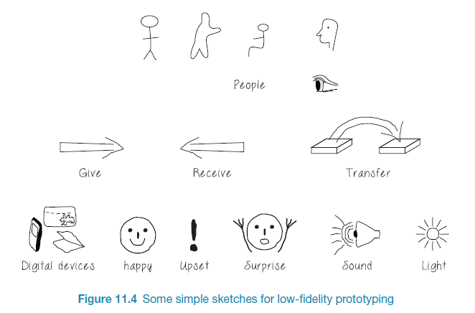
Generate storyboard from scenario

Slide 41
Explore the user’s experience
Use personas, card-based prototypes or post-it-notes to model the user experience
Visual representation called:
  design map
  customer/user journey map
  experience map
Two common representations
  wheel
  timeline

Slide 42
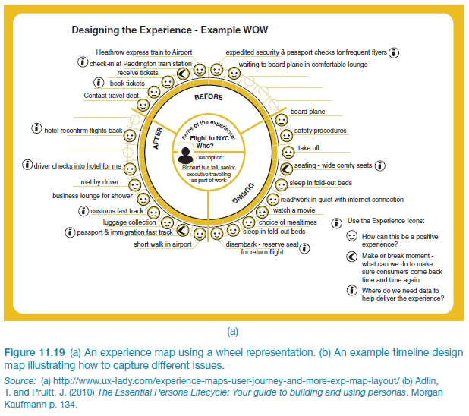
An experience map drawn as a wheel

Slide 43
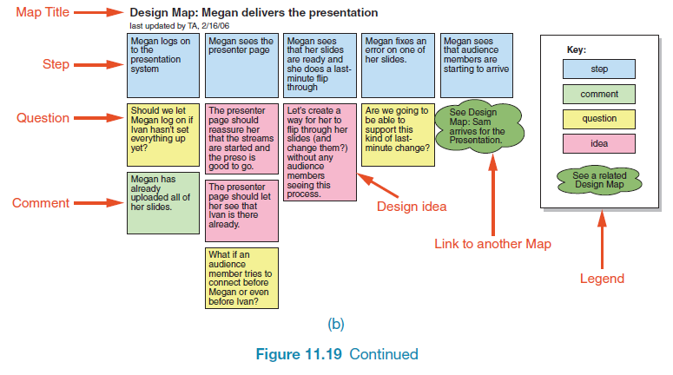
An experience map drawn as a timeline

Slide 44
Testable Prototype
A candidate design solution
Watch users work with an actual example of the system
Options
  Single page vs multipage prototypes
  Realistic and detailed vs hand sketched
  Interactive vs static
https://www.nngroup.com/articles/ux-prototype-hi-lo-fidelity/

Slide 45
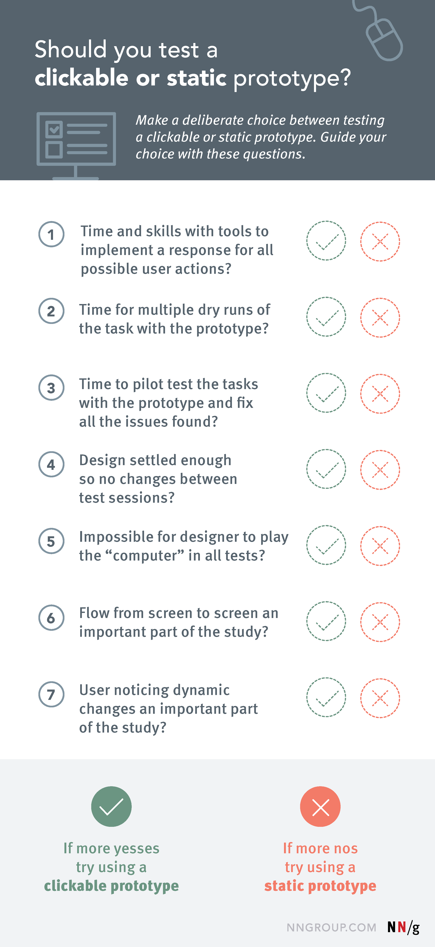
NN/g

Tool
https://www.nngroup.com/articles/ux-prototype-hi-lo-fidelity/

Slide 46
Example Tools
Axure RP
Adobe XD
Figma
Balsamiq
JustInMind
UXPin
Mockplus
Pencil
I don’t recommend any specific tool for your project; you can decide which tool is the right one for you.

Slide 47
Construction: physical computing
Build and code prototypes using electronics
Toolkits available include
  Arduino
  LilyPad (for fabrics)
  Senseboard
  MaKey MaKey
  Raspberry Pi
  Partice
Designed for use by wide range of people

Slide 48
Human Interface Guidelines
Apple
Windows
Android
Ubuntu
Links are available on Moodle

Slide 49
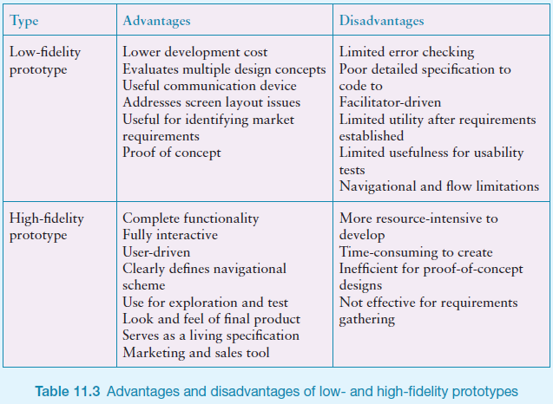

Slide 50
Take Home Message…
Consider the message that you want to create when designing your interfaces.

Slide 51
References and Resources
Babich, N. (2017) “Prototyping 101: The Difference between Low-Fidelity and High-Fidelity Prototypes and When to Use Each” [Available: https://theblog.adobe.com/prototyping-difference-low-fidelity-high-fidelity-prototypes-use/]
CanvasFlip (2016) “The art of UX sketching and paper” [Available: https://uxplanet.org/the-art-of-ux-sketching-and-paper-prototyping-5dae5a1efc7d]
Interaction Design Foundation (2016) “UX Tools: Wireframing and Prototyping Tools [Available: https://www.interaction-design.org/literature/article/ux-tools-wireframing-and-prototyping-tools]
Tubik Studio (2017) “Information Architecture. Basics for Designers” [Available: https://uxplanet.org/information-architecture-basics-for-designers-b5d43df62e20]

Slide 52
Things
to think
about
What is the purpose of prototyping?
What is the difference between Lo-fi and Hi-fi designs?
What is a storyboard? When can these be used?
What should you show your client?

Slide 53
Questions

