Slide 1
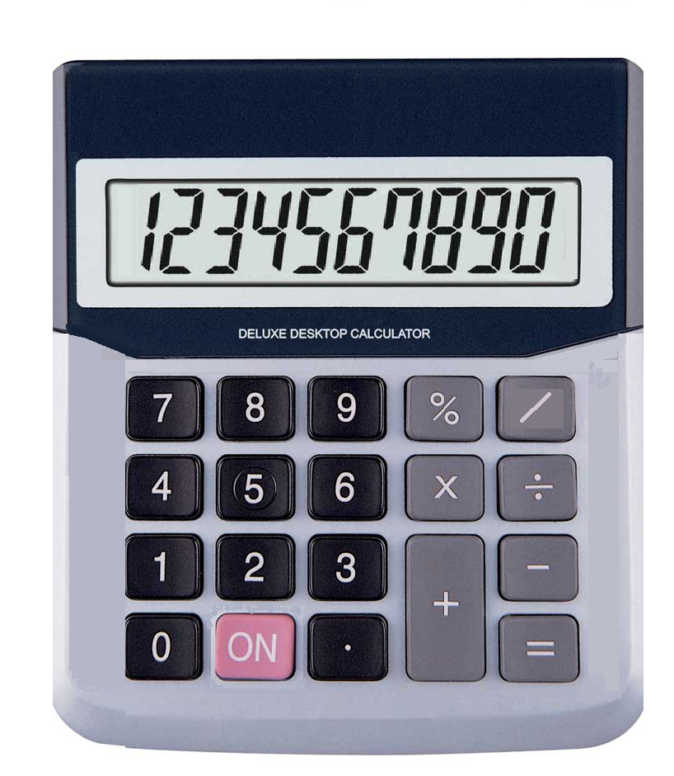
CALCULATOR
NAME:LAVADIYA KAMAKSHI BAI
ORGANIZATION:MICRO IT
TOPIC:CALCULATOR

Slide 2

INTRODUCTION
Purpose of the project: To develop a basic calculator to perform arithmetic operations.
Tools used: (e.g.,python,javascript,java,etc.)

Slide 3

OBJECTIVES
Build a user-friendly interface.
Perform basic operations:addition,subtraction,multiplication and division.
Ensure accuracy and error handling.

Slide 4

TOOLS & TECHNOLOGIES
Programming languages: (e.g,python with tkinter,HTML/CSS/JS,java)
IDE: (e.g VS code,pycharm,Eclipse)
Platform: Desktop/web

Slide 5
FEATURES
Simple GUI or CLI (as per project)
Real-time calculations
Error handling (e.g., division by zero)

Slide 6

DESIGN
Include a screenshot of the calculator interface (GUI or CLI)
Briefly explain layout: buttons,display screen,etc.

Slide 7
CODE OVERVIEW
Show key parts of the code (e.g., function for addition ,event handler)
Keep it readable and brief

Slide 8
DEMO
calculator program in javascript

Slide 9
CHALLENGES FACED
Handling floating point errors
Managing user input
Designing a responsive UI

Slide 10
CONCLUSION
Summary of what was achieved
Future improvements (e.g., scientific functionos,history of operations)

Slide 11
THANK YOU

