Slide 1
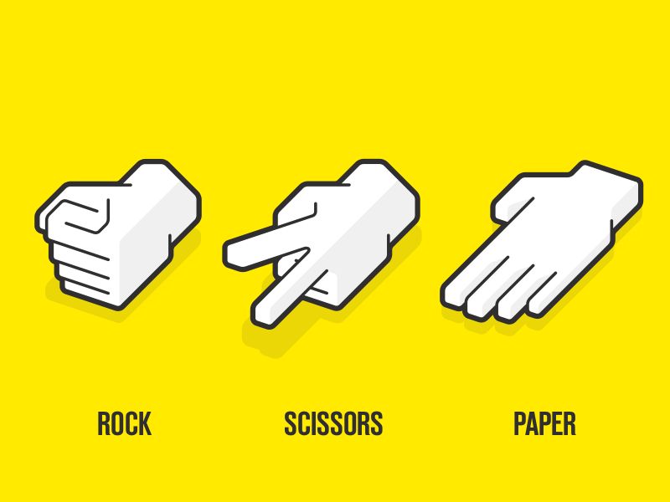
ROCK-PAPER-SCISSORS
NAME: LAVADIYA KAMAKSHI BAI
ORGANISATION:MICRO IT

Slide 2
Introduction
Overview of the game:A hand game played between two people with three possible moves: Rock,Paper,or Scissors.
Goal: To implement a digital version of the game.

Slide 3
THE HAND SIGNS
Rock: ✊ -- a fist
Paper:✋ -- an open hand
Scissors:✌️ -- a fist with the index and middle fingers extended.

Slide 4
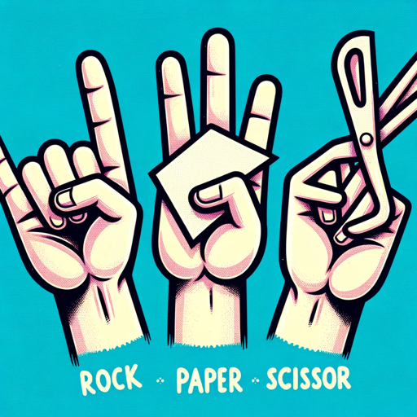
Rr RULES OF THE GAME
Rock crushes scissors (rock wins)
Scissors cuts paper (scissors wins)
Paper covers rock (paper wins)
If both choose the same shape, it’s a tie.

Slide 5
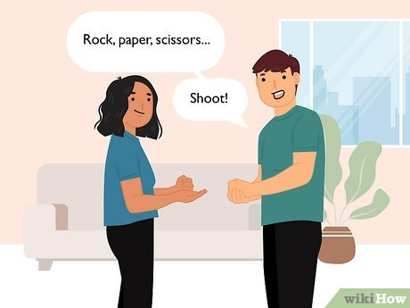
How to play
Players count to 3 aloud (“Rock,paper,scissors,shoot!”)
On “shoot!”, each player shows one of the three signs.
Determine the winner based on the rules.

Slide 6
GAME STRATEGY
Randomness:best strategy is often being unpredictable.
Psychological play: some try to predict oppenent’s patterns.
Tournaments: used in competitive formats with elimination

Slide 7
Fun facts:
Originated in china around 200 BC.
Known as “jan-ken” in japan.
Commonly used to make trivial decisions.

Slide 8
Demo
Invite two people to play a round live.
OR embed a short video demonstrating a match.

Slide 9
APPLICATIONS
Used in:
Decision making
Programming exercise
AI and game theory research

Slide 10

CONCLUSION:
A timeless,fun, and educational game.
Great teaching logic, randomness, and decision-making.

Slide 11


