Slide 1



Solving the Business Problem: Bank Churn Prediction
Solving the Business Problem: Customer Churn Prediction
Improving Customer Retention Through Predictive Analytics
Kamakshi Sharma
Data enthusiast and lifelong learner ✨

Slide 2
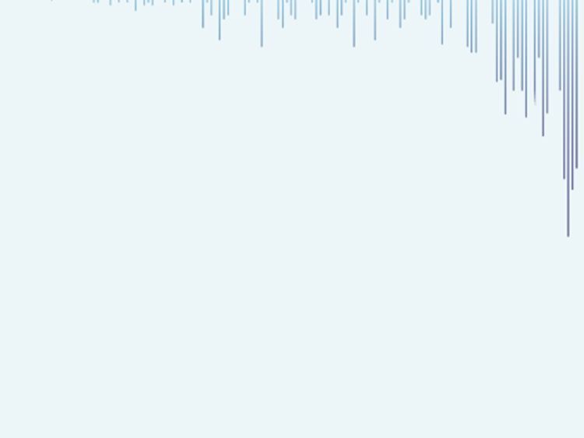
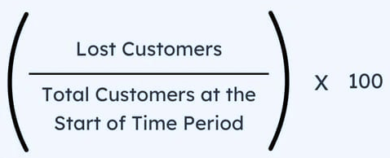
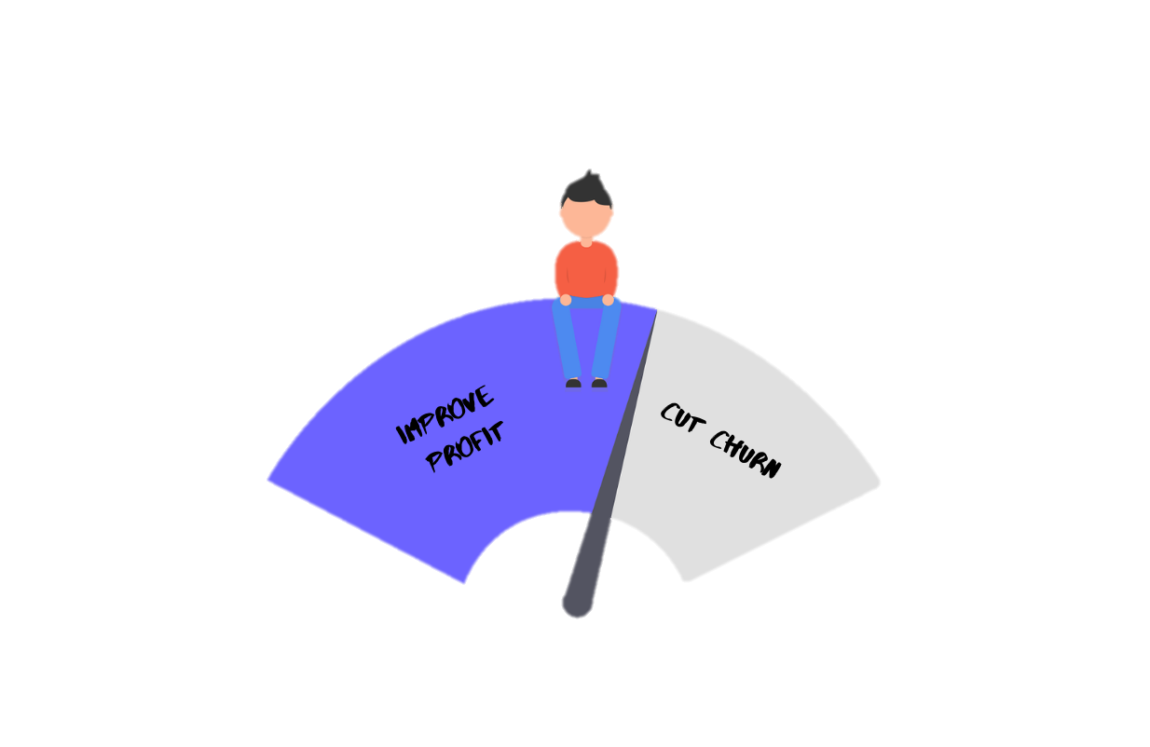
Problem Statement :
Customer churn, is a significant challenge for businesses in various industries.
Customer Churn Rate =
Losing customers can lead to reduced revenue and market share, highlighting the importance of accurately predicting and mitigating churn
In the context of banks, customer churn specifically refers to the phenomenon where account holders close their accounts, discontinue using banking services.
The objective of this project is to predict whether a customer will continue with their account or close it (i.e., churn).

Slide 3
Dataset Description :
The dataset contains information on bank customers, including those who have churned (Exited = 1) and those who continue to be customers (Exited = 0).
Key dataset specifications: 165,034 rows & 14 columns
The dataset includes the following attributes:
Attribute | Description
id | A unique identifier for each customer.
Surname | The customer's surname or last name.
Credit Score | A numerical value representing the customer's credit score.
Geography | The country where the customer resides (France, Spain, or Germany).
Gender | The customer's gender (Male or Female).
Age | The customer's age.
Tenure | The number of years the customer has been with the bank.
Balance | The customer's account balance.
NumOfProducts | The number of bank products the customer uses (e.g., savings account, credit card).
HasCrCard | Whether the customer has a credit card (1 = yes, 0 = no).
IsActiveMember | Whether the customer is an active member (1 = yes, 0 = no).
EstimatedSalary | The estimated salary of the customer.
Exited | Whether the customer has churned (1 = yes, 0 = no).
Type of Machine Learning Task
Supervised Learning – Classification Task
As we haven to classify whether 1 or 0 (churned or not) on the basis of given feature (‘Exited’)

Slide 4
Algorithm Used:
Logistic Regression
Random Forest
XG Boost (Extreme Gradient Boost)
Logistic regression is like drawing a straight line through data points to separate them into two groups (churned and not churned)
Why? : As it straightforward and easy to interpret hence due to its simplicity and interpretability is a good choice a for churn predictions.
Random forest is like asking a bunch of friends for advice, then making a decision based on the most popular answer.
Why ? : captures complex relationships in the data, is less prone to overfitting and requires minimal feature engineering
XGBoost is like a team of experts working together to solve a problem, with each expert focusing on a specific aspect.
It builds a sequence of decision trees, where each tree corrects the errors made by the previous ones. It combines the predictions of all trees to make a final prediction.
Why? : Due to it’s speed and high performance

Slide 5
Overview :
In this project, I aimed to predict customer churn in a banking dataset using machine learning techniques. i performed extensive data analysis, including exploratory data analysis (EDA) to understand the characteristics of the dataset, and then proceeded with data preprocessing, model building, and evaluation.
i built three classification models: Logistic Regression, Random Forest, and XGBoost, and evaluated their performance using various techniques:
Normal: without any balancing technique
Over-sampling: using SMOTE (Synthetic Minority Over-sampling Technique.)
Under-sampling: using RandomUnderSampler
I found that over-sampling produced the best results, particularly for identifying churners. Among the models, XGBoost consistently performed the best, offering a good balance of precision and recall for identifying churners.
Additionally, i visualized the performance of the models using confusion matrices and classification report.
Overall, this project demonstrates the importance of addressing class imbalance in predictive modeling tasks, especially in scenarios like customer churn prediction, where identifying minority classes (churners) accurately is crucial for business decision-making so to retain the customer as much as possible.

Slide 6
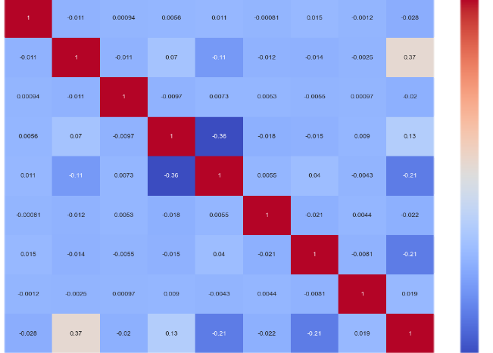
EDA (Exploratory Data Analysis) :
Data Cleaning
Univariate Analysis
0 – 79% (approx.)
Dataset is Imbalanced (“Exited”) –
Dropped Unnecessary columns – "CustomerId“ , "Surname"
No nulls & duplicates were found.
Handled outliers by capping extreme values at the 95th percentile - "CreditScore", "Age“ & "Balance”
1 – 21% (approx.)
Insights into
gender distribution - 2
number of products – 4
Tenure – 10
Geography – 3
Bivariate Analysis
Explored the impact of categorical variables (e.g., credit card ownership, active membership) & numerical variables (e.g., credit score, balance, estimated salary) on customer churn.
Multivariate Analysis
Found that higher credit scores & larger A/c balances doesn't gaurantee loyalty
Customer churn analysis highlighted that customers aged 50-60, females, and those with a tenure of 0-2 years exhibited the highest churn rates.
Collinearity among variables was checked using a correlation heatmap, revealing no strong multicollinearity issues.

Slide 7
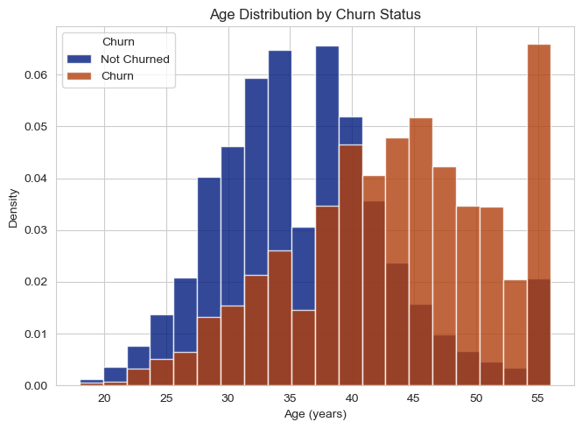
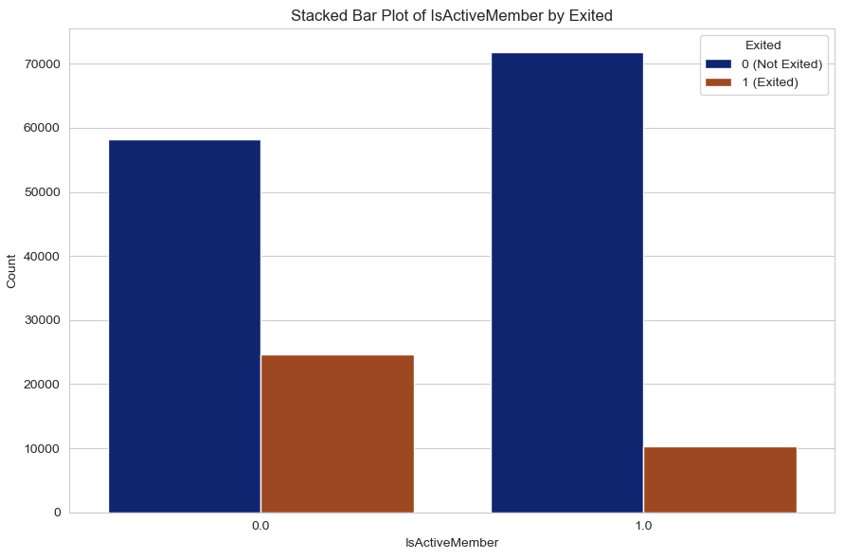
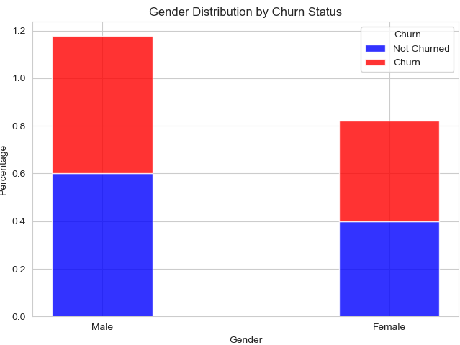
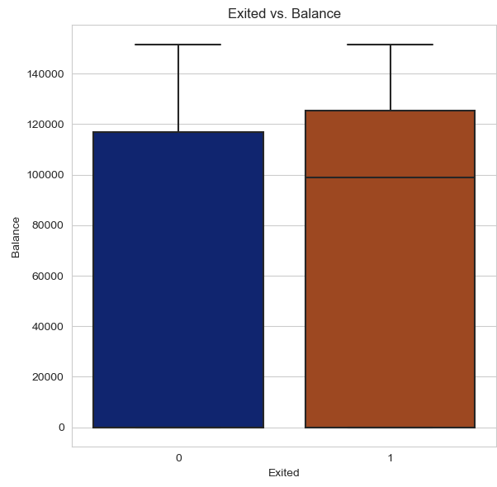
Key Findings of EDA :
More likely to churn :
Females & customers with shorter tenure
Customer churn tends to occur more frequently among those with higher account balances may be due to dissatisfaction or better offers elsewhere.
Important factors influencing customer churn:
Age, Gender, Tenure, Credit score, A/c balance, and active status

Slide 8
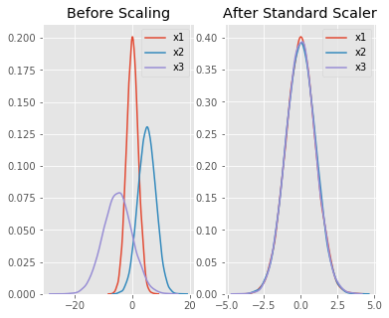
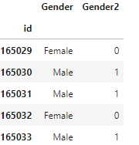
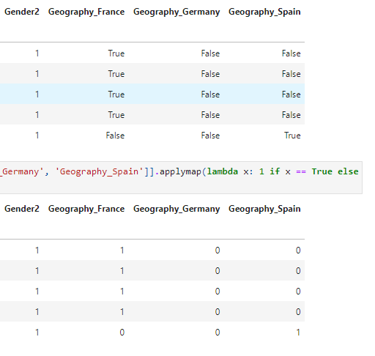
Data Preprocessing :
Converted Categorical Variables to numerical:
“Gender” : Transformed into numerical representation by replacing male as 1 and female as 0
“Geography”: Utilized one-hot encoding to represent categorical values as binary.
Performed standard scaling to normalize numerical features.
Ensures all variables are on a similar scale, preventing features with larger magnitudes from dominating the model.
Standard Scaling:

Slide 9
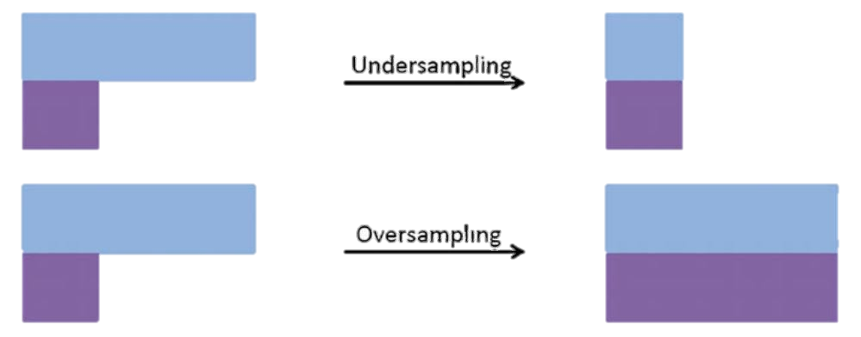
Model Building:
In model building , machine learning algorithms are trained on historical data to make predictions.
ML Algorithm that I have used is Logistic Regression, Random Forest & XG Boost
Three techniques were employed for building and evaluating predictive models for customer churn prediction:
Normally
Models built without any balancing technique
Over-Sampling
SMOTE (Synthetic Minority Over-sampling Technique) -
a smarter way to oversample, it creates synthetic samples that are similar to the existing minority class samples.
Under-Sampling
Random Under Sampler do under-sampling by randomly removing samples from the majority class.
Adding more copies of the minority class to balance the dataset.
trimming down the majority class to match the minority class

Slide 10
Evaluation Matrix of Classification Task -
Confusion Matrix
True Positives (TP): Instances that were correctly classified as positive.
Classification Report
Precision: The proportion of correctly predicted instances of a class out of all instances predicted as that class
Recall : The proportion of correctly predicted instances of a class out of all instances that truly belong to that class.
True Negatives (TN): Instances that were correctly classified as negative.
False Positives (FP): Instances that were incorrectly classified as positive.
False Negatives (FN): Instances that were incorrectly classified as negative.
F1- score : It is a combination of precision and recall into a single value. It gives you a balanced measure of how well model is performing.
Accuracy : the proportion of correctly classified instances out of the total instances.
(summary of correct and incorrect predictions)

Slide 11
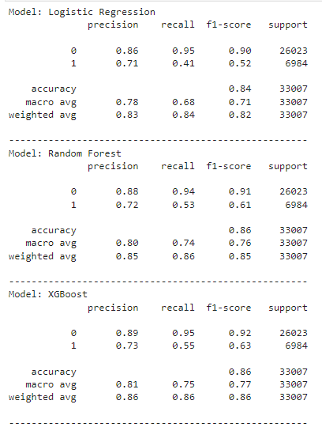
Evaluation of Models (without balancing) :
Insights :
Logistic Regression: Performs slightly lower than other models.
Random Forest: Offers a balanced precision and recall.
XG Boost: Excels at identifying recall, crucial for targeting customer retention efforts.
Overall Insights:
All models achieve good accuracy (84% to 86%), but accuracy alone isn't sufficient due to data imbalance.
XG Boost demonstrates the highest average performance across precision, recall, and F1-score.
XG Boost notably stands out for its higher recall in identifying churning customers (55%).

Slide 12
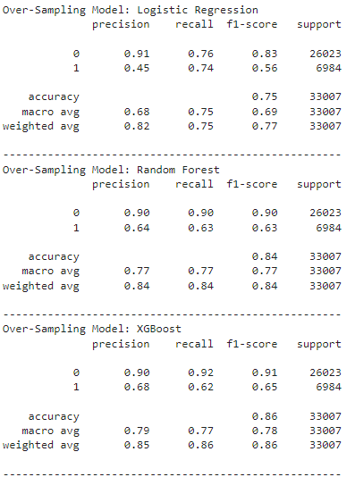
Evaluation of Models (with Over- Sampling) :
Insights:
Logistic Regression: Lowest F1-score, highest precision for non-churners, lower recall for churners.
Random Forest: Good recall but slightly lower precision compared to others.
XGBoost: Maintains lead, excels in both precision and recall for churners, balanced performance.
Overall Performance:
Effect of Over-sampling: Improved performance for all models, especially in recalling churners.
XG Boost Dominance: Best performer overall, highest F1-score, balanced precision and recall.
Random Forest: Follows closely behind XG Boost in F1-score.
Logistic Regression: Lowest F1-score but highest precision for non-churners.

Slide 13
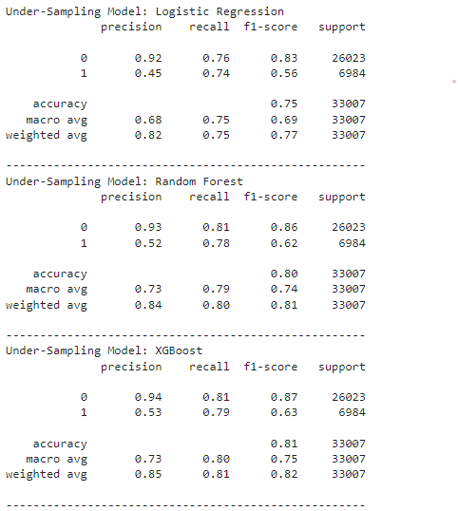
Evaluation of Models (with Under-Sampling) :
Insights :
Logistic Regression: Performance remains consistent with over-sampled model.
Random Forest: Precision for churned class improved slightly, accompanied by increased accuracy but decreased recall.
XGBoost: Similar to Random Forest with slightly improved precision and accuracy but decreased recall.
Overall Analysis:
Effectiveness of Under-Sampling: Less beneficial compared to over-sampling due to decreased recall, crucial for retention efforts.
Considerations for Model Selection: Under-sampling may not offer the desired balance between precision and recall for identifying churning customers.

Slide 14
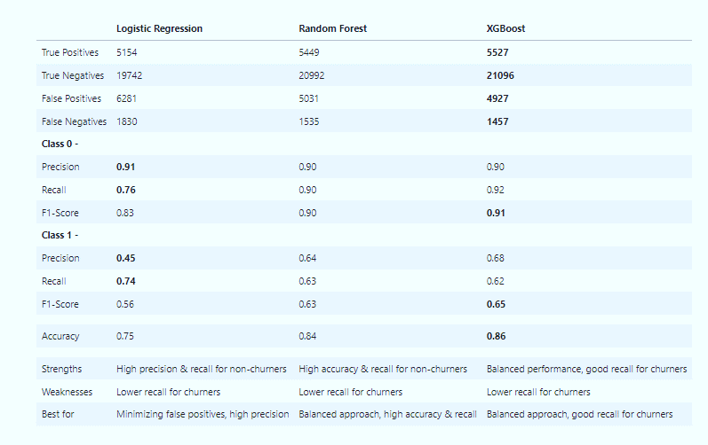
Final Outcome :
Final Decision: Over-Sampling Technique
Improved recall for churners, crucial for customer retention.
Maintained overall accuracy.
Balanced performance demonstrated by XG Boost's F1 score.
Selecting the Best Model:
Considering objective- Maximize retention and prioritize catching every potential churner.
XG Boost exhibits high accuracy, good precision for non-churners, and reasonable recall for churners.
Missing a churner is costlier than reaching out to a non-churner who stays, making high recall a priority.
Comparison Table

Slide 15

Further Improvement :
To further improve our model, we can explore additional feature engineering techniques, such as creating new features or incorporating external data sources.
We can also experiment with different model architectures and hyperparameter tuning techniques to optimize the model's performance.
Additionally, continuous monitoring and updating of the model with new data can help ensure its effectiveness over time.
This project demonstrates the importance of predictive modeling in identifying and mitigating customer churn in the banking sector. By leveraging machine learning techniques, banks can proactively retain customers and maximize revenue.
And chosen model, XGBoost, offers a balanced approach with high accuracy and recall, making it a valuable tool for banks in their customer retention efforts.

Slide 16
Application of this model in Other Industries:
It has diverse industry applications beyond banking, including telecommunications, e-commerce, and subscription-based services.
Model can be adapted to to predict customer churn in various sectors by customizing features and refining algorithms based on industry-specific attributes..
Project Link: Github_Churn_analysis

Slide 17
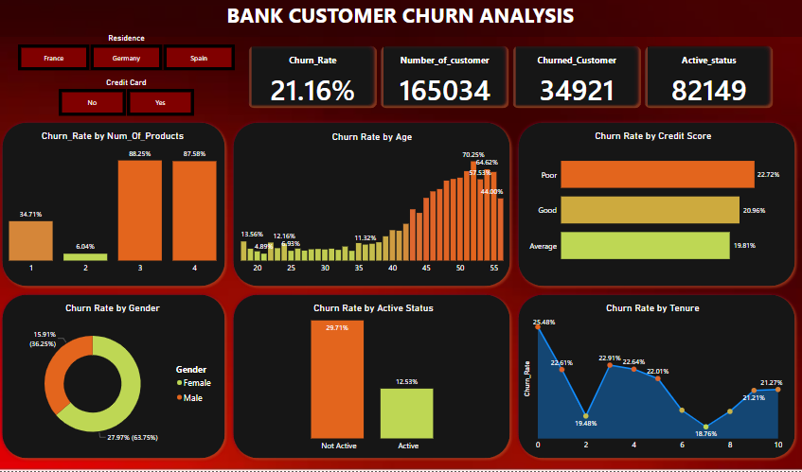
Power Bi Dashboard - github-PowerBI

Slide 18
Key insights :
The churn rate for credit card customers is 21.16%.
There is a positive correlation between the number of products a customer has and their churn rate.
Customers with a poor credit score are much more likely to churn than customers with an average credit score.
Active customers are less likely to churn than inactive customers.
Customers with a tenure of less than 1 year are more likely to churn than customers with a longer tenure and many more.....

Slide 19


