Slide 1


Securing Financial Transactions: Credit Card Fraud Detection
Advancing Financial Security and Prevention Through Machine Learning Innovations
Kamakshi Sharma
Data enthusiast and lifelong learner ✨

Slide 2

Did you know credit card fraud affects millions globally each year?
This widespread criminal activity leads to financial losses and identity theft for consumers, while businesses face chargebacks and reputational damage. Secure financial transactions are the bedrock of trust in today's digital economy.
This project tackles the critical challenge of credit card fraud detection and prevention.
Our goal is to develop effective methods using machine learning, anomaly detection, and deep learning to identify fraudulent activities.
Objective : Enhancing financial transaction security and minimizing fraudulent losses.

Slide 3
Dataset Description
This project leverages a simulated credit card transaction dataset encompassing the period from January 1st, 2019, to December 31st, 2020. The data provides valuable insights into both legitimate and fraudulent transactions, enabling us to develop robust fraud detection methods.
Key dataset specifications:1296675 rows & 23 columns
The dataset includes these attributes:
 | Column Names | Description
Transaction Details | trans_date_trans_time, trans_num, unix_time | Transaction date, time, number, and Unix timestamp
Card Information | cc_num | Credit card number
Merchant Details | merchant, category, amt, merch_lat, merch_long | Merchant's information and transaction details
Customer Details | first, last, gender, street, city, state, zip, lat, long, city_pop, job, dob | Customer's information and transaction details
Fraud Indicator | is_fraud | Indicates whether the transaction is fraudulent (1 for fraud, 0 for legitimate)

Slide 4
Overview
In this project, I aimed enhance financial transaction security and minimize fraudulent losses using machine learning techniques, anomaly detection technique, and deep learning technique. Where, I performed extensive data analysis, including exploratory data analysis (EDA) to understand the characteristics of the dataset and to do data cleaning, and then proceeded with data preprocessing, model building & evaluation and improving the best chosen model.
Here, built 4 models using Machine Learning (Logistic Regression & Random Forest), Anomaly Detection (Isolation Forest) & Deep Learning (Neural Network (MLP –Multi layer Perceptron)), and evaluated their performance using different Evaluation Matrices (Classification Report , ROC - AUC score & curve and Precision - Recall Curve)
After comparison, Random Forest emerged as the optimal choice according to the problem statement as we can choose a model prioritizing high fraud detection while tolerating some false positives.
To further enhance results, an ensemble model combining Random Forest with Isolation Forest was implemented, Leveraging the strengths of both models, Random Forest maintains good performance across classes, while Isolation Forest excels at identifying outliers (potentially fraudulent transactions)..
Overall, this project showcases the effectiveness of various techniques in combating credit card fraud and underscores the importance of continuous exploration and refinement in financial transaction security.

Slide 5
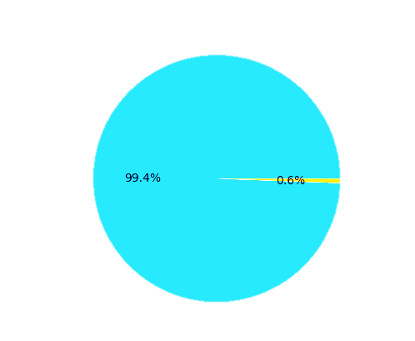
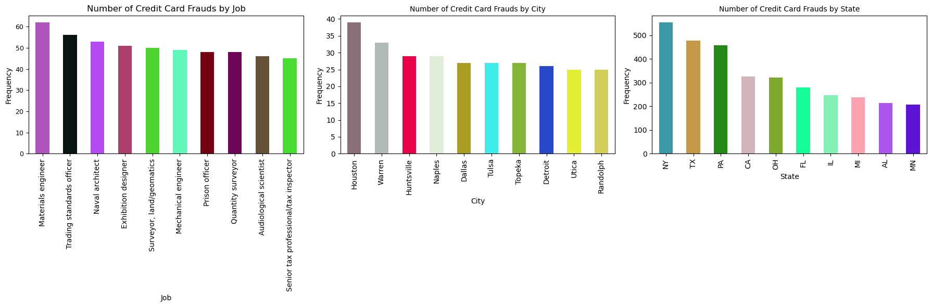
EDA (Exploratory Data Analysis)
Data Cleaning
Feature Engineering
Removed the columns that are not required for model building
Created Some new features as required
Numerical Variable Analysis
No nulls were there & Rectified inappropriate datatype
For e.g., is_fraud_cat for categorical analysis,
Categorical Variable Analysis
Transaction categories and gender distribution, both for the entire dataset and specifically for fraudulent transactions.
for numerical analysis age' , 'trans_month', 'trans_year', 'month_name’,etc.
Top 10 fraudulent transactions by job, city, and state
Visualized -
Visualized Overall Skewness
Class balance –
Bivariate Analysis - Vizualisation with 'is_fraud'
age groups ,
Not Fraud (99.4%)
Fraud (0.6%)
latitudinal & longitudinal distance and
month & year.

Slide 6
Key Findings of EDA :
Data Quality:
Categorical Variables:
Top fraudulent transaction jobs include materials engineer, trading standards officer, and naval architect. Cities with the most fraud are Houston, Warren, and Huntsville. States with the most fraud are NY, TX, and PA.
Numerical Variables:
The dataset is imbalanced, with a very small percentage of fraudulent transactions compared to non-fraudulent ones.
Age group 20-40 seems to be more targeted by fraudsters. There's a potential location component to the fraud, with more cases closer to the equator and eastern hemisphere.
Most frauds occur in March, May, and February. 2019 has significantly more fraud cases compared to 2020.
Gender distribution is nearly balanced for both overall and fraudulent transactions.
Shopping_net and grocery_pos categories have the highest number of fraudulent transactions, despite gas_transport having the most overall transactions.
There are no missing values (nulls) in dataset,
but some data types need correction.

Slide 7
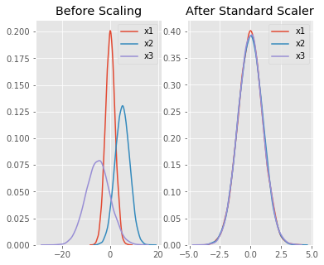
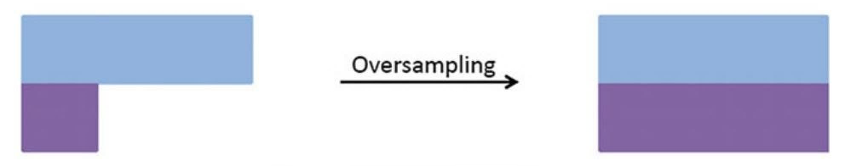
Data Preprocessing
Performed standard scaling to normalize numerical features.
Ensures all variables are on a similar scale, preventing features with larger magnitudes from dominating the model.
Encoding
One Hot Encoding : Transaction Category
Standard Scaling:
Binary Encoding : Gender
converted categorical into numerical variables-
Oversampling
SMOTE (Synthetic Minority Over-sampling Technique) -
To handle imbalance of the dataset.
Adding more copies of the minority class to balance the dataset.
a smarter way to oversample, it creates synthetic samples that are similar to the existing minority class samples.

Slide 8
Algorithm Used for Model Building
Machine Learning Technique
Logistic Regression:
Interpretability: Provides straightforward interpretations of coefficients for understanding feature impact on fraud likelihood.
Simplicity: Easy implementation and understanding facilitate communication with stakeholders.
Random Forest:
Complex Relationship Capture: Excels at capturing complex data relationships to detect subtle fraud patterns.
Minimal Feature Engineering: Requires minimal feature manipulation, suitable for challenging feature selection scenarios.
Anomaly Detection Technique
Isolation Forest:
Efficient Anomaly Detection: Efficiently isolates anomalies (fraudulent transactions) in high-dimensional data.
Distribution Agnostic: Robust against various fraud patterns without assuming specific data distributions.
Deep Learning Technique
Neural Network (MLP Classifier):
Nonlinear Pattern Detection: Captures nonlinear data relationships for sophisticated fraud detection.
Scalability: Handles large data volumes and adapts to real-time fraud detection needs.

Slide 9
Evaluation Matrix Used
Precision: The proportion of correctly predicted instances of a class out of all instances predicted as that class
Recall : The proportion of correctly predicted instances of a class out of all instances that truly belong to that class.
Classification Report
F1- score : It is a combination of precision and recall into a single value. It gives you a balanced measure of how well model is performing.
Accuracy : the proportion of correctly classified instances out of the total instances.
ROC-AUC Score:
ROC-AUC Curve:
Precision-Recall Curve (PR Curve):
Receiver Operating Characteristic (ROC) Area Under Curve (AUC): A measure of the classifier's ability to distinguish between classes. A higher AUC indicates better classifier performance.
Graphical representation of the true positive rate (recall) against the false positive rate at various threshold settings. It illustrates the trade-off between true positive rate and false positive rate.
Graphical representation of the trade-off between precision and recall for different threshold settings. It helps evaluate classifier performance when classes are imbalanced.

Slide 10
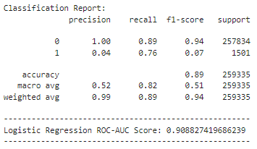
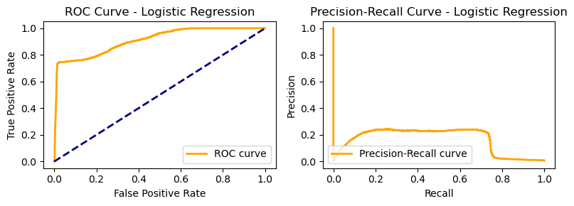
Logistic Regression Evaluation and Inferences
What does Logistic regression do ?
It creates a linear decision boundary by fitting a logistic function to the input features, separating the data into two classes. It calculates the probability of a data point belonging to a certain class based on its features.
Evaluation :
Inferences :
This model achieves an accuracy of 89%, with high precision (1.00) for non-fraudulent transactions but low precision (0.04) for fraudulent ones.
It exhibits high recall (0.76) for fraud, but lower recall (0.89) for non-fraud cases, indicating some missed normal transactions.
The F1-scores are 0.94 for non-fraud and 0.07 for fraud, suggesting a significant imbalance between precision and recall for fraudulent transactions.
The ROC-AUC score is 0.9088, indicating good discriminative ability between fraudulent and normal transactions.
ROC-AUC curve displays good separation between TPR and FPR.
The PR curve shows prioritization of capturing fraud (high recall) at the expense of misclassifying normal transactions (low precision).
Overall, the model performs well in identifying fraud but misclassify normal transactions.

Slide 11
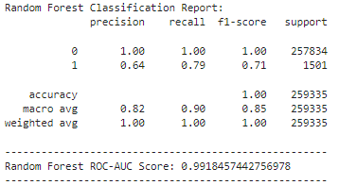
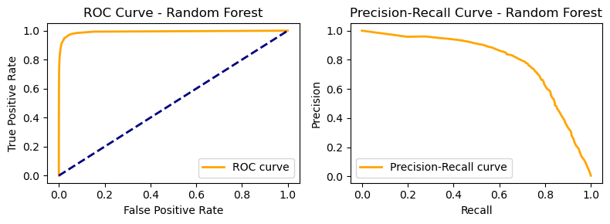
Random forest Evaluation and Inferences
What does Random Forest do ?
It constructs multiple decision trees using bootstrapped samples of the dataset and randomly selected subsets of features. Each tree "votes" on the class of an input, and the final prediction is determined by the most common class among all trees. This ensemble approach helps capture complex relationships in the data.
Evaluation :
Inferences :
Achieves a perfect accuracy (1.00), indicating it classified all transactions correctly (might be due to overfitting on the training data).
Both precision and recall are high for both fraudulent and non-fraudulent transactions.
F1-scores are also high for both classes.
ROC-AUC score (0.9930) suggests excellent discriminative ability between classes.
ROC Curve: Close to top-left corner, indicating good TPR-FPR trade-off.
Precision-Recall Curve: Fairly close to top-left corner, indicating good precision-recall balance.
However, the perfect accuracy on the test data raises concerns about potential overfitting and the model's ability to generalize to unseen data.

Slide 12
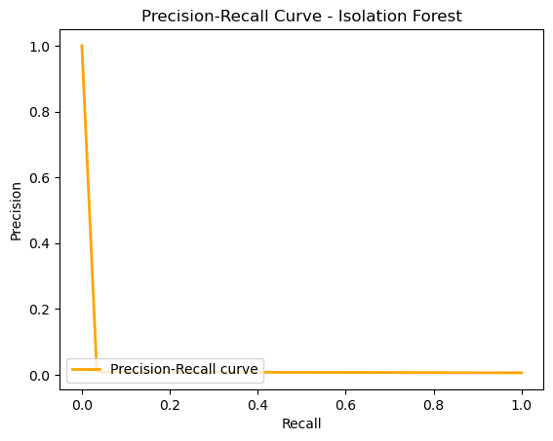
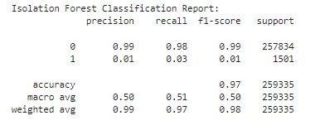
Isolation Forest Evaluation and Inferences
What does Isolation Forest do ?
It isolates anomalies by recursively partitioning the data into subsets. It randomly selects a feature and a split value, aiming to isolate outliers quickly. Anomalies are identified as instances that require fewer partitions to isolate, as they are different from the majority of the data.
Evaluation :
Inferences :
Achieves high accuracy (0.97) but with a significant imbalance in precision and recall.
Very high precision (0.99) for non-fraudulent transactions but extremely low precision (0.01) for fraudulent ones.
Recall is also high for non-fraud (0.97) but very low for fraud (0.03).
F1-score reflects the imbalance (0.98 for non-fraud, 0.01 for fraud).
Doesn't have probability prediction capability, so ROC curve cannot be plotted.
Precision-Recall Curve: PR curve not close to top-left corner, indicating poor performance.
While it identifies most normal transactions correctly, it struggles to detect fraudulent ones.

Slide 13
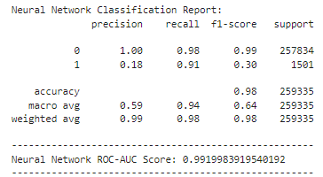
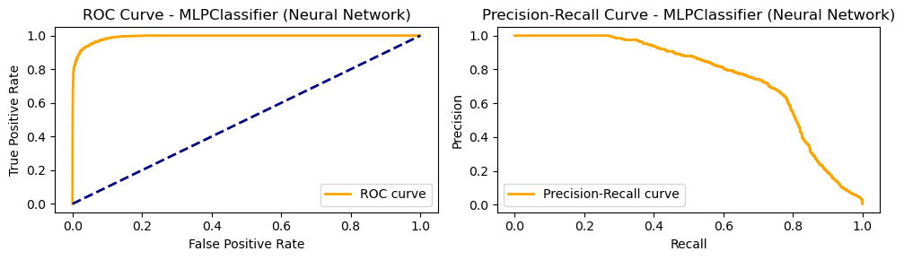
Neural Network Evaluation and Inferences
What does Neural Network (MLP Classifier) do ?
It consist of layers of interconnected neurons that process input data. In the case of MLP Classifier, multiple layers of neurons process the input through nonlinear activation functions. These layers learn to represent the data in a hierarchical manner, capturing intricate patterns and relationships. The network adjusts its weights through backpropagation, minimizing prediction errors during training.
Evaluation :
Inferences :
Achieves high accuracy (0.98) similar to Logistic Regression.
High precision (1.00) for non-fraudulent transactions but lower than Logistic Regression for fraud (0.20).
Recall is high for fraud (0.89) but lower than Random Forest.
F1-score highlights the class imbalance (0.99 for non-fraud, 0.32 for fraud).
ROC-AUC score (0.9919) indicates good discriminative ability.
ROC Curve: Close to top-left corner, confirming good performance.
Precision-Recall Curve: Reasonably close to top-left corner, suggesting good precision-recall trade-off.
Overall, performs well in identifying fraud with a more balanced approach compared to Logistic Regression, but might miss some fraudulent transactions compared to Random Forest

Slide 14
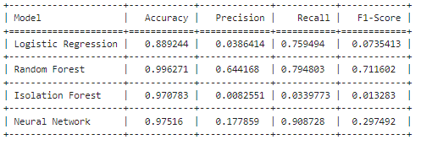
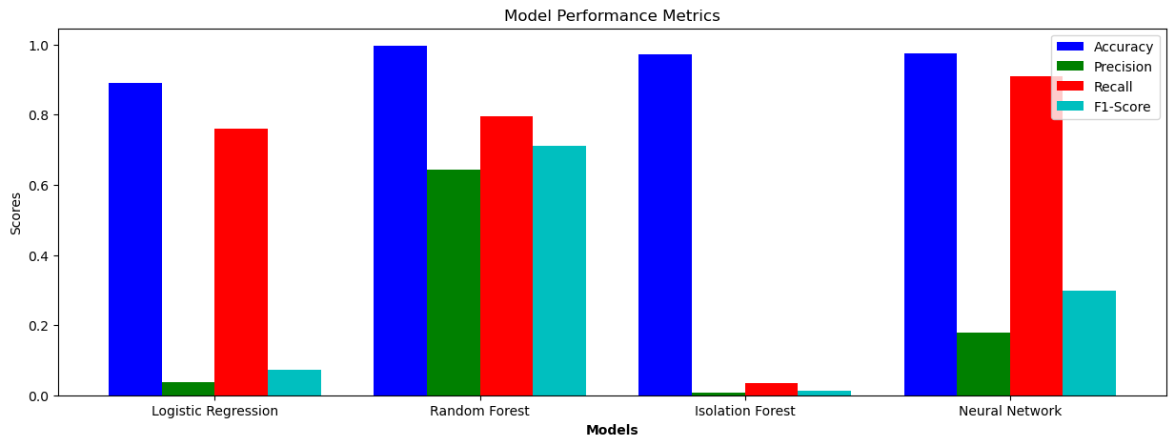
Models Comparison
Selecting Best Model
Considering the importance of maximizing fraud detection while tolerating some false positives, Random Forest emerges as a promising choice.
Overall Conclusion
All models achieved high overall accuracy, but Random Forest and MLP might be overfitting on the training data.
Logistic Regression and MLP struggle with precision for fraudulent transactions, while Random Forest offers a more balanced approach.
Isolation Forest excels at identifying normal transactions but fails to capture most fraudulent ones.
Hence, Best Model out of these 4:
Random Forest

Slide 15
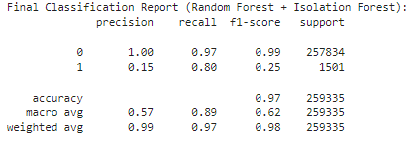
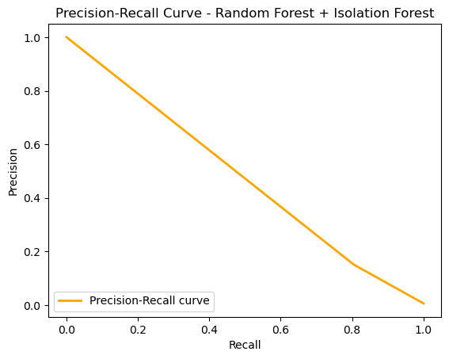
Ensemble Method - Random Forest & Isolation Forest
Considering that there might be overfitting in Random Forest,
Combining Random Forest and Isolation Forest –
Random Forest maintains good performance in fraud detection and normal transaction classification.
Isolation Forest excels at identifying outliers, potentially fraudulent transactions, that Random Forest might miss.
By combining them, a wider range of fraudulent activities can be captured.
Evaluation:
Final Classification Report (Random Forest + Isolation Forest):
Achieves an accuracy of 0.97, indicating less overfitting compared to Random Forest alone.
Lower precision (0.15) for fraudulent transactions but higher recall (0.80) compared to Random Forest. This means it might miss some fraudulent transactions but captures more overall.
Inferences:
The ensemble method shows promising results, achieving high accuracy and improved recall for fraudulent transactions.
By leveraging the strengths of both Random Forest and Isolation Forest, a more comprehensive fraud detection system is established.

Slide 16
Conclusion
While Random Forest performs well on its own, the Ensemble Method (Random Forest + Isolation Forest) seems to be a better choice for credit card fraud detection in this case as it offers:
Reduced Overfitting Risk
Improved Fraud Detection
This analysis explored various machine learning models for credit card fraud detection. The ensemble method combining Random Forest and Isolation Forest emerged as the most promising choice due to its balanced performance, reduced overfitting risk, and improved fraud detection capabilities.
GitHub Link:
For further details and access to the project code, visit my GitHub repository:
Project_Fraud_Detection.ipynb

Slide 17
Real-time Implementation Challenges
Challenges
Considerations
Model Interpretability:
Explanation of model decisions is crucial for compliance.
Complex models may lack interpretability.
Computational Efficiency:
Real-time systems require fast inference.
Complex models may cause latency issues.
Handling Concept Drift:
Fraud patterns change over time, leading to concept drift.
Models must adapt to maintain effectiveness.
Model Explainability:
Use interpretable models alongside complex ones.
Implement techniques like SHAP values.
Computational Optimization:
Optimize model architecture and feature engineering.
Use model compression techniques.
Conclusion
Real-time implementation of fraud detection models poses challenges related to interpretability, computational efficiency, and concept drift. By addressing these challenges and considering the aforementioned considerations, organizations can deploy effective fraud detection systems in real-time payment processing environments
.

Slide 18


