Slide 1
Excel Final Assessment
Kamalakannan S
LVADSUSR92

Slide 2
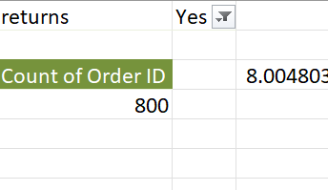
Q1
The returned orders represent 8% of the total orders.
INFERENCE:
FORMULA:
=(Orders returned/Total Orders)*100
INSIGHTS :
800 Orderes were returned.
The returned orders represent 8% of the total orders.

Slide 3
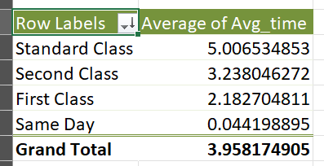
Q2
Same Day shipping Mode has the fastest delivery mode.
Standard Class has the slowest delivery mode.
INFERENCE:
FORMULA:
Date_diff = Ship_date – Order_date
Used Pivot table to take the distinct shipping modes and to calculate the average time.
INSIGHTS :

Slide 4
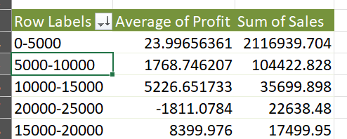
Q3
The customer segment have 5000-10000 sales records have better profitability.
INFERENCE:
FORMULA:
Used pivot table to group customers based on their sales records.
Even though the customer segement with sales records between 0-5000 have the highest sum of sales, their average profit is less compared the customer segment with 5000-10000
INSIGHTS :

Slide 5
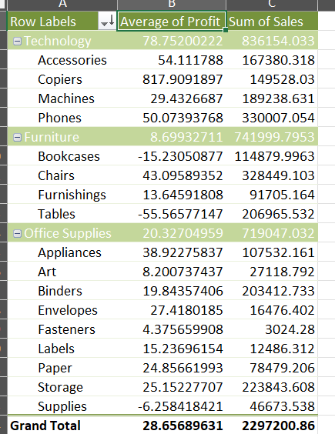
Q4
Technology is the highest selling category.
Phones is the highest selling sub-category.
INFERENCE:
FORMULA:
Used pivot table to get distinct category and sub-category and their respective sum of sales.
INSIGHTS :
Technology is the highest selling category. The average profit margin for each category is in the pivot table. Copiers have higher profitability.

Slide 6
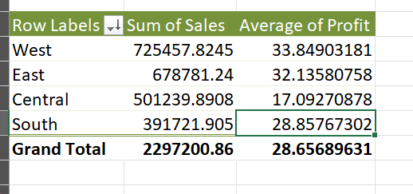
Q5
West has the highest sales record and south has the lowest sales record.
INFERENCE:
FORMULA:
Used pivot table to get distinct regions and their sales sum of average profit.
INSIGHTS :
The trend of profitability is added in this slide.

Slide 7
Q6
We can infer that discount has a negative correlation with profits but a positive correlation with the Sales.
INFERENCE:
FORMULA: =CORREL(V2:V9995,T2:T9995)
=CORREL(W2:W9995,S2:S9995)
INSIGHTS :
The correlation between Discounts and Profit is -0.2194
The correlation between Discounts and quantity is 0.008622
The correlation between Discounts and quantity is 0.58777

Slide 8
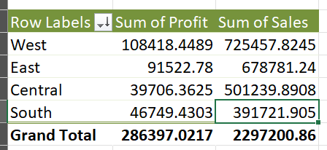
Q7
South Region has a lot of potential and can be expanded by providing extra discounts to get better sales numbers with bearable decrease in the profit.
INFERENCE:
FORMULA:
Used pivot table to get the regions and to analyse the data.
INSIGHTS :
The South Region has a low market situation as the sales are low but the considerable profits are high with respect to the sales quantity.

Slide 9
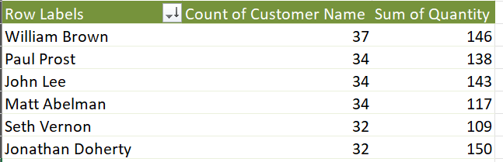
Q8
INFERENCE:
William brown has the highest repeat order count.
The retention rate is calculated to be 7.9%
FORMULA:
Used the pivot table to get distinct customers and their repeat order count.
INSIGHTS :
Used the repeat order count to calculate the retention rate

Slide 10
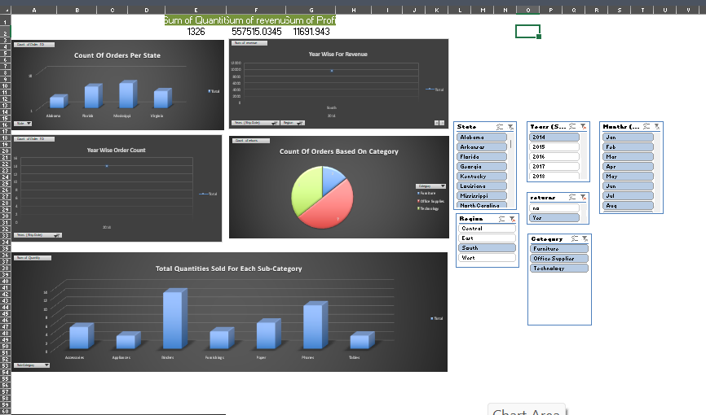
Q9- Dashboard

