Slide 1

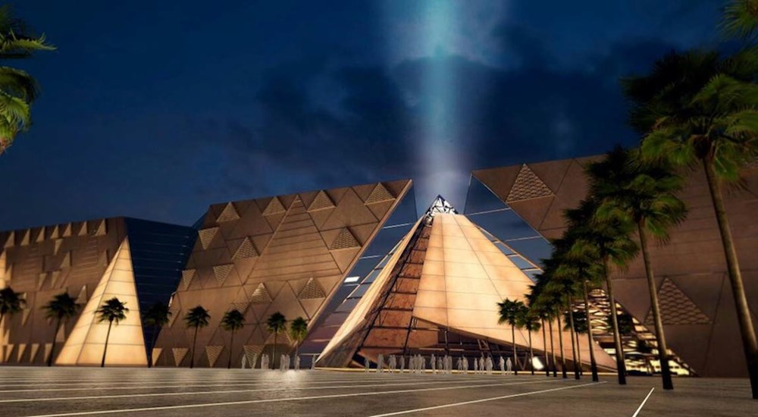
Pharaohs
Legacy
Pharaohs Legacy is a full-stack web application inspired by the rich history of Ancient Egypt. The platform combines historical exploration with tourism services, allowing users to discover Egyptian pharaohs, temples, museums, and gods while also booking visits directly through the system.
The website is designed with a modern Egyptian-themed user interface using dark and gold styling to create an immersive experience. The system provides both educational content and a complete tourism booking solution in one integrated platform.

Slide 2
Pharaohs
Legacy
Pharaohs Legacy is a full-stack web application inspired by the rich history of Ancient Egypt. The platform combines historical exploration with tourism services, allowing users to discover Egyptian pharaohs, temples, museums, and gods while also booking visits directly through the system.
The website is designed with a modern Egyptian-themed user interface using dark and gold styling to create an immersive experience. The system provides both educational content and a complete tourism booking solution in one integrated platform.

Slide 3
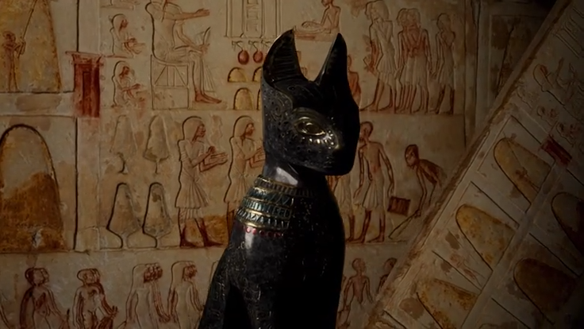
Team members
Sara mostafa kamel seddek
Dina salah aldin saber
Kamal aldin abdulbasit
Saad alhussaini
INFORMATION SYSTEM SECTION – 2
Under the supervision of: Mostafa Abdelhalim

Slide 4
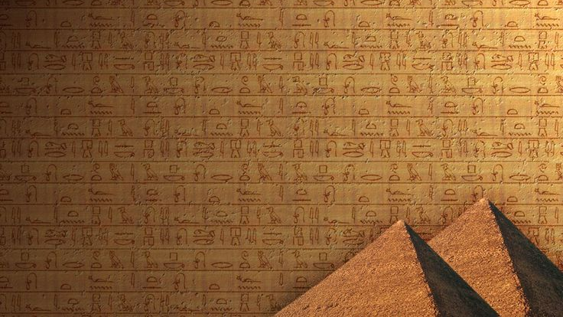
Tech Stack
ASP.NET Core MVC (.NET 8)
Entity Framework Core + SQL Server
Session-based Authentication
C# / Razor Views
JavaScript / CSS (Egyptian Dark Gold Theme)

Slide 5
Project Goals
Promote Ancient Egyptian history and culture.
Provide an interactive educational experience.
Offer an organized tourism booking platform.
Allow users to explore and save historical attractions.
Deliver a responsive and visually engaging web application.

Slide 6
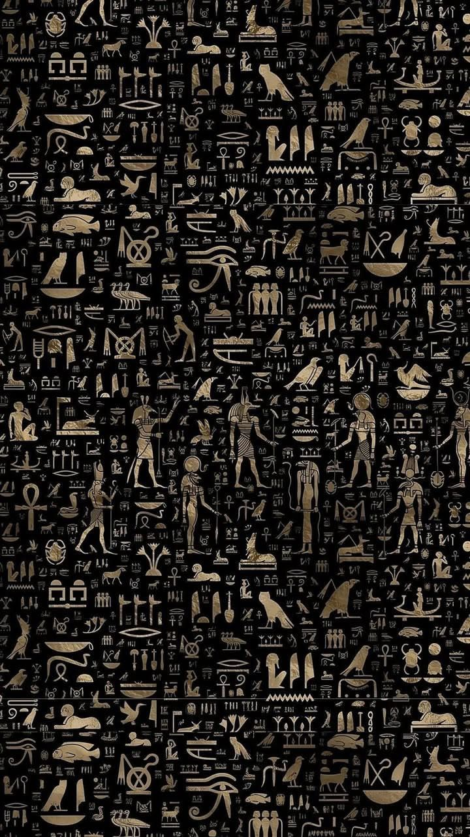
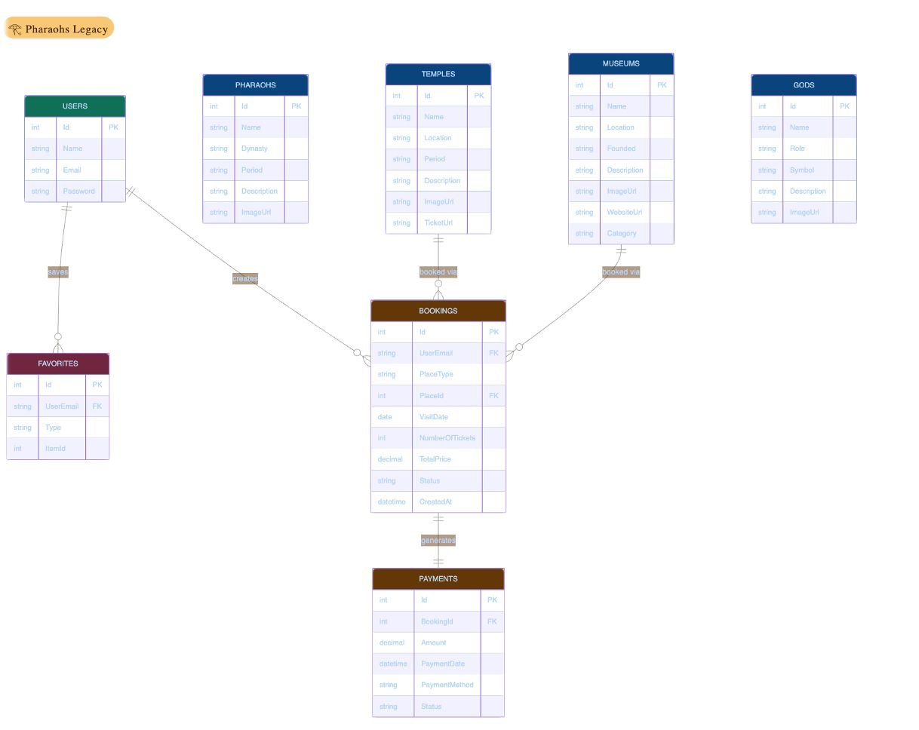
ERD

Slide 7
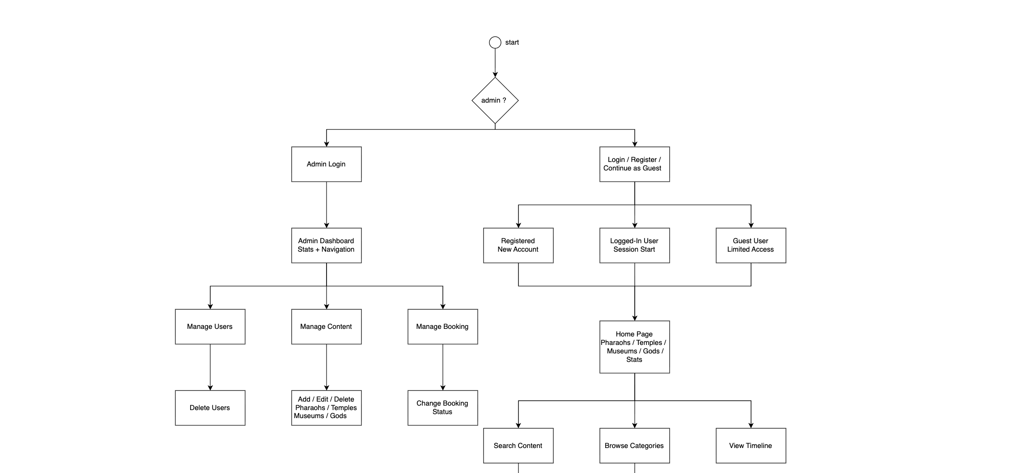
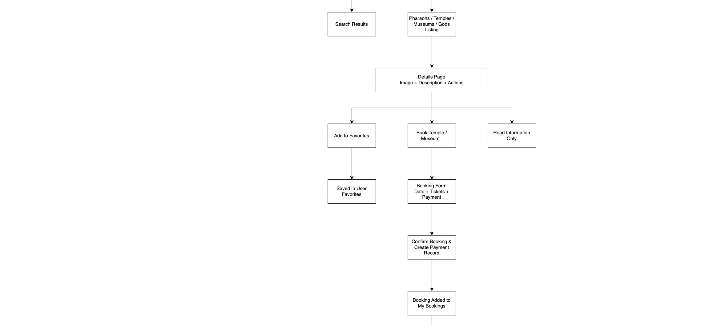

FLOW diagram

Slide 8
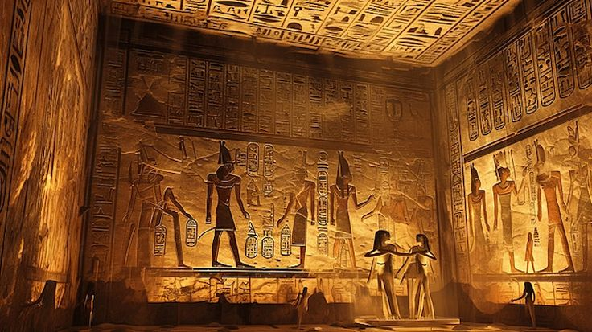
Authentication & System
The platform includes a complete user authentication system with: User Registration
User Login
Guest Access
Logout Functionality
Session-based Authentication
Password Validation
Password Strength Indicator
Show/Hide Password Feature
Confirm Password Validation
- Guests have limited access and cannot use protected features like bookings and favorites.

Slide 9
Authorization
& System
The system controls what users can access after login.
Only authenticated users can access protected features.
Registered users can:
Create bookings
Add items to favorites
View booking history
Guests can:
Browse temples, museums, gods, etc.
View general content only
Guests cannot:
Make bookings
Add favorites
Access payment pages
Protected pages redirect unauthorized users to the login page.
Authorization ensures each user has access only to allowed features.

Slide 10
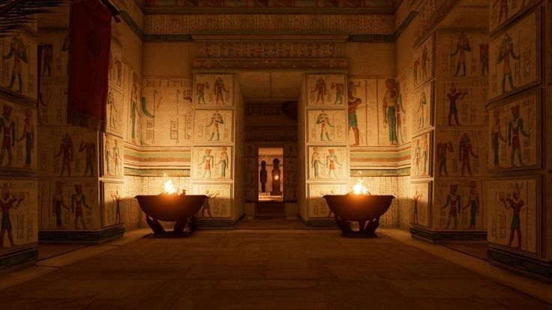
Home Page
The home page acts as the main portal of the platform and includes:
Animated Statistics Counter
Featured Pharaohs
Featured Temples
Featured Museums
Featured Egyptian Gods
Navigation Menu
Responsive Hamburger Menu
Search across Pharaohs and Temples

Slide 11
Pharaohs Section
Browse all pharaohs
View detailed information
Read about dynasties and historical periods
Add pharaohs to favorites
The system currently contains:
20 Pharaohs with images and descriptions

Slide 12
Egyptian Gods Section
A dedicated section for Ancient Egyptian gods including:
God Name
Role
Symbol
Description
Images
Favorites Support
Users can explore detailed pages for each god and save them to favorites.

Slide 13
Temples Section
Users can:
Browse Egyptian temples and historical sites
Read historical descriptions
View images and locations
Book visits directly
Add temples to favorites
The system currently includes:
15 Temples and historical sites

Slide 14
Museums Section
The museums module includes:
Egyptian museums only
Detailed museum pages
Historical information
Booking support
Favorites system
The system currently contains:
10 Egyptian museums

Slide 15
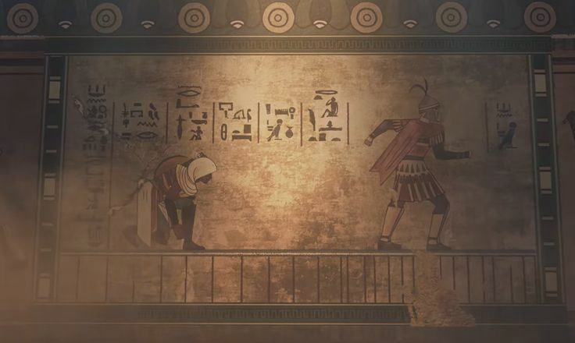
Timeline Feature
The application includes an interactive historical timeline displaying:
Pharaohs ordered by dynasty
Vertical golden timeline design
This feature visually presents Ancient Egyptian history in chronological order.

Slide 16
Favorites System
Logged-in users can save items to favorites including:
Pharaohs
Temples
Museums
Gods
Feature
Add to favorites
Remove from favorites
Favorites dashboard section
Dynamic favorite status checking

Slide 17
Booking System
The platform contains a fully integrated booking system where users can:
Book temple visits
Book museum visits
Choose visit date
Select number of tickets
Choose payment method
View booking history
Cancel bookings
Additional Features:
Automatic booking confirmation + Payment record creation
Ticket pricing: Temple = 150 EGP | Museum = 100 EGP
Booking tracking timeline
Countdown timer + 48-hour cancellation and refund system

Slide 18
User Dashboard
The user dashboard contains 4 main tabs:
Overview: Stats cards + last 5 bookings + favorites preview
My Bookings: All bookings with filter + cancel button
Favorites: Pharaohs, Temples, Gods and Museums with hover effects
Profile: Account information + Sign Out

Slide 19
Admin Dashboard
Admin Features
Dashboard statistics
Revenue monitoring
Booking management
User management
Full CRUD operations for:
Pharaohs
Temples
Museums
Gods
Booking status management
Search system inside tables

Slide 20
thank you

