Slide 1
Binary Trees,
Binary Search Trees

Slide 2
Trees
Linear access time of linked lists is prohibitive
  Does there exist any simple data structure for which the running time of most operations (search, insert, delete) is O(log N)?

Slide 3
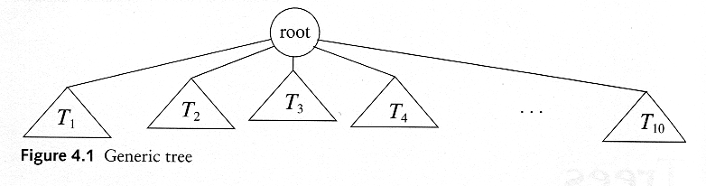
Trees
A tree is a collection of nodes
  The collection can be empty
  (recursive definition) If not empty, a tree consists of a distinguished node r (the root), and zero or more nonempty subtrees T₁, T₂, ...., T_{k}, each of whose roots are connected by a directed edge from r

Slide 4
Some Terminologies
Path
Length
  number of edges on the path
Depth of a node
  length of the unique path from the root to that node
  The depth of a tree is equal to the depth of the deepest leaf
Height of a node
  length of the longest path from that node to a leaf
  all leaves are at height 0
  The height of a tree is equal to the height of the root
Ancestor and descendant
  Proper ancestor and proper descendant

Slide 5
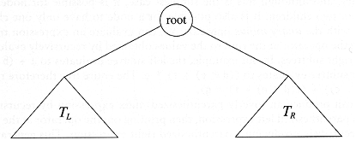
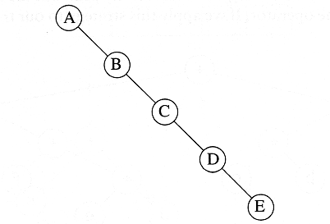
Binary Trees
A tree in which no node can have more than two children
The depth of an “average” binary tree is considerably smaller than N, eventhough in the worst case, the depth can be as large as N – 1.

Slide 6
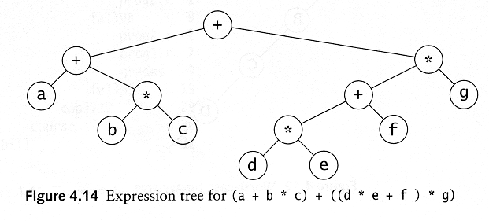
Example: Expression Trees
Leaves are operands (constants or variables)
The other nodes (internal nodes) contain operators
Will not be a binary tree if some operators are not binary

Slide 7
Tree traversal
Used to print out the data in a tree in a certain order
Pre-order traversal
  Print the data at the root
  Recursively print out all data in the left subtree
  Recursively print out all data in the right subtree

Slide 8
Preorder, Postorder and Inorder
Preorder traversal
  node, left, right
  prefix expression
    ++a*bc*+*defg

Slide 9
Preorder, Postorder and Inorder
Postorder traversal
  left, right, node
  postfix expression
    abc*+de*f+g*+
Inorder traversal
  left, node, right.
  infix expression
    a+b*c+d*e+f*g

Slide 10

Binary Search Trees
A binary search tree
Not a binary search tree

Slide 11

Binary search trees
Two binary search trees representing
the same set:
Average depth of a node is O(log N); maximum depth of a node is O(N)

Slide 12
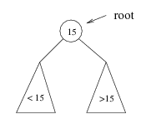
Searching BST
If we are searching for 15, then we are done.
If we are searching for a key < 15, then we should search in the left subtree.
If we are searching for a key > 15, then we should search in the right subtree.

Slide 13
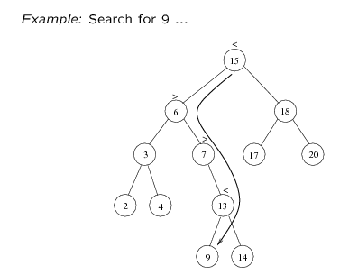
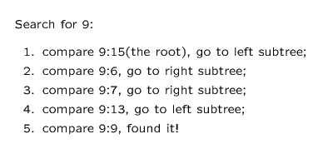

Slide 14
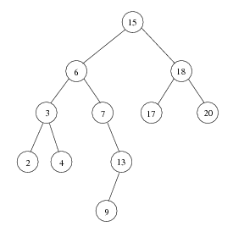
Inorder traversal of BST
Print out all the keys in sorted order
Inorder: 2, 3, 4, 6, 7, 9, 13, 15, 17, 18, 20

Slide 15
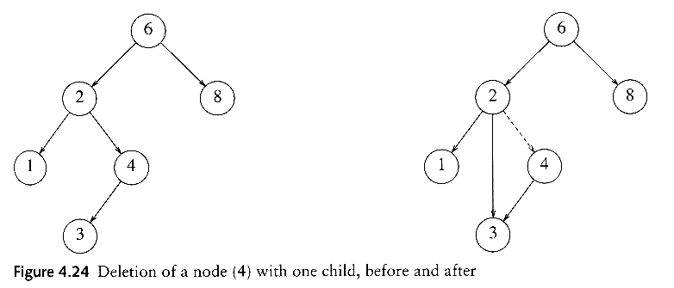
delete
Three cases:
(1) the node is a leaf
  Delete it immediately
(2) the node has one child
  Adjust a pointer from the parent to bypass that node

Slide 16
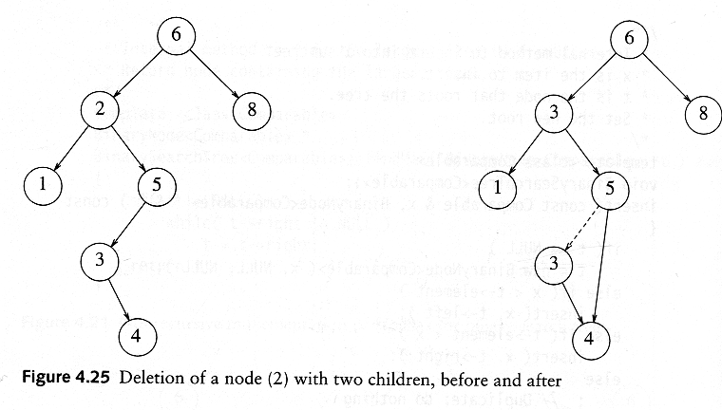
delete
(3) the node has 2 children
  replace the key of that node with the minimum element at the right subtree
  delete the minimum element
    Has either no child or only right child because if it has a left child, that left child would be smaller and would have been chosen. So invoke case 1 or 2.
Time complexity = O(height of the tree)

