Slide 1
Computer Networks
Topic 12:
Virtual Private Networks

Slide 2
Computer Networks
Topic 12 – Lecture 1: VPN Theory

Slide 3
Scope and Coverage
Virtual Private Networks Topic 12 - 12.3
This topic will cover:
Virtual private networks (VPN)
Advantages and disadvantages of VPN
Installing and configuring VPN

Slide 4
Learning Outcomes
Virtual Private Networks Topic 12 - 12.4
By the end of this topic, students will be able to:
Explain the operation of a Virtual Private Network (VPN)
Describe the advantages and disadvantages of a VPN
Install and configure a VPN

Slide 5
What is a VPN?
Virtual Private Networks Topic 12 - 12.5
A private network that uses public telecommunication, such as the Internet, instead of leased lines to communicate.
Remote network communication through Internet
Used by companies/organisations who want to communicate confidentially
Two parts:
Protected or “inside” network
“Outside” network or segment (less trustworthy)

Slide 6
The User’s Perspective
Virtual Private Networks Topic 12 - 12.6
From the user’s perspective, it appears as a
network consisting of dedicated network links.
These links appear as if they are reserved for the VPN clients only.
Because of encryption, the data appears to be private.

Slide 7
How a VPN Works - 1
Virtual Private Networks Topic 12 - 12.7
Two connections - one is made to the Internet and the second is made to the VPN
Datagrams - contain data, destination and source information
Firewalls - VPNs allow authorised users and data to pass through the firewalls
Protocols - protocols create the VPN tunnels that allow a private connection over a public network

Slide 8
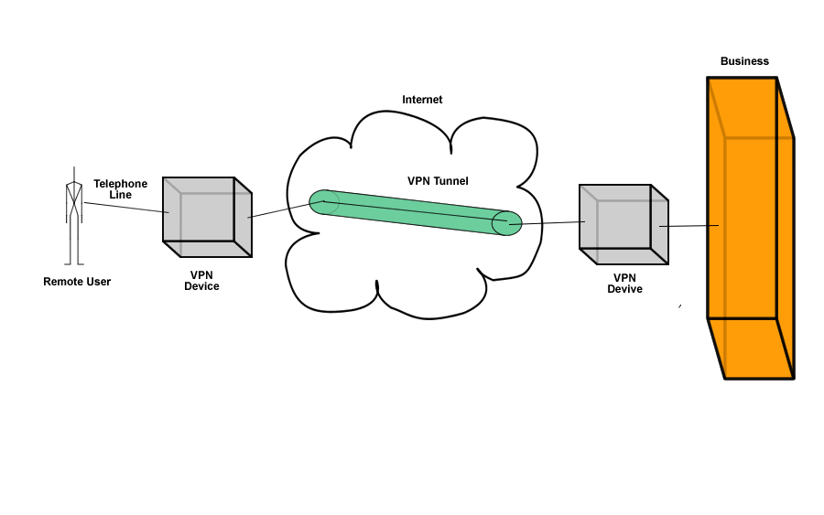
How a VPN Works - 2
Virtual Private Networks Topic 12 - 12.8

Slide 9
Key Functions
Virtual Private Networks Topic 12 - 12.9
Authentication - validates that the data was sent from the sender
Access Control - preventing unauthorised users from accessing the network
Confidentiality - preventing the data from being read or copied as the data is being transported
Data Integrity - ensuring that the data has not been altered

Slide 10
Encryption
Virtual Private Networks Topic 12 - 12.10
Encryption – public key
Authentication – digital signatures
A virtual connection is made through the Internet
Datagrams are sent along the virtual connection
The outer part of the datagram contains a header and may or may not be encrypted
The inner part is encrypted

Slide 11
Protocols
Virtual Private Networks Topic 12 - 12.11
There are three main protocols used:
IP Security (IPsec)
Point-to-Point Tunneling Protocol (PPTP)
Layer 2 Tunneling Protocol (L2TP)

Slide 12
IPsec
Virtual Private Networks Topic 12 - 12.12
An open standard protocol suite
Provides privacy and authentication services
Has two modes of operation
Transport Mode encrypts data but not the header
Tunnel Mode encrypts both data and header

Slide 13
PPTP
Virtual Private Networks Topic 12 - 12.13
A data link protocol
Used to establish a direct connection between two networking nodes
Creates the virtual connection across the Internet
Can provide:
Connection authentication
Transmission encryption
Compression

Slide 14
L2TP
Virtual Private Networks Topic 12 - 12.14
A tunneling protocol
Does not provide encryption or confidentiality, but relies on an encryption protocol that it passes within the tunnel
The entire L2TP packet, including payload and header, is sent within a UDP datagram.

Slide 15
Protocols Working Together
Virtual Private Networks Topic 12 - 12.15
It is common to carry PPTP sessions within an L2TP tunnel.
L2TP does not provide confidentiality or strong authentication by itself.
IPsec is often used to secure L2TP packets by providing confidentiality, authentication and integrity.
The combination of these two protocols is generally known as L2TP/IPsec.

Slide 16
Advantages
Virtual Private Networks Topic 12 - 12.16
Cost effective
Greater scalability
Easy to add/remove users
Mobility
Security

Slide 17
Disadvantages
Virtual Private Networks Topic 12 - 12.17
Understanding of security issues
Unpredictable Internet traffic
Difficult to accommodate products from different vendors

Slide 18
Computer Networks
Topic 12 – Lecture 2: Implementing VPN

Slide 19
VPN Connections
Virtual Private Networks Topic 12 - 12.19
A VPN is a secure, private communication tunnel between two or more devices across a public network (e.g. the Internet)
VPN devices can be:
a computer running VPN software
a special device like a VPN enabled router
Remote computers can connect to an office network
Two computers in different locations can connect to each other over the Internet

Slide 20
VPN Categories
Virtual Private Networks Topic 12 - 12.20
There are several types of VPN
There are different ways of classifying VPNs
We divide them into 2 broad categories based upon architecture:
Client-initiated VPNs
Network access server (NAS)-initiated VPNs

Slide 21
Client-Initiated VPNs
Virtual Private Networks Topic 12 - 12.21
Users establish a tunnel across the ISP shared network to the customer network.
Customer manages the client software that initiates the tunnel
Advantage - they secure the connection between the client and ISP
Disadvantage - they are not as scalable and are more complex than NAS-initiated VPNs

Slide 22
NAS-Initiated VPNs
Virtual Private Networks Topic 12 - 12.22
Users connect to the ISP NAS which establishes a tunnel to the private network.
More robust than client-initiated VPNs
Do not require the client to maintain the tunnel- creating software
Do not encrypt the connection between the client and the ISP
– not a concern for most customers, because the Public Switched Telephone Network (PSTN) is much more secure than the Internet.

Slide 23
VPNs and the Workplace
Virtual Private Networks Topic 12 - 12.23
VPNs can run from a remote client PC, remote office router across the Internet, or an IP service provider network to one or more corporate gateway routers (remote access).
VPNs between a company’s offices are a company
intranet.
VPNs to external business partners are extranets.

Slide 24
Extranet
Virtual Private Networks Topic 12 - 12.24
An extranet is where the Internet or one or two Service Providers are used to connect to business partners.
Extends network connectivity to:
Customers
Business partners
Suppliers
Security policy is very important as potentially the VPN could be used for large orders or contracts.

Slide 25
Intranet
Virtual Private Networks Topic 12 - 12.25
Intranet VPNs extend a basic remote access VPN to other corporate offices.
Connectivity is across the Internet or across the Service Provider IP backbone.
Service levels are likely to be maintained and enforced within a single Service Provider.
For VPNs across the Internet (multiple Service Providers) there are no performance guarantees
– no one is in charge of the Internet!

Slide 26
Remote Access VPN - 1
Virtual Private Networks Topic 12 - 12.26
Encrypted connections between mobile or remote users and their corporate networks
Remote user can make a local call to an ISP, as opposed to a long distance call to the corporate remote access server
Ideal for a telecommuter or mobile sales people
VPN allows mobile workers & telecommuters to take advantage of broadband connectivity

Slide 27
Remote Access VPN - 2
Virtual Private Networks Topic 12 - 12.27
Utilises access technologies to allow remote users to become part of a corporate VPN
Usually involves the use of the Point-to-Point Protocol (PPP) and tunnels that extend the PPP connection from the access server to the corporate network
In Microsoft Point-to-Point Tunneling Protocol (PPTP) the tunnel is extended from the access server out to the end-user PC.

Slide 28
Virtual Private Dial-Up Networking
Virtual Private Networks Topic 12 - 12.28
Virtual private dial-up networking (VPDN) enables users to configure secure networks that rely upon ISPs to tunnel remote access traffic.
Remote users can connect using local dial-up
Dial-up service provider forwards the traffic
Network configuration and security remains in the control of the client
The dialup service provider provides a virtual pipe between the sites.

Slide 29
VPN in Industry
Virtual Private Networks Topic 12 - 12.29
Healthcare: transferring confidential patient information within a healthcare provider
Manufacturing: suppliers can view inventories & allow clients to purchase online safely
Retail: securely transfers sales data or customer info between stores & headquarters
Banking: enables account information to be transferred safely within departments & branches

Slide 30
VPN – Future Trends?
Virtual Private Networks Topic 12 - 12.30
As the VPN market becomes larger, more applications will be created along with more VPN providers and new VPN types.
Networks may converge to create an integrated VPN.
Improvements in protocols are expected which could improve the performance and services available via VPNs.

Slide 31
References
Virtual Private Networks Topic 12 - 12.31
Tanenbaum, A.S. & Weatherall, D.J. (2010). Computer Networks, 5th edition. Pearson Education.
The Cisco website: http://www.cisco.com/
The Microsoft website: http://technet.microsoft.com/en- us/library/cc739294(WS.10).aspx

Slide 32
Topic 12 – Virtual Private Networks
Virtual Private Networks Topic 12 - 12.32
Any Questions?

