Slide 1
Computer Networks
Topic 1:
Introduction to the Module and to Networks

Slide 2
Computer Networks
Topic 1 – Lecture 1:
Introduction to the Module: What is a Network?

Slide 3
Scope and Coverage
Introduction to the Module and to Networks Topic 1 - 1.3
This topic will cover:
Introduction to module
What is a network?
Real world networks
The OSI seven layer model

Slide 4
Learning Outcomes
Introduction to the Module and to Networks Topic 1 - 1.4
By the end of this topic, students will be able to:
Describe the purpose and development of computer networks
Explain the overarching principles of the OSI seven-layer model

Slide 5
Module Aims
Introduction to the Module and to Networks Topic 1 - 1.5
This module aims to provide you with:
a broad introduction to the networking and communication systems commonly employed in a business environment;
an understanding of the underlying theoretical frameworks;
an understanding of associated issues such as the testing and security of these systems.

Slide 6
Module Syllabus - 1
Introduction to the Module and to Networks Topic 1 - 1.6
Introduction to Networks
Network Protocols and Standards
Wireless Networking Standards
Network Topology and Architecture
Network Media and Connectors
Network Hardware

Slide 7
Module Syllabus - 2
Introduction to the Module and to Networks Topic 1 - 1.7
Wireless Network Hardware
Security Software
Firewalls
Network and Server Software
Voice over IP and Video Conferencing
Virtual Private Networks

Slide 8
Module Delivery
Introduction to the Module and to Networks Topic 1 - 1.8
The teacher-led time for this module is comprised of lectures and laboratory sessions.
Lectures are designed to start each topic.
You will be encouraged to be active during lectures by raising questions and taking part in discussions.
Laboratory sessions are designed to follow the respective topic lecture.
During these sessions, you will be required to work through practical tutorials and various exercises.

Slide 9

Private Study
Introduction to the Module and to Networks Topic 1 - 1.9
You are also expected to undertake private study to consolidate and extend your understanding.
Exercises are provided in your Student Guide for you to complete during this time.

Slide 10

Assessment
Introduction to the Module and to Networks Topic 1 - 1.10
This module will be assessed by:
an examination worth 75% of the total mark
an assignment worth 25% of the total mark

Slide 11
Network – a Definition
Introduction to the Module and to Networks Topic 1 - 1.11
If we consider networks in general, rather than computer networks, then a good broad definition is:
“a group or system of interconnected people or
things”
(Source: http://www.oxforddictionaries.com)

Slide 12
Network Types
Introduction to the Module and to Networks Topic 1 - 1.12
Modern society requires many networks to operate:
Transport networks
Communications networks
Power network (electricity distribution)
Social networks
Business networks
Etc.
Society simply could not exist without these interconnections

Slide 13
The Rise of Computer Networks
Introduction to the Module and to Networks Topic 1 - 1.13
The Early Years
Highly centralised computing facilities
Few computers, even in large organisations
Miniaturisation
Computers get more powerful, smaller and cheaper
Many more computers
Merging with Communications Systems
Computers connect to each other
A network is born

Slide 14
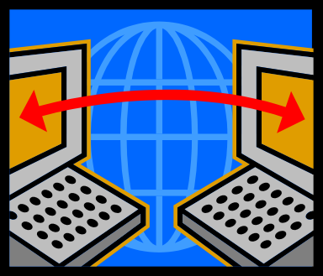
What is a Computer Network?
Introduction to the Module and to Networks Topic 1 - 1.14
A basic network could consist of two computers connected by a transmission medium that allows signals to pass between them.
But there is no need to limit it to 2 computers.

Slide 15
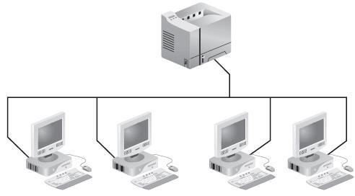
Larger Networks
Introduction to the Module and to Networks Topic 1 - 1.15
Even in a single office it makes sense to add more devices to the network:
More computers
Peripheral devices (printers, etc).

Slide 16
Multiple Locations
Introduction to the Module and to Networks Topic 1 - 1.16
Networks are not limited to a single location.
Modern communications systems allow an organisation to have networks that span:
Multiple rooms in the same building
Different buildings
Different towns
Different countries
Different continents

Slide 17
Across the World
Introduction to the Module and to Networks Topic 1 - 1.17
The development of the Internet and global communications systems allows the network of a single organisation to cover the whole world.
The only limiting factor is the availability of technology in remote areas.
In reality, our networks go beyond the world’s
boundaries ...

Slide 18
Computer Networks
Topic 1 – Lecture 2: Real World Networks

Slide 19
Why Network?
Introduction to the Module and to Networks Topic 1 - 1.19
There would be no point building networks if there was no demand for them.
We will briefly examine the computer networks in use today for:
Home use
Business use
Mobile use
We will also consider some of the social issues raised as a result of networking.

Slide 20



Networks in the Home
Introduction to the Module and to Networks Topic 1 - 1.20
With many sources suggesting there were over 1 billion computers in the world in 1998, it is no surprise that many homes have a PC or laptop.
But PCs and laptops are not the only computing hardware in many homes …

Slide 21
Networked Devices in the Home
Introduction to the Module and to Networks Topic 1 - 1.21
PCs and laptops
Telephones – landline and mobile
Games consoles
TV including cable and satellite
Radio
Others that are not computer/communication networks such as electricity, gas, water, sewage, etc.

Slide 22
Why do we have Home Networks?
Introduction to the Module and to Networks Topic 1 - 1.22
In the early days of home PCs, they were mainly used for word processing and games.
Modern home networks are used for:
Accessing information from a range of sources
Personal communications
Entertainment
E-commerce

Slide 23

Networks in Business
Introduction to the Module and to Networks Topic 1 - 1.23
Most businesses have a number of computers and peripheral devices.
Good communications are important if a business is to be successful.
Large businesses hold a huge amount of data and information processing is a key business function.
Networks are needed to compete!

Slide 24
Networked Devices in Business
Introduction to the Module and to Networks Topic 1 - 1.24
PCs and laptops
Telephones – landline, mobile, and exchanges
Peripheral devices
Data storage devices
Production machinery
Others that are not computer/communication networks such as electricity, gas, water, sewage, etc.

Slide 25
The Purpose of Business Networks
Introduction to the Module and to Networks Topic 1 - 1.25
Resource sharing
General communications
Business-to-business communication
E-commerce

Slide 26
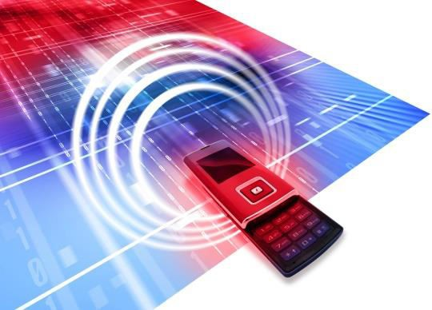
Mobile Networks
Introduction to the Module and to Networks Topic 1 - 1.26
People like to keep in touch whilst on the move.
For business, the ability to remain in contact whilst out of the office is important.
Modern handheld devices have the processing power to do much more than phone calls and text.

Slide 27
Networked Mobile Devices
Introduction to the Module and to Networks Topic 1 - 1.27
Laptops, notebooks, iPad, etc.
Mobile telephones
Smartphones (iPhone, Blackberry, etc.)
GPS systems

Slide 28
The Purpose of Mobile Networks
Introduction to the Module and to Networks Topic 1 - 1.28
General communications
Mobile office
Location-based services
M-commerce
General applications

Slide 29
Social Issues
Introduction to the Module and to Networks Topic 1 - 1.29
Patterns of work
Individual privacy
Education
Copyright
Other legal issues

Slide 30
Computer Networks
Topic 1 – Lecture 3:
How do Devices Communicate with Each Other?

Slide 31
Human Communication - 1
Introduction to the Module and to Networks Topic 1 - 1.31
Think how you communicate a message to the person sitting nearest to you. The basic steps are:
Create a message (decide what you are going to say)
Transmit the message (speak to the person)

Slide 32
Human Communication - 2
Introduction to the Module and to Networks Topic 1 - 1.32
But that is only half of the process.
For the message to be useful the other person must get the message and understand it. The basic steps are:
Receive a message (listen to what the person says)
Understand the message (process the message in the brain)

Slide 33
Potential Problems - 1
Introduction to the Module and to Networks Topic 1 - 1.33
The sender cannot send properly
They have a condition that prevents them speaking.
They speak very quietly.
The receiver cannot understand
They are deaf.
The message is too quiet.
There is a word they do not understand.

Slide 34
Potential Problems - 2
Introduction to the Module and to Networks Topic 1 - 1.34
The listener is not listening (transmission problems)
They are already in a conversation with someone else.
The listener does not like the sender and does not wish to have a conversation with them.
There is too much background noise.
The teacher is talking so conversation is not allowed.

Slide 35
Solutions
Introduction to the Module and to Networks Topic 1 - 1.35
Use another communication method (writing or sign language) or speak louder.
Let the sender know there is a problem and send the message in a different way (writing, sign language) or explain the unknown word.
Let the receiver know you have a message for them (tap them on the shoulder, wave, etc.) or wait until a suitable time to have a conversation.

Slide 36
Machine Communication
Introduction to the Module and to Networks Topic 1 - 1.36
As humans we instinctively know what to do if the message has not been sent, received and understood.
Machines do not do this instinctively.
We need rules and standards that ensure a message is transmitted correctly so that the correct receiver receives and understands it.
There also needs to be rules and standards that deal with transmission problems.

Slide 37
A Simple Conversation? - 1
Introduction to the Module and to Networks Topic 1 - 1.37
When you talk to your fellow student it seems simple – but what really happens?
A concept in your brain is translated into words
Words are converted to electrical signals
Electrical signals are sent to muscles
These muscles move to create pressure differences in the air (sound waves)
Sound waves create movement in the
listener’s ear

Slide 38
A Simple Conversation? - 2
Introduction to the Module and to Networks Topic 1 - 1.38
They are converted to electrical signals
The brain receives the signals and converts to words
The brain translates the words into concepts
It is a complex process!

Slide 39
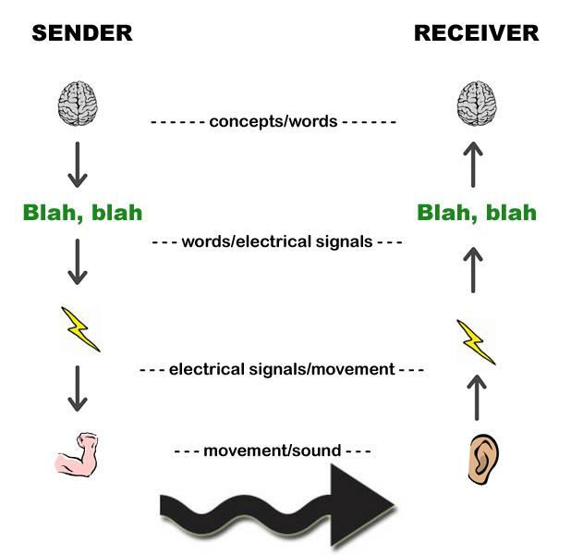
A Simple Conversation?
Introduction to the Module and to Networks Topic 1 - 1.39

Slide 40
A Layered Approach
Introduction to the Module and to Networks Topic 1 - 1.40
Considering our conversation, we can see that there are equivalent processes at both receiver and sender:
Converting between concepts and words
Converting between words and electrical signals
Converting between electricity and movement
Converting between muscle movement and sound waves
We can model this as 4 layers

Slide 41
A Scenario
Introduction to the Module and to Networks Topic 1 - 1.41
Your colleague on the other side of the world needs to send you a fax message but there are problems:
Your colleague speaks German
His company secretary speaks French
Your company secretary speaks French
You speak English
How does the message, “mein Name ist Heidi” (“my name is Heidi”), get to you?

Slide 42
A Solution - Sender
Introduction to the Module and to Networks Topic 1 - 1.42
German colleague writes message “Mein Name ist Heidi” and states who message is to be sent to.
Translator converts this to French, “Je m’appelle Heidi” and adds detail that this is French.
Secretary sends message in fax to your office.

Slide 43
A Solution - Receiver
Introduction to the Module and to Networks Topic 1 - 1.43
Secretary receives message in fax in your office.
Translator converts this to English, “My name is Heidi”.
You receive and read message.
Details of how we know which translator to use or how you get the message from the translator, etc, have not been included here.

Slide 44
A Solution - Layers
Introduction to the Module and to Networks Topic 1 - 1.44
Write/read message in native language.
Translate to common language.
Send receive message in common language.

Slide 45
Developing a model for real-life networks
Introduction to the Module and to Networks Topic 1 - 1.45
We know we can develop a layered approach but have to deal with many issues including:
Message language
Transmission format
Addressing who the message is for
Ensuring the receiver is listening
Dealing with errors in transmission
Understanding the message
The model must apply to all networks.

Slide 46
Computer Networks
Topic 1 – Lecture 4:
The OSI Reference Model

Slide 47
A Hierarchy of Layers
Introduction to the Module and to Networks Topic 1 - 1.47
Networks can be modelled as a hierarchy or stack of layers.
This simplifies the design of a network.
Each layer is built upon the layer immediately underneath it.
The purpose of each layer is to provide services to the layer above whilst hiding the detail of how those services are created.

Slide 48
Our Earlier Scenario
Introduction to the Module and to Networks Topic 1 - 1.48
Our secretary presented the message in French to the translator. The translator did not need to know how the message was received.
The translator presented the message in English to you. You did not need to know what the French message was, nor how it was translated, nor how it was transmitted to your company.

Slide 49
Communicating
Introduction to the Module and to Networks Topic 1 - 1.49
Each layer operates via rules, a protocol.
There is an interface between adjacent layers that defines the operations and services that the lower layer provides.
Communication requires several layers:
Data and control information passes from top layer to bottom layer in sending device;
This is then transmitted to the receiving device;
It passes from bottom to top at the receiving end.

Slide 50
Design Issues
Introduction to the Module and to Networks Topic 1 - 1.50
There are a number of key issues when designing a network and these appear in one or more layers:
Addressing
Error control
Flow control
Multiplexing
Routing

Slide 51
The OSI Model
Introduction to the Module and to Networks Topic 1 - 1.51
Based upon a proposal first developed by the International Standards Organization (ISO) as a first step in the standardisation of the protocols used in various layers.
It was revised in 1995.
It deals with connecting open systems – the Open Systems Interconnection (OSI) Reference Model – so deals with systems that are open to connection with other systems.

Slide 52
Principles Behind the Model
Introduction to the Module and to Networks Topic 1 - 1.52
A layer should be created where a different abstraction is needed.
Each layer has a well-defined function.
Each layer should link to standardised protocols.
Layer boundaries should be chosen to minimize information flow across interfaces.
The number of layers should be sufficient to separate functions but not be unwieldy.

Slide 53
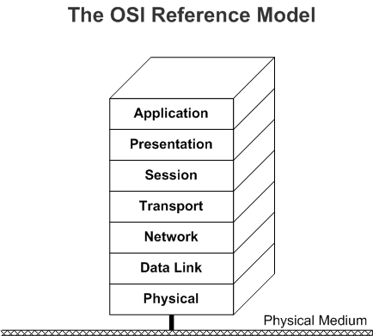
The OSI Seven Layer Model
Introduction to the Module and to Networks Topic 1 - 1.53

Slide 54
Physical Layer – Layer 1
Introduction to the Module and to Networks Topic 1 - 1.54
Concerned with transmitting bits (1s and 0s) over a communication channel.
Design considerations include:
What voltage represents a 1
How long a bit lasts (nanoseconds)
How connection is established
How connection is ended
What connectors are required
Largely mechanical, electrical, timing issues

Slide 55
Data Link Layer – Layer 2
Introduction to the Module and to Networks Topic 1 - 1.55
Responsible for communications between adjacent network nodes.
Transforms raw transmitted data into a line of data that is error free and passed to the network layer.
Deals with the different data rates between sender and receiver.

Slide 56
Network Layer – Layer 3
Introduction to the Module and to Networks Topic 1 - 1.56
Responsible for establishing paths for data transfer through the network (routing).
Routing can be static so that paths remain constant or dynamic so as to reflect network load.
The network layer is used to overcome differences in addressing, protocols and message sizes.

Slide 57
Transport Layer – Layer 4
Introduction to the Module and to Networks Topic 1 - 1.57
Responsible for delivering messages between networked hosts.
Also responsible for fragmentation and reassembly of messages.

Slide 58
Session Layer – Layer 5
Introduction to the Module and to Networks Topic 1 - 1.58
Responsible for establishing process-to-process communications between networked hosts.
Establishes sessions between different machines that allow for:
Deciding whose turn it is to transmit;
Preventing simultaneous transmissions;
Synchronisation to allow transmission to continue if there has been a failure mid- transmission.

Slide 59
Presentation Layer – Layer 6
Introduction to the Module and to Networks Topic 1 - 1.59
Responsible for defining the syntax which two network hosts use to communicate.
Makes it possible for different systems with different data structures to communicate.

Slide 60
Application Layer – Layer 7
Introduction to the Module and to Networks Topic 1 - 1.60
Responsible for providing end-user services, such as file transfers, electronic messaging, email, virtual terminal access, and network management.
This is the layer with which the user interacts.

Slide 61
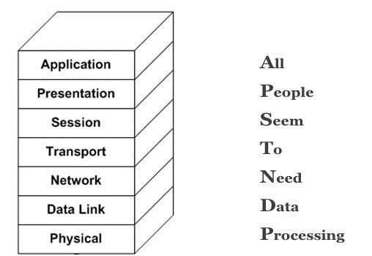
Remembering the Layers
Introduction to the Module and to Networks Topic 1 - 1.61

Slide 62
References
Introduction to the Module and to Networks Topic 1 - 1.62
Tanenbaum, A.S. & Weatherall, D.J. (2010). Computer Networks, 5th edition. Pearson Education.
The ITU website, http://www.itu.int
The IETF website, http://www.ietf.org
http://www.oxforddictionaries.com

Slide 63
Topic 1 Introduction to the Module and to Networks
Introduction to the Module and to Networks Topic 1 - 1.63
Any Questions?

