Slide 1
Computer Networks
Topic 2:
Network Protocols and Standards

Slide 2
Computer Networks
Topic 2 – Lecture 1:
Communications and Network Protocols

Slide 3
Scope and Coverage
Network Protocols and Standards Topic 2 - 2.3
This topic will cover:
Communications and network protocols
Protocols and the OSI model
Protocols in real-world networks
The Internet

Slide 4
Learning Outcomes
Network Protocols and Standards Topic 2 - 2.4
By the end of this topic, students will be able to:
Explain the purpose of network protocols
Relate protocols to the OSI Reference model
Describe the use of protocols in real-life networks
Describe the protocols used by the Internet

Slide 5
Recap of Topic 1
Network Protocols and Standards Topic 2 - 2.5
The last topic examined:
What a network is
Real-world networks
A layered architecture
The OSI 7-layer model

Slide 6
Controlling a Conversation
Network Protocols and Standards Topic 2 - 2.6
The elements of a class discussion:
What language is spoken?
Whose turn it is to speak?
Who should hear the message?
Did all receivers get the message?
Did all receivers get the message correctly?

Slide 7
Conversation Rules
Network Protocols and Standards Topic 2 - 2.7
With friends, the rules are implicit.
In more formal situations, rules may be given at the start.
In a new situation, we may be unsure what the rules are.
The rules depend upon the type of conversation we are having and the social context.
Not following the rules will make a conversation difficult or impossible.

Slide 8
Network Conversation Rules
Network Protocols and Standards Topic 2 - 2.8
The same rules apply in networks
Language
Turn to “speak”
Who the message is for
Confirming receipt
But often the rules have to be exact, because machines cannot adapt to changes or variations from what is expected in the same way that humans can.

Slide 9
What is a Protocol?
Network Protocols and Standards Topic 2 - 2.9
In terms of network communications, a protocol is an agreement between communicating parties on how a communication will take place.
It is simply the rules of the conversation.
It makes sense to have sets of rules agreed before any conversation takes place (STANDARDS).
Different conversations can use different protocols.

Slide 10
Layers and Protocols
Network Protocols and Standards Topic 2 - 2.10
We have already examined the OSI 7-layer model.
The OSI model is a conceptual model – it does not tell us how the communication is carried out.
Each layer has its own protocol.
So, we have a protocol stack with protocols matching the layers of our model.
Network communications use many protocols in one communication.

Slide 11
Protocol Types
Network Protocols and Standards Topic 2 - 2.11
We can divide protocols into general types depending upon their purpose and how they are implemented:
Hardware protocols
Software protocols
Hardware-software interface

Slide 12
Hardware Protocols
Network Protocols and Standards Topic 2 - 2.12
Define how hardware devices operate together
Includes:
Voltage levels
Wires used
Pins on connectors
Does not involve software but is controlled by electronic circuitry

Slide 13
Software Protocols
Network Protocols and Standards Topic 2 - 2.13
Programs communicate with each other via software protocols.
This includes the protocols required to talk to other devices and services.
There are different protocols for different kinds of networks.

Slide 14
Hardware/Software Interface
Network Protocols and Standards Topic 2 - 2.14
Software needs to access hardware, e.g. a message waiting in memory
Software needs to know:
Where data resides
What order to access data in
What happens next

Slide 15
Some Common Protocols
Network Protocols and Standards Topic 2 - 2.15
HTTP
FTP
IP
TCP
POP3
SMTP
IMAP
We will look at these in more detail later (after Private Study Exercise 1).

Slide 16
Computer Networks
Topic 2 – Lecture 2: Protocols and the OSI Model

Slide 17
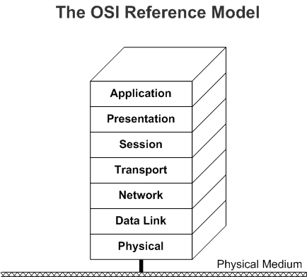
The OSI Seven Layer Model
Network Protocols and Standards Topic 2 - 2.17

Slide 18
Protocols and the OSI Model
Network Protocols and Standards Topic 2 - 2.18
There is no single protocol that is specific to a single layer.
The protocols are dependent upon:
The network type
The manufacturer of the hardware
We will examine some of the common protocols that relate to specific layers of the OSI Model.

Slide 19
The Physical Layer
Network Protocols and Standards Topic 2 - 2.19
Largely mechanical, electrical, timing issues
The protocols associated with the physical layer are dependent upon the type of network.
Many protocols that define communications in the physical layer are covered by the IEEE 802 series (but these overlap into the data link layer).
Data type: bits
Devices on this layer include the transmission media such as fibre optic cable, etc.

Slide 20
IEEE 802
Network Protocols and Standards Topic 2 - 2.20
Standards for many kinds of Local Area Networks (LANs)
Many have not survived with time, but there are a number of important standards, including:
802.3, Ethernet
802.11, Wireless LANs
802.15, Personal area networks (Bluetooth)
802.16, Broadband wireless

Slide 21
LANs
Network Protocols and Standards Topic 2 - 2.21
A LAN is a privately owned network covering a small area such as:
An office
A building
A small geographical area (e.g. a campus)
LANs are distinguished by:
Their geographical size
The transmission technology
Their topology (the layout of computer connections)

Slide 22
Physical Layer Standards
Network Protocols and Standards Topic 2 - 2.22
The Physical Layer is controlled by electronic devices, so the standards relate to these, e.g.
RS232, Interface Between Data Terminal Equipment and Data Circuit Terminating Equipment Employing Serial Binary Data Interchange
RS422, Electrical Characteristics of Balanced Voltage Digital Interface Circuits.

Slide 23
The Data Link Layer
Network Protocols and Standards Topic 2 - 2.23
Responsible for communications between adjacent network nodes
Divided into 2 sublayers:
The Media Access Control (MAC) sublayer
The Logical Link Control (LLC) sublayer
Data type: frames
Many protocols also covered by IEEE 802 series
Devices: switch, bridge

Slide 24
The Data Link Sublayers
Network Protocols and Standards Topic 2 - 2.24
The Media Access Control (MAC) sublayer manages protocol access to the physical network medium. The IEEE MAC specification defines MAC addresses, which allow multiple devices to be uniquely identified at the data link layer.
The Logical Link Control (LCC) sublayer manages communications between devices over a single link of a network. LCC is defined in the IEEE 802.2 specification.

Slide 25
What is a Frame?
Network Protocols and Standards Topic 2 - 2.25
Data packets are encapsulated into frames. A header with a hardware (MAC) destination and source address are added. A data frame includes:
Bit pattern indicating the start of a frame
Destination address
Source address
Data
Frame sequence check
Other elements that may be protocol specific

Slide 26
Data Link Layer Protocols
Network Protocols and Standards Topic 2 - 2.26
Ethernet
Token Ring
FDDI
IEEE 802.11 (WLAN, Wi-Fi)
ATM
PPP
HDLC

Slide 27
The Network Layer
Network Protocols and Standards Topic 2 - 2.27
Responsible for establishing paths for data transfer through the network (routing)
Translates the logical address into the physical address, e.g. computer name into MAC address.
Data type: packets
Devices: router, frame relay device, ATM switch

Slide 28
Packets
Network Protocols and Standards Topic 2 - 2.28
A packet is an independent, self-contained message sent over the network
Includes:
A header
Addressing information
The data

Slide 29
Network Layer Protocols
Network Protocols and Standards Topic 2 - 2.29
IP
OSPF
BGP
NetBEUI
DDP

Slide 30
The Transport Layer
Network Protocols and Standards Topic 2 - 2.30
Responsible for delivering messages between networked hosts and the fragmentation and reassembly of messages
Acknowledgement of received segments
Retransmission of segments not acknowledged
Proper re-sequencing of segments
Flow control to manage the data so no data is lost
Data type: segment
Devices: bridge router (brouter), gateway

Slide 31
Transport Layer Protocols
Network Protocols and Standards Topic 2 - 2.31
TCP
UDP
NetBEUI
SPX
ATP

Slide 32
The Session Layer - 1
Network Protocols and Standards Topic 2 - 2.32
Responsible for establishing process-to-process communications between networked hosts
Offers three communications modes
Simplex - Only one device transmits
Half-duplex - Each side takes turns transmitting from one side at a time
Full-duplex - Devices on both sides of the communications channel can talk at the same time

Slide 33
The Session Layer - 2
Network Protocols and Standards Topic 2 - 2.33
Connection split into the following three phases:
Connection establishment
Data transfer
Connection termination
Data type: session
Devices: gateway

Slide 34
Session Layer Protocols
Network Protocols and Standards Topic 2 - 2.34
ASP
NetBIOS

Slide 35
The Presentation Layer
Network Protocols and Standards Topic 2 - 2.35
Responsible for defining the syntax that two network hosts use to communicate
Makes it possible for different systems with different data structures to communicate
Provides a variety of encoding and encryption functions applied to application layer data
Ensures that information sent from the application layer of one system will be readable by the application layer of another system

Slide 36
Encoding/Encryption Schemes
Network Protocols and Standards Topic 2 - 2.36
Conversion of character representation formats –
e.g. convert to ASCII characters
Common data representation formats - standard image, sound, and video formats -
e.g. JPEG, MPEG, and RealAudio
Common data compression schemes -
e.g. WinZip or Gzip

Slide 37
Presentation Layer Protocols
Network Protocols and Standards Topic 2 - 2.37
AFP
SMB
NCP
SSL
MIME

Slide 38
The Application Layer
Network Protocols and Standards Topic 2 - 2.38
Responsible for providing end-user services, such as file transfers, email, virtual terminal access, and network management
The layer with which the user interacts
This layer deals with application data

Slide 39
Application Layer Protocols
Network Protocols and Standards Topic 2 - 2.39
DHCP
FTP
SMTP
POP3
IMAP
HTTP

Slide 40
Research Topic
Network Protocols and Standards Topic 2 - 2.40
You should research all of the protocols mentioned in this lecture to get an idea what they do.
See Private Study, Exercise 4.

Slide 41
Computer Networks
Topic 2 – Lecture 3:
Protocols in Real-World Networks

Slide 42
Network Classifications
Network Protocols and Standards Topic 2 - 2.42
Defined by the area covered
Local Area Network (LAN)
A LAN is a privately owned network covering a small area
Metropolitan Area Network (MAN)
Covers a town or city
Wide Area Network (WAN)
A network that crosses regional, national and international boundaries

Slide 43
Networks
Network Protocols and Standards Topic 2 - 2.43
Ethernet
Fast Ethernet
Token Ring
Other LAN technologies
Peer-to-Peer
Client-Server

Slide 44
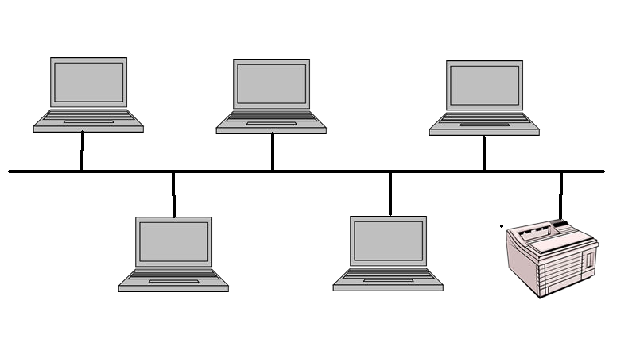
Ethernet
Network Protocols and Standards Topic 2 - 2.44
Very common LAN standard
Bus topology – all computers and peripherals are connected along a single cable segment
IEEE 802.3

Slide 45
Broadcast Network
Network Protocols and Standards Topic 2 - 2.45
When a node (computer) sends a message to another computer, it broadcasts the message to the entire network
The other nodes listen and if the message is for them they keep the data, if not they ignore it
Each node has an address
Data is sent with the address to identify the recipient

Slide 46
Ethernet Issues
Network Protocols and Standards Topic 2 - 2.46
Cable breaks
What happens if there is a break in the cable?
Signal reflection
A message is an electrical signal. What happens when it reaches the end of the cable?
Collisions
How does the network determine who has the right to send a message? What happens if two nodes send messages at the same time?

Slide 47
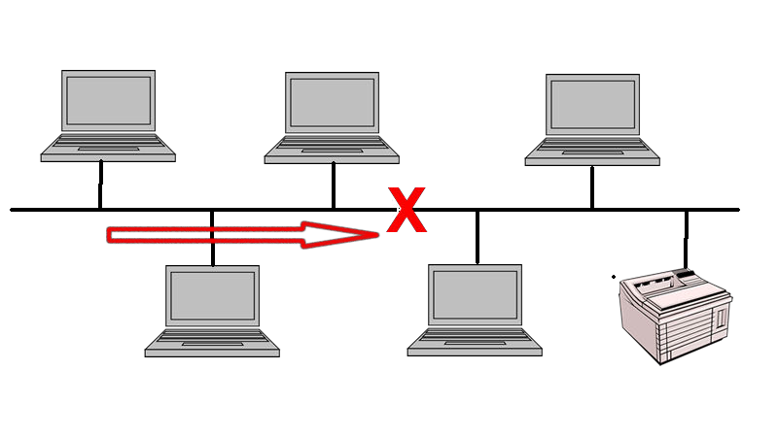
Cable Breaks
Network Protocols and Standards Topic 2 - 2.47
There is a split in the network, so communication is impossible between the two sections.

Slide 48
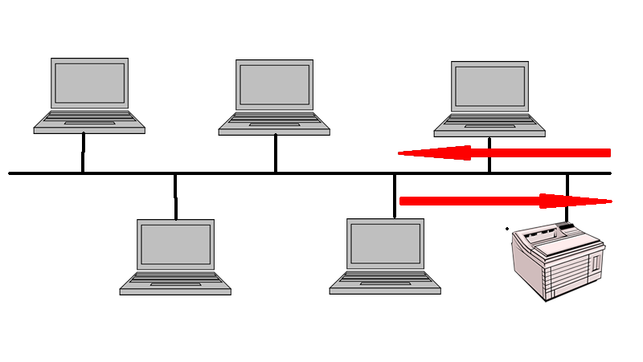
Signal Reflection
Network Protocols and Standards Topic 2 - 2.48
The messages passed are simple electrical signals
These will be reflected at cable ends and appear as a collision

Slide 49
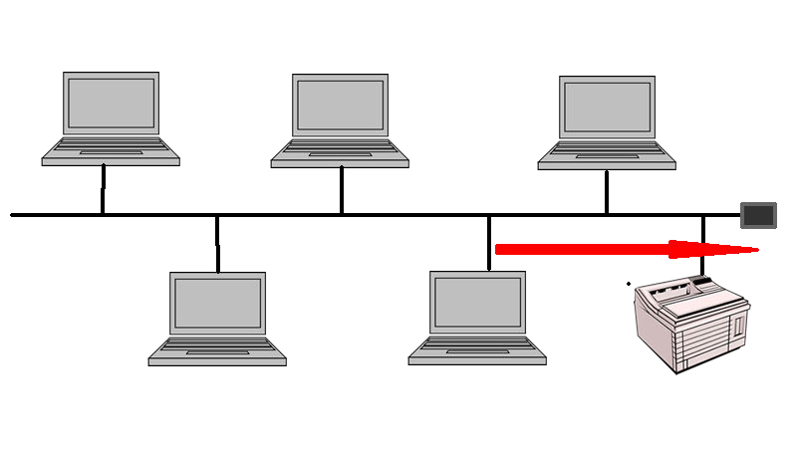
Cable Termination
Network Protocols and Standards Topic 2 - 2.49
Reflection is prevented by having the cable terminated with a resistor
This dissipates the signal and prevents reflection

Slide 50
Collisions
Network Protocols and Standards Topic 2 - 2.50
Before transmitting a signal, a node listens to the network and only transmits if there is no traffic.
This does not prevent two nodes transmitting at the same time.
If two or more nodes broadcast at the same time, there is a collision and the message cannot be received.
A method is required for dealing with this.

Slide 51
CSMA/CD
Network Protocols and Standards Topic 2 - 2.51
Carrier Sense Multiple Access with Collision Detection
A simple protocol
Any node can send a message when the network is free.
If the cable is busy, it waits until it is free.
Removes a lot of unnecessary waiting time by allowing transmission at any time.

Slide 52
CSMA/CD Collisions
Network Protocols and Standards Topic 2 - 2.52
Two nodes may detect that the network is free at any one time and both transmit.
The signals collide preventing either from being received.
Energy levels on the line are increased and the collision is detected, nodes then:
Stop transmitting
Wait for a random back-off interval
Then attempt to retransmit

Slide 53
CSMA/CD Characteristics
Network Protocols and Standards Topic 2 - 2.53
No predetermined transmission order
No guaranteed wait time before transmission
Probability of collision increases as data rates increase - network saturates before theoretical limit
Nodes transmitting at a high rate tend to take over the network

Slide 54
Fast Ethernet
Network Protocols and Standards Topic 2 - 2.54
Ethernet originally ran at 5Mbps, then 10 Mbps
This is too slow for many applications
Fast Ethernet was introduced that ran CSMA/CD at speeds of 100Mbps
This was followed by Gigabit Ethernet at speeds of 1000Mbps
100 Gigabit Ethernet is now a formal standard.
It is suggested that Terabit Ethernet will be available by 2015

Slide 55
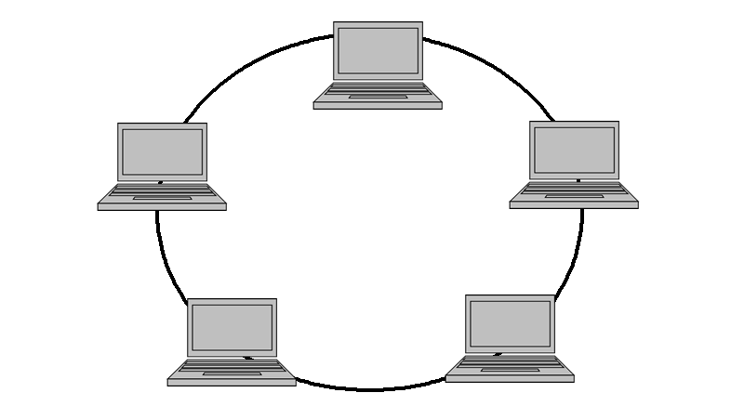
Token Ring
Network Protocols and Standards Topic 2 - 2.55
All nodes are connected in a ring
IEEE 802.5
Now mainly present in legacy IBM systems

Slide 56
Token Passing
Network Protocols and Standards Topic 2 - 2.56
A token is a special frame that circulates the ring, node by node.
Only the node in possession of the token can transmit.
Messages pass around the ring until they reach the destination node.
The transmitting node then passes the token to the next node.
Fairly distributes right to transmit

Slide 57
Problem
Network Protocols and Standards Topic 2 - 2.57
Transmission is one way, a break in the ring stops transmission
Modern rings are physically star shaped and operate through a hub that automatically removes damaged nodes thus “fixing” the ring

Slide 58

FDDI
Network Protocols and Standards Topic 2 - 2.58
Fibre Distributed Data Interface
Double ring transmitting in two directions, so transmission is possible if one ring is broken
Now not a competitive technology

Slide 59
ATM
Network Protocols and Standards Topic 2 - 2.59
Asynchronous Data Transfer Mode
Intended as a replacement for telephony and data networks
Uses a cell switching approach for high data rate transmission
Has been widely used as a LAN backbone technology, despite requiring complicated interfaces
Now overtaken by Gigabit Ethernet

Slide 60
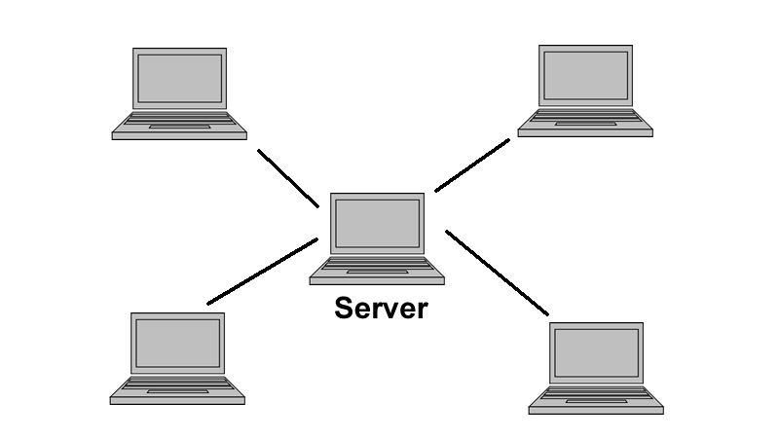
Client-Server Networks
Network Protocols and Standards Topic 2 - 2.60
Typically star-shaped networks
Central server holds data and programs for client computers
Clients (workstations) often have no hard drive

Slide 61
DHCP
Network Protocols and Standards Topic 2 - 2.61
Client-server networks often allow for devices to be added and removed
The Dynamic Host Configuration Protocol is often used to assign unique IP addresses to devices
The address can be released when a device leaves the network
This same address can then be allocated to another device when it joins

Slide 62
Peer-to-Peer (P2P) Networks
Network Protocols and Standards Topic 2 - 2.62
Nodes generally have their own hard drive
Nodes often have their own peripheral devices
Control of a node is autonomous
Resources are shared at the discretion of individual users
Individual nodes can act as both clients and servers
Gnutella is a common (P2P) protocol

Slide 63
Computer Networks
Topic 2 – Lecture 4: The Internet

Slide 64
What is the Internet?
Network Protocols and Standards Topic 2 - 2.64
A collection of networks that use common protocols to provide common services.
Uses the TCP/IP reference model
Uses the TCP/IP protocol stack
To be part of the Internet, a computer must also:
Have an IP address
Be able to send IP packets to other machines on the Internet

Slide 65
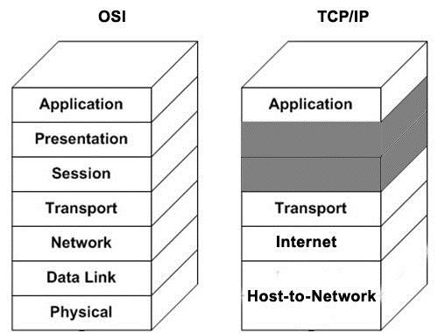
TCP/IP Reference Model
Network Protocols and Standards Topic 2 - 2.65
Has 4 layers

Slide 66
Host-to-Network Layer
Network Protocols and Standards Topic 2 - 2.66
Not specified in detail in the model
The host has to connect to the network via some protocol
The protocol must allow it to send IP packets

Slide 67
Internet Layer
Network Protocols and Standards Topic 2 - 2.67
Permits hosts to inject packets into any network and travel independently to their destination
Packets may be delivered in any order
Role is to ensure packets get to the right address
The Internet Protocol (IP) is responsible for this
The internet layer is present in the Internet but not specific to the Internet
Packet switching is the key function

Slide 68
Transport Layer
Network Protocols and Standards Topic 2 - 2.68
Is designed to allow source and destination to have a conversation
Uses one of two protocols:
Transmission Control Protocol (TCP)
User Datagram Protocol (UDP)
Comparable to the OSI Transport Layer

Slide 69
Application Layer
Network Protocols and Standards Topic 2 - 2.69
The TCP/IP model does not have session or presentation layers
This layer consists of high level protocols such as:
File Transfer Protocol (FTP)
Simple Mail Transfer Protocol (SMTP)
HyperText Transfer Protocol (HTTP)

Slide 70
Internet Protocol
Network Protocols and Standards Topic 2 - 2.70
Defines the rules that determine how packets are transferred from one host to another
It is not a reliable protocol:
Packets may not be delivered
Packets may be delivered out of sequence
Every host must have a unique IP address that identifies it.

Slide 71
IPv4 Addresses
Network Protocols and Standards Topic 2 - 2.71
Internet Protocol version 4
Each address is a dotted quad in the form 101.4.233.1
Each address is made up of four decimal numbers between 0 and 255 separated by a dot
Each address is 32 bits
2³²= 4 294 967 296 possible addresses

Slide 72
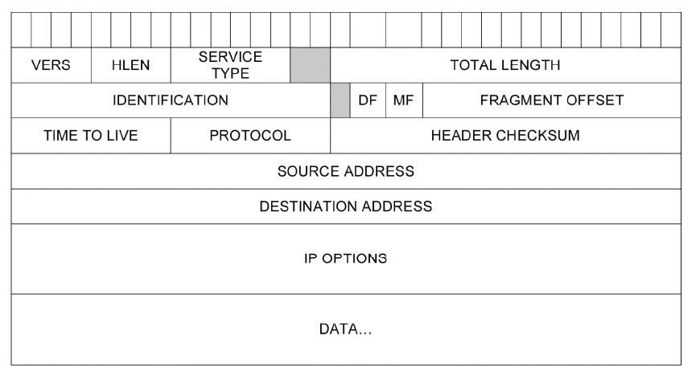
IP Datagram - 1
Network Protocols and Standards Topic 2 - 2.72

Slide 73
IP Datagram - 2
Network Protocols and Standards Topic 2 - 2.73
The datagram is the packet sent around the network.
Header information contains detail of where it came from, where it is going to and processing information.
Data is the actual payload intended for the recipient.

Slide 74
Subnets
Network Protocols and Standards Topic 2 - 2.74
A subnet is a logical subdivision of an IP network.
Subnets are meaningless to any router outside the business.
Internal routers can use this to route packets to the relevant subnetwork.
By organising hosts into logical groups, subnetting can improve network security and performance.

Slide 75
Subnet Addressing
Network Protocols and Standards Topic 2 - 2.75
The most significant part of the address is used to indicate which network is intended, e.g. 192.168.1.0.
Devices on this subnet have addresses in the range 192.168.1.1 - 192.168.1.254.
192.168.1.255 cannot be assigned as it is reserved for broadcast.
Multiple subnets can be used on one network.

Slide 76
Multiple Subnets
Network Protocols and Standards Topic 2 - 2.76
A router could have the address 192.168.0.0.
There could be a number of subnets within an address:
– 192.168.1.0
– 192.168.2.0
– 192.168.3.0
– Etc.

Slide 77
IPv6
Network Protocols and Standards Topic 2 - 2.77
Problem with IPv4 - Not enough addresses
Solution – a new version of IP
IP version 6 addresses are made up of 128 bits.
2¹²⁸, or about 3.403×10³⁸, unique addresses
Represented by 8 groups of 16-bit hexadecimal values separated by colons, e.g. 2001:0db8:85a3:0000:0000:8a2e:0170:4334
Many applications do not yet support IPv6.

Slide 78
From IPv4 to IPv6
Network Protocols and Standards Topic 2 - 2.78
Address increased from 32-bit to 128-bit
Allows node to specify the message path
Smaller header but addresses are longer
Allows for more header options in the future
Quality of service capabilities allow non-standard handling of packets
Allow for the handling of authentication, confidentiality and data integrity

Slide 79
Transmission Control Protocol - 1
Network Protocols and Standards Topic 2 - 2.79
Designed to provide reliable delivery for IP
Takes care of breaking data into packets and reassembling at the destination host
Checks if packet is corrupted and requests a resend if it is
Checks number of packets and requests replacement if one is missing
Handles timeouts and transmission errors

Slide 80
Transmission Control Protocol - 2
Network Protocols and Standards Topic 2 - 2.80
A connection-oriented protocol - a connection is established and maintained until such time as the messages have been exchanged
Establishes a full duplex virtual connection between two endpoints
Each endpoint is defined by an IP address and a TCP port number
Used with WWW, email and file transfer

Slide 81
User Datagram Protocol - 1
Network Protocols and Standards Topic 2 - 2.81
A simple transmission model using headers of only 8 bytes
Does not provide:
Reliability
Ordering
Data integrity
Assumes error checking and correction is not necessary

Slide 82
User Datagram Protocol - 2
Network Protocols and Standards Topic 2 - 2.82
Does not have the delays that can be associated with TCP
Used with IP in time-sensitive applications:
Gaming
Voice over IP (VoIP)
DNS

Slide 83
File Transfer Protocol
Network Protocols and Standards Topic 2 - 2.83
Uses TCP/IP to transmit/receive
Works at the application layer
Uses a generic file structure that is independent of the operating system
Allows file transfer between dissimilar hosts

Slide 84
Simple Mail Transfer Protocol
Network Protocols and Standards Topic 2 - 2.84
Uses TCP/IP to transmit
Does not provide a user interface for sending and receiving messages
Many Internet email applications do provide interfaces.
Commonly used for sending email
Most email clients use POP3 or IMAP for incoming mail.

Slide 85
Hypertext Transfer Protocol
Network Protocols and Standards Topic 2 - 2.85
Used throughout the World Wide Web for sending messages and getting responses from servers
Most common method is the GET method to request and receive a web page
Other common methods are:
PUT
POST
DELETE
TRACE

Slide 86
References
Network Protocols and Standards Topic 2 - 2.86
Price B. (ed) (2003). Networking Complete, 3rd edition. Sybex.
Tanenbaum, A.S. & Weatherall, D.J. (2010). Computer Networks, 5th edition. Pearson Education.
The IETF website: http://www.ietf.org

Slide 87
Topic 2 – Network Protocols and Standards
Network Protocols and Standards Topic 2 - 2.87
Any Questions?

