Slide 1
Computer Networks
Topic 4:
Network Topology and Architecture

Slide 2
Computer Networks
Topic 4 – Lecture 1: Network Topology Concepts

Slide 3
Scope and Coverage
Network Topology and Architecture
Topic 4 - 4.3
This topic will cover:
Network topology concepts
Common network topologies and their application
Topologies and protocols

Slide 4
Learning Outcomes
Network Topology and Architecture Topic 4 - 4.4
By the end of this topic, students will be able to:
Explain the concept of network topology and its design
Discuss various common network topologies and their application(s)
Propose a simple network topology in response to detailed requirements

Slide 5
Topology
Network Topology and Architecture Topic 4 - 4.5
To install a network, you need to know how to connect all the elements together.
A network topology is the layout of computers, cables and peripherals and also the paths that data travels along on the network.
There are two forms of network topology:
Physical topology
Logical topology
Physical and logical topology may differ.

Slide 6
Network Elements
Network Topology and Architecture Topic 4 - 4.6
There are two main components of a network:
Nodes
Links
A network node is an intersection between links that will contain some equipment:
To aid signal transmission (hub, switch, bridge, etc)
For data processing (computer, printer, etc)
A link is the media through which the signals are transmitted (fibre-optic, coaxial cable, RF, etc)

Slide 7
Physical Topology
Network Topology and Architecture Topic 4 - 4.7
Explains how the computers and peripherals are physically connected together
It is a map showing how each piece of hardware is connected to the other hardware on a network.
This may be via physical cables or could be wireless.

Slide 8
Logical Topology
Network Topology and Architecture
Topic 4 - 4.8
Explains how data passes between network devices
It is a map showing the logical path of data around the network.
The logical topology of a network may be different to its physical topology.

Slide 9
Topology Categories
Network Topology and Architecture Topic 4 - 4.9
There are many different topologies.
There are many different technologies for physical connections.
There are many different protocols for logical connections.
We can broadly categorise networks as:
Point-to-point networks
Broadcast networks

Slide 10
Point-to-Point Networks
Network Topology and Architecture
Topic 4 - 4.10
Many connections between individual pairs of machines
Packets of information may have to pass through intermediate machines.
Multiple routes of different length are possible, so routing algorithms are used.
Generally used in larger networks (e.g. Internet)

Slide 11
Broadcast Networks
Network Topology and Architecture Topic 4 - 4.11
Single communication channel that is shared by all the machines on the network
Packets sent by a machine are received by all the others.
Address field specifies the recipient
Generally used for smaller networks (LANs)

Slide 12
Redundancy
Network Topology and Architecture Topic 4 - 4.12
Redundancy involves having more links and/or nodes in a network than are strictly necessary for network operation.
Redundancy is built into a network as a back-up feature to allow the network to function if one part fails.
High levels of redundancy are required where network operation is vital.

Slide 13
LAN Physical Topology
Network Topology and Architecture Topic 4 - 4.13
Main factors that determine the choice of physical topology of a LAN are:
Office layout
Need for redundancy
Cost

Slide 14
Office Layout
Network Topology and Architecture Topic 4 - 4.14
Several issues that determine physical topology
A single room provides more options.
Multiple rooms may mean cables through walls/ceilings or reduced signal strength for wireless.
Large building with several floors enhances the problem

Slide 15
Need for Redundancy
Network Topology and Architecture
Topic 4 - 4.15
Dependent upon how important guaranteeing network integrity is
Some topologies isolate breaks in the network so that the rest of the network functions normally.
Other topologies have built in redundancy so that:
If a link breaks, alternative paths are available
If a device breaks, there are back up devices available

Slide 16
Cost
Network Topology and Architecture
Topic 4 - 4.16
Cost is a function of:
The network topology
The size of the network
The office layout
Not all topologies have equal cost.
A bigger network requires more cable, etc.
The office layout may make laying cables difficult.

Slide 17
Real World Networks
Network Topology and Architecture Topic 4 - 4.17
There is no “one size fits all” solution.
Must determine topology based upon the specifics of the organisation the network is for
One private study exercise will involve deciding on a topology for a specific network.

Slide 18
Computer Networks
Topic 4 – Lecture 2:
Common Network Topologies

Slide 19
Standard Topologies
Network Topology and Architecture Topic 4 - 4.19
There are three main network topologies in common use:
Bus is a series of computers connected along a single cable segment.
Star is a group of computers connected through a central point (hub).
Ring has computers connected to form a loop.
There are variations:
Extended star
Mesh
Star combined with bus

Slide 20
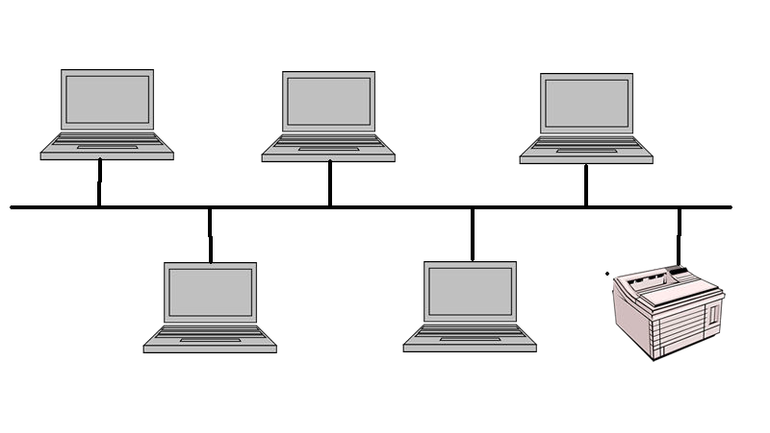
Bus Topology - 1
Network Topology and Architecture Topic 4 - 4.20

Slide 21
Bus Topology - 2
Network Topology and Architecture Topic 4 - 4.21
E.g. Ethernet
Devices connected along a single cable
Electrical pulses (signals) travel along the length of the cable in all directions.
The signals continue to travel until they weaken enough so as not to be detectable or until they encounter a device that absorbs them.
At the end of a cable, the signal bounces back unless there is a terminator.

Slide 22
Logical Bus
Network Topology and Architecture
Topic 4 - 4.22
Logical topologies describe the path that data travels from computer to computer.
A physical bus topology is usually also implemented as a logical bus.
The physical bus has fallen out of use due to technological advances.
Logical bus topology is used on some physical topologies, in particular a star topology.

Slide 23
Passive Topology
Network Topology and Architecture
Topic 4 - 4.23
The bus topology is a passive topology.
Workstations on the bus are not responsible for regenerating the signal as it passes them.
The workstations are not required for the bus to function.
If a workstation fails, the bus does not fail.

Slide 24
Physical Bus Advantages
Network Topology and Architecture
Topic 4 - 4.24
Cost
Less cable required than star or mesh
No additional devices such as hubs
Ease of installation
Simply connect device to cable segment
Resistant to workstation failure
Network functions if device fails
NOTE: problems if cable breaks

Slide 25
Physical Bus Disadvantages
Network Topology and Architecture Topic 4 - 4.25
Difficult to troubleshoot
Faults are usually a break in the main cable and this is difficult to isolate on a large network
Scalability
Increasing network size and layout can be important for productivity
Bus topology is not easily scaled up.

Slide 26
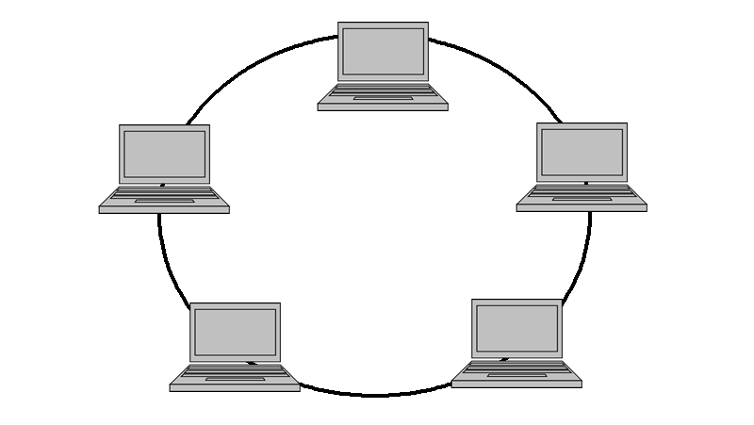
Ring Topology
Network Topology and Architecture Topic 4 - 4.26

Slide 27
Physical Ring Topology
Network Topology and Architecture Topic 4 - 4.27
All computers are connected in a ring.
The ring has no start and no end.
Does not need a terminator as there are no reflected signals
Signals travel in one direction.
Signals are regenerated by each computer in turn
Active topology.

Slide 28
Logical Ring Topology
Network Topology and Architecture Topic 4 - 4.28
Data travels from one node to the next device until it reaches its destination.
Modern ring topologies use “smart hubs” that recognise a computer failure and remove that computer from the ring automatically.
Shares network resources fairly

Slide 29
Physical Ring Advantages
Network Topology and Architecture Topic 4 - 4.29
Low signal degeneration
Each workstation is responsible for boosting the signal
In passive systems, the signal is not boosted and weakens, which limits the size of the network
Strong signal means signal seldom needs retransmitting
Fair allocation of network access to nodes

Slide 30
Physical Ring Disadvantages
Network Topology and Architecture Topic 4 - 4.30
Not resistant to workstation failure
Failure of workstation or cable causes network to fail
Note: modern systems and logical rings can isolate failed workstation and maintain network uptime
Network maintenance
Changes to cabling or moving a workstation can cause network downtime.

Slide 31
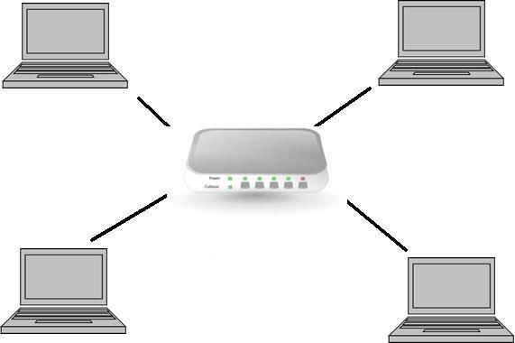
Star Topology
Network Topology and Architecture Topic 4 - 4.31

Slide 32
Physical Star Topology
Network Topology and Architecture
Topic 4 - 4.32
All devices connected through a central hub or switch
Each workstation is connected directly to the hub.
Very popular topology for modern networks

Slide 33
Star Topology Advantages
Network Topology and Architecture
Topic 4 - 4.33
Easy to add new devices – just connect to hub
Cable break only affects one single node.
Ease of administration
– Centralised management and monitoring of network traffic simplifies job of network administrator
Ease of changing configuration

Slide 34
Star Topology Disadvantages
Network Topology and Architecture
Topic 4 - 4.34
Hub Failure
If the hub fails, the whole system fails.
However, this is easy to troubleshoot.
Cost
Cost is higher as extra cabling and devices (hubs) are required.
However, this cost is no longer great and therefore not a real barrier to implementing a star topology.

Slide 35
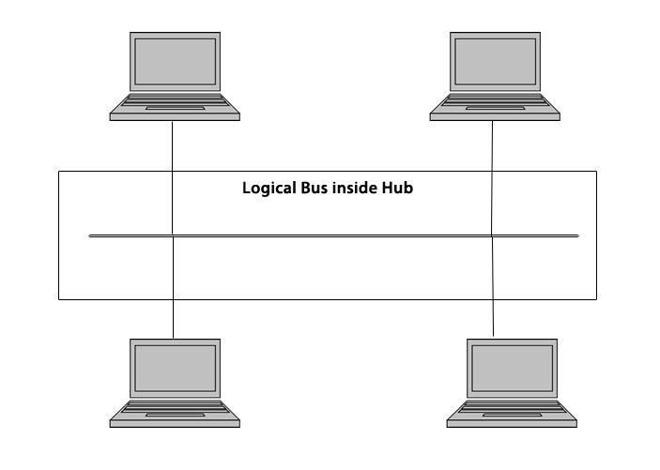
Star as Logical Bus
Network Topology and Architecture Topic 4 - 4.35

Slide 36

Star as Logical Ring
Network Topology and Architecture Topic 4 - 4.36

Slide 37
Switching as Star Topology
Network Topology and Architecture Topic 4 - 4.37
Switched networks are neither bus nor ring logically, but are implemented as a physical star.
A switch takes a signal coming from a network device and builds a link to the intended destination computer on the fly.
Superior to other logical topologies, because multiple computers can communicate simultaneously without affecting each other
Main method used in most LAN designs

Slide 38
WLAN as Physical Star Topology
Network Topology and Architecture Topic 4 - 4.38
Uses a central device (access point) to control communications
Star physical topology because all the signals travel through one central device

Slide 39
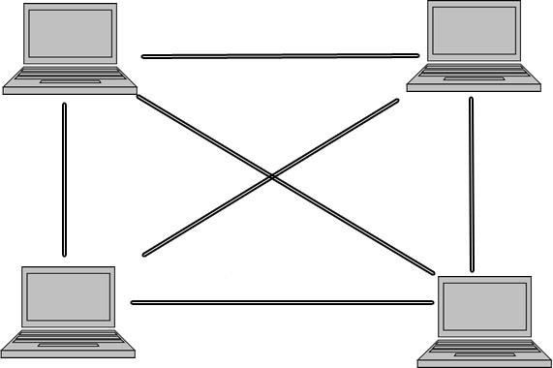
Mesh Topology
Network Topology and Architecture
Topic 4 - 4.39
Every workstation is connected to every other workstation.
Not very common

Slide 40
Mesh Topology Advantages
Network Topology and Architecture Topic 4 - 4.40
Resilience
Multiple pathways for sending data
Cable fault is not a problem as data can go via another path
Almost impossible for network to fail due to cable failure as there are so many routes available

Slide 41
Mesh Topology Disadvantages
Network Topology and Architecture
Topic 4 - 4.41
Cost
Additional cabling
Additional interfaces
Difficult to administer
Due to the number of connections

Slide 42
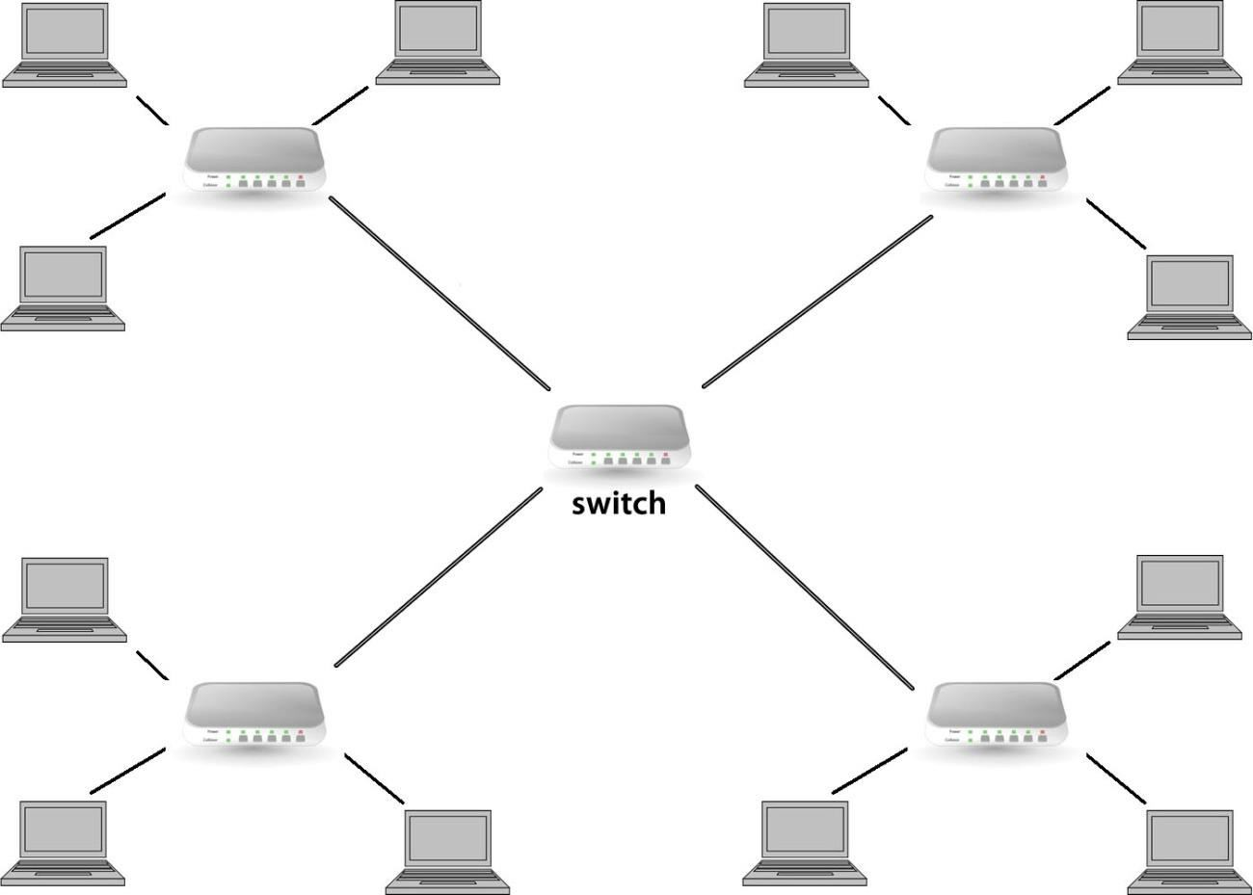
Extended Star
Network Topology and Architecture Topic 4 - 4.42
Several stars connected in a star from a switch

Slide 43
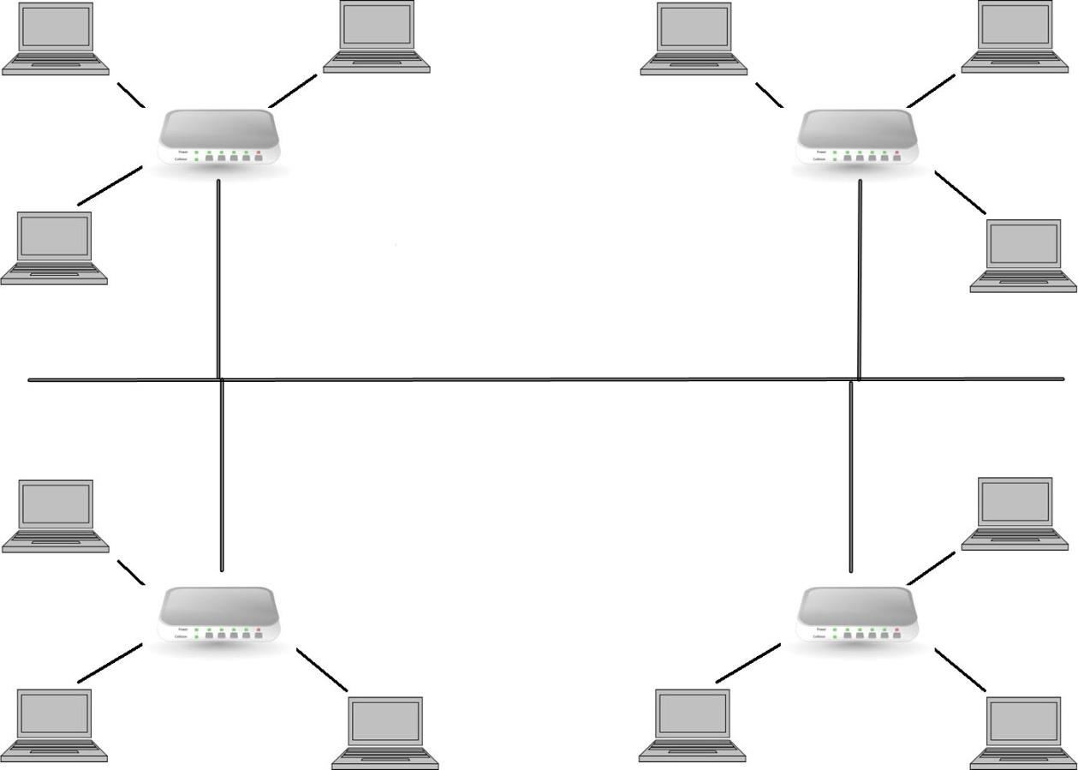
Combination of Star & Bus
Network Topology and Architecture Topic 4 - 4.43
Several stars connected along a bus

Slide 44
Computer Networks
Topic 4 – Lecture 3: Topologies & Protocols

Slide 45
Star Topology
Network Topology and Architecture
Topic 4 - 4.45
The most common physical topology in modern LANs
Requires a device at the centre of the network that controls traffic
Both hubs and switches can act as the centre of a star topology.

Slide 46
Hubs
Network Topology and Architecture Topic 4 - 4.46
Active hubs are the most common type of hub.
Regenerate or repeat the signals
Needs electrical power
Has many ports
Also called multiport repeaters or repeating hubs
Signal comes in on one port
Cleans the signal (filters out noise)
Strengthens the signal
Sends the regenerated signal out to all other ports

Slide 47
Switches
Network Topology and Architecture Topic 4 - 4.47
Central connecting point in a star topology network
Does more than regenerate signals
Has several ports for connecting workstations in a star topology
Determines which port the destination device connects to and forwards the message to that port
Handles several conversations at a time
Provides the full network bandwidth to each device rather than requiring bandwidth sharing

Slide 48
Network Access
Network Topology and Architecture Topic 4 - 4.48
In any network, providing access for nodes to transmit messages is a key element.
It must be assumed that any node may require access at any time.
Controlling access to networks becomes more difficult for larger networks and faster data speeds.
Access is controlled by a combination of topology, wiring and protocols that combine into network standards.

Slide 49
Non-contention Techniques
Network Topology and Architecture Topic 4 - 4.49
Designed to prevent conflict between nodes wishing to transmit
Does not allow two nodes to transmit at the same time
Each node is given exclusive access to the network.
This right to access is passed throughout the network.
Token passing is a common form.

Slide 50
Contention Techniques
Network Topology and Architecture
Topic 4 - 4.50
Allow conflicts and collisions to occur
Dealing with collisions is part of the design
No order of access to transmit
Any node can transmit at any time.

Slide 51
Common Contention Technique
Network Topology and Architecture
Topic 4 - 4.51
CSMA/CD
As used in Ethernet
When a collision occurs, each node waits a random time before retransmitting, why?

Slide 52
Designing a Network
Network Topology and Architecture Topic 4 - 4.52
The main steps are as follows:
Determine what the network will be used for – this will be a major factor in deciding the topology you use.
Choose the types of devices that will be used for interconnecting computers and sites.
Consider the type of devices the network will employ and the usage of network resources – this will determine how many servers are required and where servers should be placed.

Slide 53
Selecting a Topology
Network Topology and Architecture Topic 4 - 4.53
Modern networks have one key factor in this choice
- how fast should the network be?
Physical topology will almost certainly be a star
Logical topology is usually a switched network
Ethernet switches are used on most LANs
Other logical topologies can be the result of:
Use of legacy equipment
Network size
Cost restrictions
Difficulty of running cables

Slide 54
Planning a Logical Topology - 1
Network Topology and Architecture Topic 4 - 4.54
Can either start from scratch or upgrade an existing network?
You should have sufficient information about:
Networking components
Hardware
Protocols
Physical topologies

Slide 55
Planning a Logical Topology - 2
Network Topology and Architecture
Topic 4 - 4.55
Analyse the following:
Security needs
Traffic patterns
Need for future expansion
Server capabilities
Internet access requirements
You should also make a plan for disaster recovery, data recovery and troubleshooting techniques.

Slide 56
Creating a Network Layout - 1
Network Topology and Architecture Topic 4 - 4.56
A network layout must be documented in a diagram.
Factors to consider
Number of client computers
Number of servers
Will there be an Internet connection?
The architecture of the building
The best topology or topologies
Any diagram must be updated if the layout changes
Version control.

Slide 57
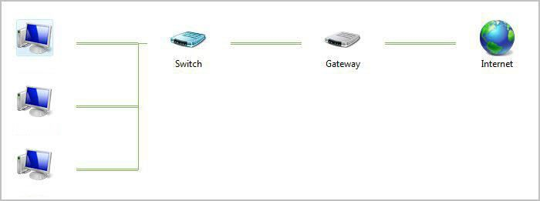
Creating a Network Layout - 2
Network Topology and Architecture Topic 4 - 4.57

Slide 58
References
Network Topology and Architecture
Topic 4 - 4.58
Price, B. (ed) (2003). Networking Complete, 3rd edition. Sybex.
Tomsho, G. (2006). Guide to Networking essential,
5th edition. Course Technology.

Slide 59
Topic 4 – Network Topology and Architecture
Network Topology and Architecture
Topic 4 - 4.59
Any Questions?

