Slide 1
Computer Networks
Topic 5:
Network Media & Connectors

Slide 2
Computer Networks
Topic 5 – Lecture 1: Network Media

Slide 3
Scope and Coverage
Network Media & Connectors
Topic 5 - 5.3
This topic will cover:
Network media
Network connectors
Selecting media and connectors

Slide 4
Learning Outcomes
Network Media & Connectors Topic 5 - 5.4
By the end of this topic, students will be able to:
Categorise network cables and connectors
Describe the usage of network cables and connectors

Slide 5
Network Media
Network Media & Connectors Topic 5 - 5.5
Support the sending and receiving of signals
For each media type, we require knowledge of:
Physical characteristics
Limitations
Each medium has a unique design and usage with implications for:
Cost
Performance
Installation

Slide 6
Physical Media
Network Media & Connectors Topic 5 - 5.6
Factors to consider when choosing network media:
Bandwidth rating
Maximum segment length
Maximum number of segments per internetwork
Maximum number of devices per segment
Interference susceptibility
Connection hardware
Cable grade
Bend radius
Costs of materials and insulation

Slide 7
Bandwidth
Network Media & Connectors Topic 5 - 5.7
In analogue systems, this describes the band of frequencies that can carry information.
In digital, the number of bits per second
Customers demand more complex and powerful services and these require a much higher bandwidth.
Bandwidth limits of existing technologies have been expanded:
Older networking components can remain in use
Supports higher bandwidth than originally rated

Slide 8
Physical Cable Types
Network Media & Connectors
Topic 5 - 5.8
Carry a physical signal that may be:
Electrical
Light pulses
The primary cable types are:
Coaxial cable
Twisted-pair
Fibre-optic cable

Slide 9
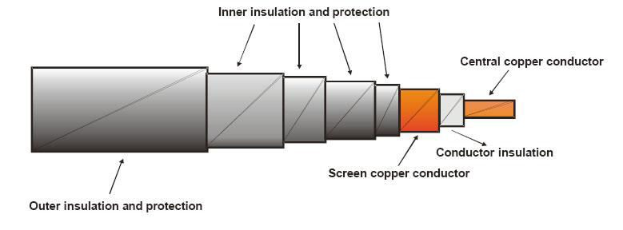
Coaxial Cable
Network Media & Connectors Topic 5 - 5.9
Was the main original form of network cabling
Now obsolete
Contains shielding - protective layer(s) wrapped around cable to protect it from external interference

Slide 10
Twisted Pair Cable
Network Media & Connectors
Topic 5 - 5.10
Unshielded Twisted Pair (UTP)
Most popular LAN cabling type
10BaseT
– Maximum length is 100 meters
Includes one or more pairs of insulated wires
Specifications give the number of twists per foot (or per metre).

Slide 11
10BaseT
Network Media & Connectors
Topic 5 - 5.11
10 for 10 Mbps operation
Base for baseband
T for twisted pair
Maximum length per segment 100 meters (330 ft)
Maximum of 2 devices per segment
– one is the station and the other is the hub
Uses a star topology

Slide 12
UTP Cabling Categories
Network Media & Connectors Topic 5 - 5.12
UTP cabling is rated according to a number of categories devised by the TIA and EIA
Cat1: 0.4 MHzTelephone and modem
Cat2: Unsuitable for modern systems
Cat3: 16MHz10BASE-T and 100BASE-T4 Ethernet
Cat4: 20MHz16 Mbit/s Token Ring
Cat5: 100MHz 100BASE-TX & 1000BASE-T Ethernet
Cat6: 250MHz 1000BASE-T Ethernet
Cat6a: 500MHz 10GBASE-T (under development)
Cat5 and Cat6 are the most common

Slide 13
Fibre Optic Cable
Network Media & Connectors
Topic 5 - 5.13
The core and cladding are made of ultra-pure glass.
Light is guided down the centre of a fibre and reflects off the inner surface.
Each fibre is protected by a plastic buffer coating.
Further protection from the outer covering.

Slide 14
Fibre Optic Cable Types
Network Media & Connectors
Topic 5 - 5.14
Two types:
Single-mode: costs more and generally works with laser-based emitters, but spans the longest distances
Multimode: costs less and works with light emitting diodes (LEDs), but spans shorter distances
Installation is more difficult, time-consuming and costly than copper wire.

Slide 15
Fibre Optic Advantages
Network Media & Connectors
Topic 5 - 5.15
Immune to electrical interference
Can cover large distances
High transmission speeds
Not easily tapped
The big disadvantage is cost.

Slide 16
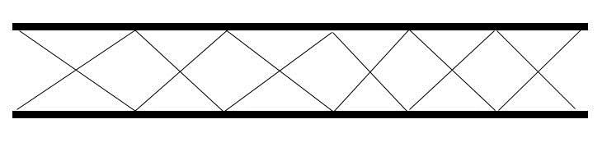
Multimode Fibre Optic
Network Media & Connectors
Topic 5 - 5.16
Early fibre optic cables
Light signals from a laser are broken up into a number of paths.
Each is reflected off the internal wall of the fibre.
Signal quality is determined by the amount of reflection.

Slide 17

Monomode Fibre Optic
Network Media & Connectors Topic 5 - 5.17
Single stream down each strand
Further developed to allow multiple frequencies to be sent down the same core
Allows for greater distances and transmission speeds

Slide 18
Wireless Media
Network Media & Connectors
Topic 5 - 5.18
Media does not have to be physical.
Wireless connections are also network media.
Frequency is measured in Hertz
Affects the amount and speed of data transmission
Lower-frequency transmissions carry less data more slowly over longer distances
Radio -10 KHz (kilohertz) to 1 GHz (gigahertz)
Microwave -1 GHz to 500 GHz
Infrared - 500 GHz to 1 THz (terahertz)

Slide 19
Computer Networks
Topic 5 – Lecture 2: Network Connectors

Slide 20
Connectors
Network Media & Connectors
Topic 5 - 5.20
Network consists of:
Nodes
Media
Also need to connect the media to the nodes
Range of devices for doing this
Choice depends upon
Cable type
Network type
Device

Slide 21
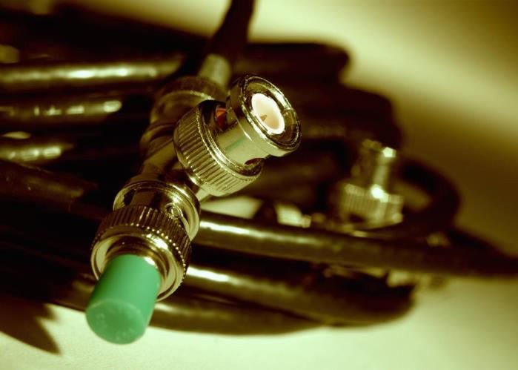

Coaxial Cable Connector
Network Media & Connectors Topic 5 - 5.21
Most common type of connector used with coaxial cables is the Bayonet Neill-Concelman (BNC) connector
E.g. 10Base2 thin Ethernet (now obsolete)
Different adapters available for BNC connectors
T-connector
Barrel connector
Terminator

Slide 22
UTP Connectors
Network Media & Connectors
Topic 5 - 5.22
UTP comes in 2 main forms:
Two-pair (four wire) for telephone
Four-pair (eight wire) for data networks
Each has a different connector:
RJ-11 for four-wire telephony
RJ-45 for eight wire data networks

Slide 23
RJ-11
Network Media & Connectors
Topic 5 - 5.23
RJ stands for registered jack
Strictly this is a combination of plug and wiring configuration
Used for a single telephone line

Slide 24
RJ-45
Network Media & Connectors Topic 5 - 5.24
The standard connector for UTP cabling in data networks
Like a large telephone-style connector
Made of plastic
Can only be inserted one way
Standard designates which wire goes with each pin inside the connector

Slide 25
Wiring an RJ-45 Connector
Network Media & Connectors
Topic 5 - 5.25
The wiring configuration depends upon the standard being followed.
Private Study Exercise 2 asks you to investigate the wiring configurations.

Slide 26
Fibre Optic Connectors
Network Media & Connectors
Topic 5 - 5.26
Terminate the end of an optical fibre
Enable connection faster than splicing
Align the cores of fibres so that light can pass
Common connectors are:
FC
LC
MT-RJ
SC
ST

Slide 27
FC Connectors
Network Media & Connectors
Topic 5 - 5.27
Ferrule Connector
A popular connector for monomode fibre optic cable
A screw on connection
Must have the key aligned in the slot properly before tightening
It is steadily being replaced by SCs and LCs.

Slide 28
LC Connectors
Network Media & Connectors Topic 5 - 5.28
Lucent Connector (or Local Connector)
A relatively recent connector that is smaller than many others
A standard ceramic ferrule connector
It is easily terminated with adhesive
Good performance
Used widely in monomode

Slide 29
MT-RJ Connectors
Network Media & Connectors
Topic 5 - 5.29
Mechanical Transfer Registered Jack
A duplex connector
Both fibres in a single polymer ferrule
Uses pins for alignment
Has male and female versions
Multimode only

Slide 30
SC Connectors
Network Media & Connectors
Topic 5 - 5.30
Subscriber Connector (or Square Connector or Standard Connector)
A snap-in connector
Widely used in monomode systems
Has excellent performance
Connects with a simple push-pull motion
Also available in a duplex configuration

Slide 31
ST Connectors
Network Media & Connectors Topic 5 - 5.31
Straight Tip
Most popular connector for multimode networks
Has a bayonet mount and a long cylindrical ferrule to hold the fibre
Ferrules are usually ceramic
Ferrules are spring-loaded; you have to make sure they are seated properly.

Slide 32
USB Connectors
Network Media & Connectors Topic 5 - 5.32
Universal Serial Bus
Developed as a means to connect a large number of devices to the PC
The standard for peripherals
Allows Plug and Play - no special user-knowledge required to install a new device
All devices distinguishable from other devices
– the correct driver software was always automatically used

Slide 33
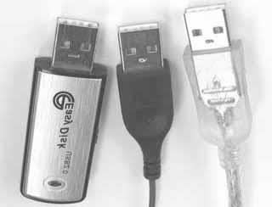
USB 2.0
Network Media & Connectors
Topic 5 - 5.33
The most common implementation
Very easy to connect
Half-duplex
USB 3.0 has been developed:
Higher data speeds
Less power consumption
Full duplex

Slide 34
NIC
Network Media & Connectors
Topic 5 - 5.34
Network Interface Card
Required for a computer to communicate on a network.
Establishes and manages the computer’s network
connection
Translates incoming/outgoing messages
Modern computers have a NIC built in

Slide 35
Computer Networks
Topic 5 – Lecture 3:
Selecting Media and Connectors

Slide 36
Selection Criteria
Network Media & Connectors
Topic 5 - 5.36
Factors to be considered:
Bandwidth
Budget
Capacity
Placement
Existing cables
Environmental considerations
Geographic area
Specifics of organisation and location

Slide 37
Small Networks
Network Media & Connectors
Topic 5 - 5.37
For small networks, such as a home network or small office, common choices are:
Ethernet using 10BaseT for a network using physical media
Wireless LANs are becoming more common due to ease of setting up and accessing the network.
For larger organisations covering several office and/or buildings, a more structured approach is required

Slide 38
Cable Choice
Network Media & Connectors
Topic 5 - 5.38
Most networks use some type of unshielded twisted-pair cabling.
Some organisations use optic fibre directly to their desktop machines.
Wireless is an option
Ideally use Cat5e UTP as a minimum, if using cable

Slide 39
Installation Standards
Network Media & Connectors Topic 5 - 5.39
Two standards bodies have recognised standards for the installation of data networks:
The Telecommunications Industry Association
(TIA)
TIA-568-C.2, Balanced Twisted-Pair Telecommunications Cabling and Components Standard, 2009
The International Organization for Standardization (ISO)
ISO 11801, 2nd Ed., Information technology - Generic Cabling for Customer Premises, 2002

Slide 40
Structured Cabling
Network Media & Connectors
Topic 5 - 5.40
Uses an extended star physical topology
Can be applied to any size network
Cabling is organised into 6 components:
Work area
Horizontal wiring
Telecommunications closets
Equipment rooms
Vertical wiring
Entrance facilities

Slide 41
Work Area
Network Media & Connectors Topic 5 - 5.41
Room containing workstations and peripherals
Faceplates and wall jacks are installed.
Patch cables connect computers and printers to wall jacks.
Wall jacks connect to a telecommunications closet.
Patch cables should be less than 6 meters long.
Standard requires at least one voice and one data outlet on each faceplate in each work area.
Connection between wall jack and telecomms closet (TC) is made via horizontal wiring.

Slide 42
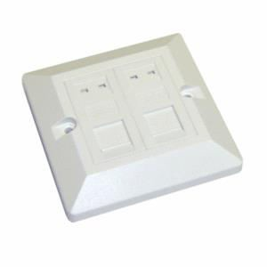
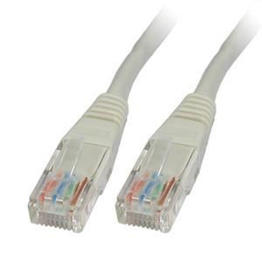
Faceplate & Patch Cable
Network Media & Connectors Topic 5 - 5.42

Slide 43
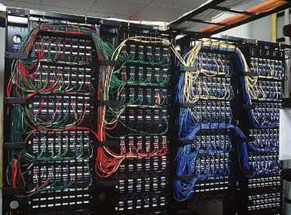
Telecommunications Closet
Network Media & Connectors Topic 5 - 5.43
Also known as cable closet

Slide 44
Horizontal Wiring
Network Media & Connectors
Topic 5 - 5.44
Runs from the work area wall jack to the telecommunications closet
Types include four-pair UTP (Category 5e or 6) or two fibre-optic cables
Horizontal wiring from the wall jack to the patch panel should be no longer than 90 metres
– Patch cables in the work area and in the telecommunications closet can total up to 100 meters

Slide 45
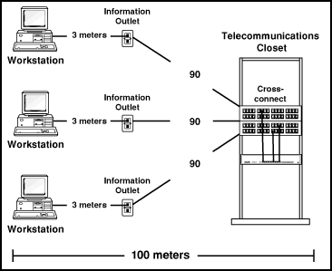
Structured Cabling Max Distances
Network Media & Connectors Topic 5 - 5.45

Slide 46
Equipment Rooms
Network Media & Connectors
Topic 5 - 5.46
Contains servers, routers, switches, and other major network equipment
Serves as a connection point for vertical cabling running between TCs
In installations covering several buildings, each building may have its own equipment room.

Slide 47
Vertical Cabling
Network Media & Connectors Topic 5 - 5.47
Interconnects telecommunications closets and equipment rooms
Runs between floors and between buildings
Often fibre optic (but can be UTP)
Multimode fibre optic, up to 2000 meters
Single-mode fibre optic, up to 3000 meters
Between equipment rooms and TCs, distance is limited to 500 metres for both fibre optic cable types
From the main cross-connect to equipment rooms, fibre optic cable can run up to 1500 meters

Slide 48
Entrance Facilities
Network Media & Connectors Topic 5 - 5.48
The location of the cabling and equipment connecting corporate network to telecoms provider
Can also serve as an equipment room and the main cross-connect for all vertical cabling
Where a connection to a WAN is made
Where corporate LAN equipment ends and a third-
party provider’s equipment and cabling begins

Slide 49
Wireless Networks
Network Media & Connectors Topic 5 - 5.49
Remember that wireless networking is gaining in popularity
Acts like a wired network
Uses electromagnetic frequencies:
Radio
Microwave
Infrared
Laser

Slide 50
References
Network Media & Connectors Topic 5 - 5.50
Elliot, B. (2002). Designing a Structured Cabling System to ISO 11801, 2nd edition. Woodhead Publishing Ltd.
British Telecom (2004). BT Structured Cabling, British Telecom
Tomsho, G. (2006). Guide to Networking Essentials, 5th edition. Course Technology.

Slide 51
Network Media & Connectors
Topic 5 - 5.51
Topic 5 – Network Media & Connectors
Any Questions?

