Slide 1
Computer Networks
Topic 6:
Network Hardware

Slide 2
Computer Networks
Topic 6 – Lecture 1: Network Hardware

Slide 3
Scope and Coverage
Network Hardware Topic 6 - 6.3
This topic will cover:
Network hardware
Hardware selection
Creating a network

Slide 4
Learning Outcomes
Network Hardware Topic 6 - 6.4
By the end of this topic, students will be able to:
Select the hardware components of a network
Assemble the necessary hardware components to create a network according to a design specification
Test the connectivity of a network
Troubleshoot client-side connectivity issues using appropriate tools

Slide 5
A Simple Network
Network Hardware Topic 6 - 6.5
A simple network could consist of two computers connected by a transmission medium.
For even a small business, it is likely that something more complex is required, including:
Several computers
Peripheral devices
Connection to the Internet

Slide 6
Wireless or Physical Media
Network Hardware Topic 6 - 6.6
Advantages to both systems
Depends upon many factors:
Need for mobility within network
Requirements for ad hoc devices
Geography of network
This topic looks at networks that use physical cables.

Slide 7
Peer-to-Peer vs. Server-Client
Network Hardware Topic 6 - 6.7
A decision must be made as to whether a peer-to- peer network or server network is required.
Very small networks can be peer-to-peer.
Larger networks should be server based
More than 10 users
Heavy network use
Security is important.

Slide 8
Controlling Network Traffic
Network Hardware Topic 6 - 6.8
A key feature of any network is the control of the traffic between nodes.
A number of devices can be utilised to efficiently pass signals around the network:
Repeaters
Hubs
Bridges
Switches
Routers
Gateways

Slide 9
Repeaters
Network Hardware Topic 6 - 6.9
On the physical layer of the OSI model
Extend the distance a signal can travel over a network segment
Analogue devices that connect two cable segments
Signal is received on one segment
Amplified and sent along the other segment
No intelligence:
– Deals in volts not packets, headers, etc

Slide 10
Hubs
Network Hardware Topic 6 - 6.10
On the physical layer of the OSI model
Connect nodes together in a physical star topology
Echo data coming in to all other connected nodes
Do not have addressing capability
Can cut off problem nodes, e.g.
Cable break
Flooding network with traffic
Can have internal bus or ring topology
Does not prevent collisions

Slide 11
Bridges
Network Hardware Topic 6 - 6.11
On the data link layer of the OSI model
Like an “intelligent hub” that routes messages
between two LANs
When a message arrives, the bridge software looks at the header to find the destination.
Message is then routed to the correct LAN by using its routing tables.
Typically allows four or eight input lines
Modern hubs also act as bridges.

Slide 12
Switches
Network Hardware Topic 6 - 6.12
On the data link layer of the OSI model
Route messages based on header address
Establishes a one-to-one connection between two ports
A switch contains many ports.
Usually, each port links to an individual computer.

Slide 13
Routers
Network Hardware Topic 6 - 6.13
Routers use software to choose an output line for an incoming message.
Connects two or more networks
The message is stored until complete.
Routing algorithms are used to determine the next destination.
The message is forwarded.

Slide 14
Gateways
Network Hardware Topic 6 - 6.14
Gateways are used to connect two computers using different transport protocols.
Capable of taking packets from one format and translating them into packets in a different format.
Because they translate data, there is a processing time required to do this.

Slide 15
PCs and Laptops
Network Hardware Topic 6 - 6.15
Computers are required on the network.
The specification and model required is largely dependent upon what the computers will be used for.
Computers require a network adapter in order to link into a network
Included in modern computers
USB adapters are available if a computer does not have one.

Slide 16
Servers
Network Hardware Topic 6 - 6.16
A server is a computer or series of computers that provides services across the network.
The server is at the centre of a network.
Most large networks with more than a few dozen workstations rely on several network servers.
The requirements of the server hardware are determined by size of network, network operations, network operating system, etc.

Slide 17
Specialist Servers
Network Hardware Topic 6 - 6.17
It is possible to assign servers to specific roles such as:
Application servers
Communication servers
Domain controllers/directory servers
Fax servers
File servers
Print servers
Mail servers
Web servers

Slide 18
Computer Networks
Topic 6 – Lecture 2:
Choosing Hardware & Creating a Network

Slide 19
Peer-to-Peer v Server-Client
Network Hardware Topic 6 - 6.19
Before choosing equipment, decide on what type of network is required
Do you need a server?
Very small networks can be peer-to-peer.
Larger networks should be server based
More than 10 users
Heavy network use
Security is important.

Slide 20
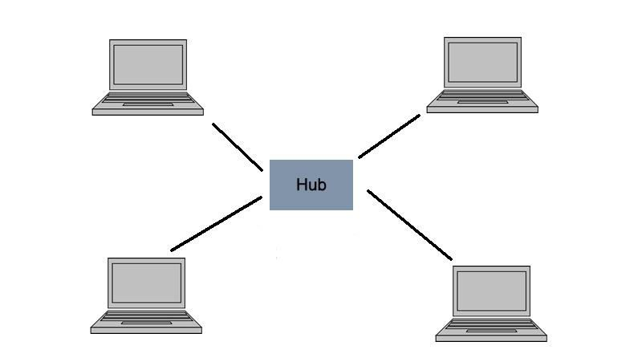
Peer-to-Peer Networks - 1
Network Hardware Topic 6 - 6.20

Slide 21
Peer-to-Peer Networks - 2
Network Hardware Topic 6 - 6.21
Works well in small networks
Every user acts as a network administrator.
Are flexible but can become chaotic as they grow
Security can be a major concern as it is difficult to enforce security across the whole network.
Computers can be grouped into workgroups.
As the network grows, it can be very difficult to manage.

Slide 22
Advantages of Peer-to-Peer
Network Hardware Topic 6 - 6.22
Easy to install and configure
Users control their own shared resources.
Inexpensive to purchase and operate
Need no additional equipment or software
No dedicated administrators are needed.

Slide 23
Disadvantages of Peer-to-Peer
Network Hardware Topic 6 - 6.23
Security applied resource by resource
May need as many passwords as there are shared resources
Each PC must be backed up to protect shared data.
PC performance is reduced when a shared resource is accessed.
No centralised approach to store or control access to data.
No access to a resource if PC storing it is unavailable

Slide 24
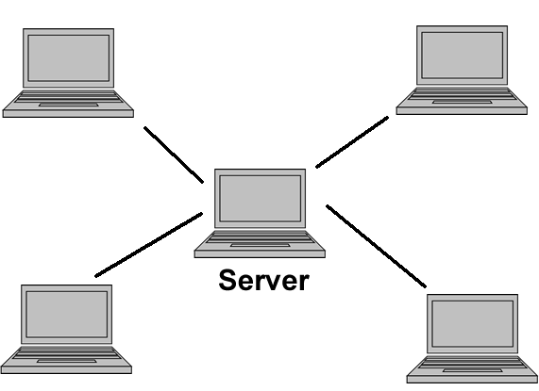
Client-Server Networks - 1
Network Hardware Topic 6 - 6.24

Slide 25
Client-Server Networks - 2
Network Hardware Topic 6 - 6.25
Works well in larger networks
Central server provides services and files
Server-based networks are the most common.
Servers can have specific functions, e.g.
File
Print
Clients may be standard PCs or thin-clients with no storage media.

Slide 26
Advantages of Client-Server
Network Hardware Topic 6 - 6.26
Network administration simplified by centrally controlled user accounts, security, etc.
More efficient access to resources
Server hardware design is more robust
A single password gives access to network-wide resources.
Used for networks with 10 or more users or any networks with high usage

Slide 27
Disadvantages of Client-Server
Network Hardware Topic 6 - 6.27
Server failure causes major problems:
May make whole network unusable
Will at least result in loss of network resources
Complex server software
Requires allocating expert staff
Increases costs
Dedicated hardware and specialised software add to the cost of server-based networking.

Slide 28
Small Business
Network Hardware Topic 6 - 6.28
A typical small business may be characterised by:
Having 100 computers or less
Being located in a single building
Not needing a complex and restrictive security policy
Not encrypting network data
Requiring a simple Internet connection
Remember all businesses are not the same:
Some may have highly complex machines (engineering)
Some will need complex security (personal and/or financial data)

Slide 29
Small Business Networks
Network Hardware Topic 6 - 6.29
Use a server if budget allows
Designate few computers as file-sharing computers
Users have their own home directory on the server.
Users may have read-only access to each other’s
home directory to facilitate file sharing.
Common folders with access for all users
Applications can be shared across a network.
Applications can be installed on a network file server and run from workstations.

Slide 30
Sharing Peripherals
Network Hardware Topic 6 - 6.30
Networking allows hardware sharing as well as software and file sharing.
Printers can be shared in a network
A typical issue in small businesses is sharing
personal printers attached directly to a user’s PC
Better: connect a printer directly to the network
Scanners can also be shared

Slide 31
Internal Communication
Network Hardware Topic 6 - 6.31
Users can use the network to communicate with each other in many ways:
Email
Instant messaging
Calendar sharing
Whiteboard sharing
Video conferencing
These functions are also available via the Internet.

Slide 32
Buying Equipment
Network Hardware Topic 6 - 6.32
Much network equipment is aimed at large companies.
A small business will not generally require such high specification equipment.
A typical small business might require:
One or two servers
A few dozen workstations
A few switches
A router to connect to the Internet

Slide 33
Buying Computers - 1
Network Hardware Topic 6 - 6.33
Many large manufacturers have small business sections to help.
Some general rules are:
Buy the best that the budget allows, to meet the business needs of the next 2-3 years
The ability to expand memory and storage is important

Slide 34
Buying Computers - 2
Network Hardware Topic 6 - 6.34
General rules (cont.)
Look for fault-tolerant storage solutions, use RAID technology on servers
Business computers offer more than home computers
May get discount for multiple purchases

Slide 35
Wiring Connections
Network Hardware Topic 6 - 6.35
Always use network jacks at the work area wired to a patch panel in the wiring closet
Never run cables from the back of the computer directly to the hub or switch
Category 5e or 6 (ideally) cable should be used.
Use switches instead of hubs
speed, support for multiple media types.
Ensure the network is secure.

Slide 36
Larger Businesses
Network Hardware Topic 6 - 6.36
Require larger networks
Networks can be made larger by:
Physically expanding a current network to support additional computers
Segmenting the network into smaller pieces to filter and manage network traffic
Extending the network to connect separate LANs.
Many devices can accomplish these tasks
Repeaters, bridges, switches, routers and gateways

Slide 37
Network Troubleshooting
Network Hardware Topic 6 - 6.37
Network problems can come from a number of areas:
Cabling and components
Fluctuations in power
Upgrades to network components
General performance (data transfer rates)

Slide 38
Cabling & Components
Network Hardware Topic 6 - 6.38
Problems with cables or computers
Use the same type of UTP cable throughout the network
Check cable lengths to make sure you do not exceed the maximum length limitation.
Check for faulty or misconfigured NICs
– If the NIC seems functional and you are using TCP/IP, use Ping to check connectivity to other computers

Slide 39
Power Fluctuations
Network Hardware Topic 6 - 6.39
Power fluctuations in a building can adversely affect computers.
Verify that servers are functioning
If there is a power outage, it takes a few minutes for servers to come back online.
Eliminate effects of power fluctuations by connecting devices to UPSs.
Some packages perform shutdowns automatically if there are power issues.

Slide 40
Network Upgrades
Network Hardware Topic 6 - 6.40
Adding new network devices may cause problems.
Keep software current and do one upgrade at a time.
Test upgrades before deploying on your production network.
Do not forget to tell users about upgrades.

Slide 41
Network Performance
Network Hardware Topic 6 - 6.41
Determine if there is anything different since the network last functioned normally:
New equipment
New applications
Check network users:
New users
Game playing/videos
Check for equipment that may cause interference.

Slide 42
Troubleshooting Method
Network Hardware Topic 6 - 6.42
Determine what the problem is
Gather relevant information
Consider possible causes
Devise a potential solution
Implement the solution
Test the solution
Document the solution
Implement methods to prevent reoccurrence

Slide 43
Troubleshooting Tools
Network Hardware Topic 6 - 6.43
Experience
Data sources (Internet, manuals)
Network documentation
Digital voltmeters
Time-domain reflectometers
Cable testers
Network monitors
Protocol analysers

Slide 44
References
Network Hardware Topic 6 - 6.44
Hallberg B. (2009). Networking, A Beginner's Guide, 5th edition. McGraw-Hill Osborne.
Tanenbaum, A.S. & Weatherall, D.J. (2010). Computer Networks, 5th edition. Pearson Education.
Tomsho G. (2006). Guide to Networking Essentials, 5th edition. Course Technology.

Slide 45
Network Hardware Topic 6 - 6.45
Topic 6 – Network Hardware
Any Questions?

