Slide 1
Monthly Expense Tracker
An Interactive Excel Dashboard for Income & Expense Analysis
Created by: Kamal Jangid
Tools Used: Microsoft Excel
Project Type: Data Analytics

Slide 2
About the Project
The Monthly Expense Tracker is an Excel-based data analytics project designed to track and analyze monthly income and expenses.
Key Features:
Record daily income and expenses.
Categorize transactions.
Analyze expenses by category.
Track payment modes.
View income, expenses and remaining balance.
Interactive dashboard using PivotCharts and Slicers.
Dataset: 20 sample transactions (November 2026).

Slide 3
Project Objectives
The main objectives of this project are:
Track monthly income and expenses efficiently.
Organize transactions into different categories.
Identify major expense categories.
Analyze spending patterns across payment modes.
Calculate total income, expenses and remaining balance.
Create an interactive dashboard for better financial insights.
Project Goal: To make personal expense tracking simple, organized and data-driven.

Slide 4
Dataset Description
Dataset Overview
Dataset contains 20 sample transactions.
Transaction Period: November 1–20, 2026.
Data is organized in an Excel worksheet.
Key Columns
Date
Description
Category
Type (Income / Expense)
Payment Mode
Amount
Categories: Salary, Food, Travel, Shopping, Rent, Bills, Entertainment, Health, Education and Other Income.
Payment Modes: UPI, Cash and Net Banking.
Note: This project uses sample data for demonstration purposes.

Slide 5
Excel Tools & Techniques
Tools and Features Used
Excel Tables – Organized transaction data.
Data Validation – Dropdown lists for categories, types and payment modes.
SUMIF & COUNTA – Calculating income, expenses and transaction count.
PivotTables – Summarizing category-wise and payment-wise expenses.
PivotCharts – Visual representation of expense analysis.
Slicers – Interactive filtering by category and transaction type.
KPI Cards – Displaying important financial metrics.
Dashboard – Presenting all key insights in one place.
Tool Used: Microsoft Excel

Slide 6
Income & Expense Analysis
Financial Summary
Total Income: ₹35,000
Total Expenses: ₹17,699
Remaining Balance: ₹17,301
Total Transactions: 20
Category-wise Expenses
Rent: ₹6,000
Shopping: ₹3,000
Food: ₹2,500
Bills: ₹1,899
Education: ₹1,600
Health: ₹1,150
Travel: ₹1,050
Entertainment: ₹500
Payment Mode Analysis
UPI: ₹8,299
Net Banking: ₹6,000
Cash: ₹3,400
Key Insight: Rent is the highest expense category.

Slide 7
Interactive Dashbord
Dashboard Components
KPI Cards – Display total income, expenses, remaining balance and transaction count.
Category-wise Expense Chart – Shows how expenses are distributed across categories.
Payment Mode Chart – Compares expenses made through different payment methods.
Category Slicer – Allows users to filter expenses by category.
Type Slicer – Allows users to filter Income and Expense transactions.
Key Benefits
Easy financial monitoring.
Quick comparison of expenses.
Interactive data filtering.
Better understanding of spending patterns.
Outcome: All important financial information is available in one interactive dashboard.

Slide 8
Key Findings & Conclusion
Key Findings
Total income recorded was ₹35,000.
Total expenses were ₹17,699.
Remaining balance was ₹17,301.
Rent was the highest expense category at ₹6,000.
UPI was the most used payment mode for expenses at ₹8,299.
The dashboard makes financial analysis easier through interactive filters.
Conclusion
This project demonstrates how Microsoft Excel can transform raw transaction data into meaningful financial insights using formulas, PivotTables, PivotCharts and Slicers.
Project Status: Successfully Completed.

Slide 9
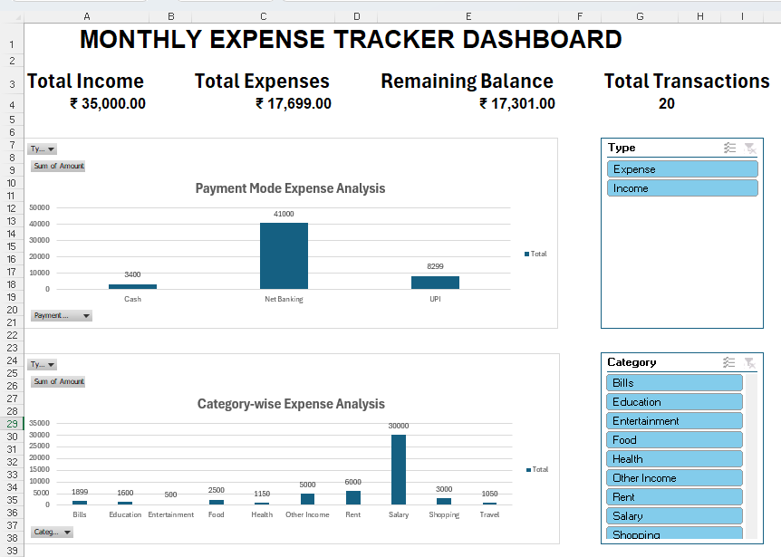
Dashboard Preview

Slide 10
THANK YOU!
Thank you for viewing my project.
Monthly Expense Tracker
An Interactive Excel Dashboard
Created By: Kamal Jangid
Tools Used: Microsoft Excel
Turning Data into Meaningful Insights

