Slide 1
PIZZA SALES
DATA ANALYSIS
SQL PROJECT
A Complete SQL-Based Business Analysis
Tools Used: MySQL | Excel
Presented by: Kamal Jangid

Slide 2
About the Project
Pizza Sales Analysis is a SQL-based data analytics project focused on analyzing pizza sales data to understand business performance and customer ordering patterns.
Key Areas of Analysis:
Total Orders and Revenue Analysis
Most Popular Pizza Sizes
Top-Selling Pizza Types
Category-wise Sales Analysis
Hourly Order Trends
Revenue Contribution Analysis
Cumulative Revenue Analysis

Slide 3
Dataset Information
DATASET OVERVIEW
The project uses Pizza Sales data containing information about orders, pizza types, pizza sizes, categories and pricing.
Dataset Tables:
Orders – Order date, time and order information.
Order Details – Pizza quantities and order details.
Pizzas – Pizza ID, size and price.
Pizza Types – Pizza names and categories.
Data Preparation:
Excel files imported into MySQL.
Tables connected using SQL JOIN operations.
Data analyzed using SQL queries.

Slide 4
Tools & Technologies
1. MySQL Workbench
Database Management
SQL Query Execution
Data Analysis
2. Microsoft Excel
Dataset Management
Data Storage
3. Visual Studio Code
SQL Query Documentation
Code Organization
4. Microsoft PowerPoint
Project Presentation
Data Analysis Documentation

Slide 5
SQL Analysis – Basic Level
Basic SQL Queries
In this section, we analyze overall pizza orders, revenue, pricing and customer ordering preferences using SQL.

Slide 6
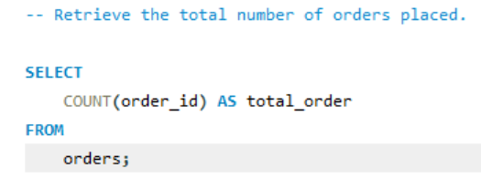
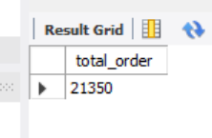
Retrieve the total number of orders placed.

Slide 7
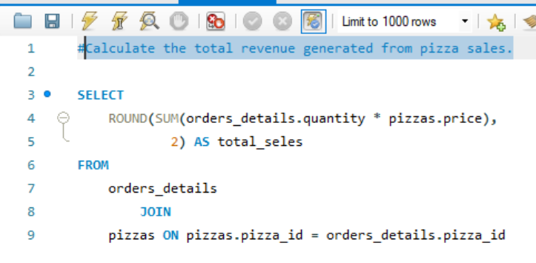
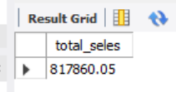
Calculate the total revenue generated from pizza sales.

Slide 8
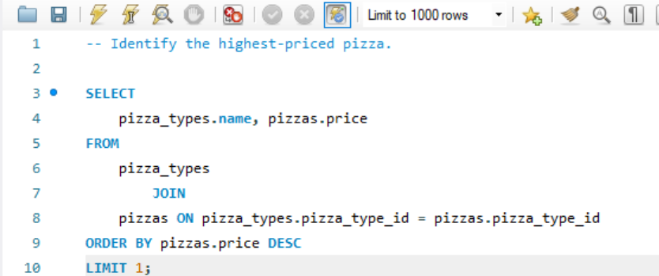
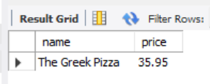
Identify the highest-priced pizza.

Slide 9
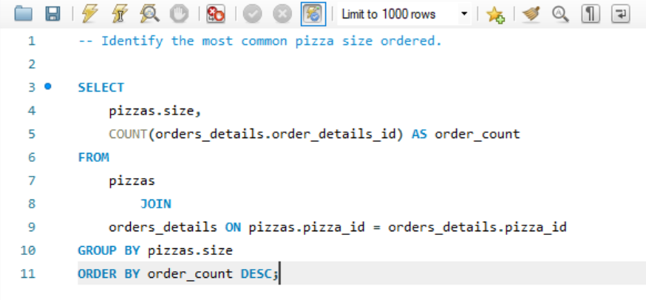
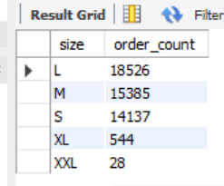
Identify the most common pizza size ordered.

Slide 10
SQL Analysis – Intermediate Level
In this section, we analyze pizza sales using SQL JOINs, GROUP BY, aggregate functions and subqueries.

Slide 11
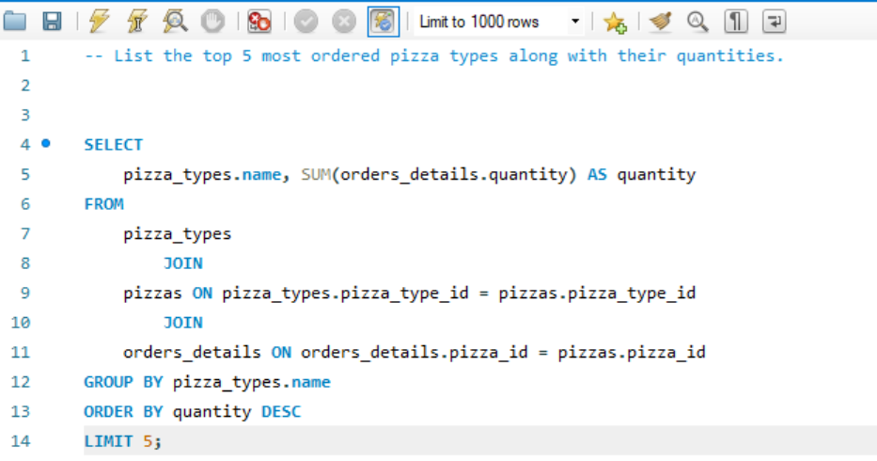
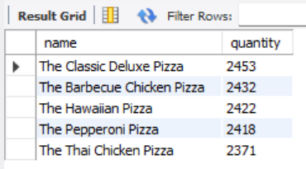
List the top 5 most ordered pizza types along with their quantities.

Slide 12
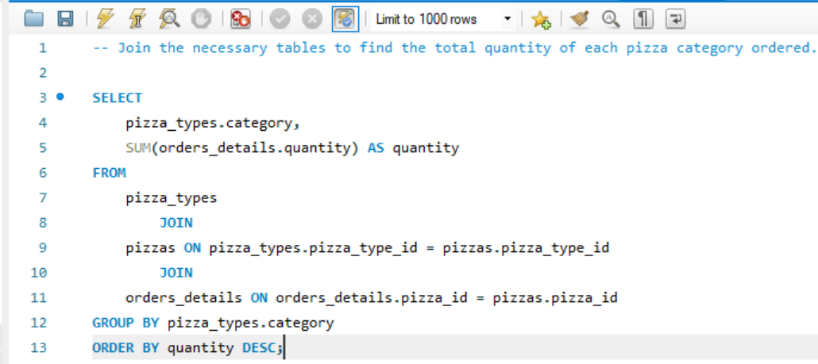
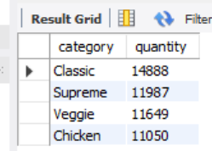
Join the necessary tables to find the total quantity of each pizza category ordered.

Slide 13
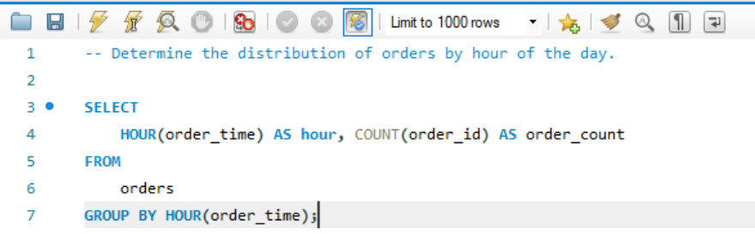
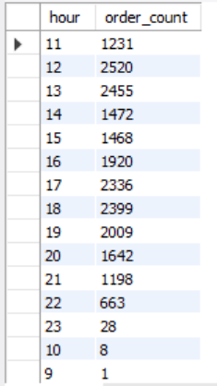
Determine the distribution of orders by hour of the day.

Slide 14
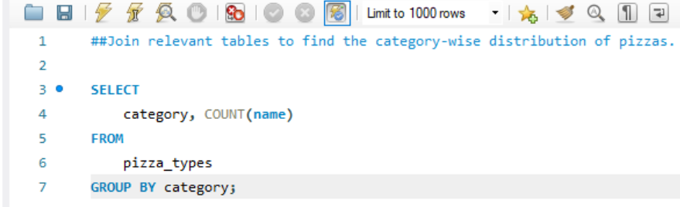
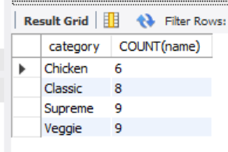
Join relevant tables to find the category-wise distribution of pizzas.

Slide 15
SQL Analysis – Intermediate Level
In this section, we analyze pizza sales using SQL JOINs, GROUP BY, aggregate functions and subqueries.

Slide 16
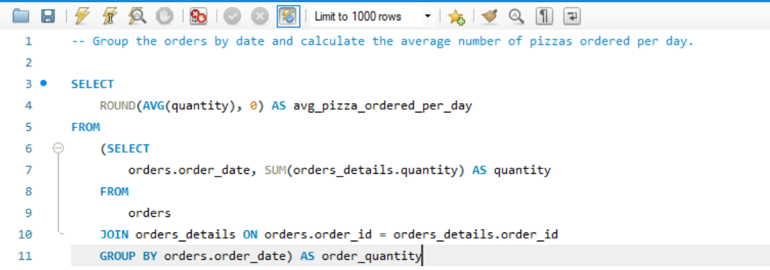
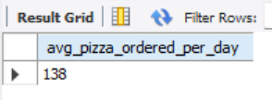
Group the orders by date and calculate the average number of pizzas ordered per day.

Slide 17
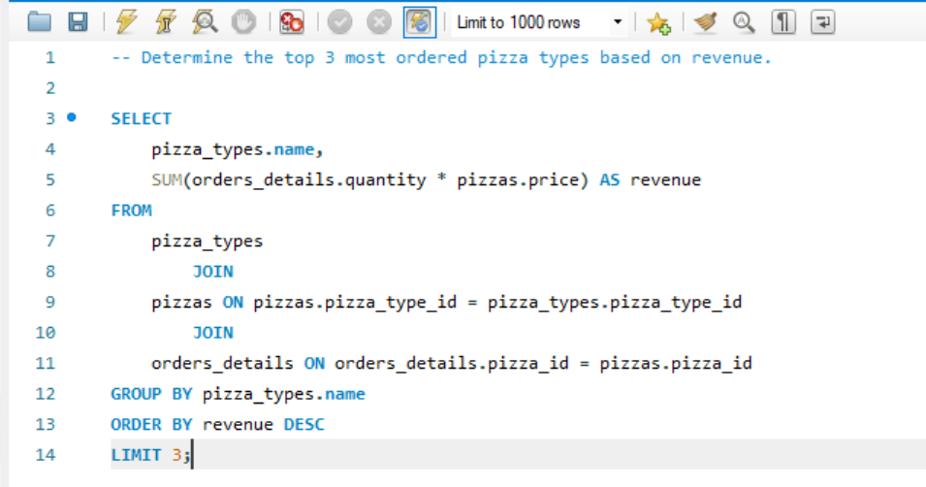
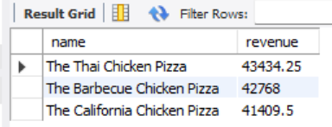
Determine the top 3 most ordered pizza types based on revenue.

Slide 18
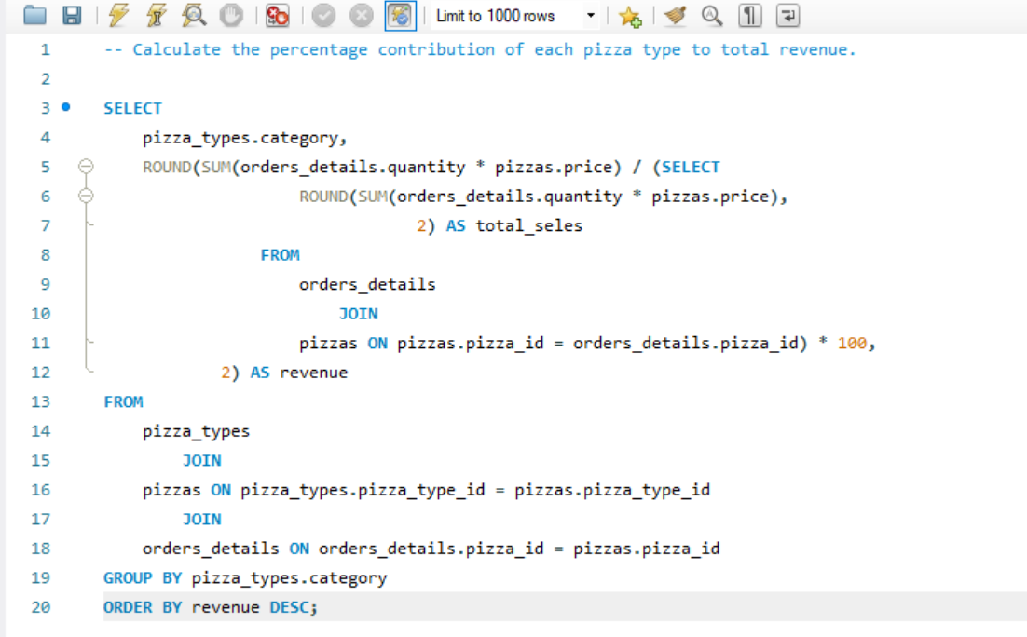
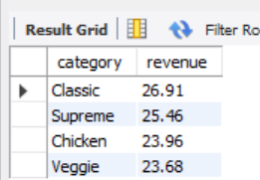
Calculate the percentage contribution of each pizza type to total revenue.

Slide 19
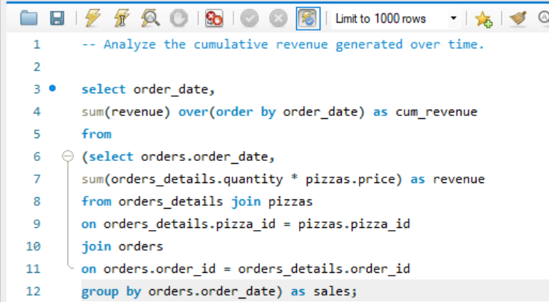
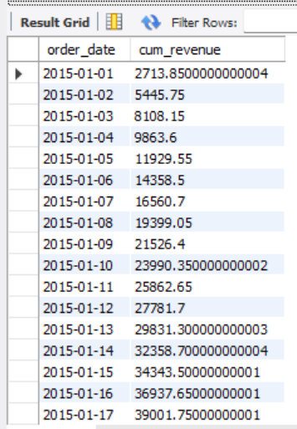
Analyze the cumulative revenue generated over time.

Slide 20
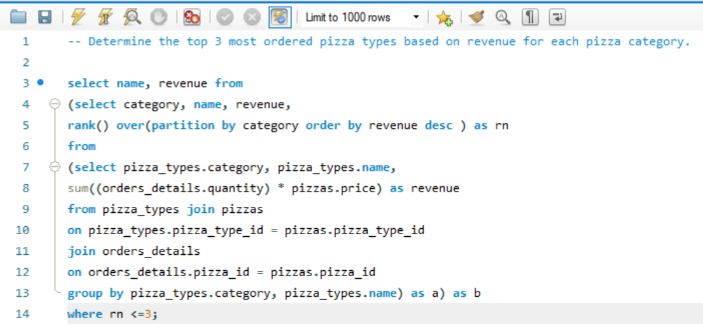
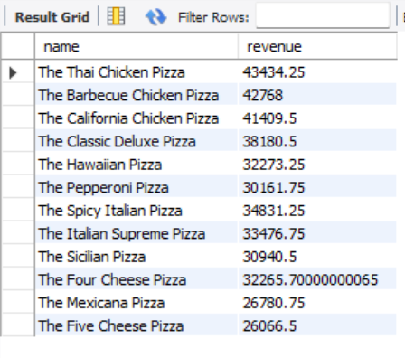
Determine the top 3 most ordered pizza types based on revenue for each pizza category.

Slide 21
PROJECT CONCLUSION
This project demonstrates practical SQL skills through Pizza Sales Data Analysis.
The analysis covers:
Total Orders and Revenue
Pizza Size and Category Analysis
Top-Selling Pizza Types
Hourly Order Distribution
Revenue Contribution
Cumulative Revenue Analysis
SQL concepts used:
JOIN, GROUP BY, ORDER BY, Subqueries,
Aggregate Functions and Window Functions.

Slide 22
THANK YOU!
Thank You for Viewing My Project!
Pizza Sales SQL Analysis
Presented by: Kamal Jangid
Data Analyst Aspirant

