Slide 3
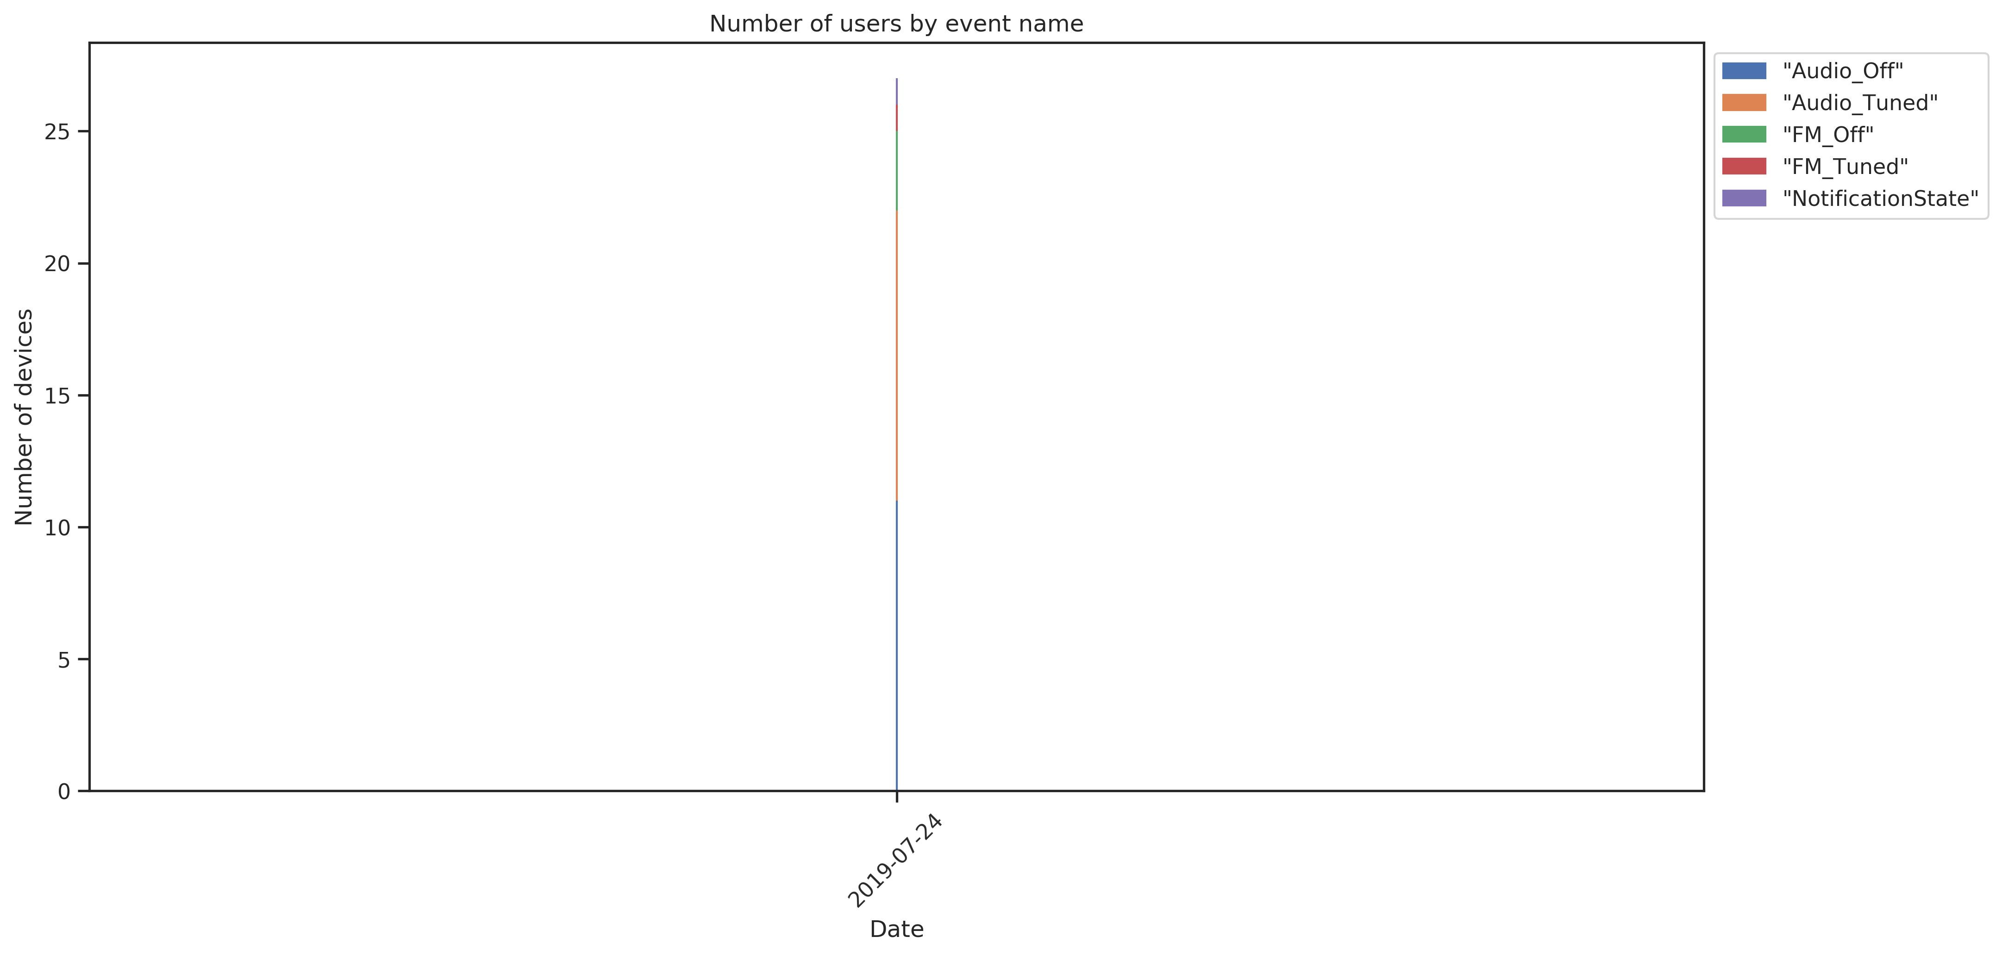
Charts/pngBarChart02.png

Slide 4
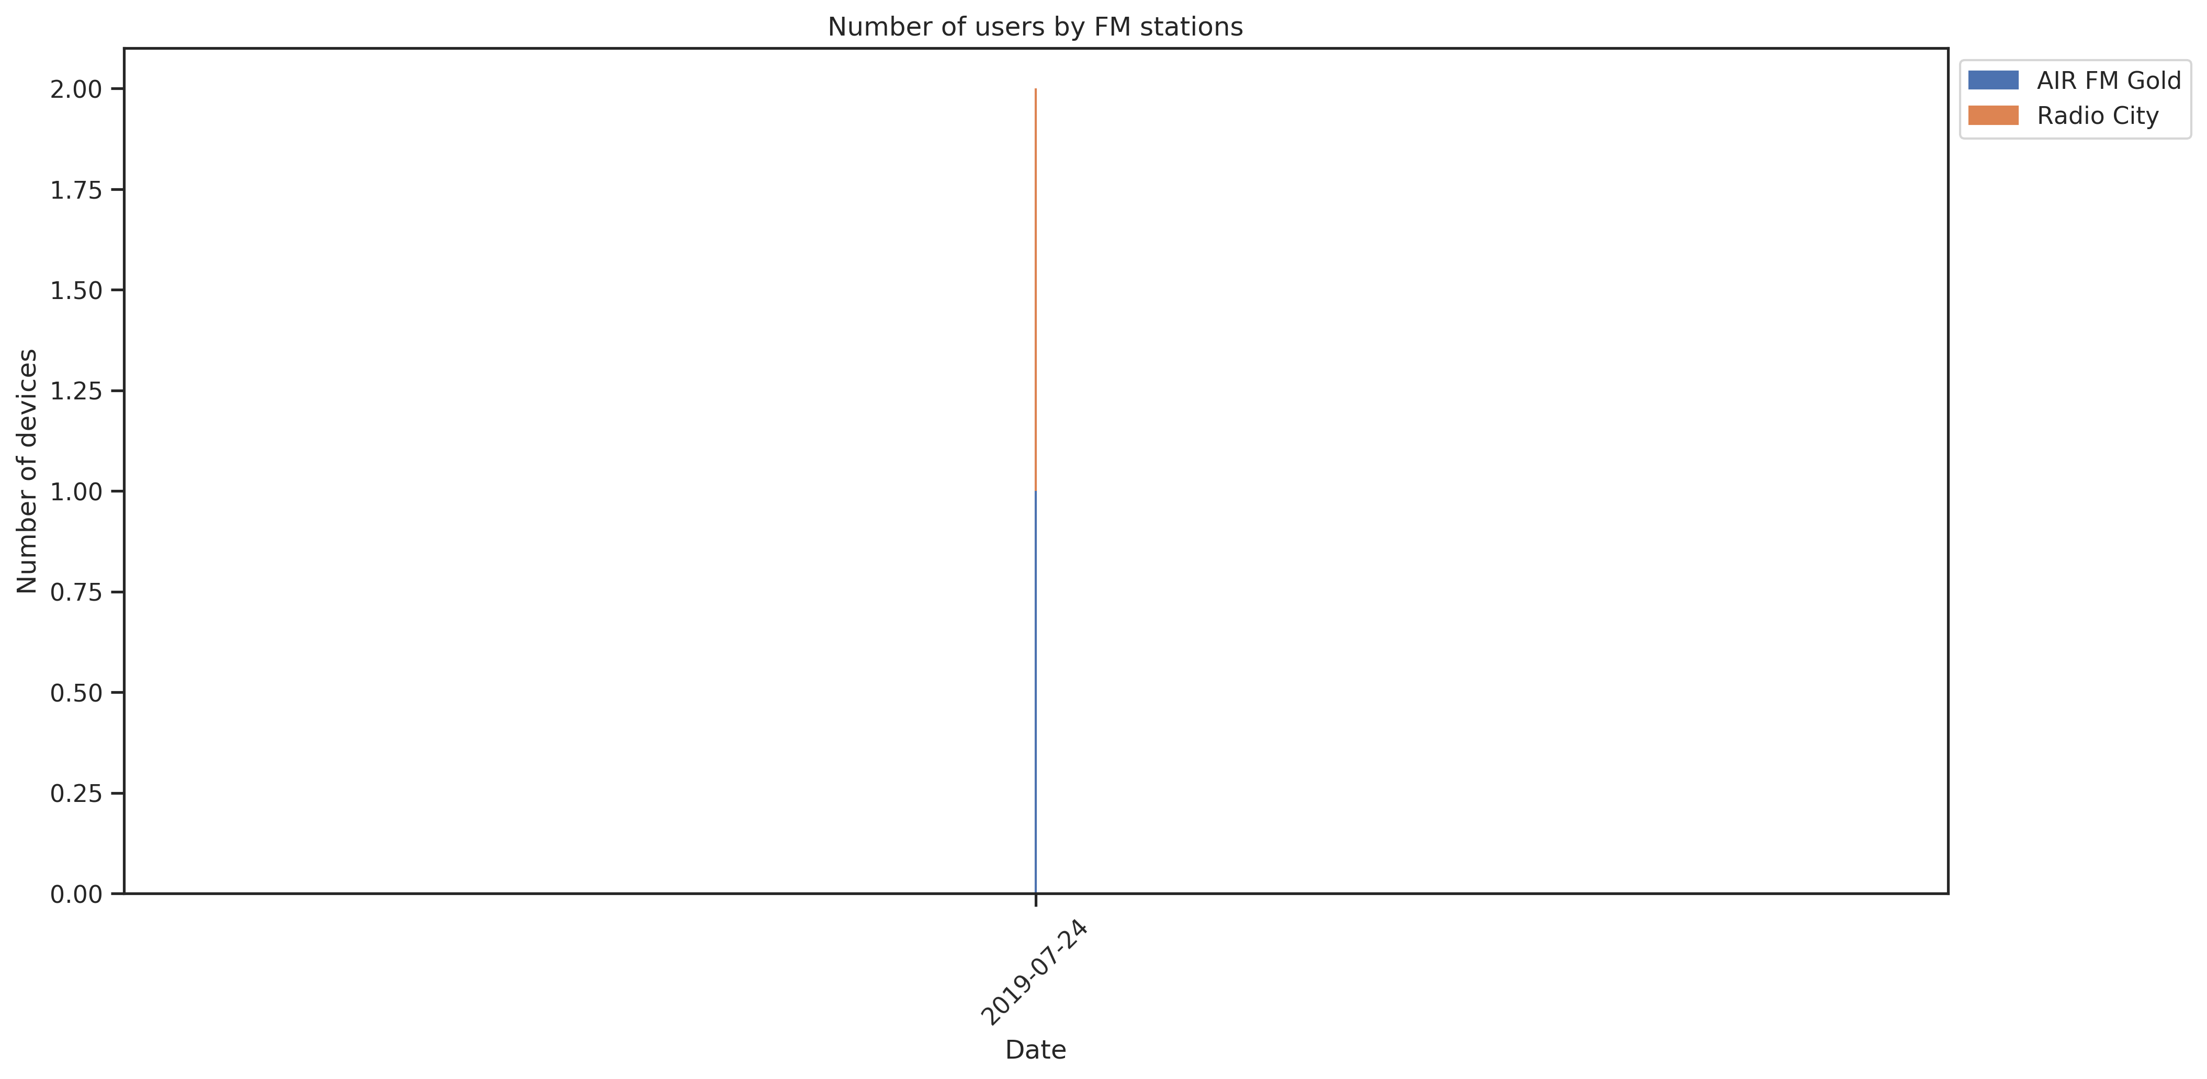
Charts/pngBarChart10.png

Slide 5
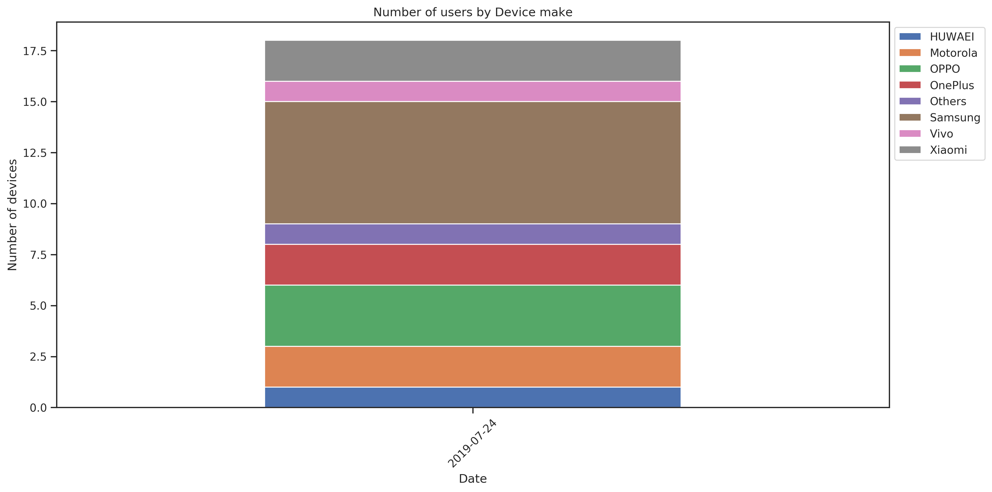
Charts/pngBarChart07.png

Slide 6
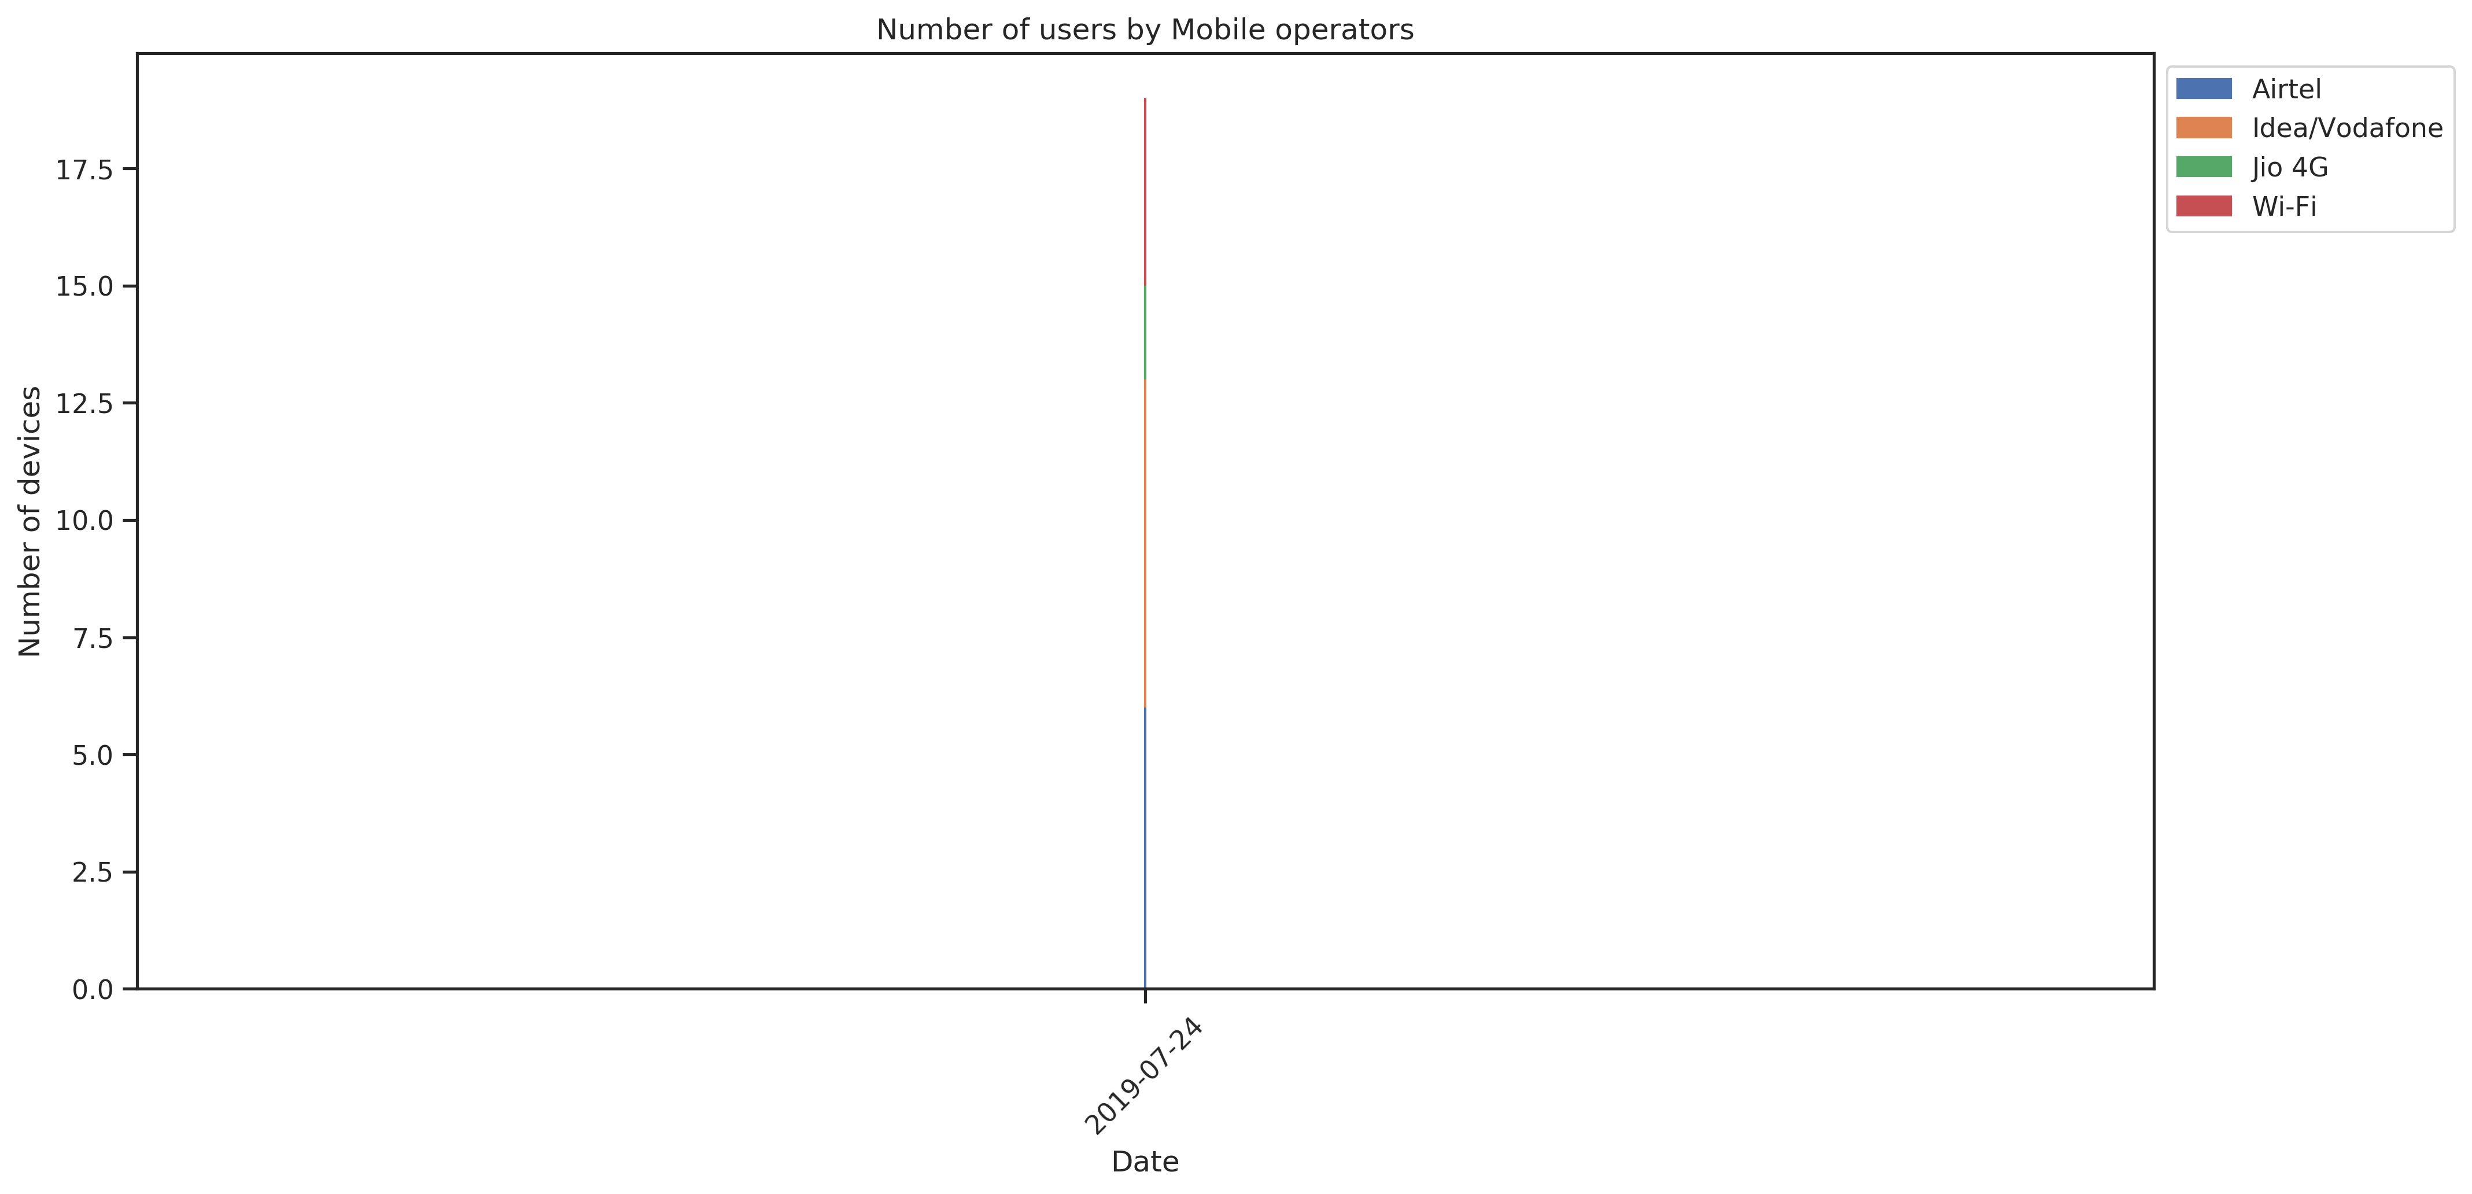
Charts/pngBarChart04.png

Slide 7

Charts/pngBarChart09.png

Slide 8
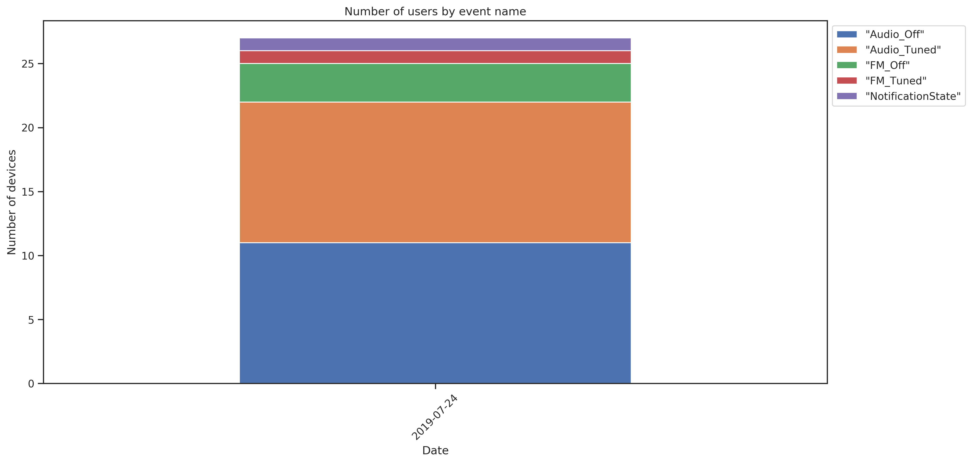
Charts/pngBarChart01.png

Slide 9
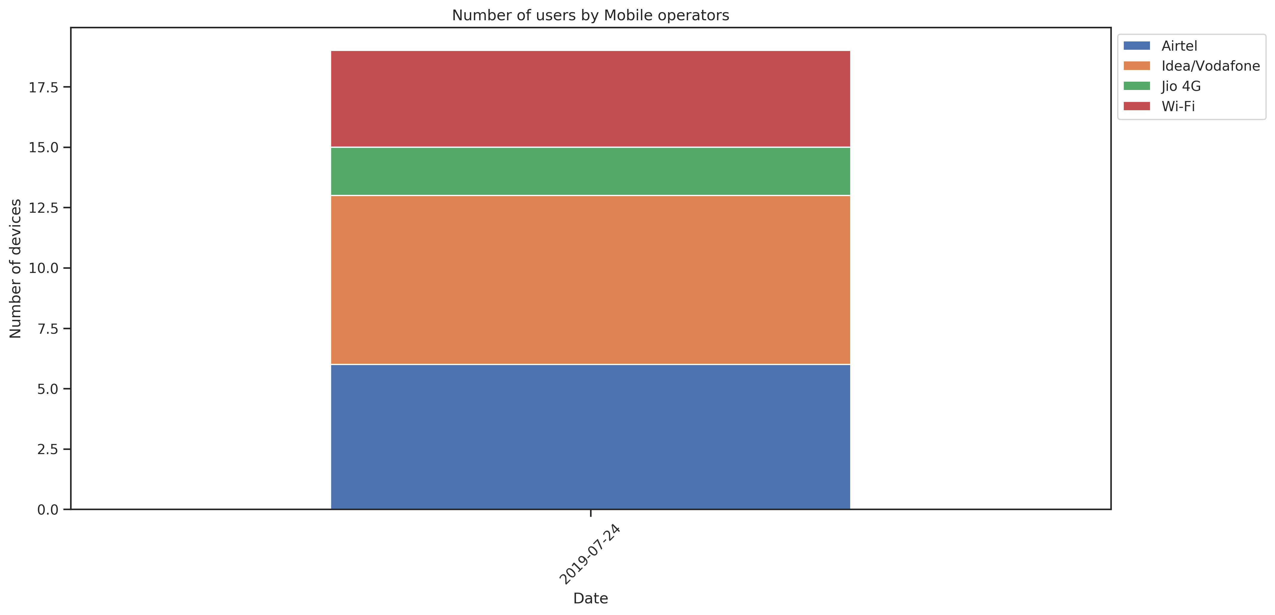
Charts/pngBarChart03.png

Slide 10
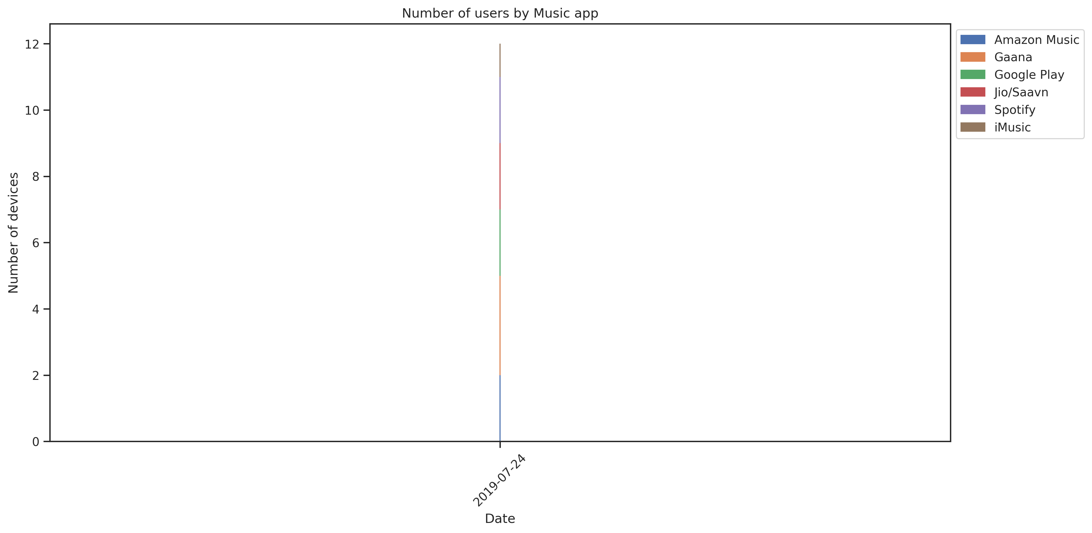
Charts/pngBarChart06.png

Slide 11
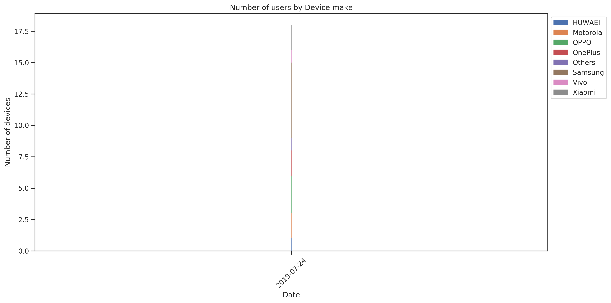
Charts/pngBarChart08.png

Slide 12
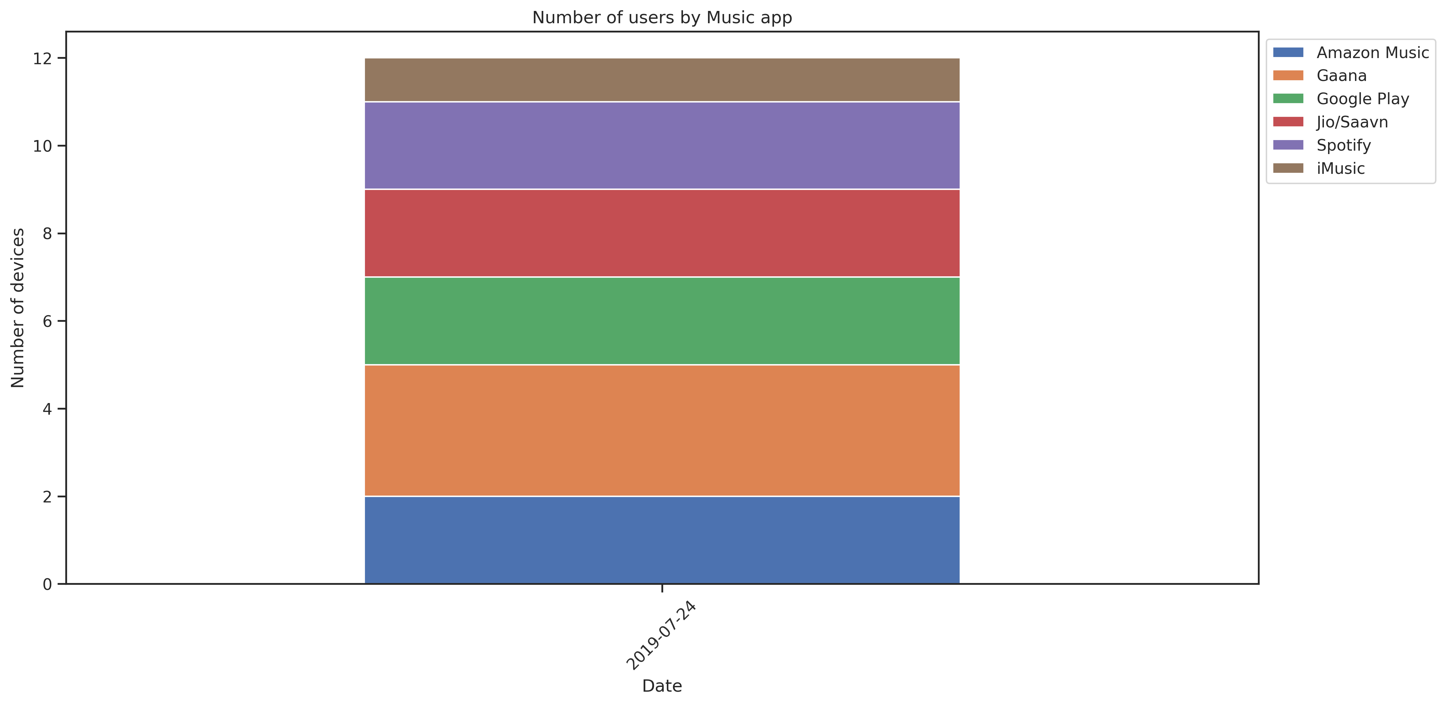
Charts/pngBarChart05.png

