Slide 1
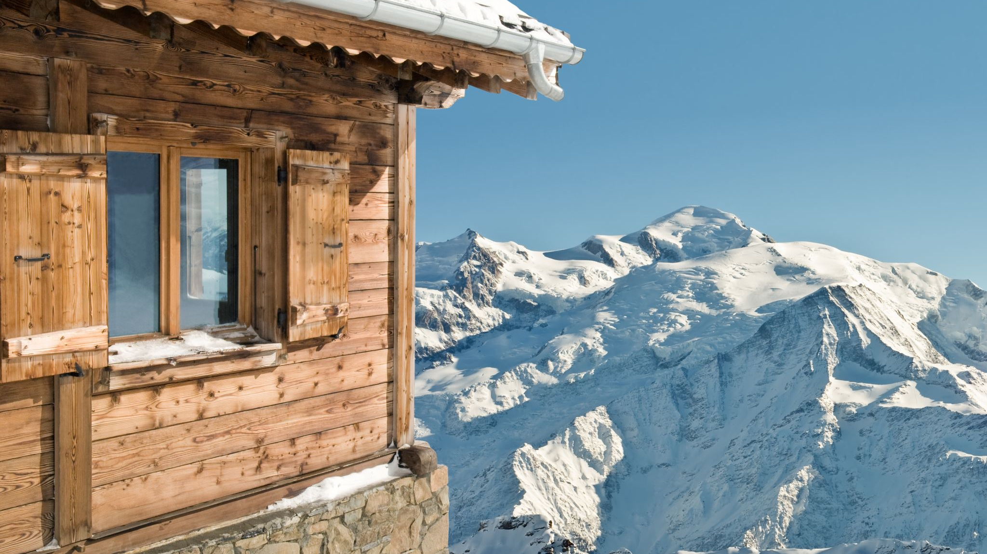
Big Mountain Resort New Price Prediction
Kamal Wagle

Slide 2
Problem Identification
How can the Big Mountain Resort overcome additional cost of $1,540,000 incurred by additional lift chairs through ticket pricing strategy and tuning available resort services within next two seasons?

Slide 3
Key Findings and Recommendations
Random forest regression model used
The expected ticket price obtained from the model is $98.85 - 20% larger from current.
Recommended to increase ticket price at least 10% from now.
Strongly recommended to close few least used runs.

Slide 4
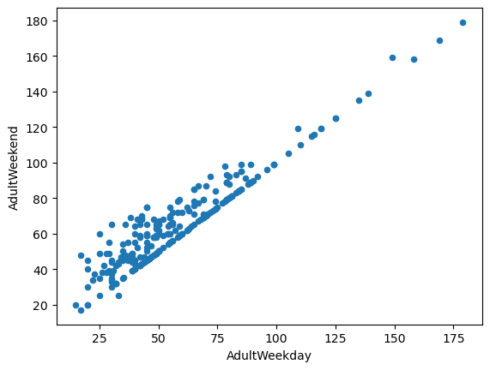
Modeling Results and Analysis Data Wrangling
Data Wrangling:
Key step of Data Science
Columns with many missing values should be dropped
Distribution of all features was visualized using histogram, seaborn's boxplot, etc., to see if data make sense
Incorrect values should be replaced or dropped
Missing values imputed or dropped
Final 277 rows out of 330 rows -- 14% of the rows had missing prices.
Relationship between key features should be studied like shown in the figure beside.

Slide 5
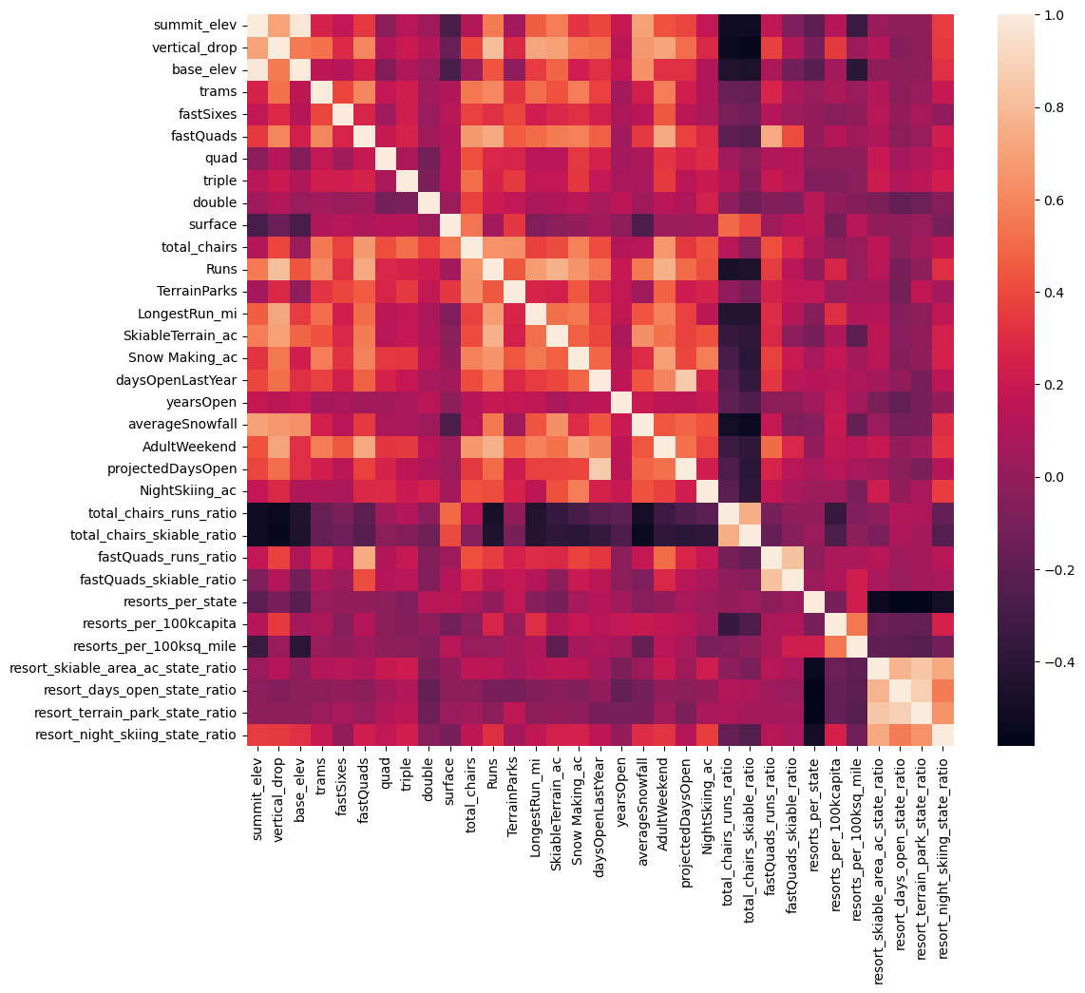
Modeling Results and Analysis Exploratory data Analysis
Exploratory data Analysis
Principal component analysis was performed: a) scaling the data, b) fit the PCA transformation, and c) apply the transformation to the data to create the derived features.
Data visualized using heatmap and scatterplot for individual features.
Target variable -- weekend ticket price
Further modeling is necessary – To see concrete relationship between state and ticket price
Heat Map

Slide 6
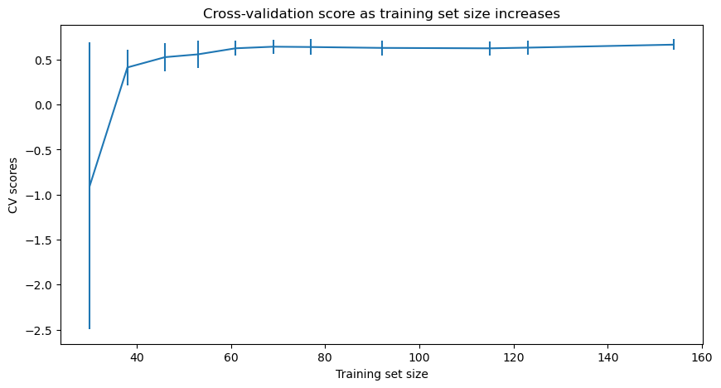
Modeling Results and Analysis Modelling and Prediction
Modelling and Prediction
Main idea -- train a model to predict Big Mountain resort’s ticket price based on data from all the remaining resorts
Random forest regression model is used.
The expected ticket price obtained from the model is $98.85.
Adding 1 run (vertical drop of 150 Feet) and 1 additional lift chair increases ticket price by $1.36 this will increase the revenue by $2,386,364 --- will cover additional operating cost of $1,540,000 (assuming each of 350,000 expected visitors buys 5 tickets).
Closing few least used or unused runs will help eventually increase the revenue.

Slide 7
Summary and Conclusion
The business leadership should consider increasing the ticket price from 10-20 % from the current price
Strongly recommended to close few least used runs
Random forest regression model performed better than linear regression model – lowered mean absolute error by ~ $1.
In future, will try gradient boosting regression and support vector machine regression models
Data of operating costs of resorts would have been more helpful

