Slide 1
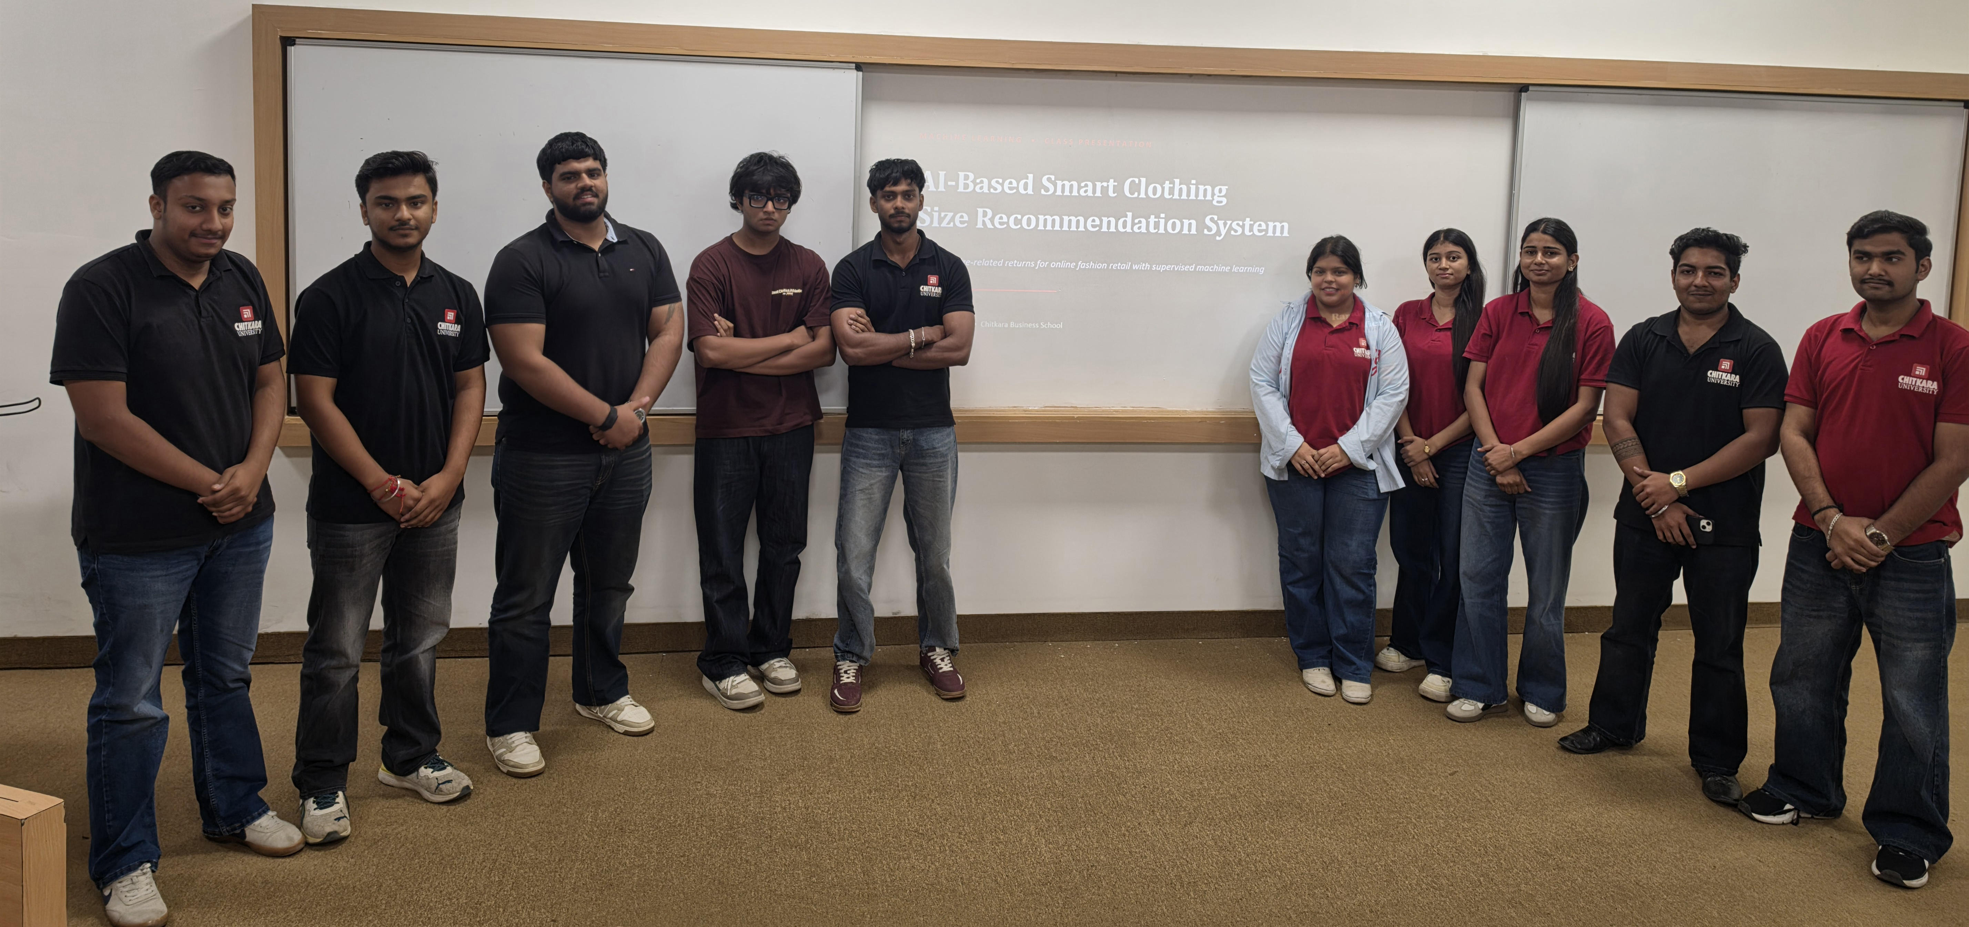
Team members : Hardik Garg , Ariv Aggarwal , Alika , Bhavya , Aman , Harshit Jain , Aditya Arora , Gopal Jindal , Chirayu Goyal , Kamalpreet Kaur , Harshpreet Singh , Aditya sharma

Slide 2
MACHINE LEARNING • CLASS PRESENTATION
AI-Based Smart Clothing
Size Recommendation System
Reducing size-related returns for online fashion retail with supervised machine learning
BBA Fintech & AI • Chitkara Business School
MODEL
Random Forest
Classifier

Slide 3
01 · THE BUSINESS PROBLEM
Why clothing size matters to online fashion
Unlike in-store shopping, online shoppers can't try before they buy — they rely on size charts that vary between brands and product lines, so wrong-size orders are common.
1
2
3
4
High Return Rates
Customer Dissatisfaction
Reduced Sales
Environmental Impact
Ill-fitting items are shipped back, driving up reverse-logistics cost.
A poor fit is a frustrating experience that erodes brand loyalty.
Sizing uncertainty causes hesitation and abandoned carts.
Extra return shipments add avoidable carbon footprint.
Goal: build an AI system that recommends the most suitable size for each customer, reducing returns and improving the shopping experience.
02

Slide 4
02 · OUR APPROACH
AI-powered personalization: the solution
This is a Supervised Machine Learning problem — specifically Classification, where the model predicts a size category rather than a continuous number.
INPUT SIGNALS THE MODEL USES
Age
Gender
We chose a Random Forest Classifier: an ensemble of decision trees that handles mixed numeric and categorical data well and gives good baseline accuracy.
Height (cm)
Weight (kg)
Previous Size
Brand
PREDICTED CLASSES
Category
Fit Preference
XS
S
M
L
XL
XXL
Previous Purchases
Previous Returns
03

Slide 5
03 · THE DATA
A synthetic dataset, built for academic use
A synthetic dataset was generated to simulate realistic customer and product data — no real Myntra or customer data was used, avoiding privacy concerns entirely.
2,500
10
2,000
500
Total Records
Input Features
Training Rows
Test Rows
6 target size classes
XS
S
M
L
XL
XXL
Why synthetic data?
Ensures customer privacy — no real records involved
Avoids data-access constraints of an academic project
Lets us design balanced, realistic relationships between attributes
04

Slide 6
04 · HOW WE BUILT IT
The machine learning workflow
01
02
03
04
05
EDA
Cleaning
Preprocessing
Train / Test Split
Model Training
Explore distributions of size, height, weight & categorical features
›
Handle missing values and inconsistent entries
›
Scale numeric features; encode categorical text into numbers
›
80/20 stratified split so every size class is represented fairly
›
Fit a Random Forest Classifier on the processed training data
05

Slide 7
05 · MODEL PERFORMANCE
How well does the model perform?
TRAINING ACCURACY
TESTING ACCURACY
WHY THE GAP?
100%
62.4%
Random Forests can overfit noisy or limited data
2,500 synthetic rows is a small dataset
62% still beats the ~17% random-chance baseline across 6 classes
The model perfectly memorizes training data — a sign it may be overfitting.
Performance on unseen data — the number that actually matters for real use.
100 trees (n_estimators=100) · class_weight = balanced · random_state = 42
06

Slide 8
05 · MODEL EVALUATION
Where the model is strong — and where it isn't
Precision, recall & F1-score per size class (test set, n = 500). Accuracy alone can hide poor performance on smaller classes.
Size | Precision | Recall | F1-score | Support
XS | 0.00 | 0.00 | 0.00 | 4
S | 0.59 | 0.26 | 0.36 | 50
M | 0.65 | 0.77 | 0.70 | 183
L | 0.54 | 0.60 | 0.57 | 136
XL | 0.70 | 0.68 | 0.69 | 107
XXL | 0.67 | 0.20 | 0.31 | 20
READING THIS
M, L and XL — the most common sizes — are predicted best (F1 ≈ 0.57–0.70)
XS and XXL are rare (4 and 20 samples) and get confused with neighbouring sizes
Overall weighted accuracy: 62.4%
07

Slide 9
06 · FEATURE IMPORTANCE
What drives the model's size prediction?
TOP 3 SIGNALS
Previous Size — 17.2%
The strongest predictor: people tend to stick with sizes close to what fit before.
Weight (kg) — 14.6%
A direct physical driver of clothing size.
Height (cm) — 9.9%
Taller customers often need longer or larger garments.
08

Slide 10
07 · BUSINESS INSIGHTS
Turning the model into business value
1
2
3
4
5
Fewer Returns
Higher Loyalty
Better Conversion
Smarter Inventory
Personalization
Show the recommended size on product pages to cut mis-sizing at the source.
A better-fitting first order builds trust and repeat purchases.
Confidence in sizing reduces cart abandonment during checkout.
Feature importance guides which sizing charts & stock levels need attention.
Move beyond generic charts to a 'Recommended for You' experience.
09

Slide 11
08 · LIMITATIONS
Staying honest about the constraints
1
2
3
Synthetic Dataset
Model Constraints
Scope & Feedback
Can't fully capture real-world sizing complexity across brands & body types
2,500 rows is small next to millions of real transactions
Random Forest trades some interpretability for accuracy
Training accuracy of 100% signals overfitting risk
Only predicts within fixed sizes (XS–XXL); no custom sizing
No live feedback loop — the model doesn't yet learn from real returns
10

Slide 12
09 · CONCLUSION
A strong foundation, with a clear next step
WHAT WE ACHIEVED
FUTURE SCOPE
Built a realistic synthetic dataset simulating customer & product attributes
Followed the full ML lifecycle: preprocessing → training → evaluation → interpretation
Trained a Random Forest model that clearly beats random-chance guessing
Surfaced actionable feature-importance insights for the business
Packaged prediction logic into a reusable function, demo-ready via an interactive widget
Collect real, detailed body-measurement data over time
Add advanced feature engineering (fabric stretch, garment cut, etc.)
Introduce a live feedback loop — did the recommended size fit?
Explore more advanced models for a possible accuracy gain
11

Slide 13
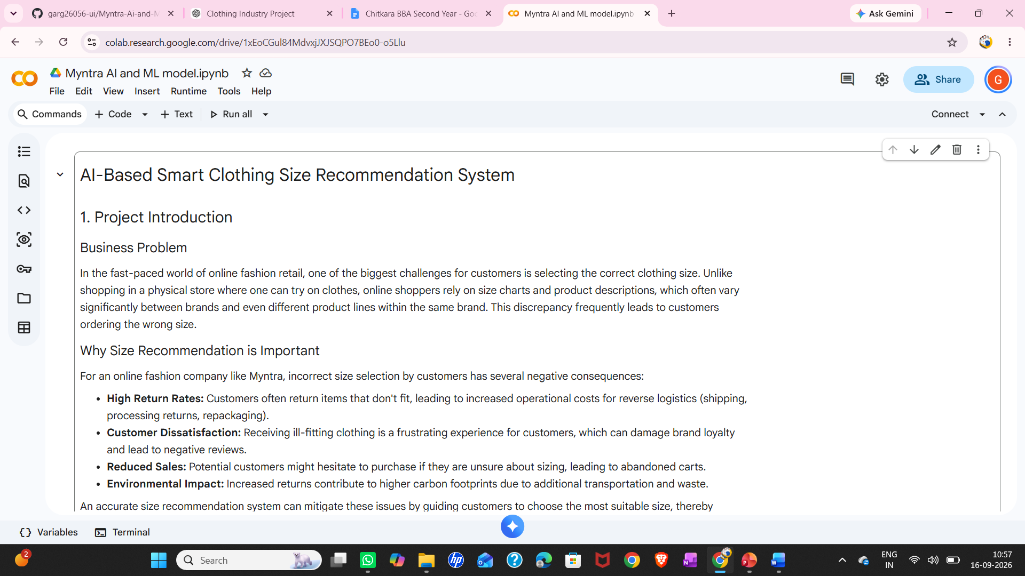
10 . AI Tools and Prompts Used
AI Tools Used : Gemini

Slide 14
11 . Pypeline
Myntra – AI-Based Clothing Size Prediction
Business Problem
↓
Wrong clothing size → Returns & exchanges
Company
↓
Myntra
Product/Service
↓
Smart Size Recommendation
ML Technique
↓
Supervised Learning → Random Forest Classification
Dataset
↓
Customer + Product + Purchase + Return Data
Data Processing
↓
Cleaning → Encoding → Feature Selection → Train/Test Split
Prediction
↓
Recommended Clothing Size
Business Insight
↓
Fewer Returns + Lower Cost + Better Customer Experience

Slide 15
11 . Github Link
Aariv Aggarwal : https://github.com/Aariv08
Alika : https://github.com/sharmaalika9-cyber
Bhavya :https://github.com/bhavyapahuja027-boop
Aditya Arora :adityaarora398-tech
Harshit Jain :https://github.com/harshitjain7056-bot
Aman :https://github.com/Matrixx-69
Kamalpreet Kaur : https://github.com/kamal1106preet-lang
Hardik Garg :https://github.com/garg26056-ui
Chirayu Goyal :
Harshpreet Singh :https://github.com/harshpreetsingh2582-cpu
Aditya Sharma
Gopal Jindal : https://github.com/jindalgopal87-create

Slide 16
THANK YOU
AI-Based Smart Clothing Size Recommendation System · Aman · BBA Fintech & AI, Chitkara Business School

