Slide 1

MiniProject(Image Processing)
Supervised by : Prof. Sekhar Kumar Mandal
  Made by : Kamal Pathak
    CST 2nd year
      510519111

Slide 2
Contents
Description Page no.
Morphological Operations
Segmentation of Image
Zone Classification
Steps for separating Zones
Sample Input /Output
3
9
10
11 - 16
17 - 18

Slide 3
Morphological Operations
1) Dilation
2) Erosion
3) Opening
4) Closing

Slide 4

Structuring element
A structuring element is a shape used to interact with a given image. It is typically used in morphological operations such as dilation, erosion, opening, closing.
Fig 1 : 2 * 2 Structuring Element

Slide 5


Dilation
Dilation adds pixels on the object boundaries and removes noise.
Fig 2: Dilation using 20 * 20 structuring element

Slide 6

Erosion
Erosion is opposite to the dilation. It removes pixels on object boundaries.
Fig 3: Erosion using 20 * 20 structuring element

Slide 7

Opening
Erosion followed by dilation is called as opening operation.
Fig 4: Opening using 20 * 20 structuring element

Slide 8

Closing
Dilation followed by erosion is called as closing operation. It can also be used to remove pepper noise.
Fig 5: Closing using 20 * 20 structuring element

Slide 9
Segmentation of Image
Three stages for segmentation of image:
1)Zone identification(Upper , Middle , Lower)
2)Separating zones
3)Separating Characters

Slide 10
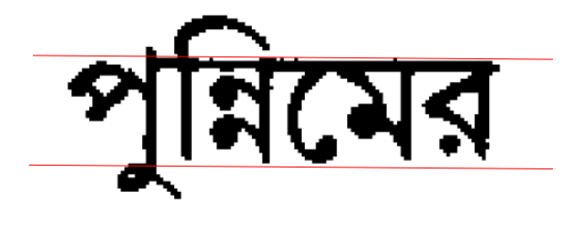
Zone Classification
Upper Zone
Middle
Zone
Lower
Zone
Fig 6

Slide 11

Steps for separating Zones
1) First of all, separate all the sentences in the document using Horizontal Projection of the image.
(We can separate the sentences as there should be proper gap between two sentences).
Fig 7: Example of Horizontal Projection

Slide 12
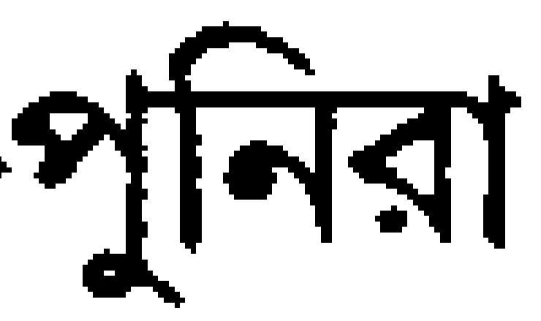
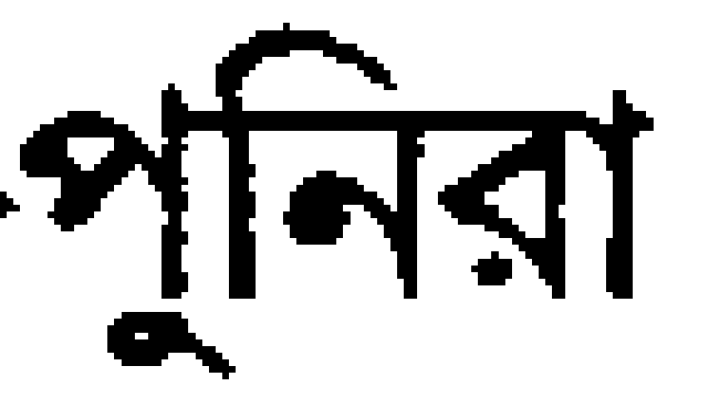
Steps for separating Zones(cont.)
2) Now using Connected Component Labeling to find the coordinates of bounding box for each word. Then, a horizontal line, called a base line is drawn through the median lowermost coordinate of this bounding box which will separate the middle zone and lower zone.
Fig 8: Word after separating the middle zone and lower zone

Slide 13
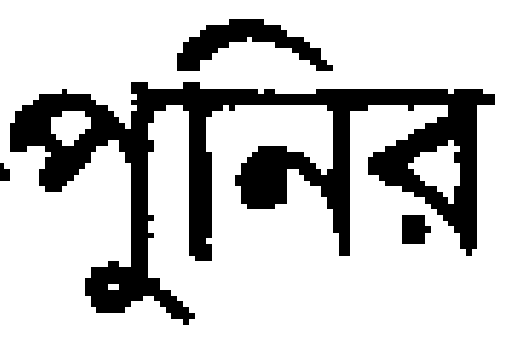
Steps for separating Zones(cont.)
3) Now we have to separate the upper zone and middle zone. First we will find the average number of pixels in a row. Then we will traverse from top to down and the first row having at least average number of pixels will be our row for the first row of headline(Shirorekha). We will cut lines above it (one or two rows).
Fig 9: Word after separating the Upper zone and middle zone

Slide 14
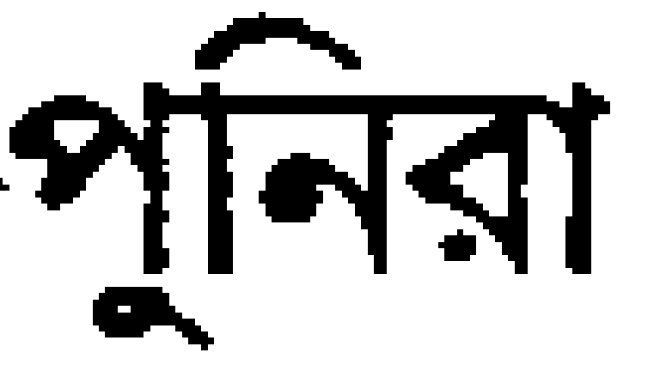
Steps for separating Zones(cont.)
So our image will look like :
Fig 10: Word after separating the zones

Slide 15
Steps for separating Zones(cont.)
4)Now our final step is to separate characters.First we will calculate the median height using bottom line and headline coordinates.
->We will have to place a vertical cut smartly.
->We will traverse upwards from lowermost point(for every column) of middle zone.
->Each pixel will have two states, either visited or not visited.
->If current pixel is not black and not visited, we will continue going upwards.
->If it is a black pixel, we will either go right or left provided they are not black. If we couldn’t move, we will stop and compare the distance travelled with the median height and place a vertical cut accordingly.
->If current pixel is already visited, we will stop and no need to compare here.

Slide 16
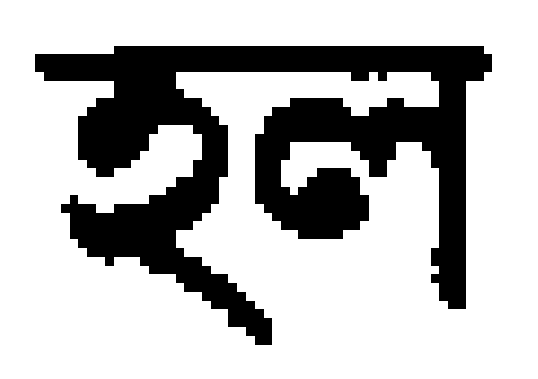
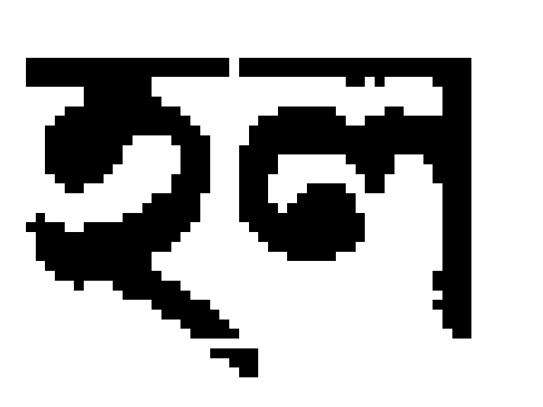
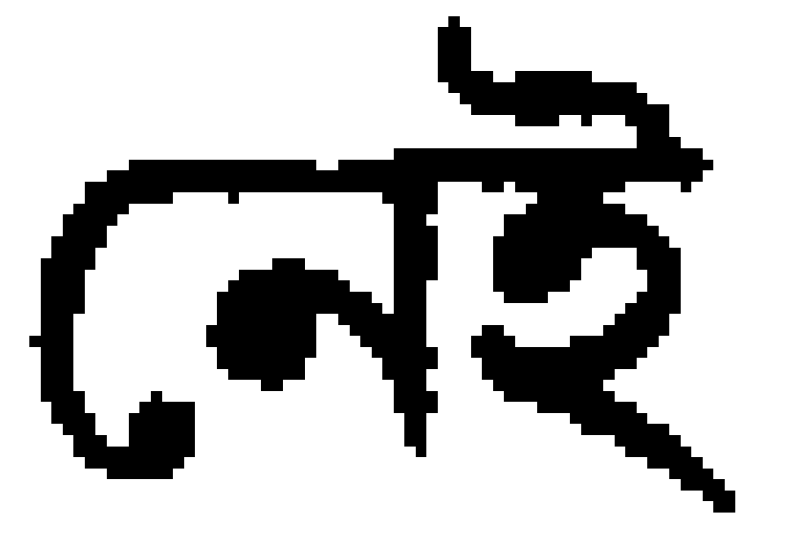
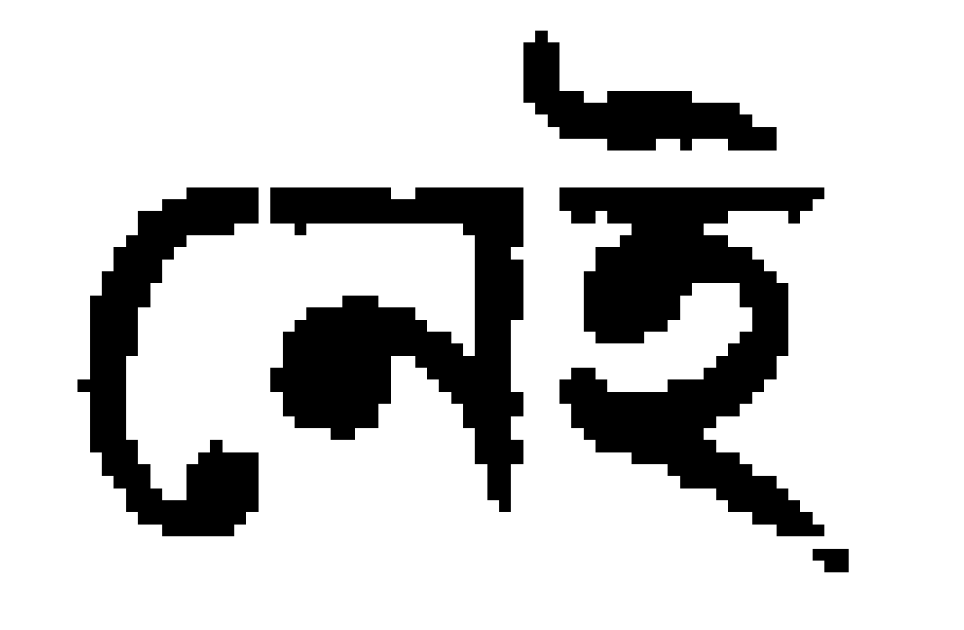
Steps for separating Zones(cont.)
So our image will look like :
Fig 11: Word after separating the zones and characters

Slide 17
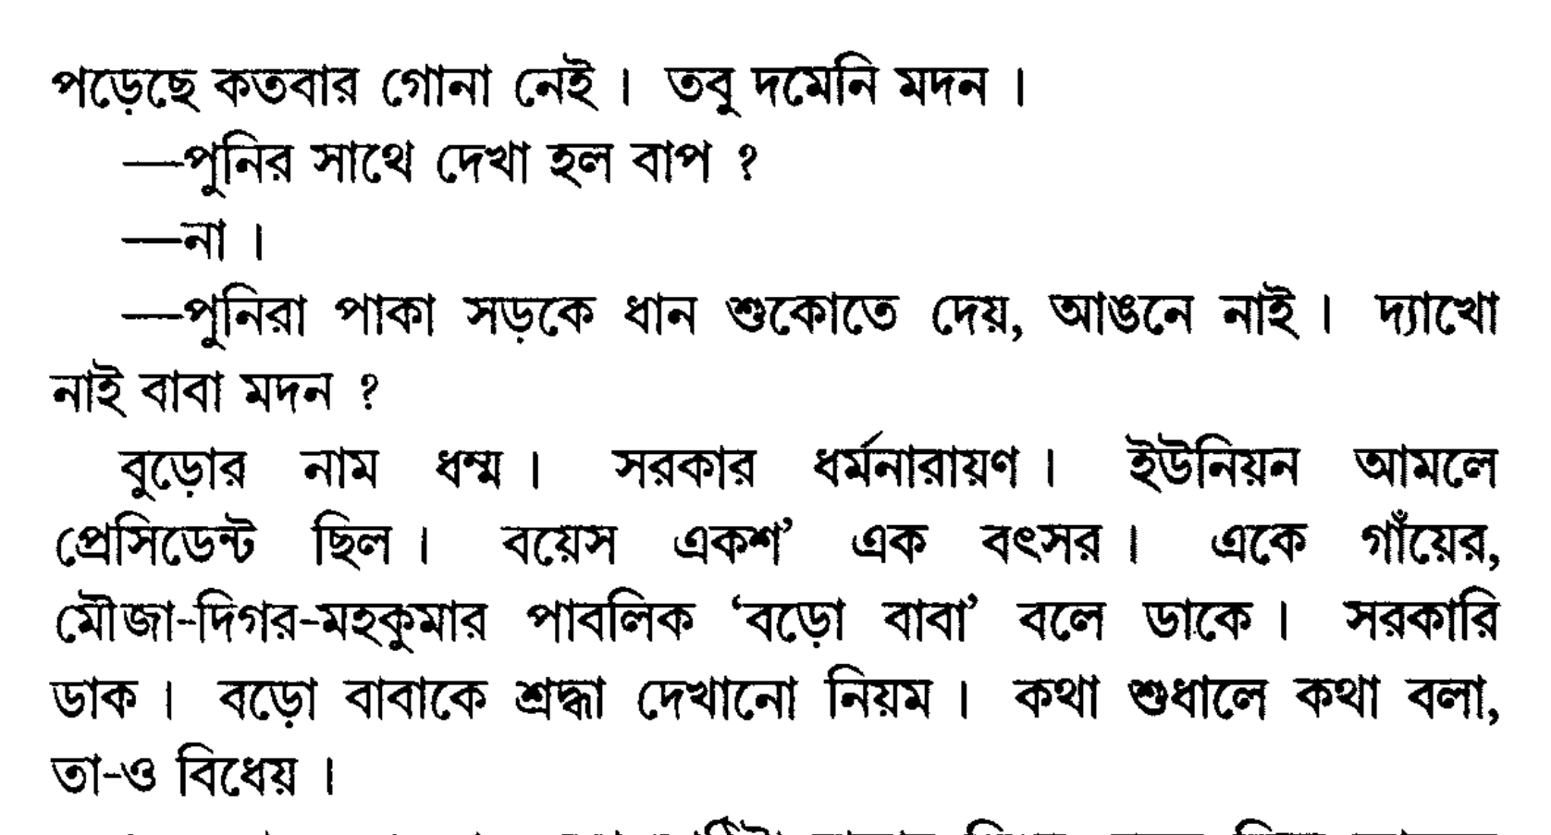
Input Image:

Slide 18
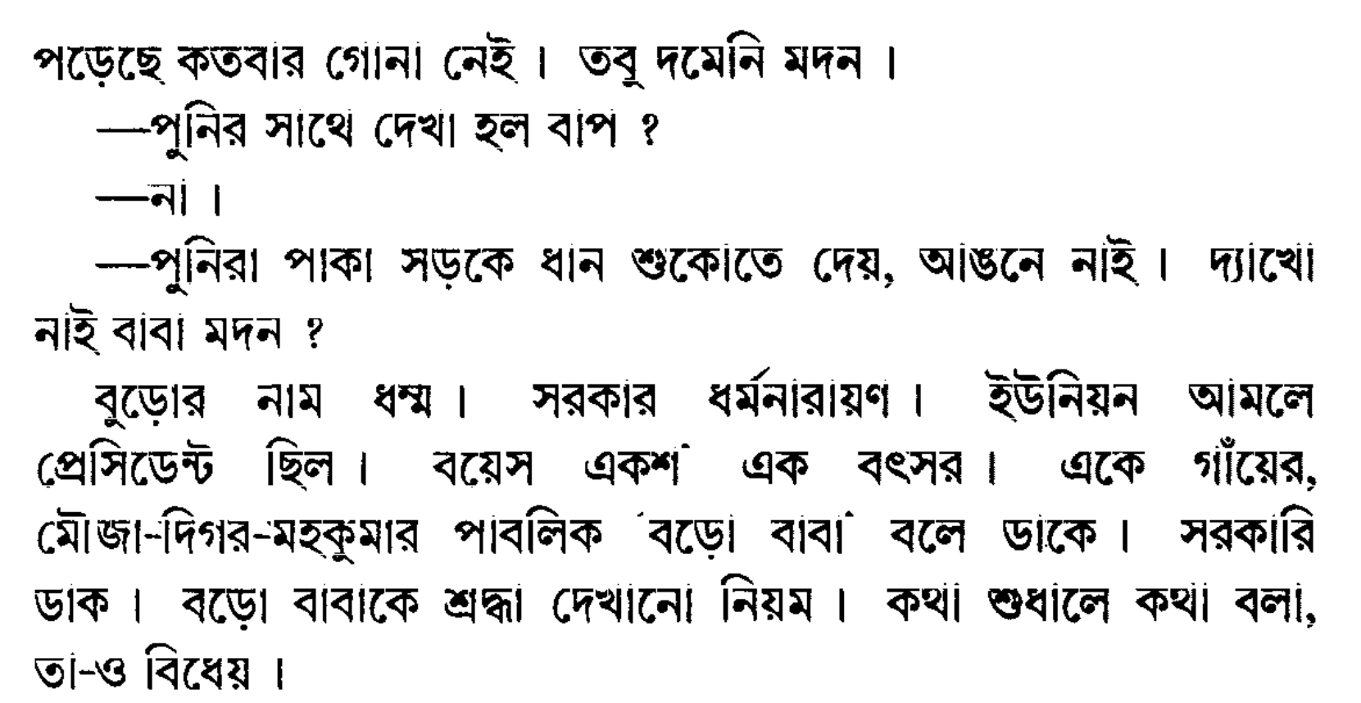
Output Image:

Slide 19
Thank You

