Slide 1

MiniProject(ImageProcessing)
Supervised by Prof. Sekhar Mandal
  Made by Kamal Pathak
    CST 2nd year
      Enrollment: 510519111

Slide 2
Contents
Description
Representation of Image
Salt and Pepper noise
Ways to remove SnP noise
Binarization
Otsu’s Method
Connected component labelling
Algorithms for CCL
Page no
3
5
7
11
12
15
17

Slide 3
Representation of an image
An image can be considered as a two-dimensional array of pixels.
Each pixel has a value associated with it.
0 represents White , 1 represents Black.
Grayscale image : Pixel value lie in the range of 0 to 255.
Binary image: Pixel value is either 0 or 1.

Slide 4
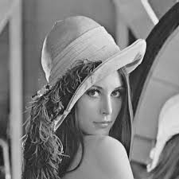
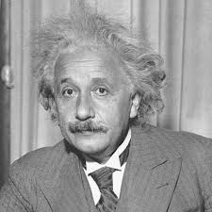
Examples of .PGM image file

Slide 5
Salt and Pepper noise
Noise is an undesired brightness/color in an image.
An image having unwanted white pixel in a matrix of black pixels or an unwanted black pixel in a matrix of white pixels is said to have Salt and Pepper noise.
This noise can be removed using filters like average filter or median filter.

Slide 6
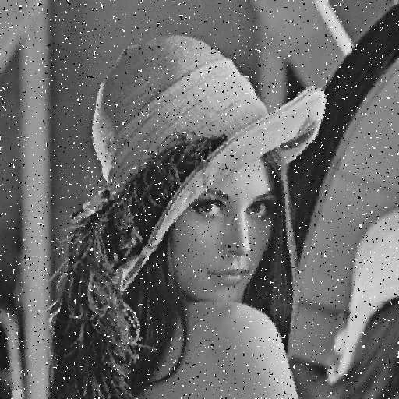
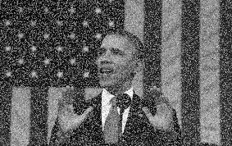
Example of Salt and Pepper noise

Slide 7
Average filters
Using 3*3 matrix: For every pixel in an image, we will take the average of all the pixels in 3*3 matrix and replace that pixel value with average value.
We can also use matices like 5*5, 7*7 and select the best image out of these.
Taking corner pixels as special cases while writing a program.

Slide 8
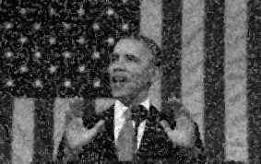
Image after using average filter
Using 3*3 window

Slide 9
Median filter
Using 3*3 matrix: For every pixel in an image, we will find the median of all the pixels present in 3*3 matrix and replace this pixel value with the median.
Here also we can use 5*5, 7*7 matrix and select the best one
Taking corners cases as special cases while writing program.

Slide 10

Image after using Median filter
Image after using Median filter
Image after using Median filter
Using 7*7window

Slide 11
Binarization
Binarization is the process to convert the grayscale image to binary image.
There are many use of binary image: 1) It helps in understanding the texts present in an image. 2) It helps in filtering a hazy or a distorted image.
There are many techniques for binarization.
A threshold value is chosen which is used to differentiate the background and the foreground of an image.

Slide 12
Otsu’s Method
The Otsu’s thresholding method has been named after Nobuyuki Otsu.
This thresholding technique is used to perform automatic image thresholding.
This threshold is determined by minimizing the intra-class intensity variance, or equivalently, by maximizing the inter-class variance.

Slide 13
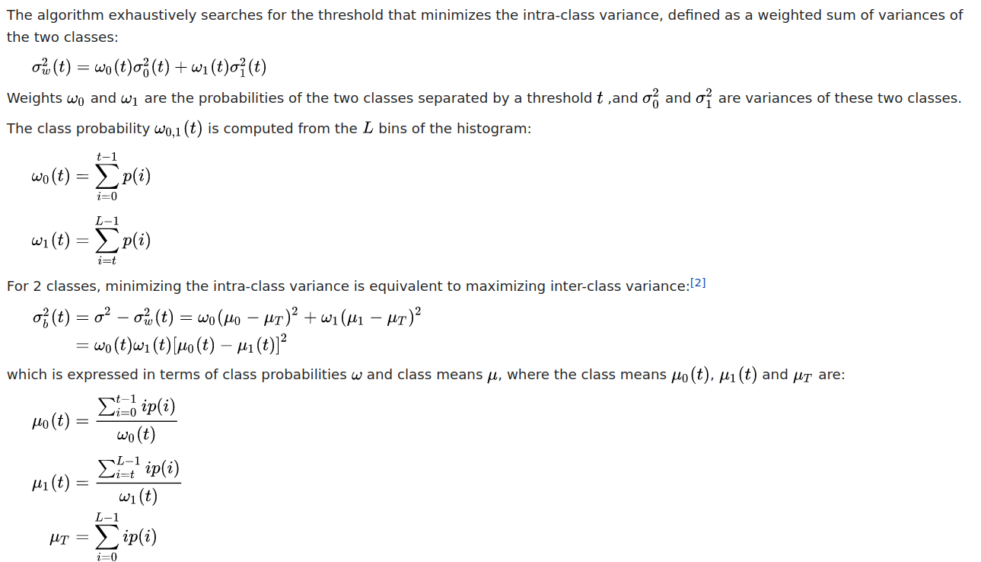
Threshold value using Otsu’s method

Slide 14

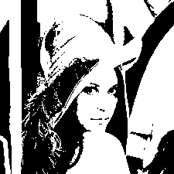

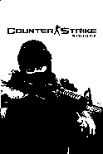
Binarization using Otsu’s method

Slide 15
Connected Component Labelling
Let S is subset of an image I and p, q € S, then p
is connected to q in S if there is a path from p to q consisting entirely of pixels in S.
Connected-component labeling is used in computer vision to detect connected regions in binary digital images.
It gives us the shape , área , boundary of the component.

Slide 16
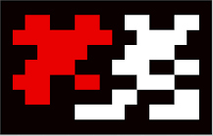
CCL example
The given image shows
two connected regions : Red and White.
Components are said to be connected on the basis of 8-connectivity here.

Slide 17
Algorithm for CCL(Recursive approach)
For every foreground pixel which is not labelled , a recursive function is called to label it.
Inside this recursive function we will call its neighbour which are foreground and not labelled.
After all the recursive calls get executed for a particular label, value of label get increased by 1.

Slide 18
Algorithm for CCL(Two pass)
This algorithm makes two passes over the image.
The first pass to assign temporary labels and record equivalences.
The second pass to replace each temporary label by the smallest label of its equivalence class.

Slide 19
References
Source of images: google search
Source of definitions: https://en.wikipedia.org/wiki/Wikipedia
Conversion of .png/.jpeg to .PGM : GIMP
Compiler used : gcc (Ubuntu 9.3.0-17ubuntu1~20.04) 9.3.0

Slide 20
Thank You

