Slide 1
IILM UNIVERSITY
STUDENT CREDENTIALS
GREATER NOIDA, UTTAR PRADESH
Kamal Negi
Roll No. 25SCS1003004399
AICTE & ICAC APPROVED INTERNSHIP
Artificial Intelligence
Internship
1-Month Professional Internship Presentation
INTERNSHIP DURATION
07 June 2026 – 07 July 2026
HOST ORGANIZATION
Codec Technologies Pvt. Ltd.

Slide 2
Candidate & Internship Overview
Candidate Details
Internship Profile
Student Name: Kamal Negi
Roll Number: 25SCS1003004399
Section: 2CSE2
Degree: B.Tech (Computer Science & Engineering)
University: IILM University, Greater Noida, U.P.
Organization: Codec Technologies Pvt. Ltd.
Role: Artificial Intelligence Intern
Program: 1 Month AICTE & ICAC Approved Internship
Duration: 07/06/2026 to 07/07/2026
Recognition: Efforts and achievements in completing the program
CERTIFICATE-BACKED PROGRAM DETAILS
The internship certificate confirms Kamal Negi's completion of the approved one-month internship program as an Artificial Intelligence Intern.

Slide 3
Organization Profile: Codec Technologies Pvt. Ltd.
Host Organization
Internship Role
Program Approval
Codec Technologies Pvt. Ltd.
The internship certificate identifies Codec Technologies Pvt. Ltd. as the organization from which the certificate was awarded.
Artificial Intelligence Intern
Role stated directly on the internship certificate.
AICTE & ICAC Approved
The certificate records the internship as a one-month approved program.
PROGRAM MANAGER
Dr. Anurag Shrivastava
As named and signed on the issued certificate of internship.

Slide 4
Internship Program Overview
Duration
Start Date
End Date
1 Month
07 June 2026
07 July 2026
Domain
Role
Approval
Artificial Intelligence
Artificial Intelligence Intern
AICTE & ICAC Approved
The certificate recognizes the successful completion of the one-month internship program and acknowledges the intern's efforts and achievements.

Slide 5
Internship Timeline
07 June 2026
June 2026
July 2026
07 July 2026
Internship Begins
Internship Program
Internship Program
Internship Ends
Certificate period: 07/06/2026 to 07/07/2026

Slide 6
Internship Focus
Artificial Intelligence
Professional Internship
The certificate identifies the internship domain as Artificial Intelligence and the role as Artificial Intelligence Intern.
A one-month approved internship program conducted from 07 June 2026 to 07 July 2026.
DOCUMENTED SCOPE
Participation
Recognition
Credential
Completed the internship program
Efforts and achievements acknowledged
Internship certificate issued

Slide 7
Completion & Recognition
The certificate states that the internship was completed in recognition of Kamal Negi's efforts and achievements.
Completed
Role
Credential
1 Month AICTE & ICAC Approved internship program
Artificial Intelligence Intern
Certificate of Internship from Codec Technologies Pvt. Ltd.
Program Manager: Dr. Anurag Shrivastava

Slide 8
Certificate & Official Verification
Certificate | Certificate of Internship
Issued to | Kamal Negi
Organization | Codec Technologies Pvt. Ltd.
Role | Artificial Intelligence Intern
Program | 1 Month AICTE & ICAC Approved Internship
Period | 07/06/2026 – 07/07/2026
Program Manager | Dr. Anurag Shrivastava

Slide 9
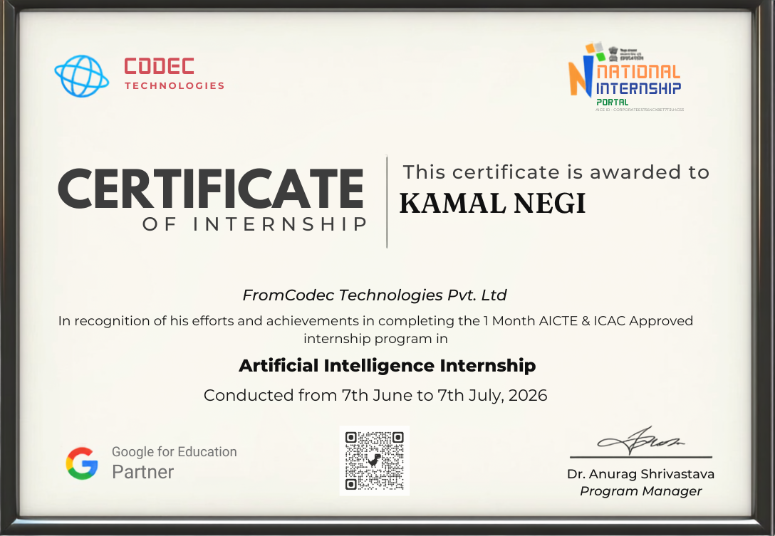
Certificate Display

Slide 10
Thank You!
Kamal Negi
Roll No: 25SCS1003004399 | Section: 2CSE2
School of Computer Science & Engineering
IILM University, Greater Noida, U.P.

