Slide 1
Prediction of ADANI GROUP STOCK PRICES 2023

Slide 2
Agenda
Understanding the independent variables
Process followed in the project
Deductions from EDA and Data Preprocessing
Stationary Data and Model Building
Conclusion
Result Table

Slide 3
agenda
To build a Time Series methodology to Forecast the Adani Group Stock Prices 2023

Slide 4
INDEPENDENT LABEL
Date: Date(Month/Day/Year)
Open: Price when the market opened
High: Highest price of the day
Low: Lowest price of the day
Close: Price at which it closed
Adj Close: Adjusted closing price
Volume: Volume traded
NUMERICAL COLUMNS (INTEGER DATATYPES)

Slide 5
TARGET LABEL
To Forecast the Stock price in month of July ,Augest (60days) 2023
Close (Price of stock) :stock price uptrend/downtrend

Slide 6
Importing data and understanding it
1750 rows and 7 columns
The date column data types are not correct
Changing the datatypes and handling the missing values
Extract the new Column Year , Month , Day from the Date Column
To get more insights pattern from the dataset
Missing values are handled by interpolation and column ‘NAN’ values deleted
Duplicates entries in the dataset are identified and all are removed from the dataset
Extrapolatory Data analysis
the dataset is imbalanced. we need to introduce some random sampling to make it balanced.
Boxplot plotted to find out the outliers

Slide 7
Data Preparation for model
Handling the Outliers , Convert non-stationary into stationary Time Series data
Splitting the Data into Train Data and Testing Data
Model Building
Build the Time Series Models are ARIMA , SARIMAX , AUTO ARIMA
Conclusion
Select the Time Series Model which gives a least RMSE value and least BIC value

Slide 8
EDA AND DATA PREPROCESSING STEPS
Drop the columns not required for prediction.
Remove the unwanted spaces in data.
Check for null values in the columns. If present, impute the null values using the Simple Imputer.
Convert the date column (object datatype) into datetime format.
Set the index as Date because the timeseries lib has been design in such a way it required date column as a index(scipy stats model) .
Visualize the data with respect to the graph of time series analysis
Moving Average to smoothening the series of averages, Calculated from historic data.

Slide 9
EDA AND DATA PREPROCESSING STEPS
Perform seasonal decompose to represent the time series as sum of components the linear trend , seasonal and random residuals.
Clean the data by removing the outliers from the data
Convert non-stationary data into stationary time series data.
Differencing , log transformation to make stationary and normalize the data
Augmented Dickey Fuller Test (ADF) gives hypothesis p-value and confidence interval defines Timeseries data is stationary or non-stationary.
Check the correlogram of Auto Correlation Function (ACF) and Partial Auto Correlation Function (PACF)

Slide 10
1750,2
MiSSING DATAS ARE REMOVED FROM THE DATASETS
Convert date dtype obj into date time format
Apply date into index of the dataset with respect to timeseries format
We use hist and ggplot, kse_plotfor visualization
Remove the otliers from the datas
Timeseries moving average rolling(window).mean
Sesaonal decompose trend,seasonal,resid----plot
Acf,pacf,graph
Datatransformation—stationary---differncing,log transformation
Checking Augmented dickie fuller test
Converting into stationay----train_test data
Arima/sarimax/autoarima

Slide 11
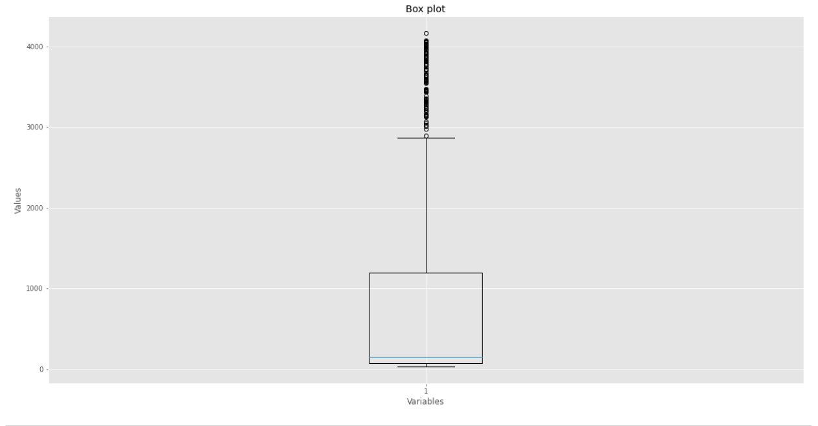
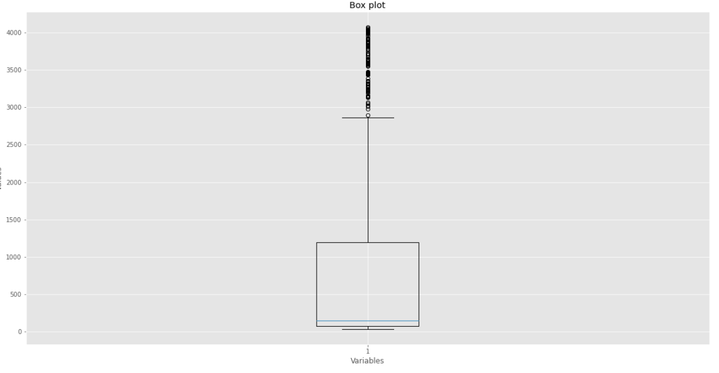
REMOVING OUTLIERS
We can see that the close stock price have many outliers.
Let we kept the validate data points which are important to forecast the stock price.

Slide 12
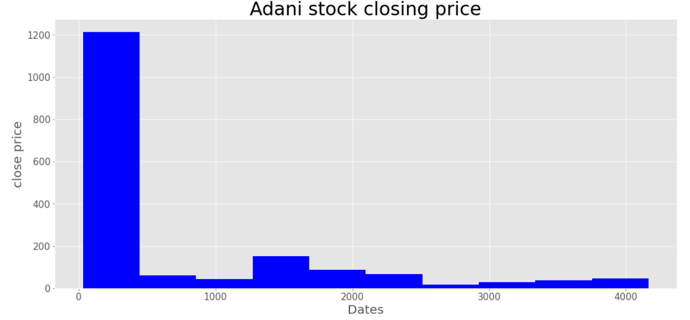
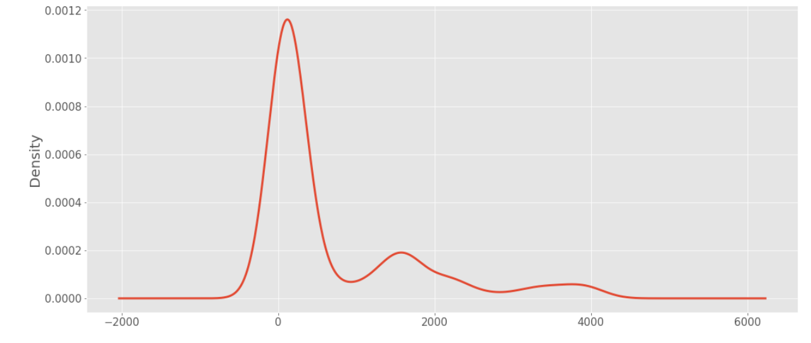
VISUALIZATION OF CLOSE STOCK PRICE
The histogram and kernel density estimation (KDE) visualization shows the distribution of close stock price.
The distribution of the close stock price column is not normally distributed , so we log normal method to get normal distribution of data from library NUMPY (np.log) .

Slide 13
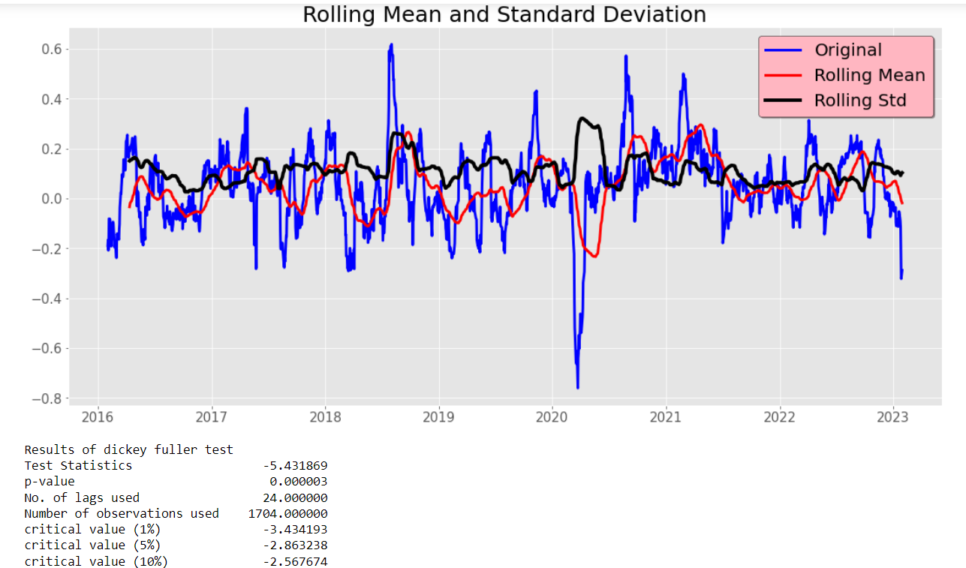
STATIONARY TIME SERIES

Slide 14
PERFORMANCE OF TIMESERIES MODELS (RMSE VALUES)
AUTO ARIMA Model gives the best RMSE(Root Mean Squared Error) Value is 0.0335974

Slide 15
MODEL SELECTION
Among the three time series models, we find the best Time Series Model which gives minimal Root Mean Squared Error value and discover the optimal order for an Auto ARIMA model.
We calculate the BIC score for the model and select the model ability to adapt properly to predicting , previously unseen data .

Slide 16
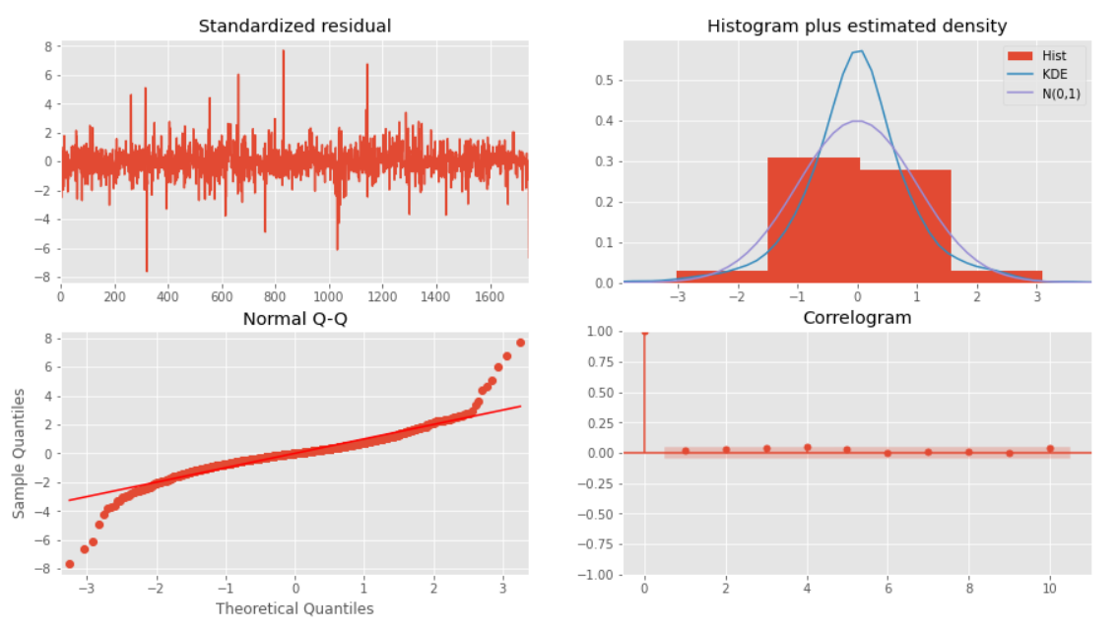
AUTO ARIMA MODEL

Slide 17
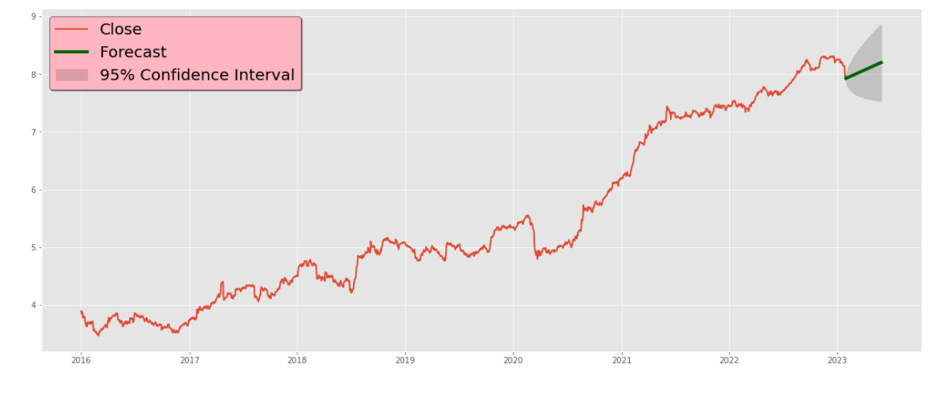
FORECASTING ADANI STOCK PRICE NEXT 120 DAYS(2023)

Slide 18
Project Title : ADANI STOCK PRICE REAL TIME FORECAST(2023)
Name: KAMALA KANNAN M
Batch: PGDA31
Email: kamalroosewelt@gmail.com

