Slide 1
The George Washington University
Advanced Software Paradigm
Authors:
Ebrahim Bonger
Abdul Bashir Kamal Summer 2021

Slide 2
Dart Criteria for programming language evaluation
Dart Language Objected-oriented concept
Dart supports all the features-oriented program
The oops concepts are given below.
Class
Object
Inheritance
Interface
Polymorphism
Abstract class

Slide 3
Dart classes and object
Dart classes are defined as the blueprint of the associated object .
class ClassName {
<fields>
<getter/setter>
<constructor>
<functions>
}
The object has two characteristics - state and behavior.
var objectName = new ClassName(<constructor_arguments>)

Slide 4
Dart Inheritance
Dart has single inheritance
class Orbiter extends Spacecraft {
double altitude;
Orbiter(String name, DateTime launchDate, this.altitude)
: super(name, launchDate);
}

Slide 5
Dart Interface & Abstract
The Interface is defined as a blueprint of the class
Dart does not have a syntax for declaring interfaces.
Classes declarations are themselves interfaces in Dart
Abstract Classes in Dart is defined for those classes which contain one or more than one abstract method
abstract class ClassName {
//Body of abstract class
}

Slide 6
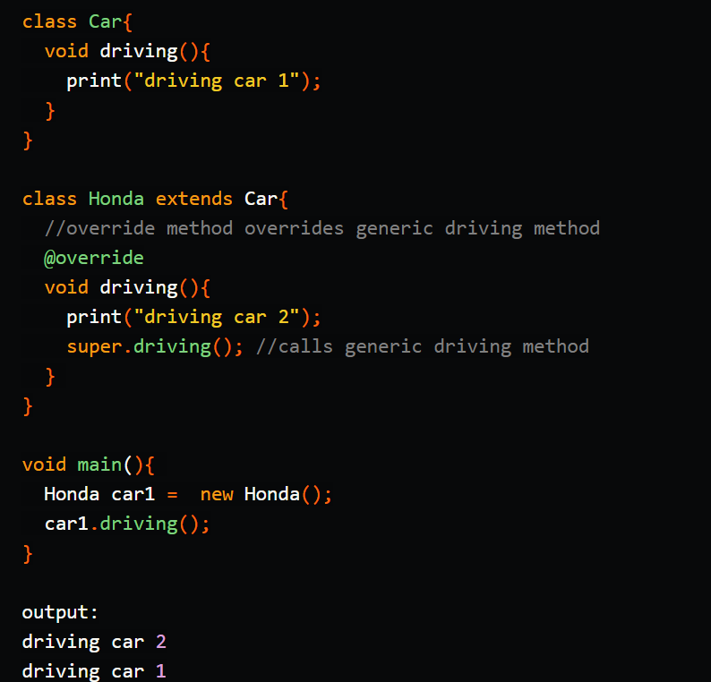
Dart support Polymorphism Example
Polymorphism, means creating many forms or configurations.

Slide 7
Dart evaluate programming language
Dart is a language worth learning
Dart was introduced in 2011
Dart programming language optimized for Android, iOS, Windows, MacOS and different other device platform.
Google use Dart language
Dart compilers are quick and reliable

Slide 8
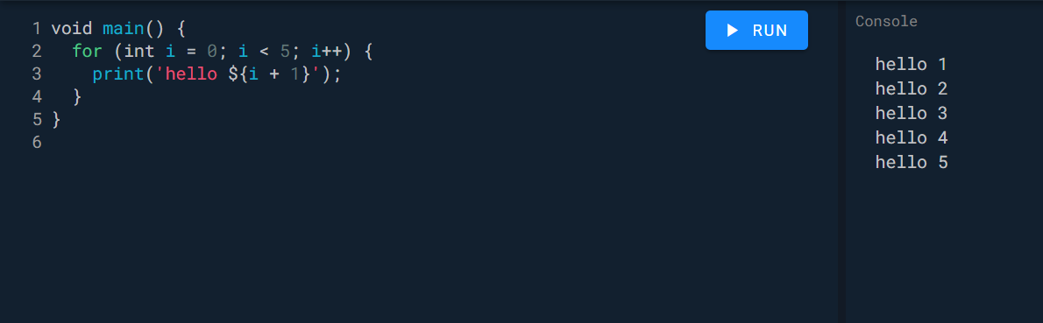
Dart is an objected oriented language with C-style syntax
Dart is object-oriented programming language it supports interfaces, classes, collections, generics etc.

