Slide 1
When all costs are the same

Slide 2
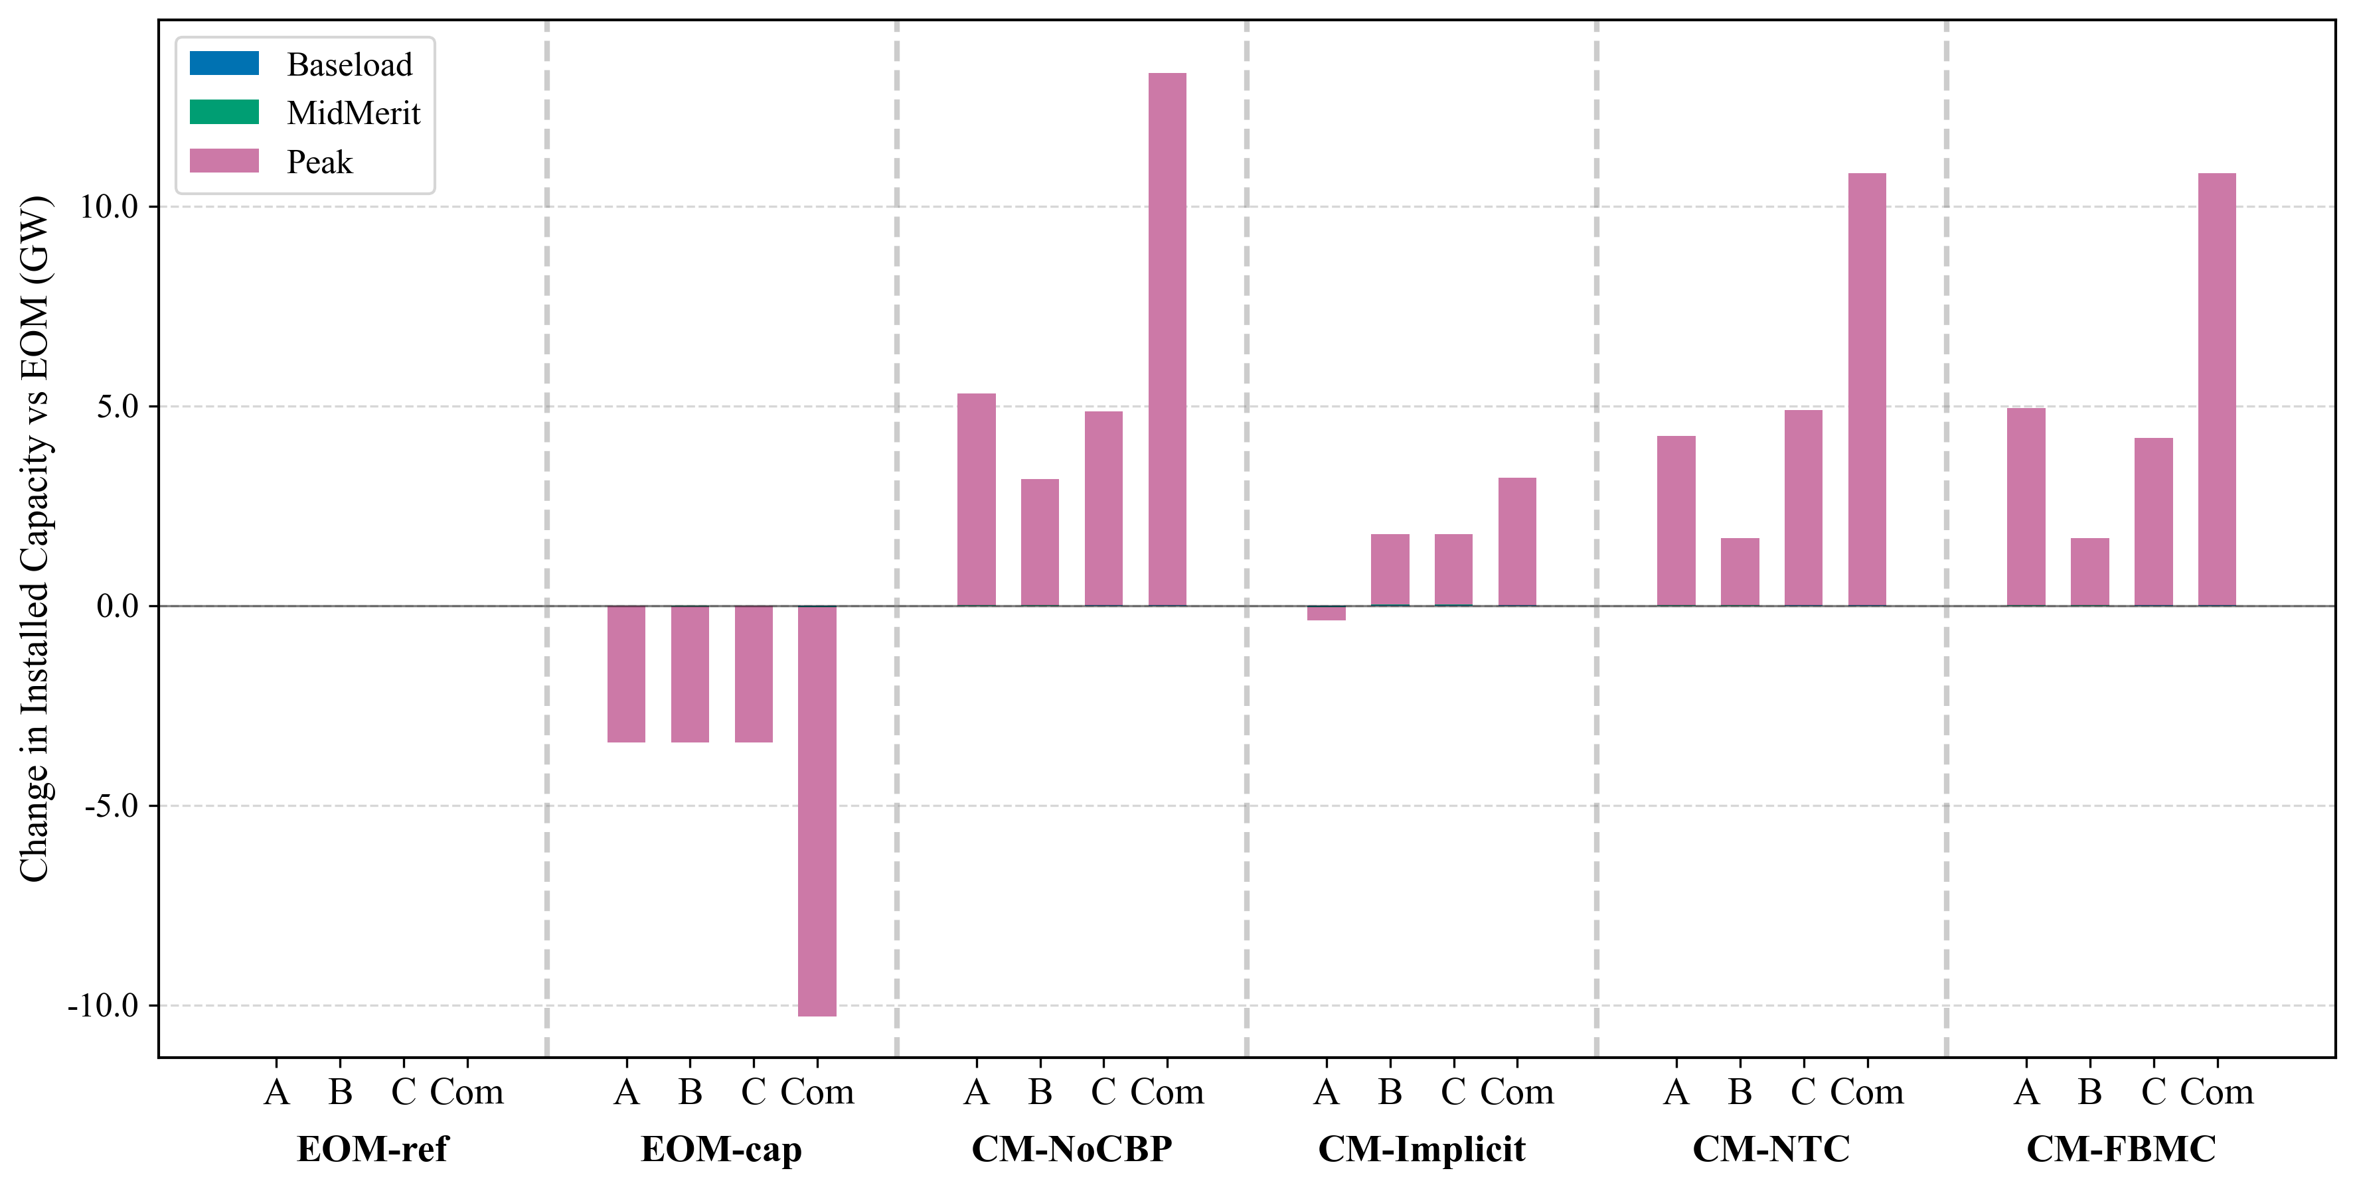
Installed capacity: capacity mix differs across both NTC & FBMC designs

Slide 3
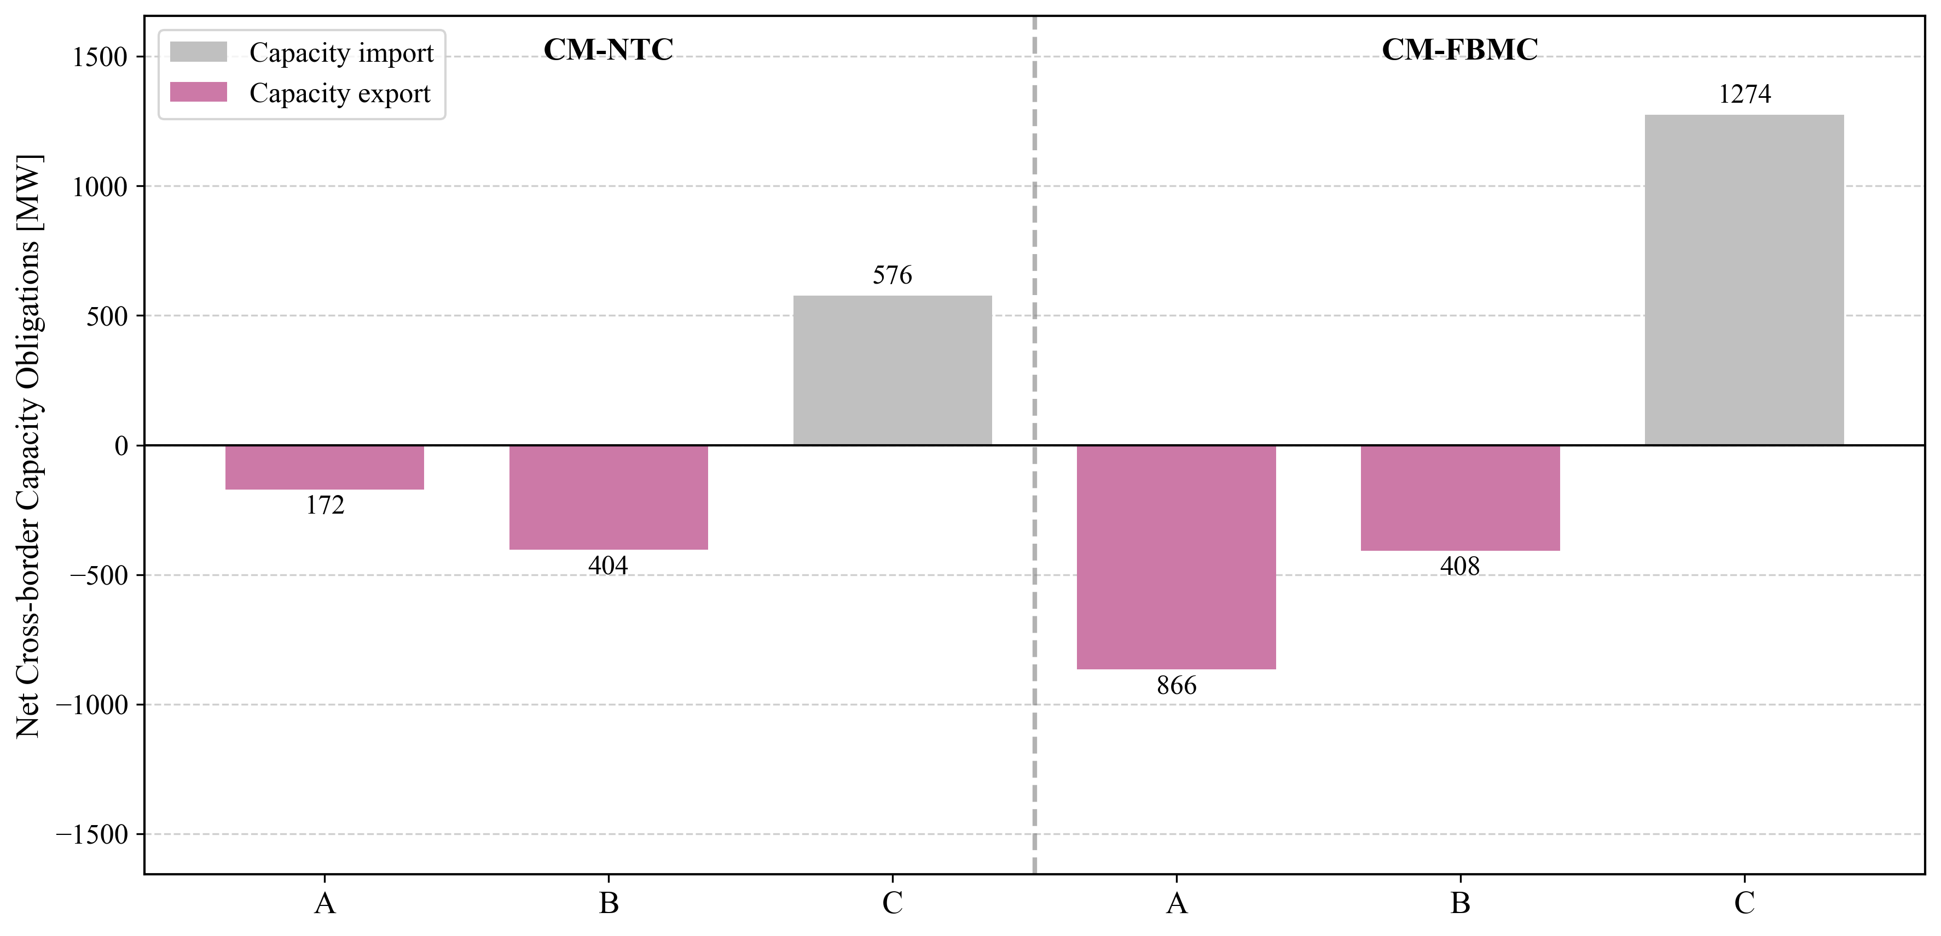
Trade of cross-border capacity obligations: FBMC unlocks more trade

Slide 4
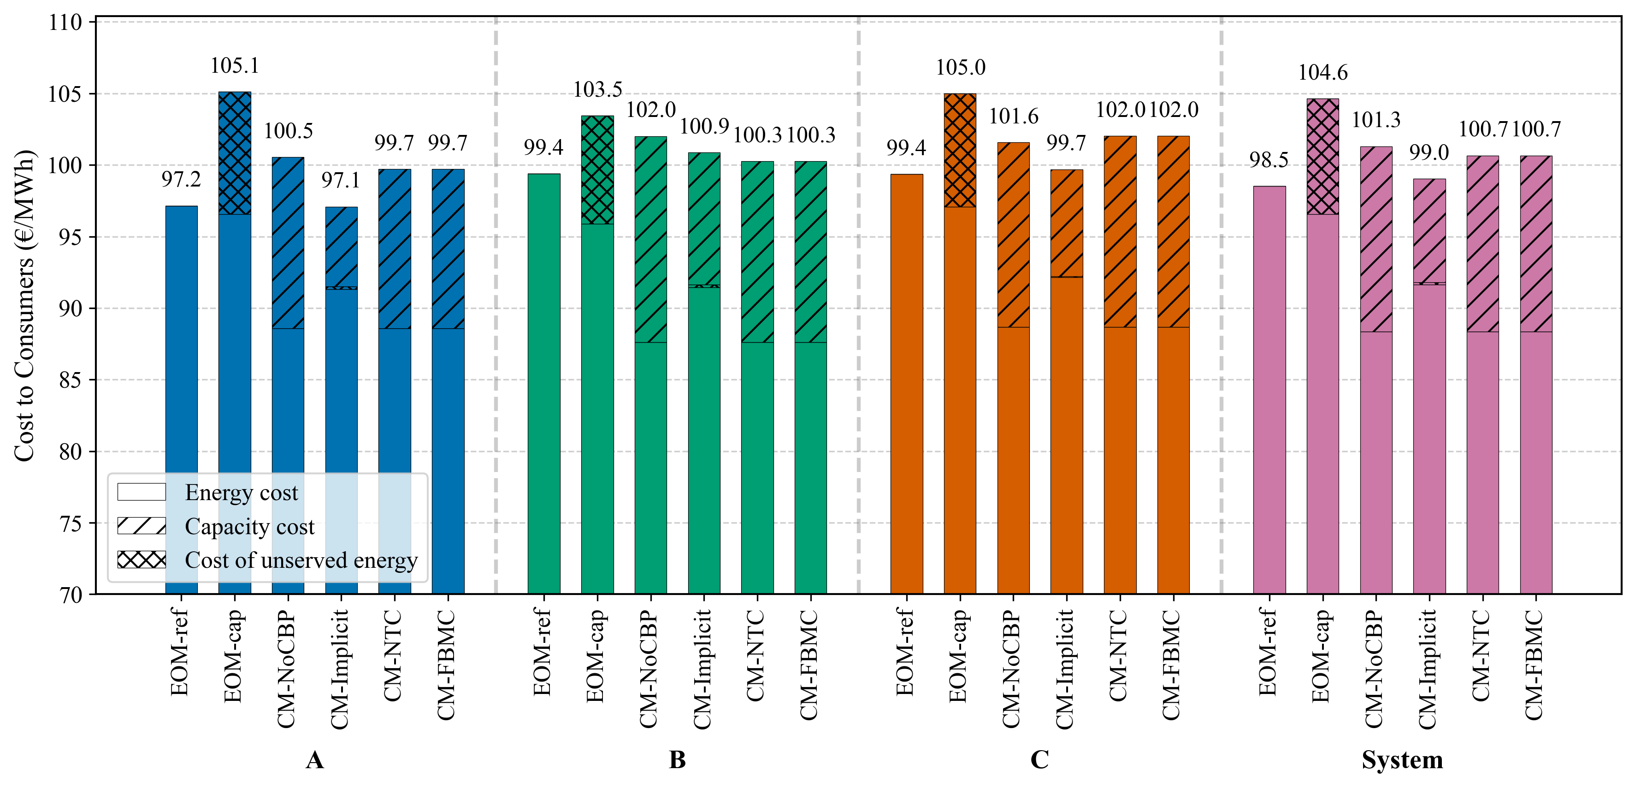
Cost to consumers: costs remain the same across FBMC and NTC because investment and operational costs are the same across the system

Slide 5
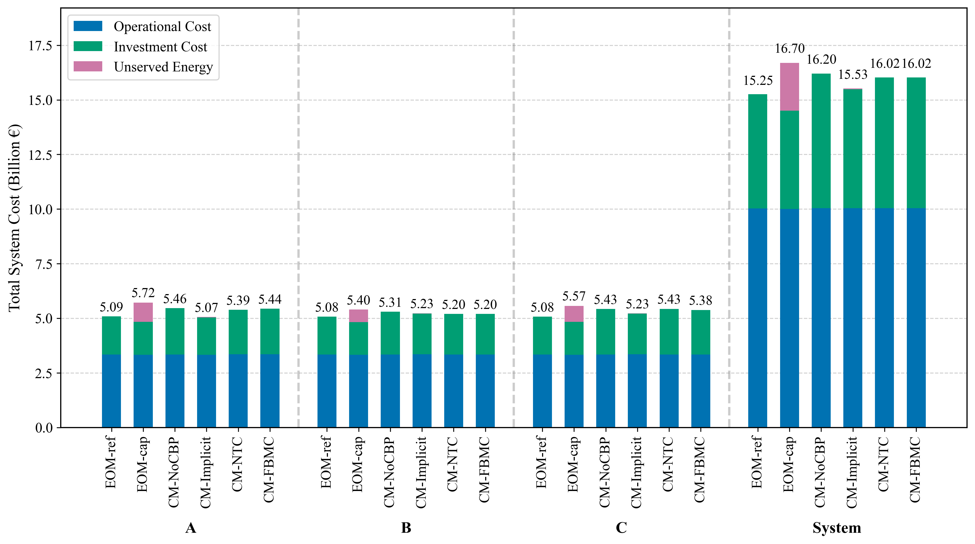
System costs: same for both FBMC and NTC since costs are the same across zones

Slide 6
Installed capacity differs across zones, with FBMC capturing more trade. However, since costs are the same across zones, it does not lead to a reduced cost. If costs were to differ across zones, then, the cross-border trade will lead to lower consumer costs

Slide 7
When all costs differ across zones

