Slide 1
Cómetelo
Kamalah Chang
Ironhack Data Analytics Bootcamp| CDMX | Septiembre 2020

Slide 2



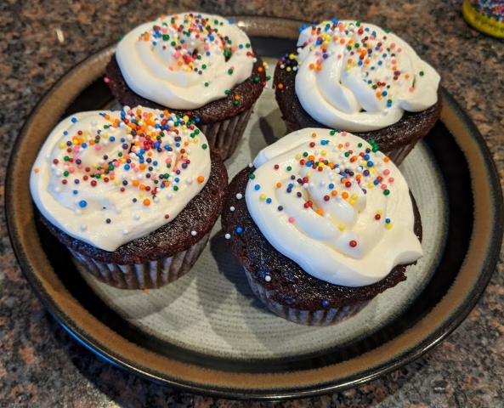


About Me
Mechanical Engineer from California, currently working for an oilfield services company in Texas.
I travel (27 countries and counting), run, and bake in my spare time

Slide 3
Problem Statement
What is the best recipe to make?
Highest rating?
Fewest ingredients?
Fewest steps?
Quickest?
What do the recipes have in common that makes them the highest rated?

Slide 4
Approach
Get Data
Kaggle database:
Develop Scoring algorithm
Return Top 5 Recipes
Food.com recipes
Food.com user interactions (ratings/comments)
Develop GUI
Notes:
*Clustering*

Slide 5
Technical Challenge | Defining the top algorithm
Some recipes only have 5 reviews, some have 5000
Combine average rating and number of reviews into a single metric
How to define the “exoticness” of an ingredient
Identify all ingredients in all recipes
Rate frequency of each ingredient for score most frequent ingredients:
salt
oil
butter
cheese
garlic
Notes:
Show and explain code snippets in your presentation slides.

Slide 6
Add a Slide Title - 4
Git:Display a screenshot of your GitHub graphs to show your commit frequency and how much work you did.

Slide 7
Demo

