Slide 1
Cloud Computing Security

Slide 2
Agenda
Cloud Computing Security
Computer Security
Computer Security Services
Cloud Computing Security Issues
Dangers and Vulnerabilities
Attackers
Threats , Concerns, Assets
Cloud Computing Security Domains
Solutions and Recommendations

Slide 3
Security Services
Availability
Confidentiality
Integrity

Slide 4
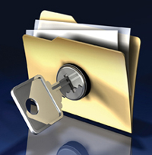
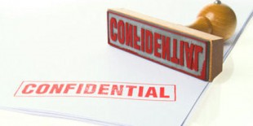
Confidentiality
Authorized to Know

Slide 5
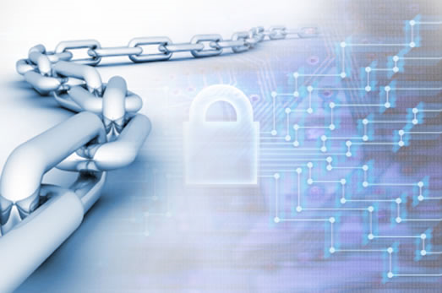
Integrity
Data Has Not Been
Tampered With

Slide 6
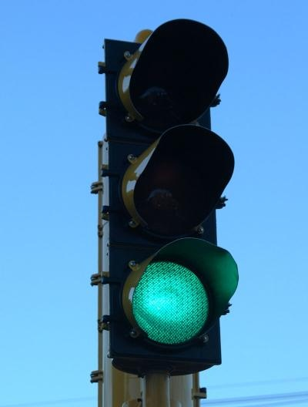
Availability
Data Never Loss Machine Never Fail

Slide 7
Cloud Security !! A major Concern
Security concerns arising because both customer data and program are residing at Provider Premises.
Security is always a major concern in Open System Architectures
Customer Data
Customer
Customer Code
Provider Premises

Slide 8
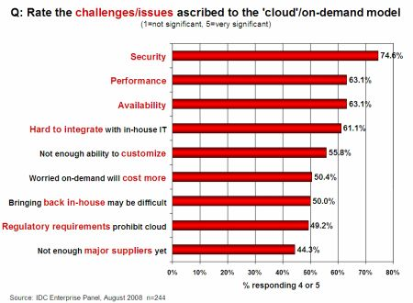
Security Is the Major Challenge

Slide 9
Why Cloud Computing brings new threats?
Traditional system security mostly means keeping bad guys out
The attacker needs to either compromise the auth/access control system, or impersonate existing users

Slide 10
Why Cloud Computing brings new threats?
Cloud Security problems are coming from :
Loss of control
Lack of trust (mechanisms)
Multi-tenancy
These problems exist mainly in 3rd party management models
Self-managed clouds still have security issues, but not related to above

Slide 11
Why Cloud Computing brings new threats?
Consumer’s loss of control
Data, applications, resources are located with provider
User identity management is handled by the cloud
User access control rules, security policies and enforcement are managed by the cloud provider
Consumer relies on provider to ensure
Data security and privacy
Resource availability
Monitoring and repairing of services/resources

Slide 12
Why Cloud Computing brings new threats?
Multi-tenancy :
Multiple independent users share the same physical infrastructure
So, an attacker can legitimately be in the same physical machine as the target

Slide 13
Who is the attacker?
Insider?
Malicious employees at client
Malicious employees at Cloud provider
Cloud provider itself
Outsider?
Intruders
Network attackers?

Slide 14
Attacker Capability: Malicious Insiders
At client
Learn passwords/authentication information
Gain control of the VMs
At cloud provider
Log client communication

Slide 15
Attacker Capability: Cloud Provider
What?
Can read unencrypted data
Can possibly peek into VMs, or make copies of VMs
Can monitor network communication, application patterns

Slide 16
Attacker Capability: Outside attacker
What?
Listen to network traffic (passive)
Insert malicious traffic (active)
Probe cloud structure (active)
Launch DoS

Slide 17
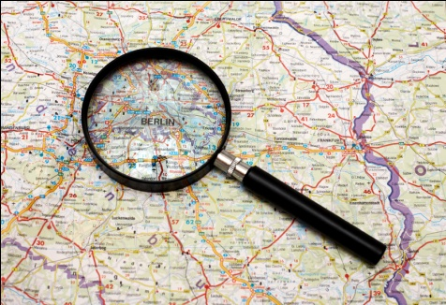
Challenges for the attacker
How to find out where the target is located
How to be co-located with the target in the same (physical) machine
How to gather information about the target

Slide 18
Threats

Slide 19
Organizing the threats using STRIDE
Spoofing identity
Tampering with data
Repudiation
Information disclosure
Denial of service
Elevation of privilege

Slide 20
Concerns
At a Broad level, Two major Questions :
How much secure is the Data?
How much secure is the Code?

Slide 21
Security Issues from Virtualization
Virtualization providers provide
is using- ParaVirtualization or full system virtualization.
Instance Isolation: ensuring that Different instances running on the same physical machine are isolated from each other.
Control of Administrator on Host O/s and Guest o/s.
Current VMs do not offer perfect isolation: Many bugs have been found in all popular VMMs that allow to escape from VM!
Virtual machine monitor should be ‘root secure’, meaning that no level of privilege within the virtualized guest environment permits interference with the host system.

Slide 22
Streamlined Security Analysis Process
Identify Assets
Which assets are we trying to protect?
What properties of these assets must be maintained?
Identify Threats
What attacks can be mounted?
What other threats are there (natural disasters, etc.)?
Identify Countermeasures
How can we counter those attacks?
Appropriate for Organization-Independent Analysis
We have no organizational context or policies

Slide 23
Identify Assets & Principles
Customer Data
Confidentiality, integrity, and availability
Customer Applications
Confidentiality, integrity, and availability
Client Computing Devices
Confidentiality, integrity, and availability

Slide 24
Identify Threats
Failures in Provider Security
Attacks by Other Customers
Availability and Reliability Issues
Legal and Regulatory Issues
Perimeter Security Model Broken
Integrating Provider and Customer Security Systems

Slide 25
Failures in Provider Security
Explanation
Provider controls servers, network, etc.
Customer must trust provider’s security
Failures may violate CIA principles
Countermeasures
Verify and monitor provider’s security
Notes
Outside verification may suffice
For SMB, provider security may exceed customer security

Slide 26
Attacks by Other Customers
Threats
• Provider resources shared with untrusted parties
• CPU, storage, network
• Customer data and applications must be separated
• Failures will violate CIA principles
Countermeasures
• Hypervisors for compute separation
• MPLS, VPNs, VLANs, firewalls for network separation
• Cryptography (strong)
• Application-layer separation (less strong)

Slide 27
Attacks by Other Customers
Threats
Provider resources shared with untrusted parties
CPU, storage, network
Customer data and applications must be separated
Failures will violate CIA principles
Countermeasures
Hypervisors for compute separation
MPLS, VPNs, VLANs, firewalls for network separation
Cryptography (strong)
Application-layer separation (less strong)

Slide 28
Legal and Regulatory Issues
Threats
• Laws and regulations may prevent cloud computing
• Requirements to retain control
• Certification requirements not met by provider
• Geographical limitations – EU Data Privacy
• New locations may trigger new laws and regulations
Countermeasures
• Evaluate legal issues
• Require provider compliance with laws and regulations
• Restrict geography as needed

Slide 29
Perimeter Security Model Broken

Slide 30
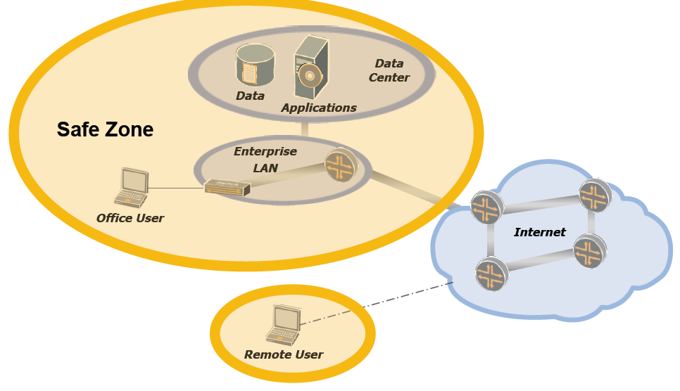
Perimeter Security Model

Slide 31
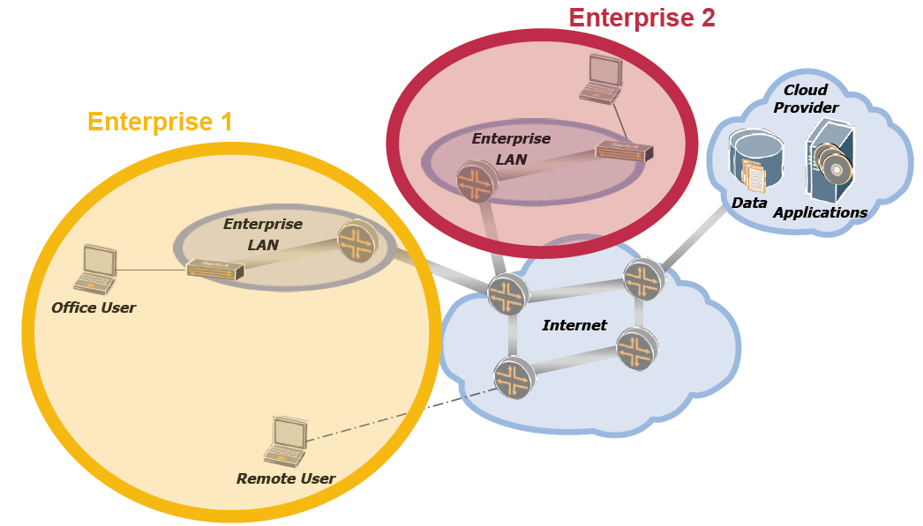
Perimeter Security with Cloud Computing?

Slide 32
Perimeter Security Model Broken
Threats
Including the cloud in your perimeter
Lets attackers inside the perimeter
Prevents mobile users from accessing the cloud directly
Not including the cloud in your perimeter
Essential services aren’t trusted
No access controls on cloud
Countermeasures
Drop the perimeter model!

Slide 33
Integrating Provider and Customer Security
Threat
Disconnected provider and customer security systems
Fired employee retains access to cloud
Misbehavior in cloud not reported to customer
Countermeasures
At least, integrate identity management
Consistent access controls
Better, integrate monitoring and notifications
Notes
Can use SAML, LDAP, RADIUS, XACML, IF-MAP, etc.

Slide 34
What, When, How to Move to the Cloud
Identify the asset(s) for cloud deployment
Data
Applications/Functions/Process
Evaluate the asset
Determine how important the data or function is to the organization

Slide 35
Evaluate the Asset
How would we be harmed if
The asset became widely public & widely distributed?
An employee of our cloud provider accessed the asset?
The process of function were manipulated by an outsider?
The process or function failed to provide expected results?
The info/data was unexpectedly changed?
The asset were unavailable for a period of time?

Slide 36
Map Asset to Models
4 Cloud Models
Public
Private (internal, external)
Community
Hybrid
Which cloud model addresses your security concerns?

Slide 37

Map Data Flow
Map the data flow between your organization, cloud service, customers, other nodes
Essential to understand whether & HOW data can move in/out of the cloud
Sketch it for each of the models
Know your risk tolerance!

Slide 38
Cloud Domains
Service contracts should address these 13 domains
Architectural Framework
Governance, Enterprise Risk Mgt
Legal, e-Discovery
Compliance & Audit
Information Lifecycle Mgt
Portability & Interoperability

Slide 39
Cloud Domains
Security, Business Continuity, Disaster Recovery
Data Center Operations
Incident Response Issues
Application Security
Encryption & Key Mgt
Identity & Access Mgt
Virtualization

Slide 40

Governance
Identify, implement process, controls to maintain effective governance, risk mgt, compliance
Provider security governance should be assessed for sufficiency, maturity, consistency with user ITSEC process

Slide 41
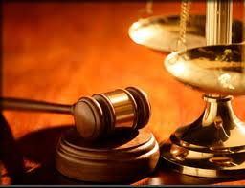
Legal
Functional: which functions & services in the Cloud have legal implications for both parties
Jurisdictional: which governments administer laws and regs impacting services, stakeholders, data assets
Contractual: terms & conditions

Slide 42
Legal
Both parties must understand each other’s roles
Provider must save primary and secondary (logs) data
Where is the data stored?
laws for cross border data flows
Plan for unexpected contract termination and orderly return or secure disposal of assets
You should ensure you retain ownership of your data in its original form

Slide 43

Compliance & Audit
Hard to maintain with your sec/reg requirements, harder to demonstrate to auditors
Right to Audit clause
Analyze compliance scope
Regulatory impact on data security
Evidence requirements are met
Do Provider have SAS 70 Type II, ISO 27001/2 audit statements?

Slide 44
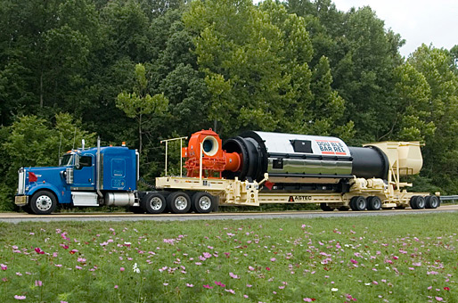
Portability, Interoperability
When you have to switch cloud providers
Contract price increase
Provider bankruptcy
Provider service shutdown
Decrease in service quality
Business dispute

Slide 45
Security, BC, DS
Centralization of data = greater insider threat from within the provider
Require onsite inspections of provider facilities
Disaster recovery, Business continuity, etc

Slide 46
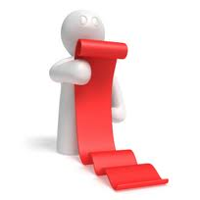
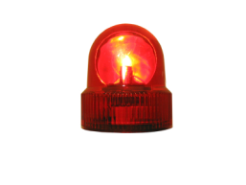
Incident Response
Cloud apps aren’t always designed with data integrity, security in mind
Provider keep app, firewall, IDS logs?
Provider deliver snapshots of your virtual environment?
Sensitive data must be encrypted for data breach regs

Slide 47
Application Security
Different trust boundaries for IaaS, PaaS, Saas
Provider web application security?
Secure inter-host communication channel

Slide 48
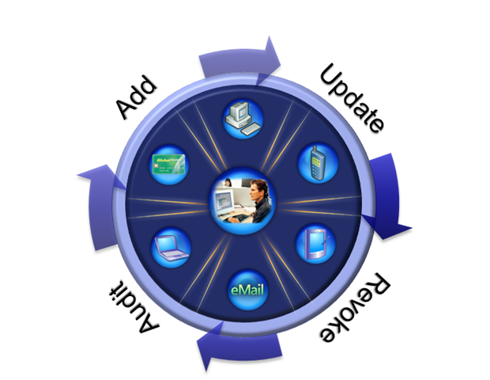
Identity and Access Mgt
Determine how provider handles:
Provisioning, deprovisioning
Authentication
Federation
Authorization, user profile mgt

Slide 49
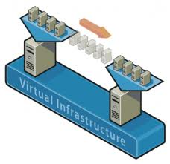
Virtualization
What type of virtualization is used by the provider?
What 3rd party security technology augments the virtual OS?
Which controls protect admin interfaces exposed to users?

Slide 50
Possible Solutions
Minimize Lack of Trust
Policy Language
Certification
Minimize Loss of Control
Monitoring
Utilizing different clouds
Access control management
Identity Management (IDM)
Minimize Multi-tenancy

Slide 51
Possible Solutions
Loss of Control
Take back control
Data and apps may still need to be on the cloud
But can they be managed in some way by the consumer?
Lack of trust
Increase trust (mechanisms)
Technology
Policy, regulation
Contracts (incentives): topic of a future talk
Multi-tenancy
Private cloud
Takes away the reasons to use a cloud in the first place
Strong separation

Slide 52
Bottom Line on Cloud Computing Security
Engage in full risk management process for each case
For small and medium organizations
Cloud security may be a big improvement!
Cost savings may be large (economies of scale)
For large organizations
Already have large, secure data centers
Main sweet spots:
Elastic services
Internet-facing services
Employ countermeasures listed above

Slide 53

Thank You

Slide 54
References
Introduction to Cloud Computing , Prof. Yeh-Ching Chung, http://cs5421.sslab.cs.nthu.edu.tw/home/Materials/Lecture2-IntroductiontoCloudComputing.pdf?attredirects=0&d=1
NIST (National Institute of Standards and Technology). http://csrc.nist.gov/groups/SNS/cloud-computing/
M. Armbrust et. al., “Above the Clouds: A Berkeley View of Cloud Computing,” Technical Report No. UCB/EECS-2009-28, University of California at Berkeley, 2009.
R. Buyya et. al., “Cloud computing and emerging IT platforms: Vision, hype, and reality for delivering computing as the 5th utility,” Future Generation Computer Systems, 2009.
Cloud Computing Use Cases. http://groups.google.com/group/cloud-computing-use-cases
Cloud Computing Explained. http://www.andyharjanto.com/2009/11/wanted-cloud-computing-explained-in.html
From Wikipedia, the free encyclopedia
All resources of the materials and pictures were partially retrieved from the Internet.
All material from “Security Guidance for Critical Areas of Focus in Cloud Computing v2.1”, http://www.cloudsecurityalliance.org
All figures in this talk taken from this paper
Various cloud working groups
Open Cloud Computing Interface Working Group, Amazon EC2 API, Sun Open Cloud API, Rackspace API, GoGrid API, DMTF Open Virtualization Format (OVF)
Cloud Computing Security Issues, Randy Marchany, VA Tech IT Security, marchany@vt.edu
Research in Cloud Security and Privacy, www.cs.purdue.edu/homes/bb/cloud/cloud-complete.ppt
Introduction to Security and Privacy in Cloud Computing, Introduction to Security and Privacy in Cloud Computing. Spring 2010 course at the Johns Hopkins University. By Ragib Hassan

