Slide 1

Main Project Seminar
On
Fake News Detection using different Machine Learning models

Slide 2

Gayatri Vidya Parishad College of Engineering
(Autonomous)
Madhurawada,Visakhapatnam-530 048
Under the esteemed guidance of
S. Kanthi Kiran
Associate Professor
Department of Information Technology
Project Team Members
K. Anusha 17131A1251
B. Kamal 17131A1217
A. Amruth 17131A1210
K. Aditya Pavan 17131A1255

Slide 3
CONTENTS
ABSTRACT
INTRODUCTION
Purpose
EXISTING SYSTEM
PROPOSED SYSTEM
REQUIREMENTS SPECIFICATION
SYSTEM ARCHITECTURE
ALGORITHMS
IMPLEMENTATION
UML DIAGRAM
DETERMINING OUTPUT
OUTPUT SCREENS
CONCLUSION
REFERENCES

Slide 4
ABSTRACT
Social media interaction especially the news spreading around the network is a great source of information now-a-days.
Twitter being a standout amongst the most well-known ongoing news sources additionally ends up a standout amongst the most dominant news radiating mediums.
Fake News have great impact on business and commerce.

Slide 5
INTRODUCTION
Fake news detection can be done by using binary classification algorithms.
To solve this as a binary classification problem, we investigate the effectiveness of different Natural Language Processing models which are used to convert character-based texts into numeric representations such as TFIDF, CountVectorizer and N-Gram models.
We use four fine tuning algorithms(Logistic Regression, Support Vector Machine, Random Forest Classifier, Naive bayes classifier) and find out which model can preserve most of the contextual information about the text used in a fake news data set and how helpful and effective it is in detecting whether the text is a fake news or not.

Slide 6
Purpose
To implement an efficient tool for analysis of fake news system which can use supervised and semi supervised learning system for better accuracy of results
The goal of this project is to find the effectiveness and limitations of language-based techniques for detection of fake news using machine learning algorithms.
The outcome of this project should determine how much can be achieved in this task by analyzing patterns contained in the text and blind to outside information about the world.

Slide 7
Existing System
Several features have been proposed and evaluated in view of the impact of features on the accuracy of the classifier.
In the existing work, the system uses only to semi-supervised learning. Only Text Classification as sentiment text and it never finds fake news.

Slide 8
Disadvantages :
In the existing work, the system uses only to semi-supervised learning.
Only Text Classification as sentiment text and it never finds fake news.

Slide 9
Proposed System
To overcome the drawbacks of the existing algorithms, the proposed algorithm has been evolved.
Our algorithm primarily focuses on classifying news into real and fake efficiently with high accuracy by using NLP models.

Slide 10
Advantages:
The system is very fast and effective due to semi-supervised and supervised learning.
Focused on the content of the news based approaches. As feature we have used count vector ,TF-IDF and N-vector.

Slide 11
SYSTEM REQUIREMENTS
Software Requirements:
Operating system : - Windows 10
Language : - Python 3
Hardware Requirements:
System : Intel i5
Hard Disk : 1 TB
RAM : 8 GB

Slide 12
Functional Requirements:
A functional requirement define a function of a system or it’s component and are expressed in the form “system must do” . It depends upon the type of software, expected users and the type of system where the software is used.
The plan for implementing functional requirements is detailed in the system design.
The functional requirements in our Project are:
Extract news from dataset
Applying NLP models on to the dataset
Calculation of accuracy for each model.

Slide 13
Non-Functional Requirements:
Performance: News has to be classified as fake or real with high accuracy.
Functionality: This software will deliver on the functional requirements mentioned in this document.
Availability: This software will retrieve data or text from the dataset available.
Recognition Ability: The software is very easy to use and recognizes the characters.
Reliability: This software will work reliably for any type of English text.

Slide 14
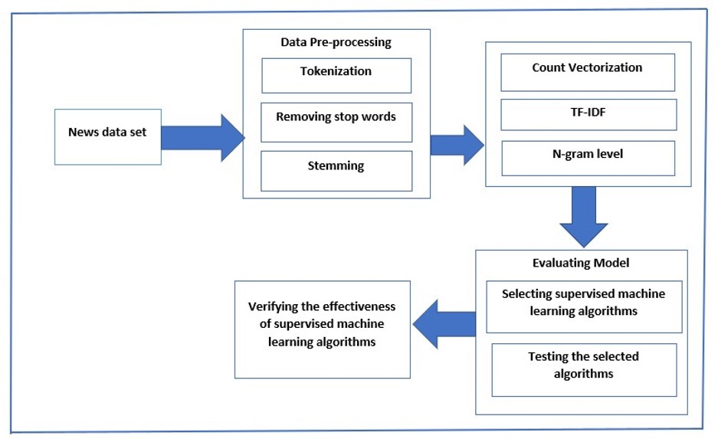
System Architecture

Slide 15
Algorithms Used
Support Vector Machine
Logistic Regression
Naive Bayes
Random Forest

Slide 16
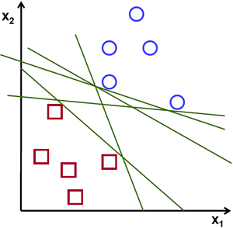
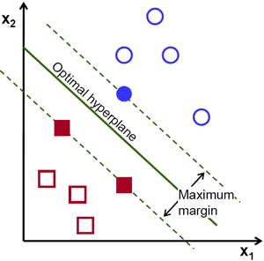
Support Vector Machine
Support Vector Machine (SVM) is a supervised machine learning algorithm in which a hyperplane is created in order to separate and categorize features.
The optimal hyperplane is usually calculated by creating support vectors on both sides of the hyperplane in which each vector must maximize the distance between each other.
In other words, the larger the distance between each vector around the hyperplane, the more accurate the decision boundary will be between the categories of features.

Slide 17
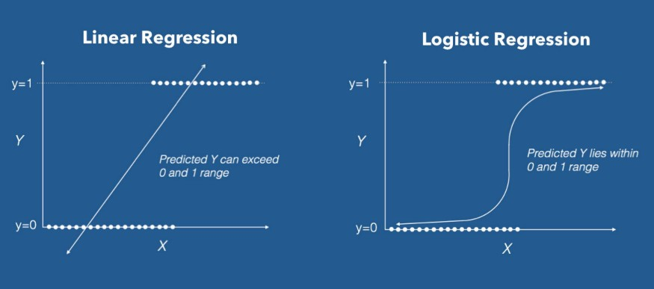
Logistic Regression
Logistic regression is a classification algorithm used to assign observations to a discrete set of classes. Unlike linear regression which outputs continuous number values, logistic regression transforms its output using the logistic function to return a probability value.
It is a supervised learning classification algorithm used to predict the probability of a target variable.

Slide 18
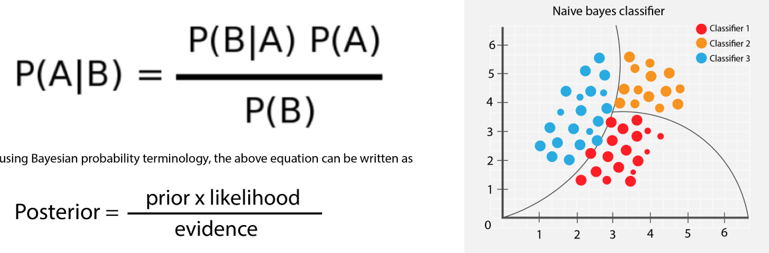
Naive Bayes
Naive Bayes Classifier is one of the simple and most effective Classification algorithms which helps in building the fast machine learning models that can make quick predictions.
Some popular examples of Naïve Bayes Algorithm are spam filtration, Sentimental analysis, and classifying articles.

Slide 19
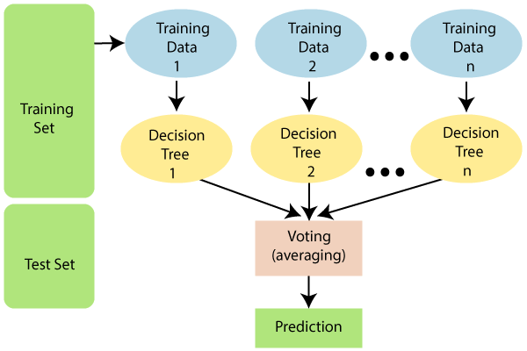
Random Forest
A Random Forest is an ensemble technique capable of performing both regression and classification tasks with the use of multiple decision trees.
The basic idea behind this is to combine multiple decision trees in determining the final output rather than relying on individual decision trees.

Slide 20
Implementation
Count Vector - Count Vector represents a notation in the form of a matrix data set matrix notation in which corpus document is represented by each row, each column represents a corpus term, and each cell represents the frequency count of a particular term in a particular document.
TF-IDF - In information retrieval, tf–idf is short for term frequency–inverse document frequency, is a numerical statistic that is intended to reflect how important a word is to a document in a collection or corpus.
tf(t,d) = count of t in d / number of words in d
idf(t) = log(N/(df + 1))
tf-idf(t, d) = tf(t, d) * log(N/(df + 1))
N- Gram- It is a sequence of tokens. In the context of computational linguistics, these tokens are usually words, though they can be characters or subsets of characters. The n simply refers to the number of tokens.

Slide 21
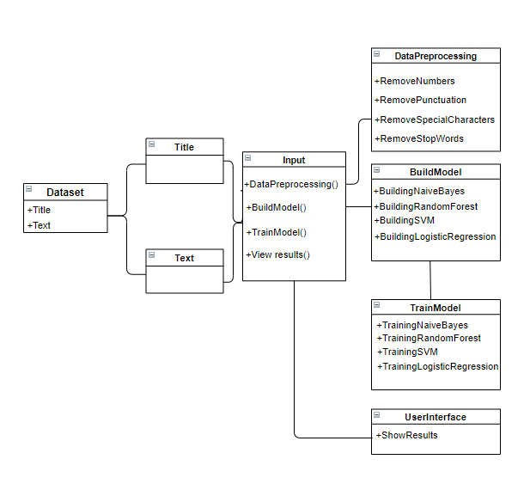
UML Diagram

Slide 22
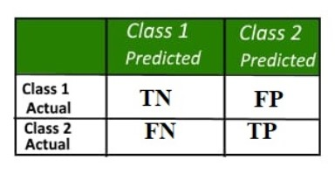
Determining output
Confusion Matrix: A confusion matrix is a table that is often used to describe the performance of a classification model (or “classifier”) on a set of test data for which the true values are known. It allows the visualization of the performance of an algorithm.

Slide 23
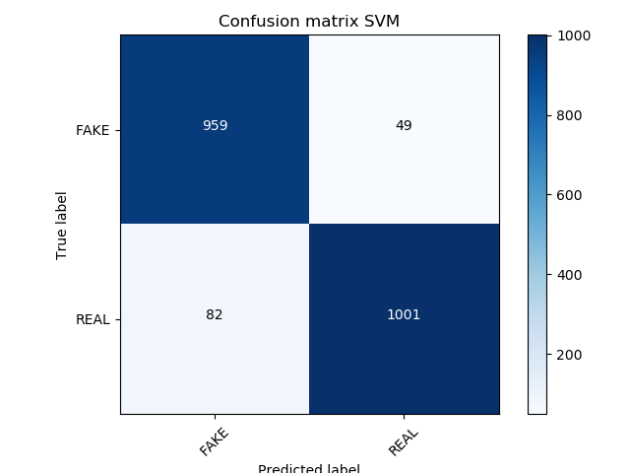
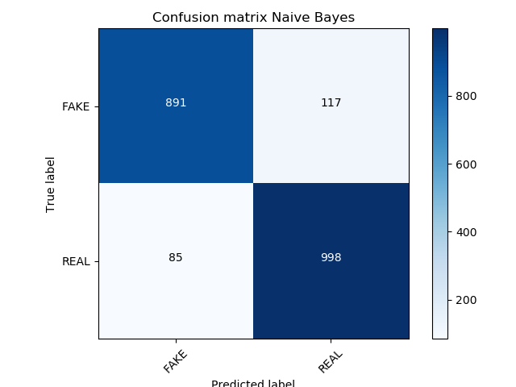

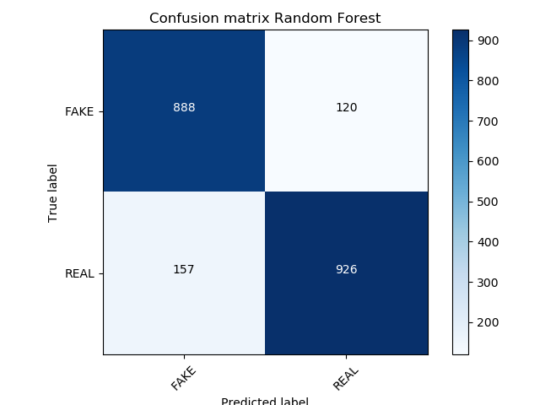
Confusion matrix of algorithms

Slide 24
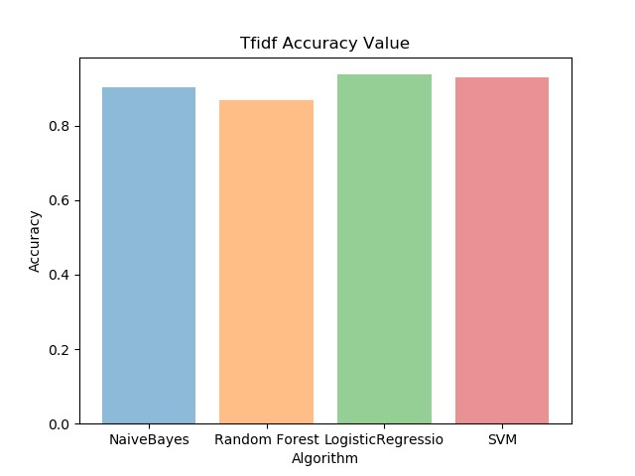
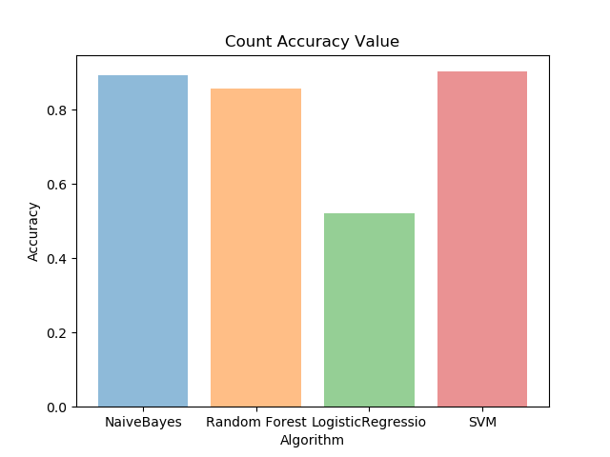
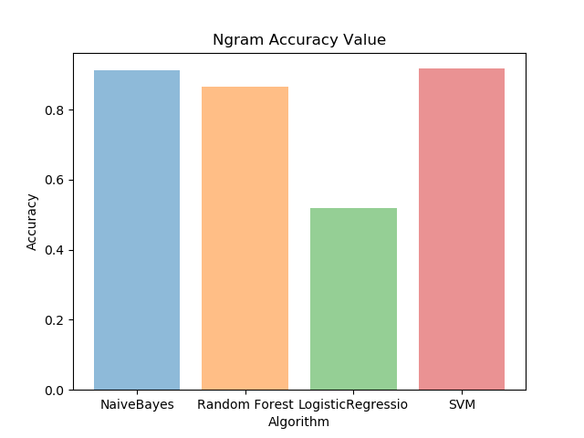
Comparing Accuracy

Slide 25
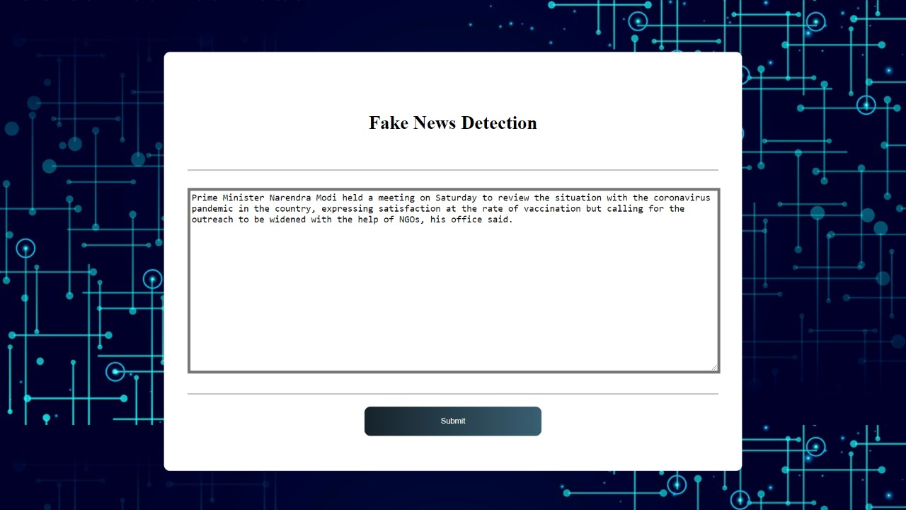
Output Screens

Slide 26
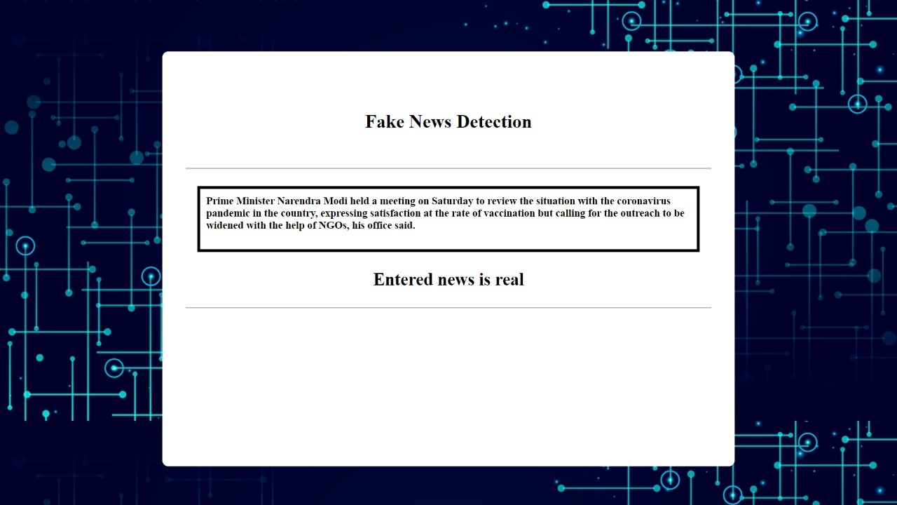

Slide 27
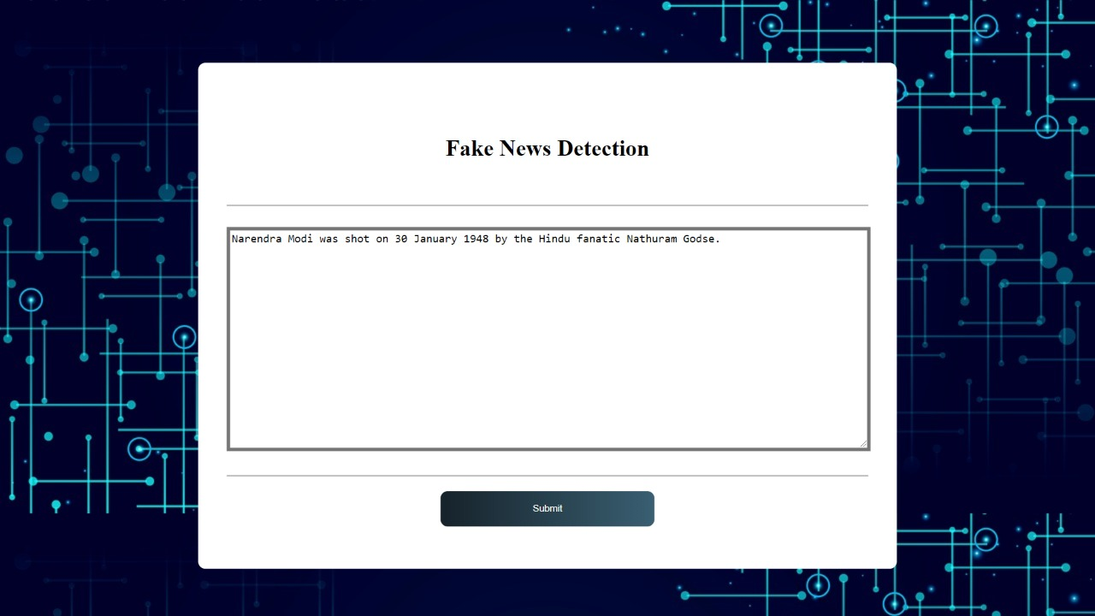

Slide 28
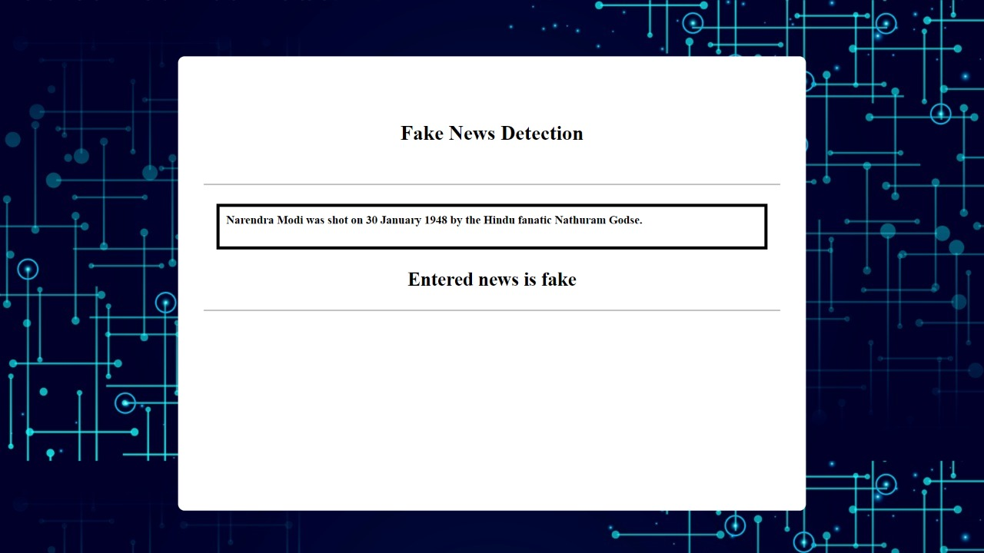

Slide 29
Conclusion
We analyzed a computerized model for checking the verification of news in media i.e., real news or fake news.
Machine Learning may find a decent outcome on such a critical issue as the spread of fake news issues worldwide. Accordingly, the aftereffects of this examination propose much more, that systems like this might come very much handy and be effectively used to handle this critical issue.
The dataset in this analysis is relied upon machine learning based statistical calculations like Support Vector Machines (SVM), Naive Bayes (NB), Logistic Regression (LR), Random Forest (RF). In this analysis , Logistic Regression performs best for characterization technique.

Slide 30
REFERENCES
Conroy, Niall & Rubin, Victoria & Chen, Yimin. (2015). Automatic Deception Detection: Methods for Finding Fake News. USA
Ball, L. & Elworthy, J. J Market Anal (2014) 2: 187. https://doi.org/10.1057/jma.2014.15
Lu TC. Yu T., Chen SH. (2018) Information Manipulation and Web Credibility. In: Bucciarelli E., Chen SH., Corchado J. (eds) Decision Economics: In the Tradition of Herbert A. Simon's Heritage. DCAI 2017. Advances in Intelligent Systems and Computing, vol 618. Springer, Cham
Rubin, Victoria & Conroy, Niall & Chen, Yimin & Cornwell, Sarah. (2016). Fake News or Truth? Using Satirical Cues to Detect Potentially Misleading News.10.18653/v1/W160802.
Kaggle Dataset : https://www.kaggle.com/nopdev/real-and-fake-news-dataset

Slide 31
Thank You

