Slide 1
Main Project Seminar
On
Fake News Detection using different Machine Learning models

Slide 2

Gayatri Vidya Parishad College of Engineering
(Autonomous)
Madhurawada,Visakhapatnam-530 048
Under the esteemed guidance of
S. Kanthi Kiran
Associate Professor
Department of Information Technology
Project Team Members
K. Anusha 17131A1251
B. Kamal 17131A1217
A. Amruth 17131A1210
K. Aditya Pavan 17131A1255

Slide 3
Contents
Abstract
Introduction
Existing System
Proposed System
Requirement Specification
Functional Requirements
Non-Functional Requirements
Software Requirements
Hardware Requirements
Algorithms used
Pre-Training Algorithms
Fine Tuning Algorithms
Flow Chart
UML Diagram
Modules
Status

Slide 4
Abstract
Many news sources contain false information and are therefore “fake news”.
Because there is a lot of “fake news” articles and fabricated, misleading information on the web, we would like to determine which texts are legitimate (real) and which are illegitimate (fake).

Slide 5
Introduction
Fake news detection can be done by using binary classification algorithms.
To solve this as a binary classification problem, we investigate the effectiveness of different Natural Language Processing models which are used to convert character based texts into numeric representations such as TFIDF, CountVectorizer and Word2Vec models.
We use five fine tuning algorithms(ANNs, LSTMs, Logistic Regression, Support Vector Machine, Random Forest Classifier) and find out which model is able to preserve most of the contextual information about the text used in a fake news data set and how helpful and effective it is in detecting whether the text is a fake news or not.

Slide 6
Existing System
Sentiment Analysis is an existing system for Fake news detection.
For classifying there are several existing algorithms like RNN(Recurrent Neural Network) ,Decision Trees, SVM(Support Vector Machines) etc. But they lack the accuracy and performance to be completely reliable.
Drawbacks
Low Accuracy.
Low Reliability.
Less Robust.
Less Adaptability.

Slide 7
Proposed System
To overcome the drawbacks of the existing algorithms, the proposed algorithm has been evolved.
Our algorithm primarily focuses on classifying news into real and fake efficiently with high accuracy by using NLP models.
Advantages
High accuracy compared to existing algorithms.
It is highly reliable.
Works on huge amount of data.
Not restricted to a single scan knowledge extraction

Slide 8
Functional Requirements
A functional requirement define a function of a system or it’s component and are expressed in the form “system must do” . It depends upon the type of software, expected users and the type of system where the software is used.
The plan for implementing functional requirements is detailed in the system design.
The functional requirements in our Project are:
Extract news from dataset
Applying NLP models on to the dataset
Calculation of accuracy for each model.

Slide 9
Non-Functional Requirements
Performance: News has to be classified as fake or real with high accuracy.
Functionality: This software will deliver on the functional requirements mentioned in this document.
Availability: This software will retrieve data or text from the dataset available.
Recognition Ability: The software is very easy to use and recognizes the characters from the image.
Reliability: This software will work reliably for any type of character images.

Slide 10
Software Requirements
Operating system: Windows, Mac, Linux
Programming language: Python
Anaconda IDE(Integrated Development Environment)
Python 3.6
Packages :
pandas 0.21.0
numpy 1.16.2
tensorflow 1.13.1
keras 2.1.2
sklearn 0.0

Slide 11
Hardware Requirements
Processor: Intel/ARM processor
RAM:8GB
Disk space: 1 TB

Slide 12
Algorithms used
CountVectorizer
TF-IDF
Word2Vec
ANNs
LSTMs
Logistic Regression
Support Vector Machine
Random Forest Classifier

Slide 13
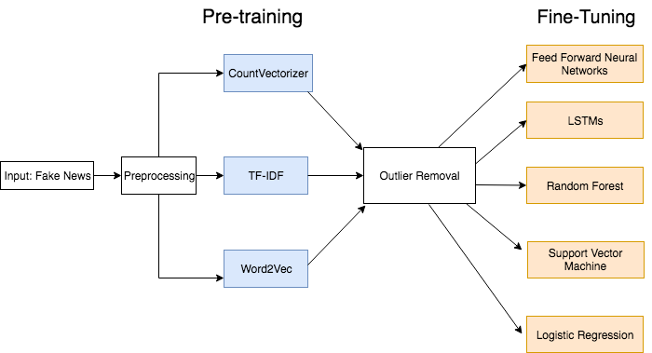
Unsupervised Pre-training to encode our texts into numeric representations

Slide 14
Pre Training Algorithms
CountVectorizer
TF-IDF
Word2Vec

Slide 15
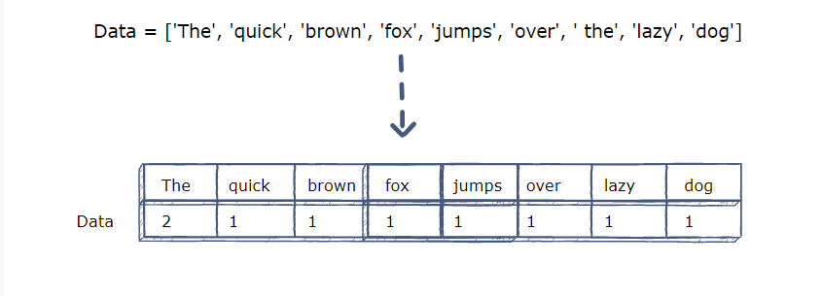
CountVectorizer
It is used to transform a given text into a vector on the basis of the frequency (count) of each word that occurs in the entire text.

Slide 16
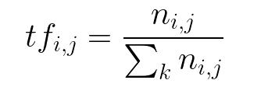
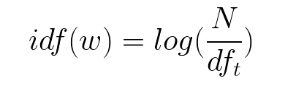
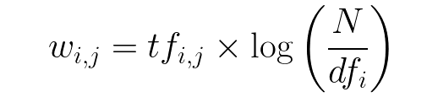
TF-IDF Vectorizer
TF-IDF stands for Term Frequency Inverse Document Frequency of records.
It can be defined as the calculation of how relevant a word in a series or corpus is to a text.
It is used to transform text into a meaningful representation of numbers which is used to fit machine algorithm for prediction.
Term Frequency : Inverse Document Frequency:
TF-IDF score:

Slide 17
Example for TF-IDF
Sentence 1 : earth is the third planet from the sun
Sentence 2: Jupiter is the largest planet
Word | TF (Sentence1) | TF (Sentence2) | IDF | TF*IDF (Sentence1) | TF*IDF (Sentence2)
Earth | 1/8 | 0 | log(2/1)=0.3 | 0 | 0
is | 1/8 | 1/5 | log(2/2)=0 | 0 | 0
the | 2/8 | 1/5 | log(2/2)=0 | 0 | 0
third | 1/8 | 0 | log(2/1)=0.3 | 0.0375 | 0
planet | 1/8 | 1/5 | log(2/2)=0 | 0 | 0
from | 0 | 0 | log(2/1)=0.3 | 0 | 0
sun | 1/8 | 0 | log(2/1)=0.3 | 0.0375 | 0
largest | 0 | 1/5 | log(2/1)=0.3 | 0 | 0.06
Jupiter | 0 | 1/5 | log(2/1)=0.3 | 0 | 0.06

Slide 18
Word2Vec
Word2Vec is another state-of-the-art model used to represent words into vectors.
Word2Vec is a simple neural network which basically tries to predict the next word within a context given a set of words provided.
Word2Vec basically represents a vector for each word within the context and the vector representation is the weights of the particular connection from the input layer node into one of the hidden layer neurons.

Slide 19
Fine Tuning Algorithms
Feed Forward Neural Networks
Long Short Term Memory networks (LSTMs)
Random Forest
Logistic Regression
Support Vector Machine (SVM)

Slide 20
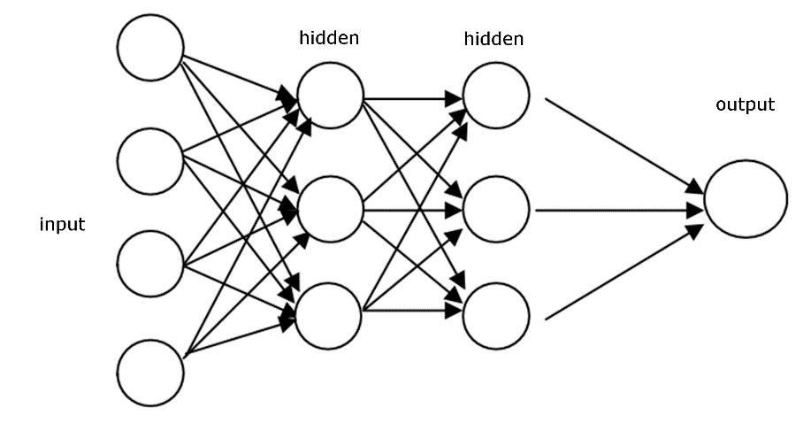
Feed Forward Neural Networks
Artificial Neural Networks, which contains an input layer, particular number of output layers (specified by a hyperparameter) in which each hidden layer contains the same number of neurons and the same activation function, and an output layer with just one node for the classification (real or fake) which uses sigmoid as an activation function.

Slide 21
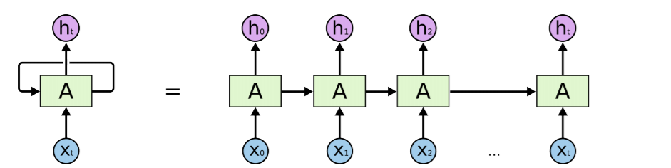
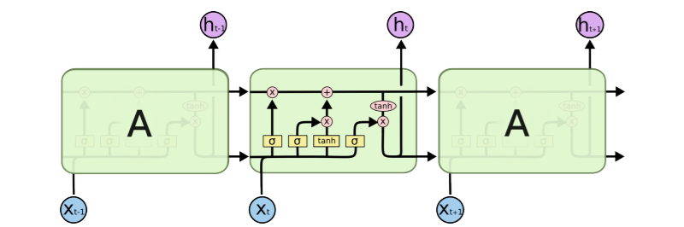
Long Short Term Memory networks (LSTMs)
Long Short-Term Memory is an advanced version of recurrent neural network (RNN) architecture that was designed to model chronological sequences and their long-range dependencies more precisely than conventional RNNs.

Slide 22
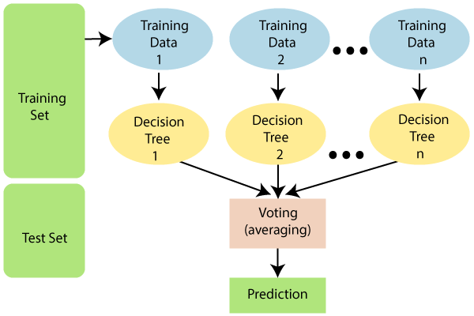
Random Forest
A Random Forest is an ensemble technique capable of performing both regression and classification tasks with the use of multiple decision trees.
The basic idea behind this is to combine multiple decision trees in determining the final output rather than relying on individual decision trees.

Slide 23
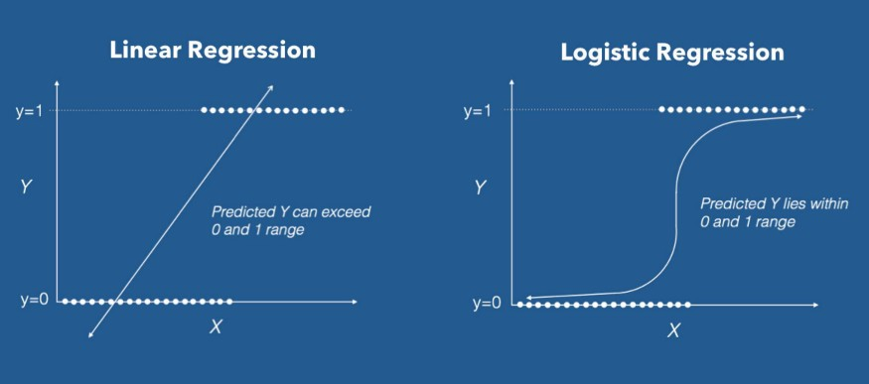
Logistic regression
Logistic regression is a classification algorithm. It is used to predict a binary outcome based on a set of independent variables.

Slide 24
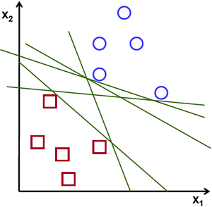
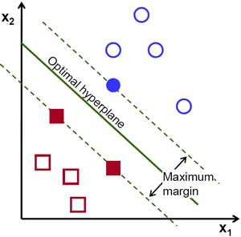
Support Vector Machine
Support Vector Machine (SVM) is a supervised machine learning algorithm in which a hyperplane is created in order to separate and categorize features.
The optimal hyperplane is usually calculated by creating support vectors on both sides of the hyperplane in which each vector must maximize the distance between each other.
In other words, the larger the distance between each vector around the hyperplane, the more accurate the decision boundary will be between the categories of features.

Slide 25
Flow Chart
Start
Extract text
Data cleaning
Classification of text
Results will be displayed
Stop

Slide 26
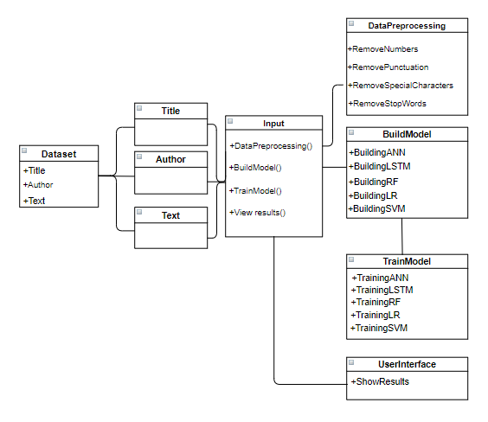
UML Diagram

Slide 27
Modules
The Dataset
Data Pre-processing
Pre-training
Outlier Removal
Fine-tuning
Results

Slide 28
Status
Data Collection - 100%
Model Building - 25%
User Interface - 0%

Slide 29
Thank You

