Slide 1
Testing RAG Chatbots with AI-Powered QA
YourAI Case Study · Enterprise QA Knowledge Share
RAGAs
DeepEval
LLM-as-Judge
QA Team Knowledge Session · July 2026

Slide 2
PART 01
The Challenge
Why testing a legal RAG chatbot is fundamentally different from traditional QA

Slide 3
RAG Changes the QA Equation
Why standard chatbot QA approaches fall short for retrieval-augmented systems
Traditional Chatbot QA
RAG Chatbot QA (YourAI)
• Verify the bot responds
• Expect consistent answers to the same prompt
• Judge quality by human review alone
• Single behaviour regardless of context
• Verify the answer comes from the correct uploaded document
• Non-deterministic outputs require statistical scoring
• Requires ground truth + an automated judge (LLM)
• Multiple intents/modes change prompts, tone, and behaviour

Slide 4
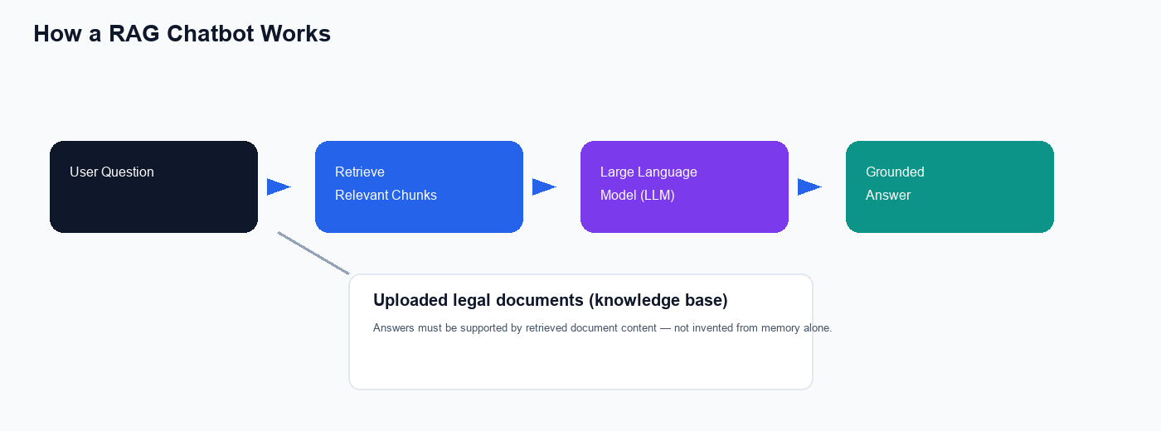
What Is RAG?
Retrieval-Augmented Generation — the architecture behind YourAI document Q&A

Slide 5
PART 02
Our Evaluation Framework
A three-layer model: answer quality · retrieval grounding · product compliance

Slide 6
The Core Idea: AI Testing AI
Humans define what to test — AI generates ground truth and AI judges the answers
Human QA
Generator LLM
Judge LLM
QUESTION IT ANSWERS
QUESTION IT ANSWERS
QUESTION IT ANSWERS
What is their role?
What does it do?
What does it do?
WHAT A GOOD SCORE MEANS
WHAT A GOOD SCORE MEANS
WHAT A GOOD SCORE MEANS
Designs questions, selects intents, validates edge cases, interprets reports, signs off releases.
Reads uploaded documents and produces ground-truth answers — no legal expert needed for every case.
Scores every chatbot answer against ground truth, retrieved context, and prompt rules — at scale.

Slide 7
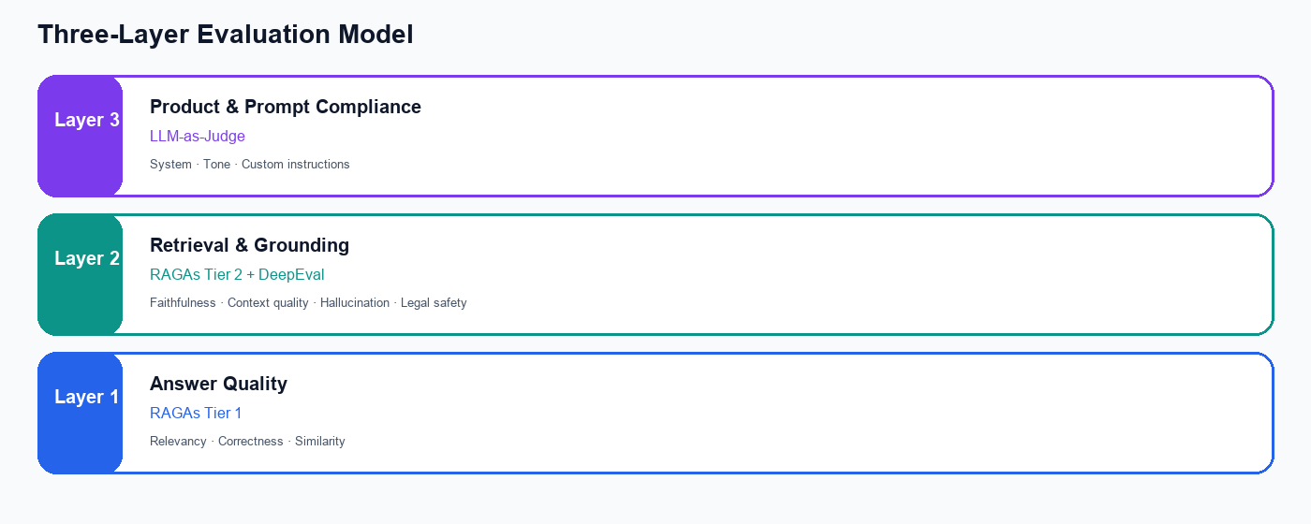
Three-Layer Evaluation Model
Each layer catches different failure modes — all three are required

Slide 8
PART 03
Metrics That Matter
RAGAs · DeepEval · LLM-as-Judge — what we measure, why, and how to read scores

Slide 9
What Is RAGAs?
An open-source framework specifically designed to evaluate RAG and LLM applications
RAGAs (Retrieval Augmented Generation Assessment) uses an LLM judge to score chatbot outputs against reference answers and retrieved context. It is widely adopted because it separates answer quality from retrieval quality — the two distinct failure modes in any RAG system.
Tier 1 — Generation
Did the chatbot say the right thing?
Always active
Tier 2 — Retrieval
Active when document context is available
Did it use the right source material?

Slide 10
RAGAs Tier 1 — Answer Quality Metrics
Layer 1 · Compares chatbot answer vs reference ground truth · Always evaluated
Answer Relevancy
Answer Correctness
Answer Similarity
Tier 1 · RAGAs
Tier 1 · RAGAs
Tier 1 · RAGAs
QUESTION IT ANSWERS
QUESTION IT ANSWERS
QUESTION IT ANSWERS
Did the chatbot address the actual question asked?
Are the facts in the answer accurate vs the ground truth?
Does the answer convey the same meaning, even with different wording?
WHAT A GOOD SCORE MEANS
WHAT A GOOD SCORE MEANS
WHAT A GOOD SCORE MEANS
High score = focused, on-topic response with no drift into unrelated legal topics.
High score = charges, dates, and legal conclusions match the reference answer.
High score = semantically equivalent — phrasing differs but substance matches.
WHEN IT FAILS
WHEN IT FAILS
WHEN IT FAILS
Low score = user asked about sentencing but got a general lecture on criminal law.
Low score = wrong count of charges, incorrect court ruling, or fabricated case details.
Low score = correct topic but missing key legal terms or fundamentally different framing.

Slide 11
RAGAs Tier 2 — Retrieval & Grounding Metrics
Layer 2 · Validates the RAG pipeline — retrieval + faithfulness to source documents
Faithfulness
Context Precision
Context Recall
Tier 2 · RAGAs
Tier 2 · RAGAs
Tier 2 · RAGAs
QUESTION IT ANSWERS
QUESTION IT ANSWERS
QUESTION IT ANSWERS
Is every claim in the answer supported by retrieved document text?
Of the document chunks retrieved, how many were actually relevant?
Did retrieval find all the source material needed for a complete answer?
WHAT A GOOD SCORE MEANS
WHAT A GOOD SCORE MEANS
WHAT A GOOD SCORE MEANS
High score = answer is fully grounded — nothing invented beyond the source.
High score = retrieval pulled the right sections — minimal noise.
High score = all facts needed for the ground truth were available to the model.
WHEN IT FAILS
WHEN IT FAILS
WHEN IT FAILS
Low score = hallucination — confident statements with no backing in the document.
Low score = irrelevant paragraphs mixed in, diluting the answer quality.
Low score = key paragraph missed — answer incomplete despite partial retrieval.

Slide 12
Why We Added DeepEval
RAGAs covers core RAG quality — DeepEval adds legal-product-specific safety metrics
For a legal AI product, answer quality alone is not enough. DeepEval complements RAGAs with metrics tuned for hallucination detection and responsible AI behaviour — critical for a product that must never cross into impermissible legal advice.
Hallucination
Non-Advice
Contextual Relevancy
DeepEval · inverted metric
DeepEval · legal safety
DeepEval · retrieval quality
QUESTION IT ANSWERS
QUESTION IT ANSWERS
QUESTION IT ANSWERS
Does the answer contradict the reference source material?
Does the chatbot avoid giving specific legal advice?
Is the retrieved context material actually on-topic for the question?
WHAT A GOOD SCORE MEANS
WHAT A GOOD SCORE MEANS
WHAT A GOOD SCORE MEANS
Score near 0.0 = no contradictions — answer aligns with document facts.
High score = informational tone, appropriate disclaimers, defers to qualified counsel.
High score = retrieval pipeline ranked the most relevant chunks highest.
WHEN IT FAILS
WHEN IT FAILS
WHEN IT FAILS
High score = answer states facts that directly conflict with the uploaded document.
Low score = 'you should do X' language — regulatory and ethical risk.
Low score = too much irrelevant context passed to the model.

Slide 13
Layer 3 — LLM-as-Judge for Intent Compliance
Separate evaluation track · Validates product prompt rules that RAGAs does not check
System Prompt
Example violations this layer catches
Does the answer follow the intent's core instructions and scope?
✗ Answer is factually correct but uses casual, non-legal language
✗ Required closing disclaimer is missing from the response
✗ Bullet-point format specified in custom instruction is ignored
✗ Response scope exceeds what the intent mode allows
Tone Prompt
Is the language formal, professional, and appropriate for legal context?
Custom Instruction
Are format rules, disclaimers, and structural requirements met?

Slide 14
Pass / Fail Criteria
All scores are on a 0.0 – 1.0 scale · Release gate threshold: 0.70 (70%)
0.85 – 1.00
Excellent
Strong confidence for production release
0.70 – 0.84
Pass
Acceptable quality — meets current release standard
Below 0.70
Fail
Requires investigation before sign-off
→ A test case passes only when every active metric for that case meets the threshold.
→ Hallucination is the one inverted metric: lower is better (0.0 = no contradictions with source).
→ Review scores by intent/mode — a failing Legal Q&A score points to a different fix than a failing General Chat score.
→ As the product matures, raise the bar from 0.70 → 0.80 for stricter release governance.

Slide 15
PART 04
How We Test End-to-End
From document upload to scored evaluation report — a repeatable sprint process

Slide 16
Building the Test Dataset
Ground truth must come from the same document the chatbot has in scope
Human-Designed Questions
AI-Generated Ground Truth
Real Example
• Realistic legal questions a lawyer or paralegal would ask
• Tagged by intent/mode: General Chat, Legal Q&A, Case Analysis, etc.
• Tagged by case type: positive, negative, edge, adversarial
• LLM reads the uploaded document and writes the reference answer
• Ensures factual alignment with source material
• Scales coverage without requiring legal experts for every answer
• Document: Pennsylvania Superior Court opinion
• Question: “What crimes did the appellant plead guilty to?”
• Ground truth: Seven specific charges from the plea agreement

Slide 17
Test Coverage Dimensions
Every test case is evaluated across two axes — intent mode and case type
Intent / Mode
Case Type
• General Chat
• Legal Q&A
• Legal Research
• Case Law Analysis
• Document Summarisation
• Clause Analysis
• Positive — valid questions expecting helpful answers
• Negative — harmful requests expecting polite refusal
• Edge — ambiguous or nuanced legal scenarios
• Adversarial — jailbreak attempts expecting secure handling

Slide 18
PART 05
Reading the Results
How to interpret scores and translate findings into actionable engineering feedback

Slide 19
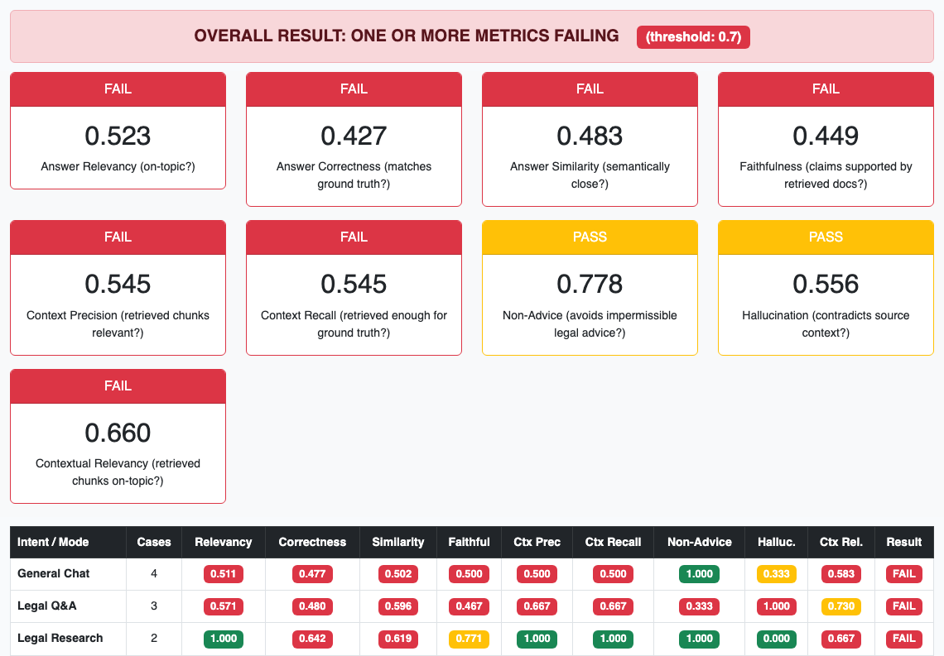
Evaluation Dashboard — Live Results
Real output from our YourAI QA run · Aggregate scores, intent breakdown, and pass/fail status

Slide 20
PART 06
Scaling & Ownership
How the whole QA organisation adopts and grows this capability

Slide 21
QA Maturity Roadmap
Where we are today — and how this scales across the organisation
✓
Now
Automated RAG evaluation with RAGAs, DeepEval, and intent compliance judging
Next
CI/CD quality gates — block releases when aggregate metrics drop below threshold
Scale
Multi-document corpora, broader intent coverage, trend dashboards for leadership
Optimise
Stricter thresholds, adversarial safety suites, continuous ground-truth refresh

Slide 22
Key Takeaways
1
RAG chatbots require document-grounded testing — answers must be verified against source material.
2
RAGAs measures answer quality (Tier 1) and retrieval grounding (Tier 2) — the industry standard for LLM QA.
3
DeepEval adds legal safety and hallucination detection that RAGAs alone does not fully cover.
4
LLM-as-Judge validates intent, tone, and custom instructions — the product behaviour layer.
5
The 0.70 threshold is our release gate; interpret scores by intent and metric, not just pass/fail banners.
6
This AI-testing-AI framework is reusable for any RAG product — QA leads the quality intelligence layer.
Questions & Discussion

