Slide 1
Cargill case study
Kamaldeep Singh

Slide 2
Agenda
- Introduction
- Data + Exploratory Data Analysis(EDA)
- Modelling - Problem Formulation and feature engineering
- Modelling details - performance etc.
- Modelling and Results including interaction effect of feature values on target
- Future Work

Slide 3
Introduction

Slide 4
Client and the problem statement
Our client is a company that wants to build a more personalized pricing policies for its customer and for this they have contacted us to build a pricing model.
Model Goal - "Build a model to predict prices for customers"
Target variable- contract_value

Slide 5
Evaluation criteria
Understand for which customers we can ask for higher or lower prices respectively
Models with identification of features are most associated with higher/lower price
1. Clean and readable code
We try and follow coding principles like DNR and PEP-8 coding guidelines as much as possible.
2. R2 score, RMSE
3. Model choices and explanation with Model Explainability through SHAP

Slide 6
Exploratory Data Analysis(EDA)

Slide 7
Preprocessing - Data cleaning / Outlier detection
Since contract value cannot be zero or lesser we removed all rows which have that leading to a dataset size of 72867 rows
Times are unformatted , we convert the year to number and subtract 1600.
We convert columns like `unneccesary_flag` to boolean which are strings but have only 2 possible values

Slide 8
Pandas-profiling and sweetviz py packages
(Don’t reinvent the wheel)
We used some external py packages like `pandas-profiling` and `sweetviz` to expedite our Exploratory Data Analysis. They provide
- Quantile and descriptive statistics
- Feature properties like Cardinality, Missing values and number of Zeros
- Interactions & Correlation plots: the relationship between two variables in the data frame as scatter plots

Slide 9
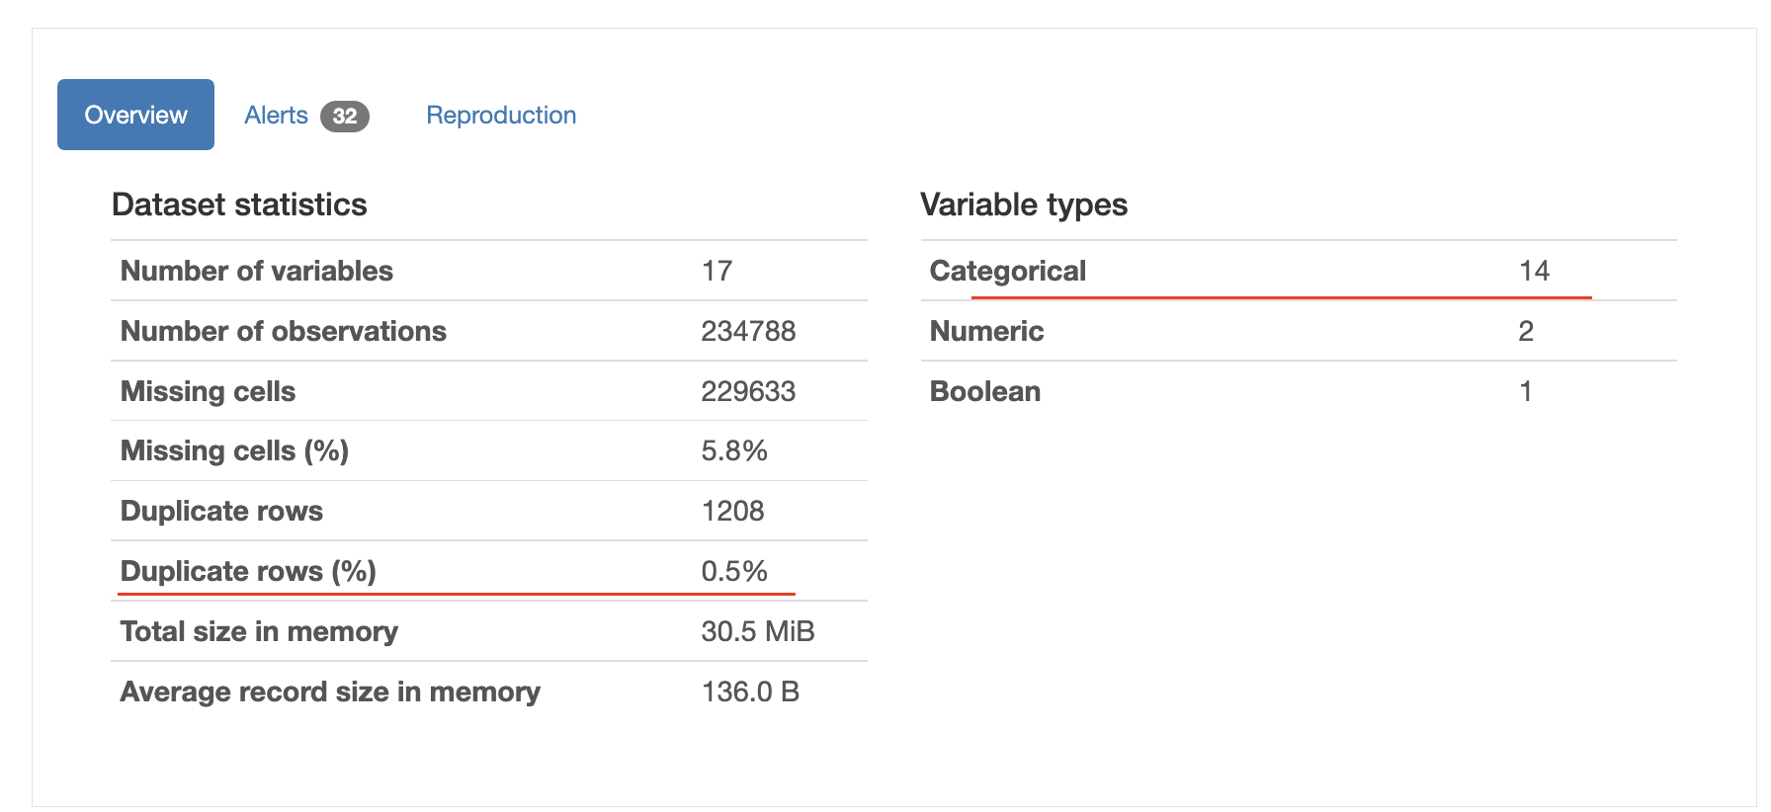
Data
1729 unique customers
Not much missing data and mostly categorical variables

Slide 10
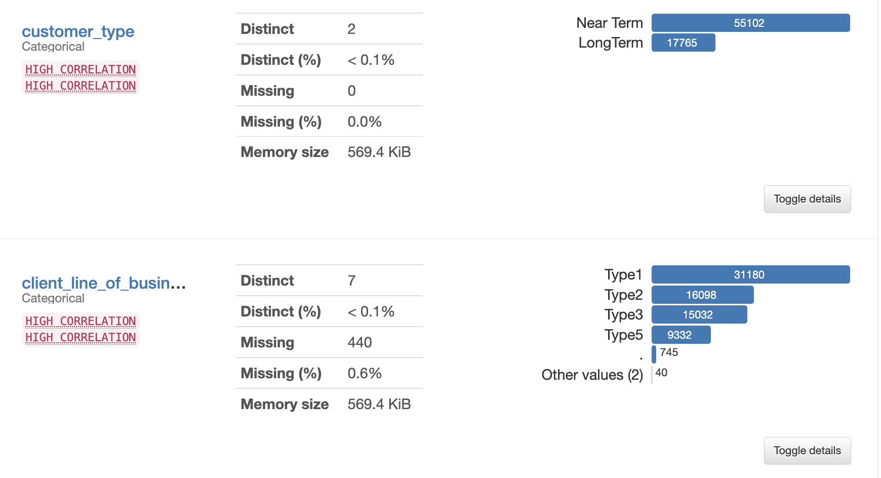
Examples of pandas profiling report

Slide 11
Pandas-profiling - Observations
- Target has no missing values
- Hardly any missing data except the code variable which we drop. Since we can use models that can handle missing values we don’t do any imputation .

Slide 12
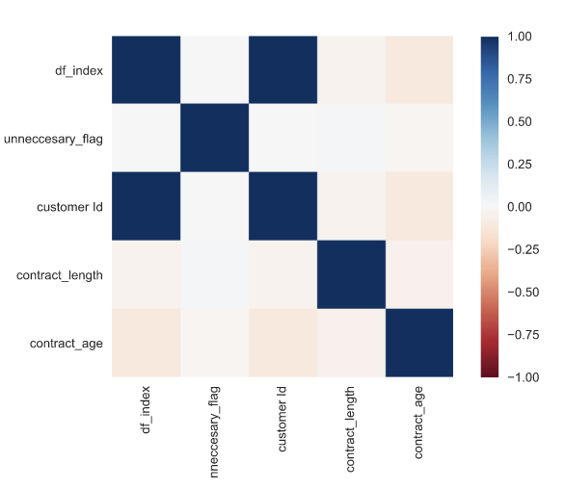
Correlations
None interesting in the numerical columns

Slide 13
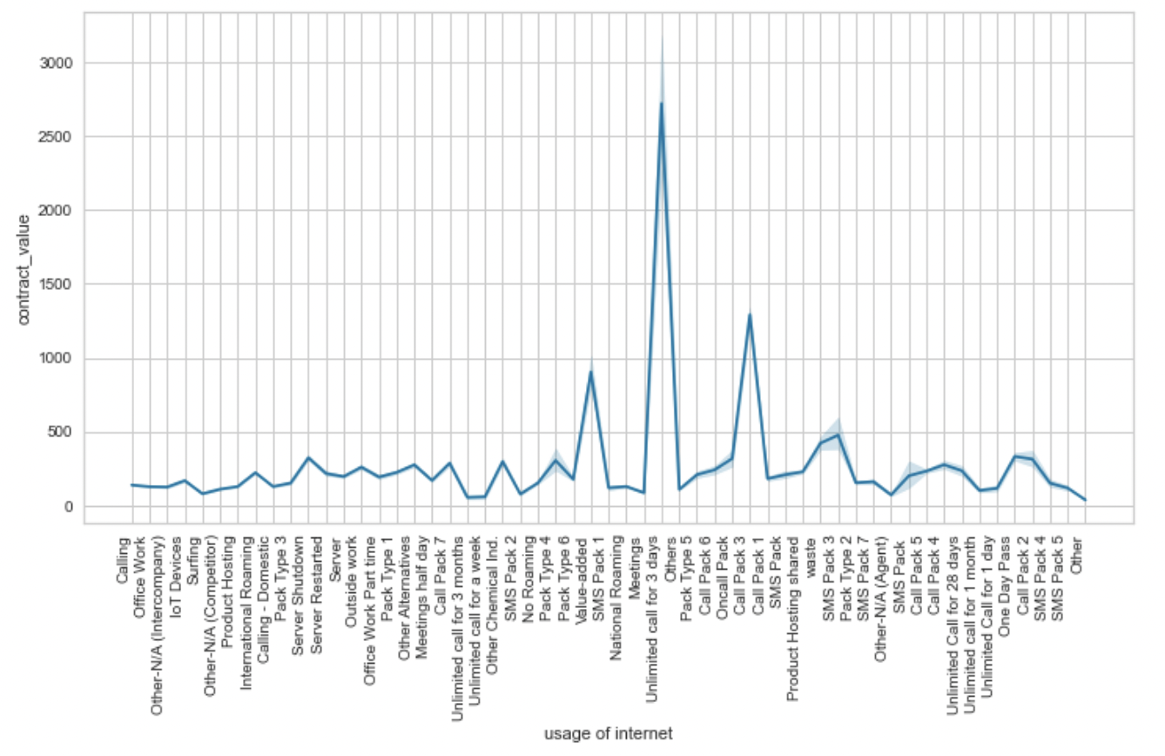
Distribution Analysis
Unlimited call for 3 days in Usage of internet already looks like an important value , we will see if SHAP feature importance and decision plots can also model that.

Slide 14
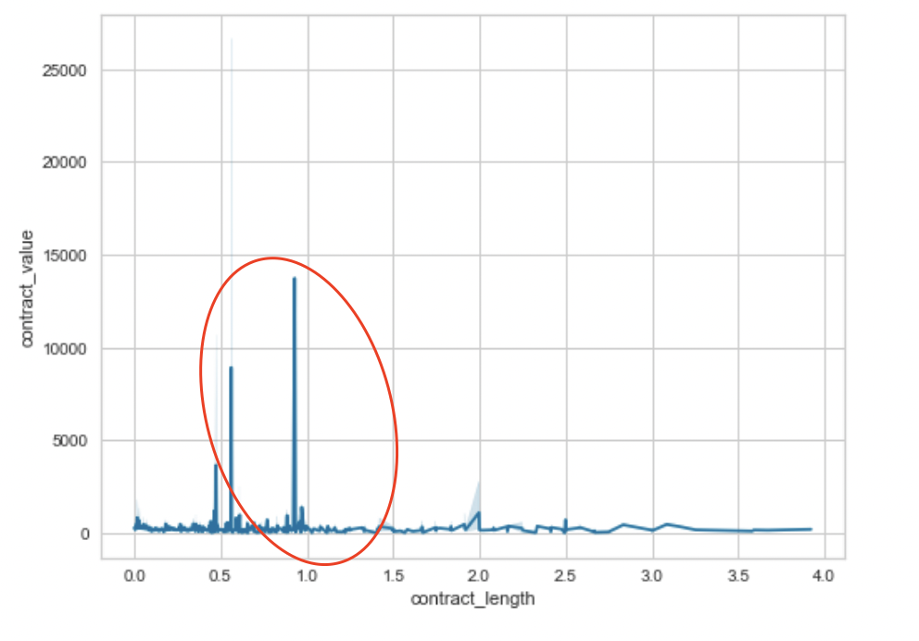
Distribution Analysis
Smaller contract length ie validity time have have higher contract_value

Slide 15
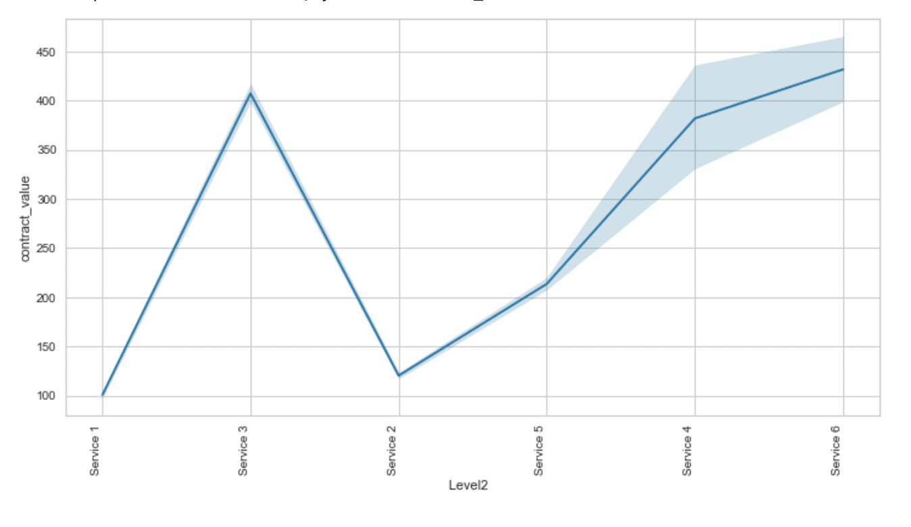
Distribution Analysis
Certain values for Level2 have a different impact than others.
Later after we model these features , we’ll be able to see their interaction effects

Slide 16
Modelling - Problem Formulation

Slide 17
Formulation as a Machine Learning problem
Build a predictor that predicts the contract_value given other features
Formulate it as a Regression problem (a supervised ML problem)
We’ll also create train and test split based on time and test set is for the last 4 months as asked in the assignment which is only 4.1% of the total set , thus test set is small

Slide 18
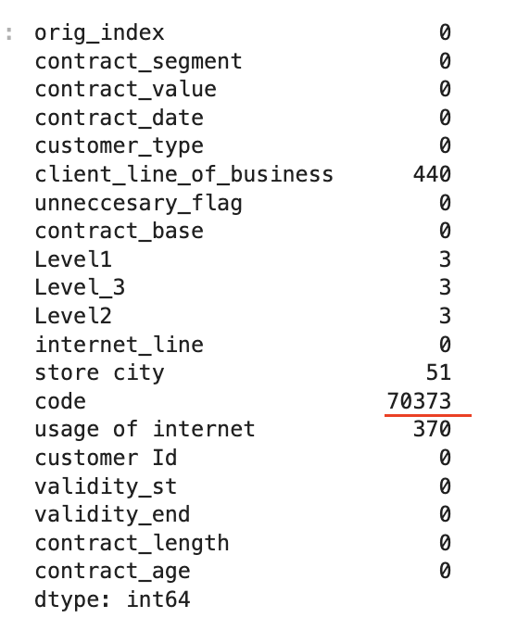
Feature engineering
Since categorical variables like dates by itself might not provide much information, we convert the dates fields - contract start and finish date to a variable called - contract_age which is the difference between these 2 columns or the time the contract was valid for
We drop columns like code which are mostly null, they won’t add much information

Slide 19
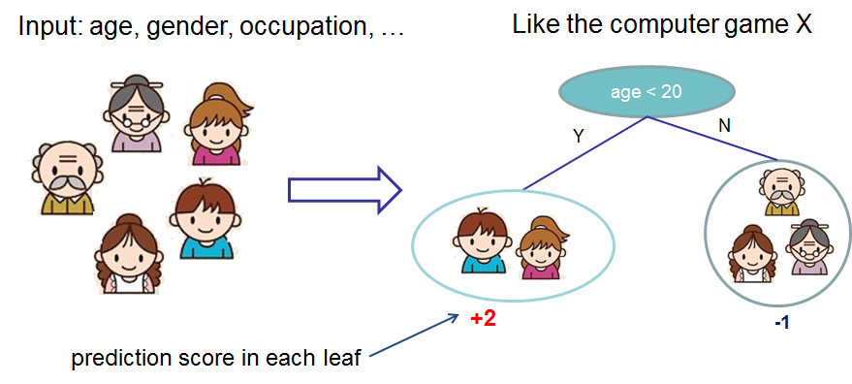
Can we come up with a decision tree?
*from XGBoost official Documentation

Slide 20
Approach/ Methodology
-
EDA
Preprocessing
Feature Engineering
Modelling
Model Evaluation
Explainability
(SHAP)

Slide 21
Modelling

Slide 22
Encoding
- LabelEncoder for categorical features since one-hot encoding is not ideal for Tree based features

Slide 23
Modelling -
Models that we consider:
XGBoost

Slide 24
Model Performance

Slide 25
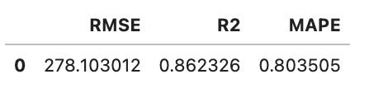
Results - Performance metrics
- RMSE
- R2
- MAPE - RMSE is inflated in case of few arge prediction errors

Slide 26
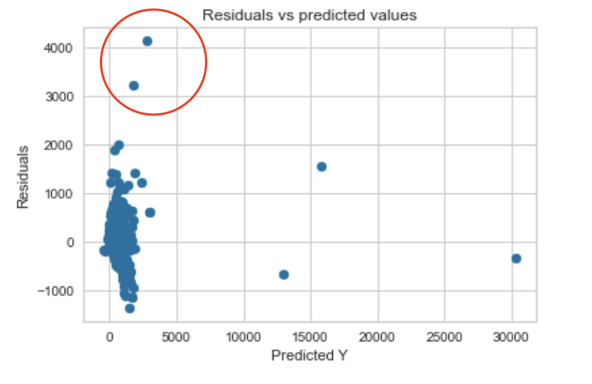
Results - Performance metrics
Residuals are very high for some predictions thus RMSE might be inflated

Slide 27
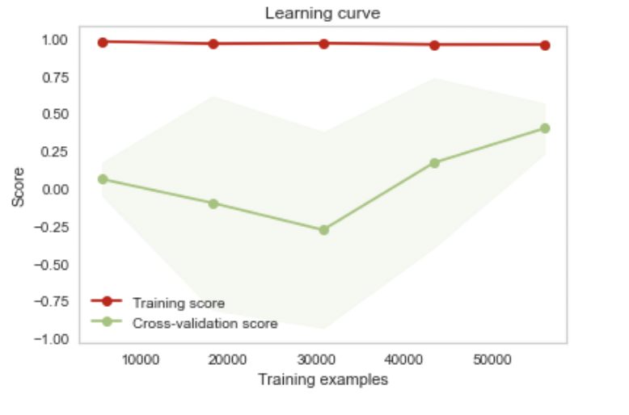
Check if the model overfits/underfits
Learning curve
Test set is too small so model is a bit overfit though the CV score eventually improves here but the CI are too wide

Slide 28
GridSearch - Hyperparameter tuning
Find the optimal parameters for the model
Params that can be considered:
max_depth
N_estimators
(Time consuming so we skip it for now )
Notes:
The number of trees (or rounds) in an XGBoost model is specified to the XGBClassifier or XGBRegressor class in the n_estimators argument. The default in the XGBoost library is 100.
Generally, boosting algorithms are configured with weak learners, decision trees with few layers, sometimes as simple as just a root node, also called a decision stump rather than a decision tree. The maximum depth can be specified in the XGBClassifier and XGBRegressor wrapper classes for XGBoost in the max_depth parameter. This parameter takes an integer value and defaults to a value of 3.

Slide 29

Results and Model Explainability

Slide 30
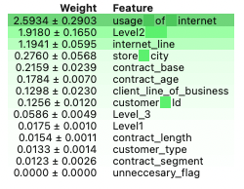
Feature Imp. using Permutation Importance
1 features that we built is in here thus Feature Engineering is very important !
We use permutation importance as a measure of feature importance which is more causal in nature.
Notes:
Does it take same time to repair

Slide 31
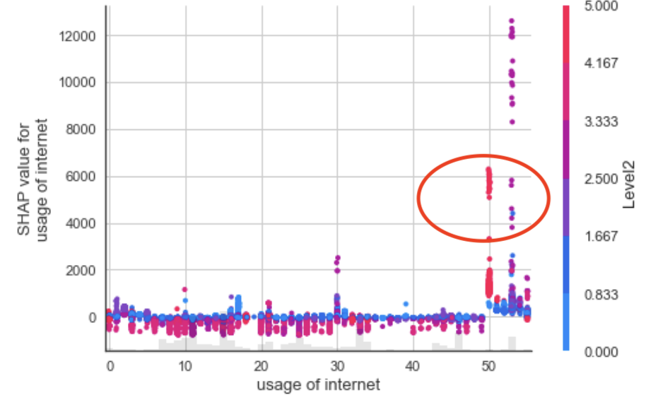
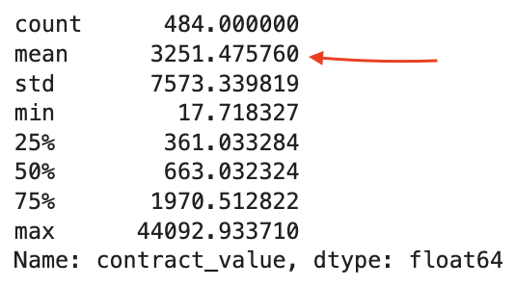
SHAP - Scatter plots age and internet_line for high and low contract_value
From SHAP we see that when the usage of internet is “Unlimited call for 3 days
“ and Level2 variables for “Service 6
“ lead to much higher prices which can also be seen in the mean for these below . The average for the whole dataset is 208 as compared to 3251 here
Notes:
Each dot is a single prediction (row) from the dataset.
The x-axis is the value of the feature (from the X matrix, stored in shap_values.data).
The y-axis is the SHAP value for that feature (stored in shap_values.values), which represents how much knowing that feature’s value changes the output of the model for that sample’s prediction. For this model the units are log-odds of making over 50k annually.
The light grey area at the bottom of the plot is a histogram showing the distribution of data values.

Slide 32
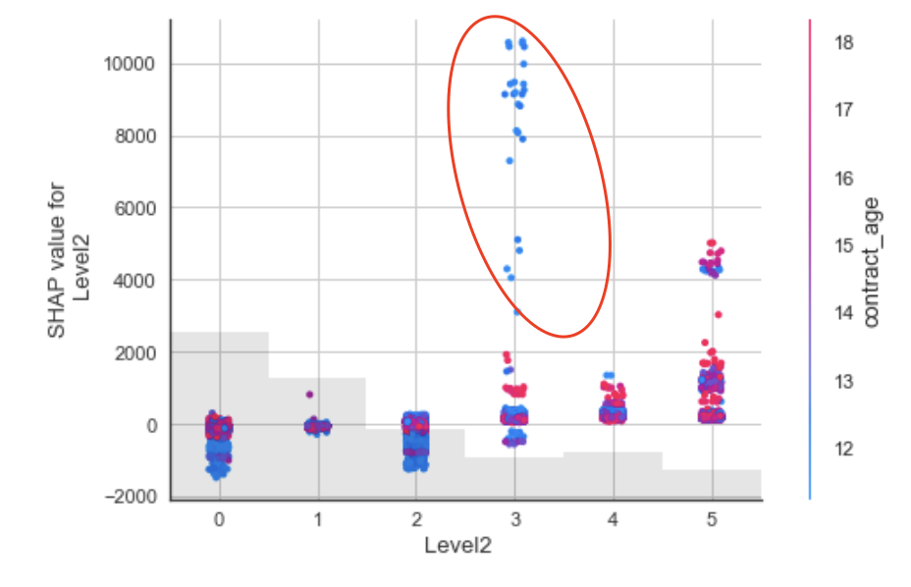
SHAP - Scatter plots age and Level2 for high and low contract_value
You can’t expect higher prices (a mean contract_value of mere 271) when and contract_age is > 17 and Level2 is at “Service 4”
Notes:
Horizontal location shows whether the effect of that value caused a higher or lower prediction.
How much was a prediction driven by the fact that the team scored 3 goals, instead of some baseline number of goals.

Slide 33
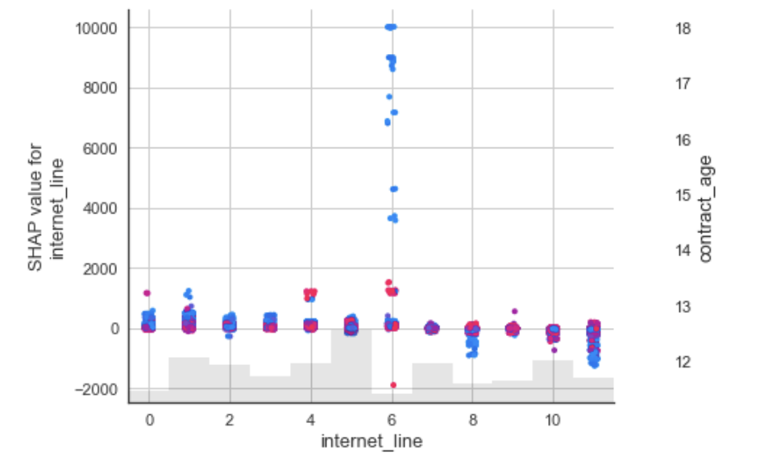
SHAP - Scatter plots age and internet_line vs contract value
Internet line == 6 or Internet Special Service along with a contract_age < 14 is predicted as lower prices
Notes:
Each dot is a single prediction (row) from the dataset.
The x-axis is the value of the feature (from the X matrix, stored in shap_values.data).
The y-axis is the SHAP value for that feature (stored in shap_values.values), which represents how much knowing that feature’s value changes the output of the model for that sample’s prediction. For this model the units are log-odds of making over 50k annually.
The light grey area at the bottom of the plot is a histogram showing the distribution of data values.

Slide 34
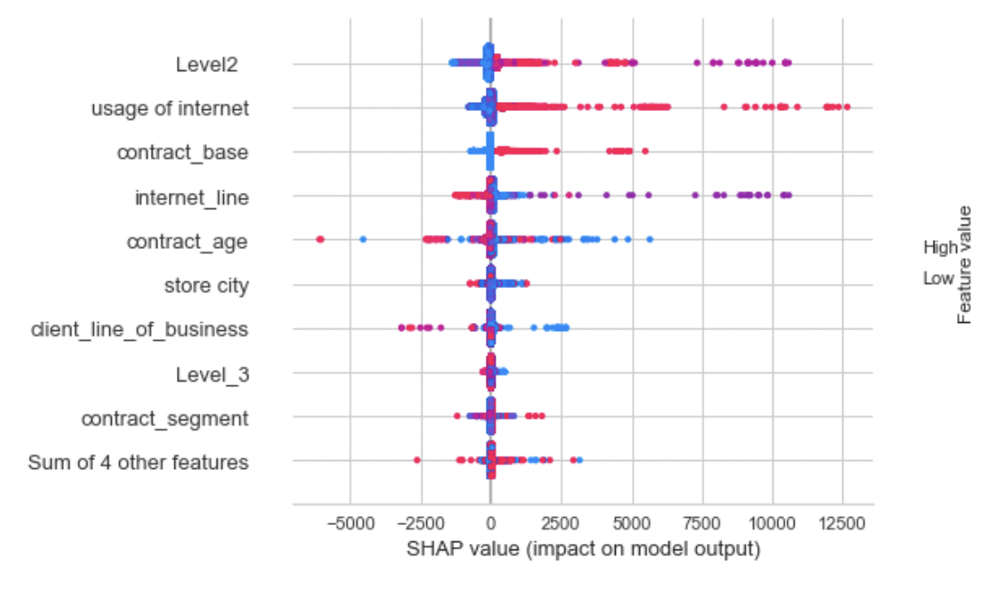
SHAP - Summary plots
Notes:
how each feature contributes to the overall prediction
Ideally more spread

Slide 35
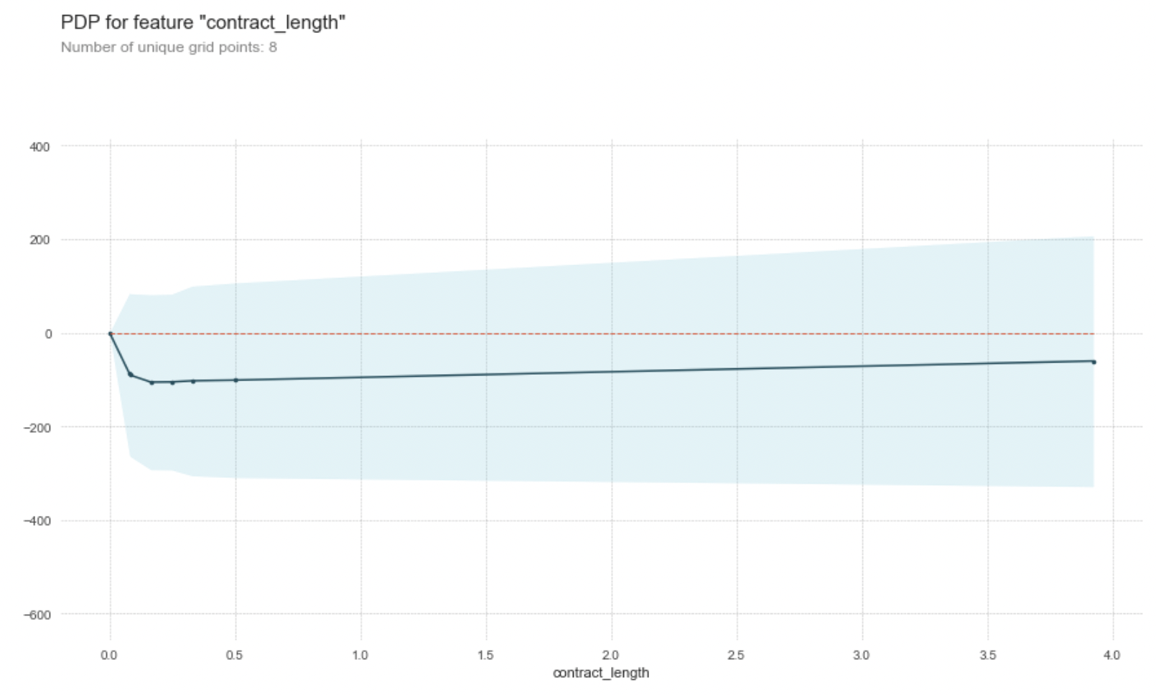
PDP plots
Notes:
The y axis is interpreted as change in the prediction from what it would be predicted at the baseline or leftmost value.
A blue shaded area indicates level of confidence

Slide 36
Decision Tree

Slide 37
Roadmap / Future Work

Slide 38
Future work
Given more time:
- Finish Gridsearch and use the optimized model. The current model is a first attempt.
- Analyze the SHAP combinations of features better and with more data
- Improve feature engineering
- Causality Analysis measuring the relationship between feature and target
Verify results with an expert of the domain knowledge

Slide 39
Appendix

Slide 40
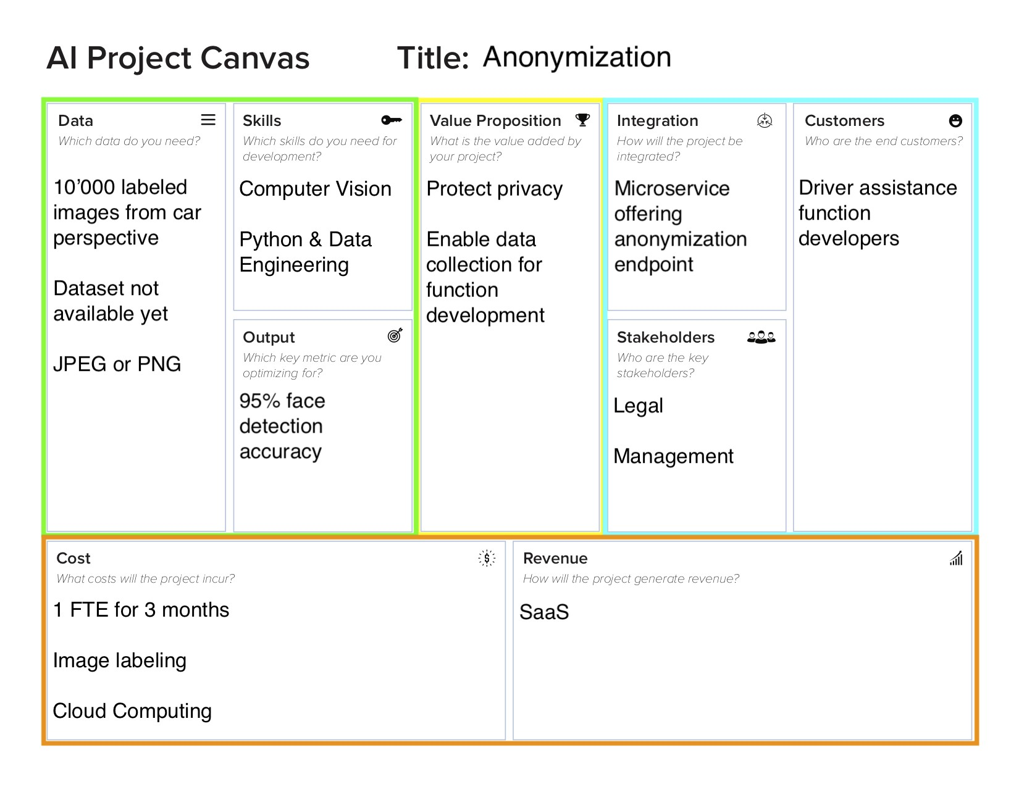
Solution Canvas

