Slide 1

Reduction of Car Crashes by Identifying The Driver’s Drowsiness and Emotions using Multilayer CNN
Vinaysheel Wagh (x18194303)
Vishakha Kale (x18181643)
Kamalesh Palani (x18180311)
Raghav Krishna Kumar (x18181848)

Slide 2
Motivation
Road crashes and related forms of accidents are a common cause of injury and death among the human population. According to 2019 data from the World Health Organization, road traffic injuries resulted in approximately 1.25 million deaths worldwide, i.e. approximately every 25 seconds an individual will experience a fatal crash. One of the primary causes of road accidents is related to driver inattention or drowsiness.
1.35 million people have faced death due to car accidents with a daily number of 3700
3% of the GDP is spent for attending and resolving the damage occurred due to the accidents happening around the world
60% of the drivers interviewed by national survey committee has accepted that they have felt sleepiness while driving
60% of the drivers interviewed by national survey committee has accepted that they have felt sleepiness while driving
For this reason, developing a real time driver monitoring system can reduce numerous accidents in roads by detecting the drivers emotion and drowsiness detections.
Notes:
Road crashes and related forms of accidents are a common cause of injury and death among the human population. According to 2019 data from the World Health Organization, road traffic injuries resulted in approximately 1.25 million deaths worldwide, i.e. approximately every 25 seconds an individual will experience a fatal crash. One of the primary causes of road accidents is related to driver inattention or drowsiness.
This was confirmed by a study conducted by the AAA Foundation for Traffic Safety, which showed that 32.5% of all automobile crashes recorded in the United States in 2019 were sleep-related: 16.5% for fatal crashes and 7% for non-fatal crashes.
For this reason, developing a real time driver monitoring system can reduce numerous accidents in roads by detecting the drivers emotion and drowsiness detections.

Slide 3
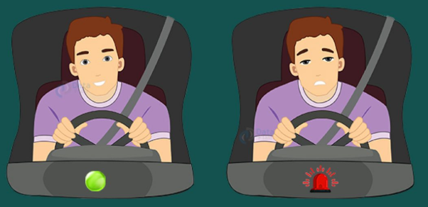
Research Question
RQ: “To what extent can the car crashes be reduced by accurately detecting the driver’s emotions and drowsiness and alerting using the deep learning techniques ?”

Slide 4
Comparison of existing methods and the proposed method
Existing solution :
Previous studies have used various methods to distinguish between open and closed eyes, such as classiﬁers based on the features obtained from image binarization, edge operators, or texture analysis. However, when it comes to eye images with different lighting conditions and resolutions, it can be difﬁcult to ﬁnd an optimal threshold for image binarization or optimal ﬁlters for edge and texture extraction.
Proposed solution:
In this research project, a novel approach is designed to detect the driver’s drowsiness and different emotions such as anger, sadness and excitement using advanced deep learning techniques. Convoluted neural networks has been devised in this approach to extract the information of driver’s facial reaction from the live feed video and then are injected to the pre-trained CNN model to determine the level of intensity of each factor . Based on that an alarm will be triggered to alert the driver so that car crash accidents will be reduced.

Slide 5

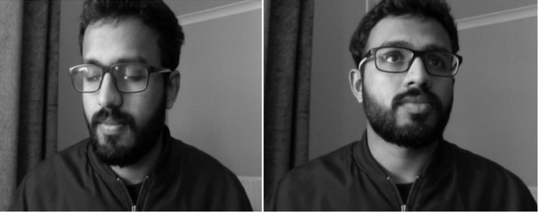
Dataset
Computer vision (OpenCV) was used to generate our own facial images
6 videos were captured with 4 subject
The videos clips are recoded in 640 * 480 pixels without audio
Converted to 30 frames per second
Total 24,000 images including emotions and drowsiness were created

Slide 6
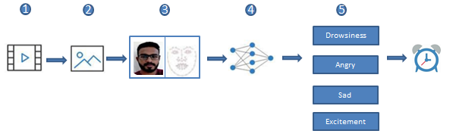
Proposed Solution
Step-1 Driver behavior is recorded in video .
Step-2 Every recorded video frames is extracted as images .
Step-3 Extracting landmark coordinates from images.
Step-4 Training the algorithm
Step-5 Model extraction
Finally Score will be calculated to Check whether Person is in which state and a threshold is defined and if the score becomes greater than 15 then we beep the alarm to alert the driver.

Slide 7
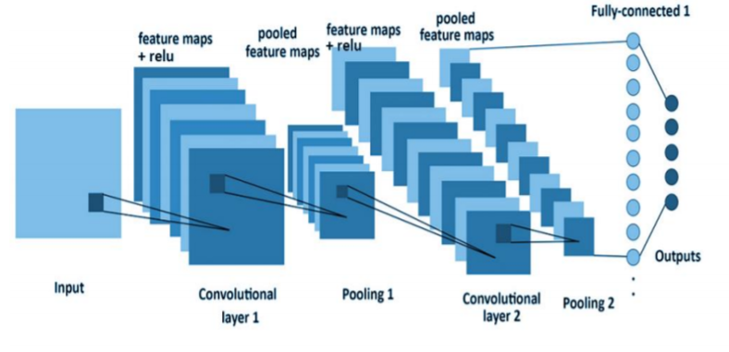
Process Flow
Activation function | ReLu/softmax
Optimizer | Adam
Loss Function | Categorical_Crossentropy
Number of Epochs | 15
Learning Rate | 0.00001
Pooling Layer | 3
Convolution layer | 3
Fully connected layer | 2
Categorization | Anger, Sadness , Excitement and Drowsiness

Slide 8
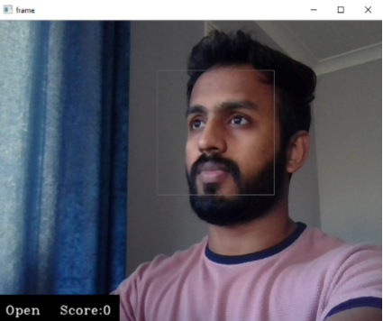
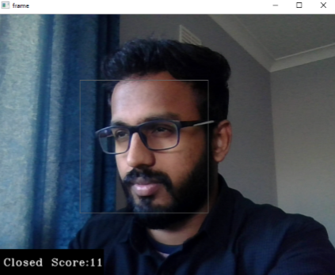
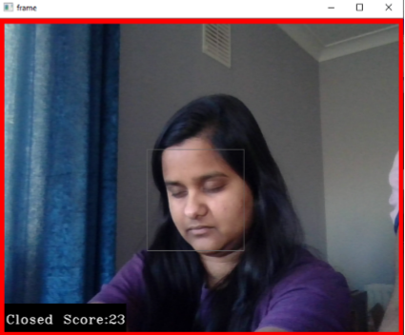
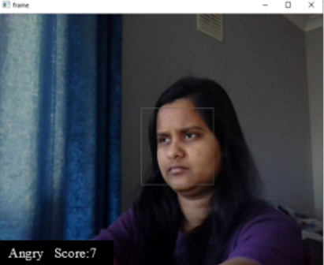
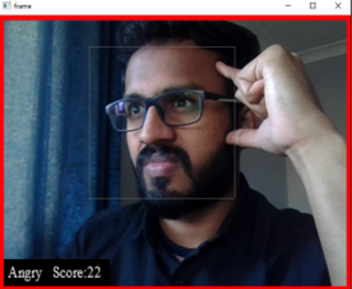
Output

Slide 9
Thank You!

