Slide 1

Cloud-Native Employee Attendance and Leave Management System
CNAD Project Review-3
28-10-2026, 8:00 AM
 | Under the Guidance of Mrs. V.Vinisha Assistant Professor, Department of Computer Science and Engineering, KLH CSE Bowrampet Campus
Team Members Nitish 2420030642 Kamalesh 2420030156 Moukshitha 2420030164

Slide 2
Outline of Project Work
Focus
Introduction
Literature Survey
Challenges
Research Objectives
Conclusion & Future Work
References
Publications Details

Slide 3
Problem Statement
Attendance and leave management are core HR functions, but legacy registers, spreadsheets, and monolithic on-premise apps are tightly coupled and hard to scale.
01
02
03
Load Spikes Overwhelm Monoliths
Downtime for Every Change
Manual Approvals, No Visibility
Hundreds of employees marking attendance at shift start, or applying for leave at month-end, strain tightly-coupled on-premise systems.
Even a minor bug fix or feature update in a monolithic application typically requires taking the entire system offline.
Manual approval chains and lack of real-time visibility into attendance and leave balances cause payroll errors and delayed approvals.

Slide 4
Objectives
Objectives
Design and implement a resilient, independently scalable Employee Attendance and Leave Management System using cloud-native and DevOps principles.
1
Decompose the system into independently deployable microservices — Employee/Auth, Attendance, Leave Management, and Notification.
2
Containerize each microservice with Docker and orchestrate on Kubernetes for autoscaling, self-healing, and rolling updates.
3
Front the services with an API Gateway handling routing, auth-token validation, and rate limiting.
4
Enable QR-code and web-based check-in/check-out plus a configurable manager-approval workflow for leave.
5
Automate build, test, and deployment through a CI/CD pipeline with infrastructure as code and centralized monitoring.

Slide 5
Literature Survey
Literature Survey
Authors | Title of the Paper | Methodology | Inferences | Limitation/Future work
Carrón (2022) – Journal of Grid Computing | Kubernetes as a Standard Container Orchestrator: A Bibliometric Analysis | Bibliometric analysis of 803 Web of Science articles (2014–2022) using Bibliometrix. | Confirms Kubernetes as the de-facto orchestrator for microservice-based systems; maps dominant research themes. | Survey-level only; does not benchmark orchestration performance empirically.
ACM Computing Surveys (2022) | Kubernetes Scheduling: Taxonomy, Ongoing Issues and Challenges | Structured literature review (2016–2022) building a top-down taxonomy across infrastructure, application and performance domains. | Useful for understanding how independently deployed services (like Attendance/Leave) get scheduled and scaled. | Focused on scheduling only; networking and storage concerns left out of scope.
Marchese & Tomarchio (2024) – CLOSER | Load-Aware Container Orchestration on Kubernetes Clusters | Proposes and experimentally evaluates a load-aware scheduling extension to the default scheduler. | Directly relevant to handling attendance/leave load spikes: load-aware placement reduces hotspots vs. default scheduling. | Evaluated on a limited cluster testbed; large-scale multi-cloud validation left for future work.

Slide 6
Problem Gap Identification
Existing HR platforms rarely apply cloud-native engineering to a routine workflow — leaving a practical gap this project addresses.
Monolithic HR Systems
No Database-per-Service Isolation
1
Most conventional attendance/leave tools ship as a single tightly-coupled codebase that cannot scale one function independently of another.
2
Shared databases across HR functions make it hard to isolate failures or evolve one service without risking the others.
Synchronous-Only Communication
Manual Ops, No IaC
3
Without event-driven design, a slow notification or approval step can block core actions like attendance logging.
4
Deployments and environment setup are rarely automated, so staging and production configurations drift apart.

Slide 7
Innovation, Creativity, and Novelty
Our project applies cloud-native engineering concepts to employee attendance and leave management.
1. Microservices Architecture
Separates employee authentication, attendance, leave management, and notifications into independent services.
2. Database-per-Service Approach
Supports independent data management for different services.
3. Event-Driven Notifications
Allows notification processing to be separated from core attendance and leave operations.
4. Containerization
Docker provides a consistent environment for packaging application services.
5. Kubernetes Orchestration
Supports container orchestration and provides capabilities such as self-healing and scaling.
6. CI/CD Automation
Automates application build, testing, and deployment processes.

Slide 8
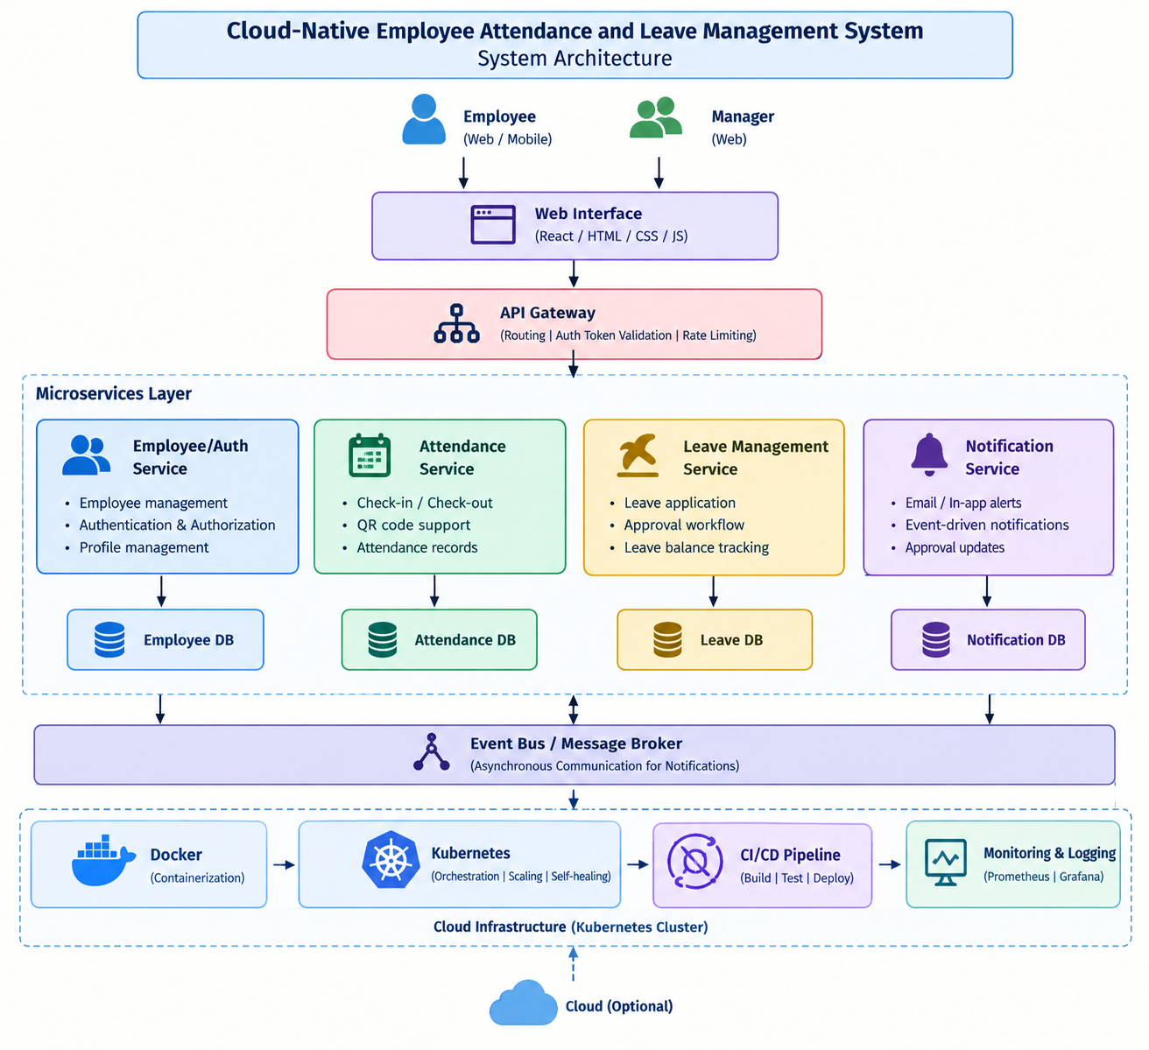
System Architecture

Slide 9
Feasibility and Project Plan
The system is feasible on a standard Kubernetes cluster and follows an eight-week, service-by-service delivery plan.
Wk 1–2
Wk 3–4
Wk 5
Wk 6
Wk 7–8
1
2
3
4
5
Auth & Employee Svc
Attendance & Leave Svc
Events & Notify
CI/CD & IaC
Scale & Observe
Employee/Auth service, database schema, API Gateway skeleton.
Check-in/QR workflows; leave apply, balance & approval logic.
Message broker integration; Notification service for alerts.
Git-triggered pipeline, Helm charts, infra-as-code for all envs.
Autoscaling, monitoring dashboards, load testing, final review.

Slide 10
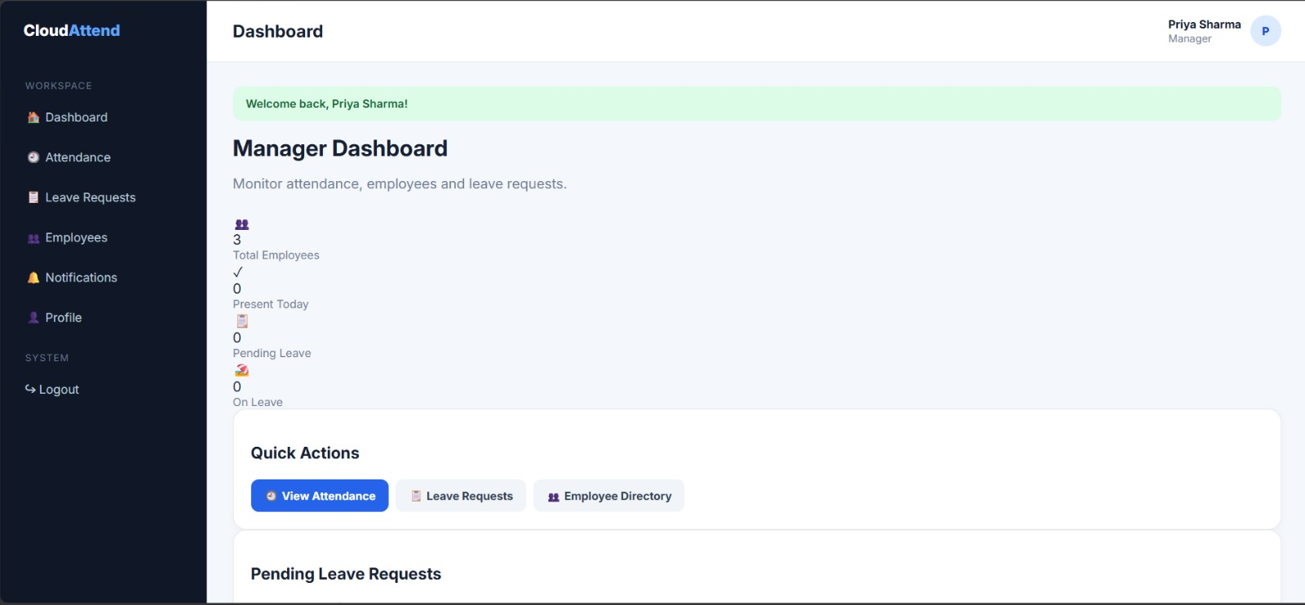
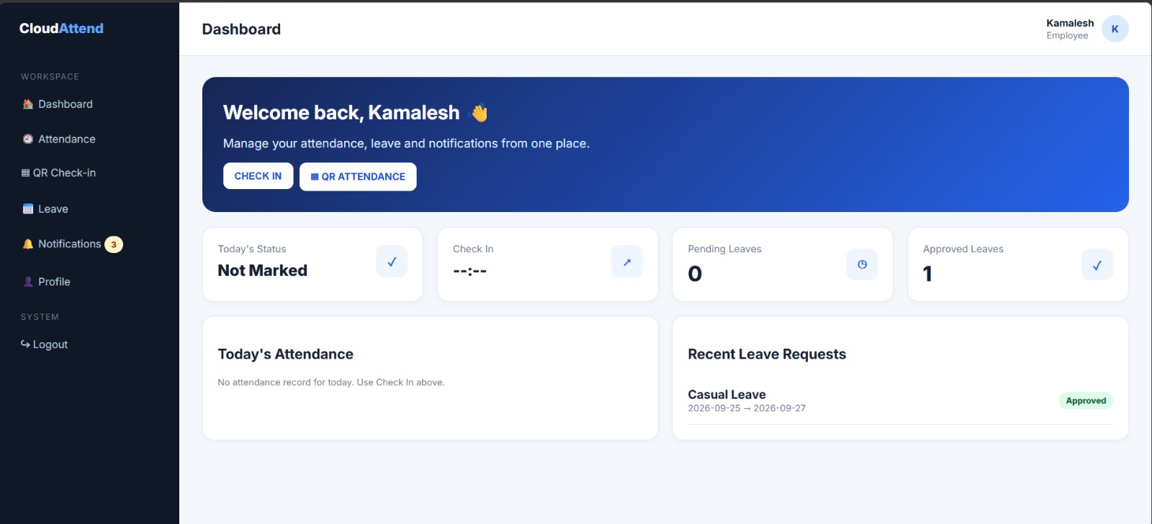
OUTPUT
Manager dashboard
Employee dashboard

