Slide 1
Dynamic Context Curation for Agentic Software Engineering using Runtime Execution Tracing and Model Context Protocol (MCP)
PROJECT WORK
SUBMITTED BY
Abdul Kareem S
23Z302
Jawahar Pretam J
23Z327
Kaarthick S
23Z330
Kamalesh G
23Z332
Rathish R
24Z466
GUIDING FACULTY
Ms. Anne Merin Mathew
CO-GUIDE
Dr. S. Suriya

Slide 2
Introduction
Dynamic Context Curation
Automatically picking only the information an AI agent needs right now, instead of handing it everything at once.
Agentic Software Engineering
Software built with AI agents that can plan, act, and make decisions on their own, rather than just answer prompts.
Runtime Execution Tracing
Recording what a program actually does while it runs: which lines execute, what values variables hold, and where it fails.
Model Context Protocol (MCP)
A standard way for an AI model to request exactly the data or tools it needs from a running system.

Slide 3
The Problem
The Problem
Debugging agents are handed entire codebases and full execution logs to fix a handful of relevant lines.
Why it matters?
This wastes tokens and compute, slows down reasoning, and makes agentic debugging costly to run at scale.
Current Limitation
Existing tools have no way to fetch just the runtime information a specific bug actually needs.
What's needed
A way for the agent to query runtime state on demand: the idea this project sets out to build.

Slide 4
Literature Survey
TITLE | ALGORITHMS / TECHNIQUES USED | ADVANTAGES | DISADVANTAGES
MENTOR: Fixing Introductory Programming Assignments with Formula-Based Fault Localization and LLM-Driven Program Repair (2026) | MaxSAT-based Fault Localization, Graph Neural Network (GNN) Variable Alignment, Program Clustering, LLM-based Repair using CEGIS (Counterexample Guided Inductive Synthesis). | Accurately identifies faulty statements before repair. Produces more precise and minimal code fixes. Combines formal methods with LLM reasoning to improve repair success rates. Achieved significantly better repair performance than existing educational APR tools. | Primarily designed for introductory programming assignments. Depends on availability of correct submissions and test cases. Focuses mainly on educational programming environments rather than real-world software systems.
TraceRepair: Enhancing LLM-Based Program Repair via Trace-Guided Multi-Strategy Debate (2026) | Runtime Trace Collection, Probe Agent, Multi-Agent Debate Framework, Execution-Based Ranking, Judge Agent Validation. | Uses runtime execution traces to understand actual program behavior. Multiple agents analyze and debate candidate fixes, reducing incorrect patches. Improves repair accuracy for complex logical bugs and silent failures. Outperformed existing LLM-based repair approaches on Defects4J benchmark. | Requires runtime instrumentation and trace collection. Larger traces can increase processing overhead. Performance depends on availability of executable test environments and runtime data.

Slide 5
Literature Survey
TITLE | ALGORITHMS / TECHNIQUES USED | ADVANTAGES | DISADVANTAGES
Empowering Autonomous Debugging Agents with Efficient Dynamic Analysis (ADI) (2026) | Agent-Centric Debugging Interface (ADI), Frame Lifetime Trace (FLT), Function-Level Dynamic Analysis, High-Level Navigation Commands. | Provides efficient dynamic analysis for debugging agents. Reduces cost compared to traditional line-by-line debugging. Enables better understanding of execution flow and program states. Improves performance of existing autonomous repair agents. | Requires specialized debugging infrastructure. Focused on function-level analysis rather than complete program behavior. Additional trace generation may introduce computational overhead.
DebugHarness: Emulating Human Dynamic Debugging for Autonomous Program Repair (2026) | Interactive Debugging, GDB-based Runtime Inspection, Signature-Driven Investigation, Dynamic State Introspection, Closed-Loop Patch Validation. | Mimics human debugging practices using runtime information. Enables deep inspection of memory states and execution paths. Achieves high success rate in repairing complex security vulnerabilities. Significantly improves repair accuracy over static LLM-based approaches. | Mainly targeted toward C/C++ security vulnerabilities. Requires reproducible crashes and debugging tools. Interactive debugging can increase repair time and resource usage.

Slide 6
Research Gaps
Prompt Bloat
High Token Cost
Wasted Reasoning
No Targeted Retrieval
Entire codebase + logs pushed into every prompt, regardless of relevance
Large, repeated context drives up computation and API cost
Model reasons over code paths that never executed or never failed
No mechanism to fetch only the runtime info a task actually needs

Slide 7
Proposed Solution
The proposed system combines fault localization, runtime tracing, and MCP-based context retrieval to dynamically investigate failures. By selectively gathering runtime evidence and tracing dependency paths, the framework identifies root causes more effectively and assists in generating accurate software repairs.
Fault Localization
Runtime Tracing
MCP Context Retrieval
Narrow down where the bug is
Capture what actually executed
Fetch only the evidence needed

Slide 8
Architecture Overview
Application Layer
User
React UI (Frontend)
FastAPI Backend
Execution Manager
Execution & Tracing
Trace Store (query layer)
Common Trace Model
Python Tracer
Python Executor
JVM Tracer
Java Executor
Context & Agent
MCP Debugging Server
get_error_context()
get_stack_trace()
Debugging Agent (LLM)
get_frame_variables()
get_source_context()
get_execution_path()
get_event()
search_trace()

Slide 9
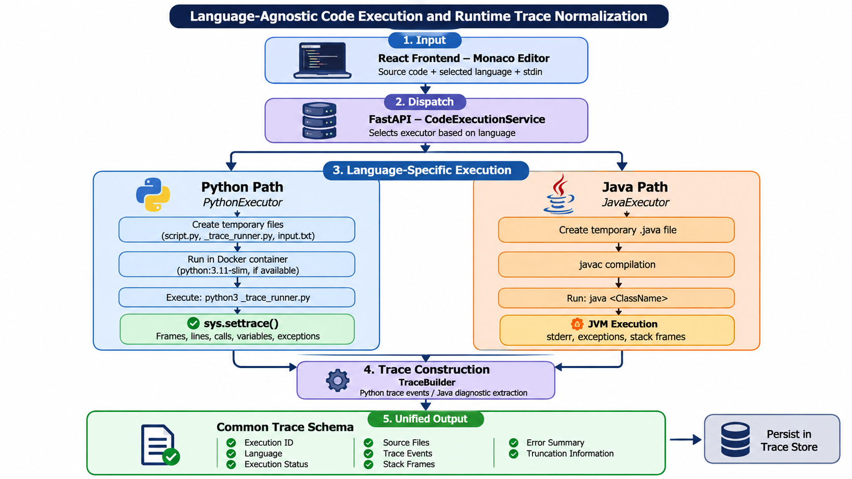
Code Execution Flow
{
“language”:”python”,
“code”:”def main()\n print(‘helo’)”
“stdin”:””
}

Slide 10
Technology Stack
Frontend
Backend
Execution Sandbox
React 18 + Vite
Monaco Editor
Axios
Lucide React Icons
Custom CSS
Python 3.10+
FastAPI
Pydantic
Docker Python SDK
MCP server
Docker Engine
Python Container
OpenJDK 17
256 MB RAM

Slide 11
Module Breakdown & Status
8 / 8 MODULES DONE
M1
Code Execution Foundation
M5
Debugging Agent
Monaco editor, Python + Java execution, Docker sandbox, structured results
LLM agent reasons with minimal context, pulls more via MCP on demand
DONE
DONE
M2
Runtime Trace Collection
M6
Automatic Bug Fixing
Python & Java tracing: calls, lines, exceptions, stack frames, variables
Generate patch, modify code, re-execute until tests pass
DONE
DONE
M3
Trace Storage & Query Layer
M7
Dynamic Context Curation
Store & query traces via get_error(), get_stack(), get_variables(), etc.
Core research contribution: decide what context to retrieve next
DONE
DONE
M4
MCP Debugging Server
M8
Baseline & Evaluation
Exposes trace queries as MCP tools for dynamic agent access
Compare full-context baseline vs. curated-context system
DONE
DONE

Slide 12
Review Feedbacks and Improvements
REVIEW 1 FEEDBACK
IMPLEMENTED IN REVIEW 2
MEASURED OUTCOME
FURTHER OPTIMIZATION
“
The code should be optimized as much as possible.
Our response: stop sending the debugger everything — send only the context it needs.
M7 – Dynamic Context Curation
Instead of sending the entire runtime trace and source context to the debugging LLM, MCP-based selective retrieval fetches only the relevant debugging information.
M8 – Evaluation
Baseline-versus-dynamic comparison measuring context size, LLM token usage, number of calls and execution time.
Across 4 Python benchmark cases
≈75.2%
less context supplied to the final debugger
≈48.8%
fewer final-debugger LLM tokens
Not yet optimized
≈3.16×
longer execution time
≈86.6%
more total LLM tokens, from extra curator calls
MCP communication is not the bottleneck — iterative LLM-based curation is. Next step: reduce curator LLM calls to cut total time and tokens.
Notes:
Review 1 feedback: the code should be optimized as much as possible.
M7: instead of sending the whole runtime trace and source context to the debugging LLM, the agent retrieves only what it needs through MCP.
M8: we compared a baseline against the dynamic approach on context size, token usage, number of LLM calls and execution time.
Result on four Python cases: about 75.2% less context to the final debugger and about 48.8% fewer final-debugger tokens.
Honest limitation: the dynamic approach is about 3.16x slower and uses about 86.6% more total tokens because of the extra curator LLM calls. MCP communication is not the bottleneck; iterative LLM curation is. Reducing curator calls is the next optimization.

Slide 13
Review Feedbacks and Improvements
REVIEW 2 FEEDBACK
IMPLEMENTED IN REVIEW 2
“
More testcases for both languages and analyse metrics for both..
Created 10 test cases for both Java and Python to evaluate key performance metrics and compare the Baseline and Dynamic Context Curation approaches.
MCP communication is not the bottleneck — iterative LLM-based curation is. Next step: reduce curator LLM calls to cut total time and tokens.
Notes:
Review 1 feedback: the code should be optimized as much as possible.
M7: instead of sending the whole runtime trace and source context to the debugging LLM, the agent retrieves only what it needs through MCP.
M8: we compared a baseline against the dynamic approach on context size, token usage, number of LLM calls and execution time.
Result on four Python cases: about 75.2% less context to the final debugger and about 48.8% fewer final-debugger tokens.
Honest limitation: the dynamic approach is about 3.16x slower and uses about 86.6% more total tokens because of the extra curator LLM calls. MCP communication is not the bottleneck; iterative LLM curation is. Reducing curator calls is the next optimization.

Slide 14
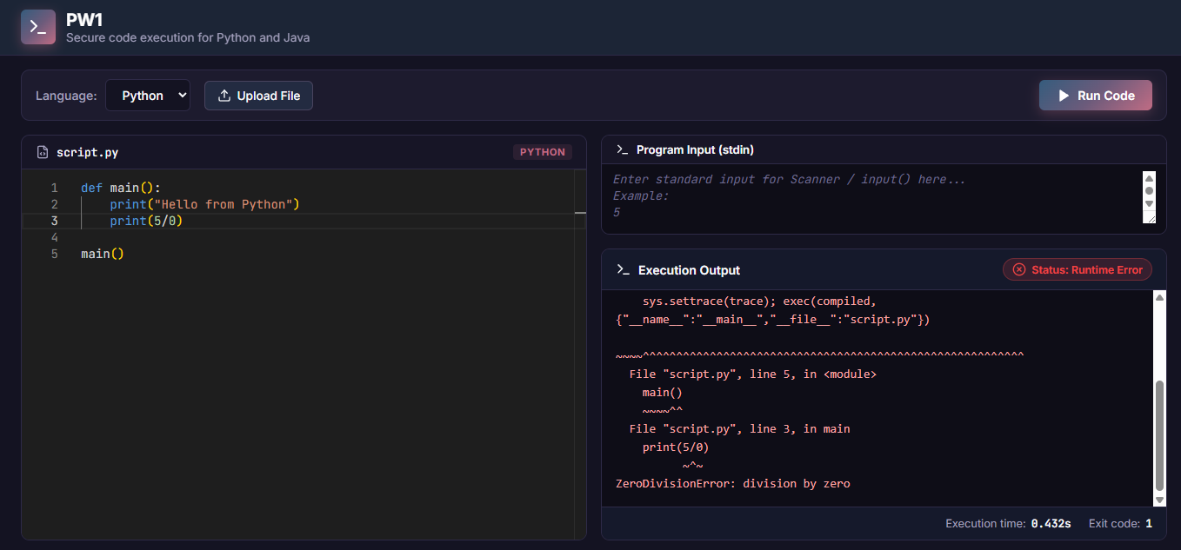
Implementation
Code Editor Module
Provides an interactive Monaco-based code editor where users can write and submit Python or Java 17 programs. The submitted code is sent to the backend execution service, which compiles and executes it in a sandboxed environment and reports the execution status, output, and errors.

Slide 15
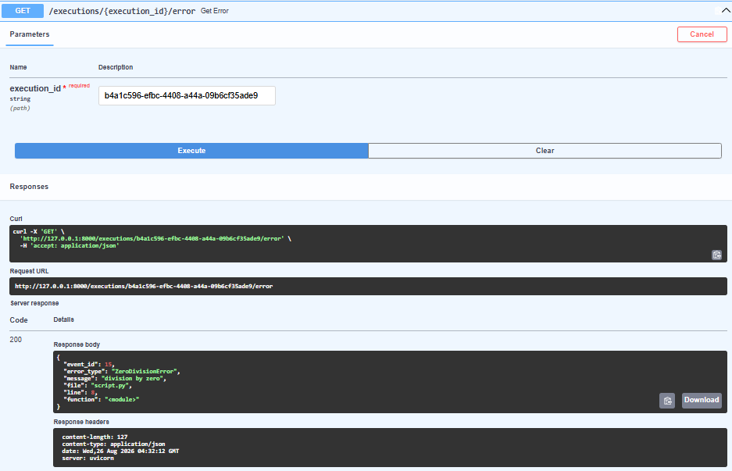
Implementation
Execution Error API
The FastAPI backend exposes each run through REST endpoints. The GET /executions/{execution_id}/error endpoint, tested here in the Swagger UI, returns the captured failure as structured JSON: event ID, error type (ZeroDivisionError), message, file, line number and function.

Slide 16
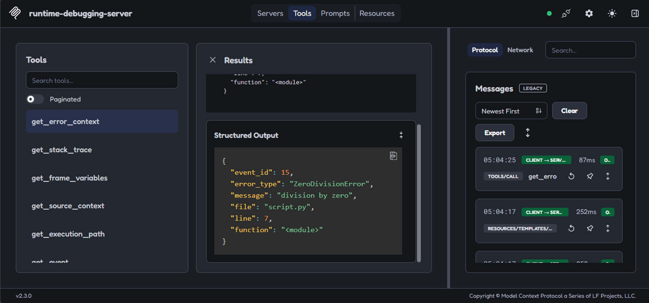
Implementation
MCP Debugging Server
The runtime-debugging-server exposes trace queries as MCP tools: get_error_context, get_stack_trace, get_frame_variables, get_source_context, get_execution_path and get_event. Verified in MCP Inspector, a tool call returns the structured error output, so the agent can pull only the context it needs.

Slide 17
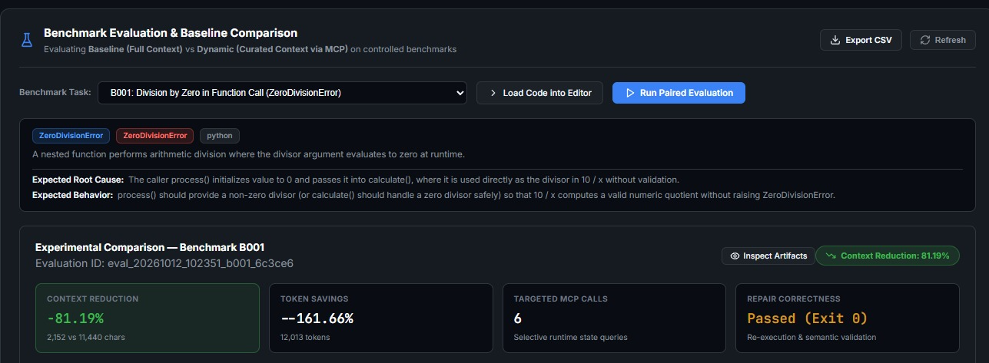
Implementation
Benchmark Evaluation
The evaluation dashboard runs a paired baseline-versus-dynamic comparison on benchmark B001 (ZeroDivisionError). The dynamic run supplied 81.19% less context (2,152 vs 11,440 chars) using 6 targeted MCP calls, and its repair passed re-execution with exit code 0.

Slide 18
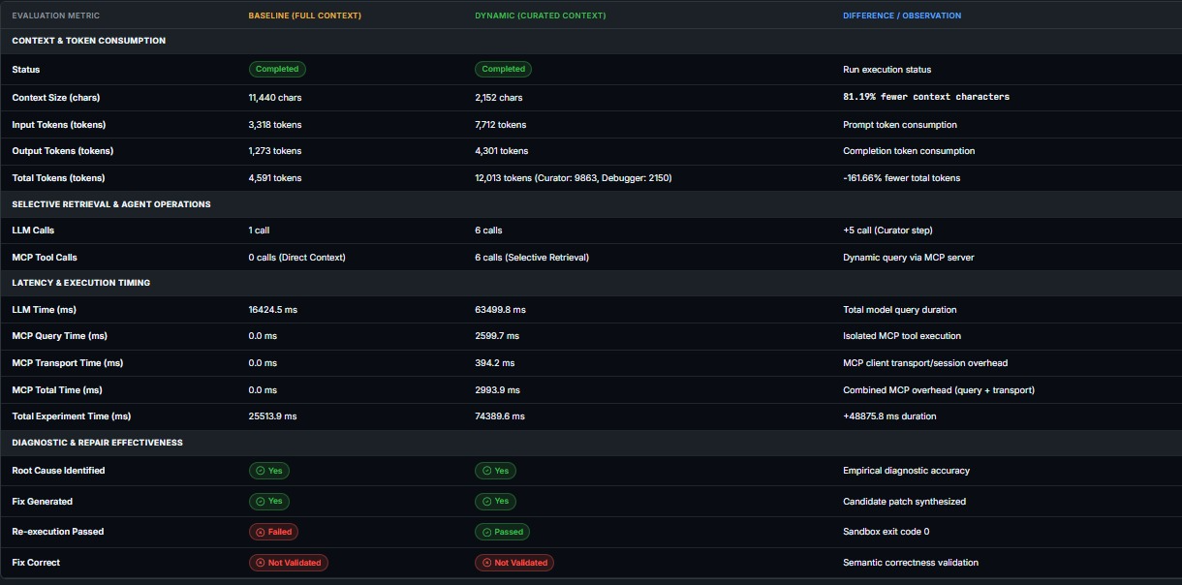
Implementation
Baseline vs Dynamic Metrics
Both runs identified the root cause and generated a fix. The baseline used 4,591 tokens in 1 LLM call (25.5 s); the dynamic run used 12,013 tokens (curator 9,863, debugger 2,150) over 6 calls (74.4 s), with MCP overhead of only 2,993.9 ms. Only the dynamic fix passed re-execution.

Slide 19
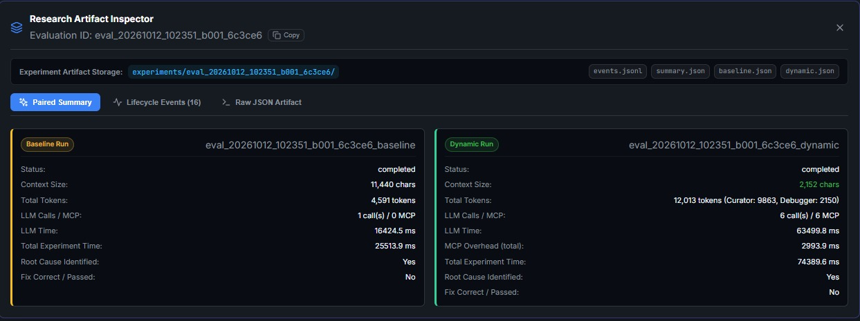
Implementation
Research Artifact Inspector
Every paired run is saved under experiments/<evaluation_id>/ as events.jsonl, summary.json, baseline.json and dynamic.json. The inspector shows the paired summary, 16 lifecycle events and raw JSON, so each result can be traced and reproduced.

Slide 20
Benchmark Test Cases
10 BUGS · PYTHON + JAVA
B001
Division by Zero in Function Call
B006
Accidental Reset in Discount Accumulator Loop
ZeroDivisionError
LogicError
B002
Rank Index Calculation Exceeds Bounds
B007
Mutable Default Argument Permission Leak
IndexError
AssertionError
B003
Missing Authentication Header Key
B008
Incompatible None State in Order Cancellation
KeyError
AttributeError
B004
String and Float Arithmetic Mismatch Across Calls
B009
Case-Sensitive Lookup in Overridden Polymorphic Method
TypeError
KeyError
B005
Invalid Literal in Transaction Segment Parsing
B010
Multi-Frame Buffer Offset Boundary Overshoot
ValueError
IndexError
Notes:
These are the ten benchmark bugs (B001 to B010) used to evaluate the system. They span runtime exceptions such as ZeroDivisionError, IndexError, KeyError, TypeError, ValueError and AttributeError, plus an AssertionError case and one silent logic error (B006) that produces incorrect output without crashing. Each bug was run twice per language: once with the full-context baseline and once with dynamic context curation through MCP.

Slide 21
Results: Python
≈88.5%
≈68.1%
less context supplied to the debugger
fewer final-debugger LLM tokens
277,498 → 31,827 chars
86,535 → 27,640
≈2.18×
7 / 10
longer total run time
dynamic fixes judged correct
268 s → 585 s
baseline: 8 / 10
Dynamic curation cut context on all 10 bugs (88.5% overall), but ran ≈2.18× slower; correct fixes slipped from 8/10 to 7/10.
Source: Python_Complete_results_PW1.csv · model: openrouter/free · 4 baseline and 5 dynamic runs ended with LLM / curator errors
Notes:
Python results over the 10 benchmark bugs, paired baseline versus dynamic. Context supplied to the debugger fell from 277,498 to 31,827 characters (88.5%), and final-debugger tokens fell by 68.1%. Total LLM tokens across both stages changed by −14.5% because the curator adds calls (10 LLM calls in baseline versus 32 in dynamic). Total run time was 2.18x the baseline (268 s versus 585 s). Correct fixes: 8/10 baseline versus 7/10 dynamic. These runs used the free-tier OpenRouter model, and 4 baseline and 5 dynamic runs ended with structured-output, curator or rate-limit errors, which depresses accuracy for both modes.

Slide 22
Results: Java
≈57.7%
≈18.9%
less context supplied to the debugger
fewer final-debugger LLM tokens
36,134 → 15,277 chars
20,908 → 16,951
≈1.29×
8 / 10
longer total run time
dynamic fixes judged correct
49 s → 64 s
baseline: 9 / 10
All 10 root causes found in both modes. Context cut 57.7% with only ≈36 ms of MCP overhead per run; run time ≈1.29×.
Source: java_csv_pw1 - m8 experiments.csv · model: openai/gpt-oss-120b · all 20 runs completed
Notes:
Java results over the same 10 bugs. Context fell from 36,134 to 15,277 characters (57.7%) and final-debugger tokens fell by 18.9%. Total tokens rose by 53.1% because the dynamic run makes 20 LLM calls versus 10. Run time was 1.29x the baseline, and MCP communication averaged only 36 ms per run, so MCP is not the bottleneck. Root cause identified in 10/10 dynamic runs and 10/10 baseline runs; correct fixes 8/10 dynamic versus 9/10 baseline.

Slide 23
Combined Results: Python + Java
Dynamic vs baseline | Python | Java | Pooled
Context supplied | −88.5% | −57.7% | −85.0%
Final-debugger tokens | −68.1% | −18.9% | −58.5%
Total LLM tokens | −14.5% | +53.1% | −1.4%
Total run time | 2.18× | 1.29× | 2.05×
Root cause found | 6 → 5 | 10 → 10 | 16 → 15 of 20
Correct fixes | 8 → 7 | 9 → 8 | 17 → 15 of 20
Re-execution passed | 9 → 8 | 10 → 9 | 19 → 17 of 20
Accuracy rows read baseline → dynamic. Pooled = all 20 paired runs.
Context shrinks in every one of the 20 paired runs (85.0% pooled), but curation costs extra LLM calls: ≈2.0× run time and roughly break-even total tokens. Accuracy dips slightly.
Sources: Python_Complete_results_PW1.csv, java_csv_pw1 - m8 experiments.csv · 10 bugs × baseline/dynamic × 2 languages (different models per language)
Notes:
Combined view across all 20 paired runs (10 bugs in Python and 10 in Java). Context reduction held on every single bug: Python between 71% and 99%, Java between 40% and 77%. Pooled, context fell 85.0% and final-debugger tokens fell 58.5%. The cost is iterative curation: run time is about 2.0x and total tokens are roughly break-even (−1.4% pooled; Python −14.5%, Java +53.1%). Correct fixes went 17 to 15 of 20. Note the two languages used different models (openrouter/free for Python, gpt-oss-120b for Java), so compare trends rather than absolute numbers. This supports the next step: reduce curator LLM calls.

Slide 24
Proposed Timeline
Phase 1
Phase 2
Phase 3
Phase 4
Phase 5
Weeks 1–6
Weeks 7–9
Weeks 10–11
Weeks 12–13
Weeks 14–16
1
2
3
4
5
COMPLETED
M1–M4: Execution, Tracing, Query Layer, MCP Server
COMPLETED
M5: Debugging Agent (minimal-context reasoning)
COMPLETED
M6: Automatic Bug Fixing & re-execution loop
COMPLETED
M7: Dynamic Context Curation (core contribution)
COMPLETED
M8: Baseline comparison, evaluation & paper writing

Slide 25
Future Scope
1
Broader language support
2
Real-world codebases
Extend tracing and execution beyond Python and Java to other languages such as C/C++ and JavaScript.
Scale from single-file programs to larger multi-file repositories and standard benchmarks.
3
Smarter context curation
4
Deeper evaluation & integration
Learn what to retrieve next and summarize large traces to reduce overhead.
Measure token cost, latency and repair success against baselines; expose the MCP server to IDEs and other agents.

Slide 26
Project's Research Gap
Increased Latency: The iterative context curation process increases total execution time to approximately 2.05× that of the full-context baseline.
LLM Interaction Overhead: Dynamic curation introduces additional LLM calls, resulting in language-dependent token consumption. Overall, total LLM tokens are approximately 1.4% lower across both languages.
Limited Language Support: Runtime tracing and execution are currently implemented for Python and Java, with support for additional programming languages yet to be explored.

Slide 27
Thank You

