Slide 1


CrowdSafe AI
Project Title : CrowdSafe AI: Intelligent Crowd Safety Command Center
Project Domain: Computer Vision / AI / Public Safety
Team Name : CrowdSafe AI
Team Members : To befilledwithteamnames
@KEC PROJXPO

Slide 2
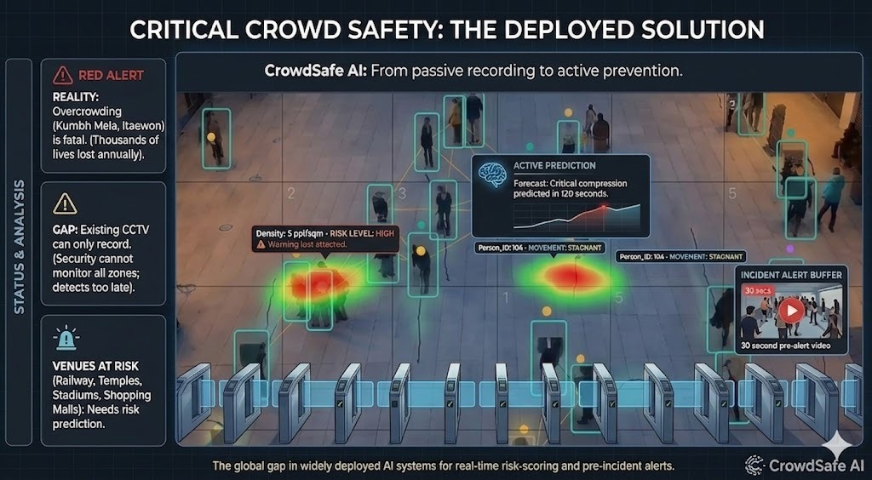
Problem Statement
Passive CCTV reacts too late.

Slide 3
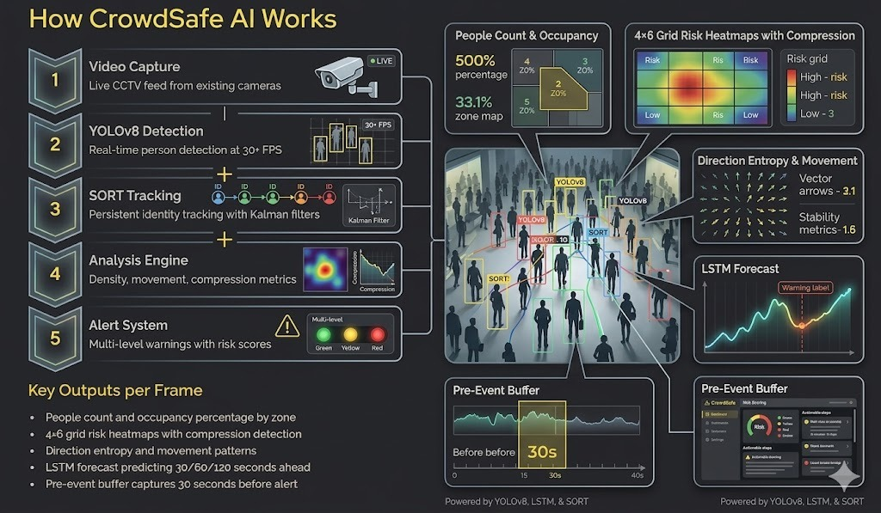
Proposed Solution
YOLOv8 + SORT + LSTM + FastAPI
Edge-first crowd intelligence pipeline.

Slide 4

Sustainability Impact
Aligned to SDG 3, 9, 11, and 16.
CrowdSafe AI

Slide 5
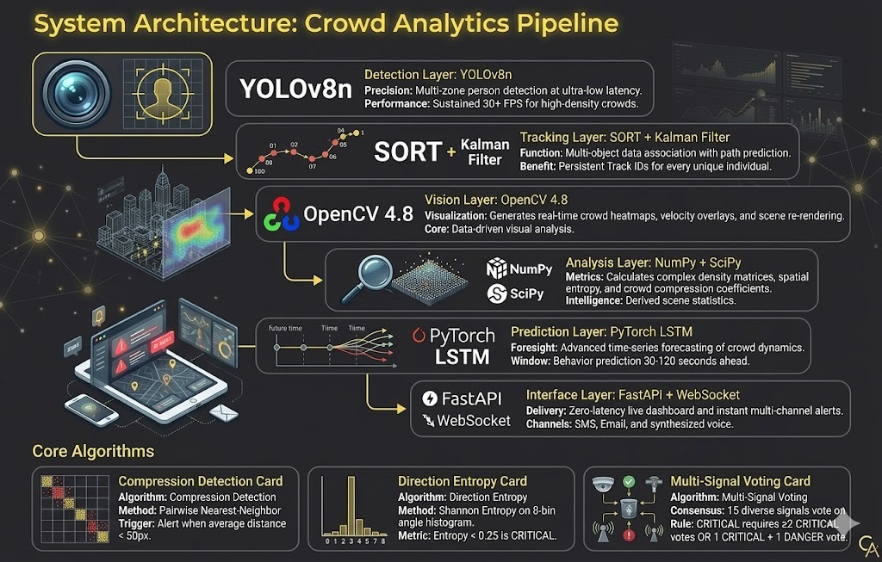
Technical Approach
YOLOv8, SORT, OpenCV, PyTorch, FastAPI, WebSocket
TECH STACK
Machine learning
HTML
CSS
Javascript
Python
Local inference and live dashboard stack

Slide 6
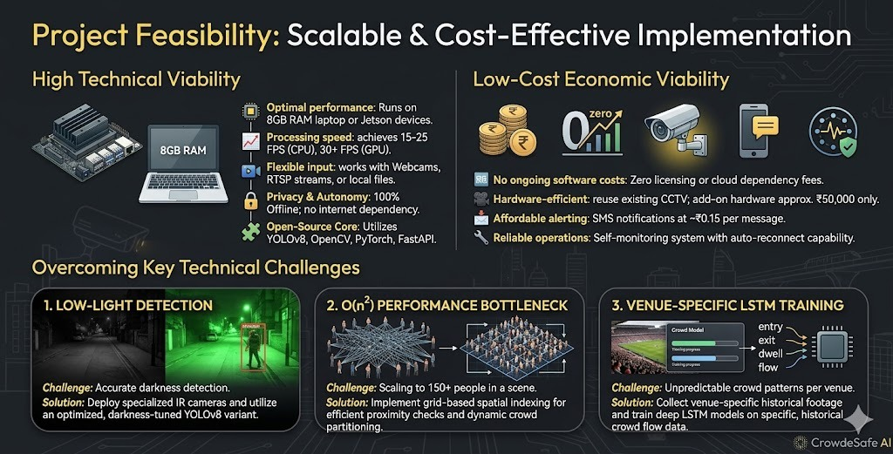
Feasibility and Viability
Runs on existing cameras, supports offline edge deployment, and keeps operating cost low.

Slide 7
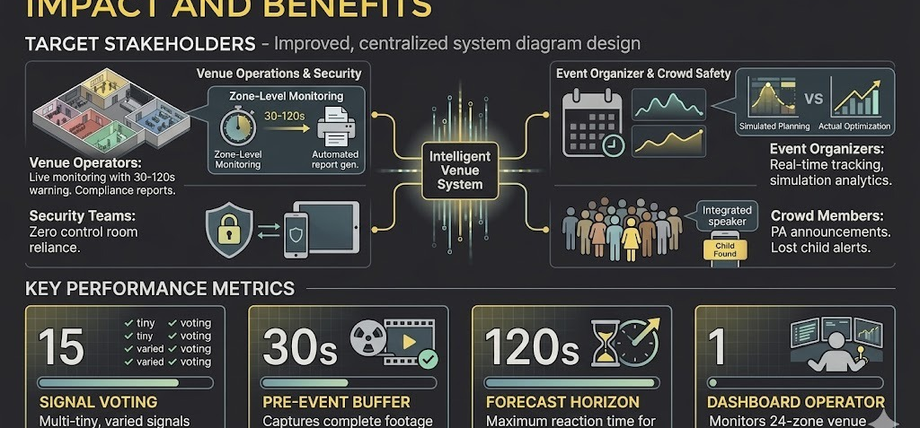
Impact and Benefits
Helps operators, security teams, and organizers intervene before incidents escalate.

Slide 8
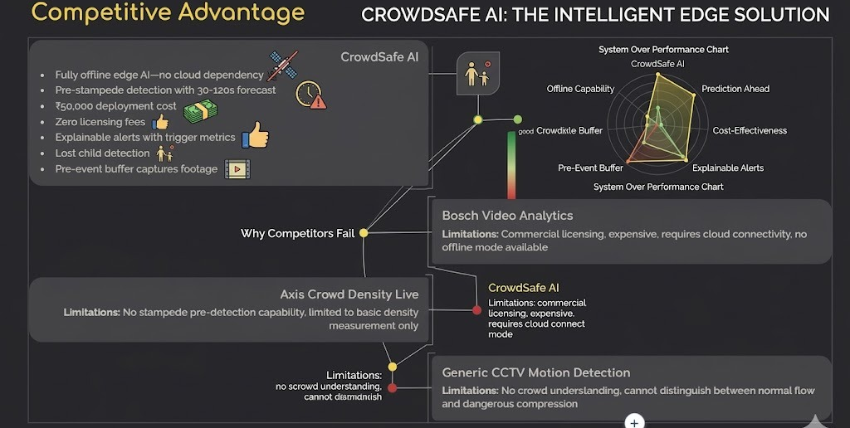
Key Differentiators
CrowdSafe AI
Predictive alerts, explainability, zone mapping, replay, and no-cloud operation.

Slide 9
Research and References
Selected stack and implementation sources.
Ultralytics YOLOv8https://docs.ultralytics.comSORT + Kalman FilterMulti-object tracking and trajectory persistenceOpenCVVideo overlays, heatmaps, and stream rendering
PyTorch LSTM30s / 60s / 120s crowd-risk forecastingFastAPI + WebSocketLive dashboard and streaming APISQLite + PDF reports
Session logs, incident timeline, and exportsProject moduleslogger.py, reporter.py, alerts.py, predictor.pyDocumentationREADME.md, QUICKSTART.md, STATUS.md@KEC PROJXPO

Slide 10
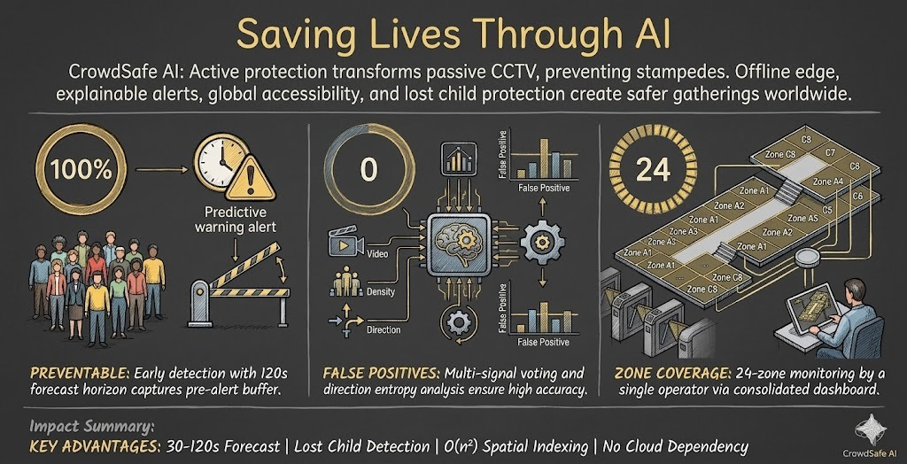
Deployment and Demo
Live video, camera switching, alerts, forecast bars, incident timeline, and replay clips.

