Slide 1
Network traffic analysis and IDS Using PCAP Feature Extraction
S KAMALESHWARAN

Slide 2
Problem Statement
What is DDoS?
- Distributed Denial of Service (DDoS) attacks overwhelm a server, network, or application with excessive traffic.
- Causes disruption to legitimate users.
Why is this a problem?
- Increasingly common in modern networks.
- Critical to detect and mitigate quickly.

Slide 3
Objectives
Create a network traffic analysis system that can detect potential malicious activity by
monitoring network traffic patterns. The system can use machine learning to classify traffic as
normal or suspicious, based on features like IP addresses, protocols, or packet size. It can be
used to identify intrusions such as DDoS attacks or malware communication.
Data Visualization: Use Matplotlib or Seaborn for visualizing traffic patterns and anomalies.

Slide 4
Methodology
1. Packet Capture File (PCAP)
- Input: Network traffic captured in .pcap format.
2. Feature Extraction Using Scapy
- Extract key features: Source/Destination IP, ports, protocols, packet sizes, and timestamps.
3. Traffic Pattern Analysis
- Analyze anomalies in packet rate, burst traffic, and protocol distribution.
4. DDoS Detection
- Heuristic-based detection using thresholds for:
• High traffic from single IP.
• Abnormal protocol usage.
• Burst traffic ratios.

Slide 5
Features Extracted
Packet-Level Features:
- Source IP, Destination IP
- Source/Destination Port
- Packet Length
- Protocol Type
- TCP Flags (e.g., SYN, ACK)
Traffic Statistics:
- Packet Count by IP
- Protocol Distribution
- Burst Traffic Ratio
Time-Based Metrics:
- Packet Intervals
- Traffic Volume Over Time

Slide 6
Implementation
PREREQUISITE
Python Version: Python 3.8+
REQUIRED LIBRARIES Install the required libraries using pip:
pip install scapy pandas matplotlib seaborn
OR
pip install -r requirements.txt
INSTALLATION
Clone the repository:
git clone https://github.com/kamalesh955/Network-Traffic-Analysis-and-IDS.git
RUN THE CODE
python app.py

Slide 7
Results
Sample Features Extracted:
Anomalies Detected:
- Highlight any suspicious IPs or protocols.
- Example: High traffic from 192.168.0.5.
DDoS Status:
- Whether the PCAP file showed signs of DDoS.

Slide 8
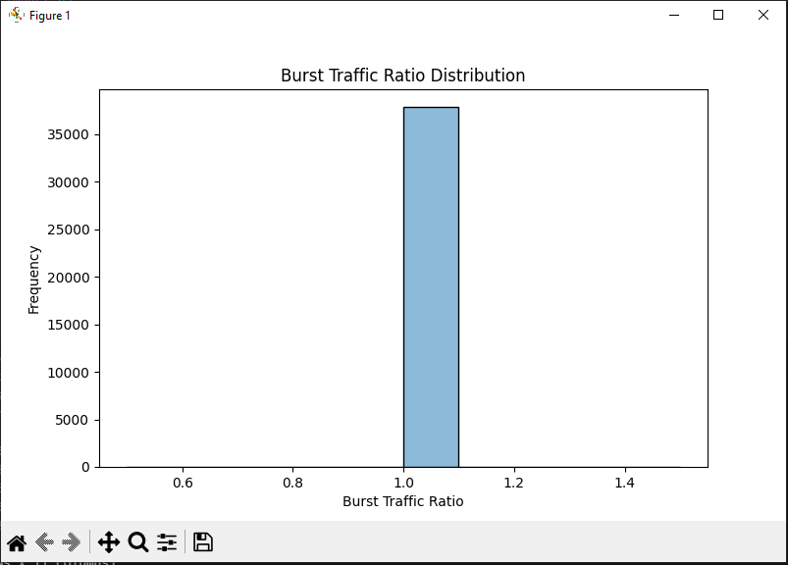
Results

Slide 9
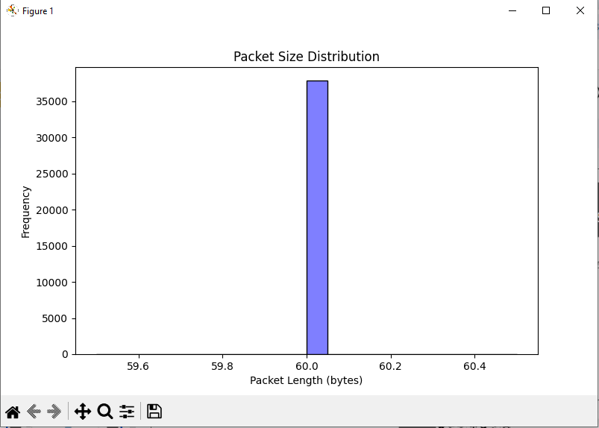
Results

Slide 10
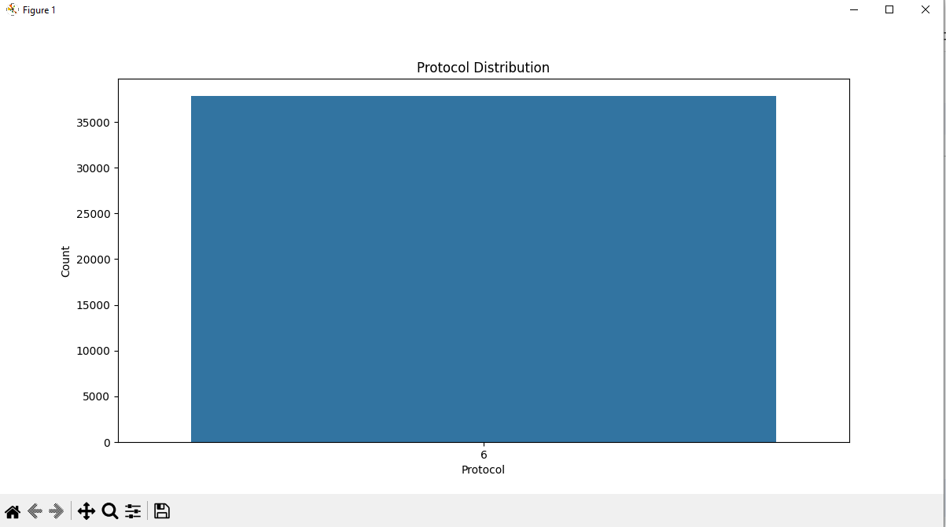
Results

Slide 11
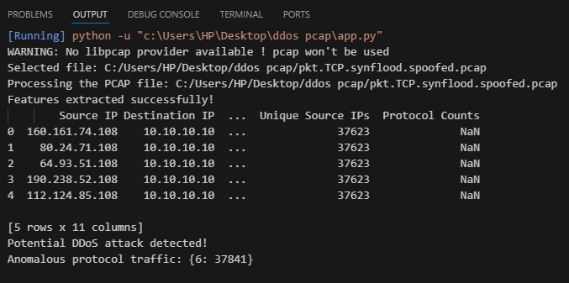
Results

Slide 12
Conclusion
Summary:
- Successfully extracted meaningful traffic features.
- Detected potential DDoS patterns using simple heuristics.

