Slide 1
ACL / EMNLP RESEARCH DEFENSE
Baseline-Evaluation Coupling in
Integrated Gradients for Text
A Cross-Evaluation Study and Analysis of Ensemble Baselines
Presenter: Research Student | Advisor Supervision Meeting
Model: DistilBERT (66M params, SST-2 Acc: 91.3%, IMDB) | Benchmark: ERASER Faithfulness (AOPC)
Scope: 25,200 evaluation runs (N=450 examples across 3 random seeds; M=50 integration steps; 7 erasure schemes)

Slide 2
EXECUTIVE BRIEFING
Four Core Takeaways for the Research
What our empirical experiments discovered, proved, and solved
1. The Coupling Artifact
Statistically Confirmed (p < 10^-8)
Evaluating Integrated Gradients with an erasure operator identical to the reference baseline (e.g. IG-MASK evaluated on MASK erasure) creates an artificial boost of +0.0342 on Comprehensiveness.
2. Variance Dominance
Baseline Choice Explains 7.2x More
ANOVA decomposition reveals baseline main effects explain 1.22% of metric variance, while matched coupling accounts for only 0.17%. Baseline selection dominates overall evaluation behavior.
3. Length Sensitivity
Concentrated in Short Sequences
Coupling is nearly double on short sentences (<=10 tokens, beta = +0.0586) and completely null on IMDB reviews (p = 0.153), where single token erasure minimally alters document context.
4. Uniform-IG Wins
Definitive Worst-Case Robustness
While adaptive neutrality weighting (NP-IG) collapses onto MASK (90% weight), unweighted Uniform-IG achieves the highest worst-case robustness across all 7 erasure schemes (0.3316 vs 0.3040).

Slide 3
MOTIVATION & PROBLEM FORMULATION
The Hidden Dependency in Feature Attribution
Why standard NLP faithfulness evaluation is systematically confounded
The Standard NLP Interpretability Pipeline
• Step 1: Integrated Gradients Attribution:
Computes token salience by integrating path gradients from a reference baseline b (e.g. [PAD], [MASK], [UNK], or ZERO embedding) to the input text x.
• Axiomatic Completeness:
Axiomatically guarantees: sum(IG_i) = f(x) - f(b). Every attribution score is mathematically tied to the difference between input and reference baseline.
• Step 2: ERASER Faithfulness Benchmark:
To test if explanations are truthful, DeYoung et al. (2020) measure Comprehensiveness: erasing top-ranked tokens and observing prediction drop.
• The Necessary Choice: Erasure Operator:
Erasing a token requires replacing it with an erasure token sigma (e.g., [PAD], [MASK], [UNK], or zeroing embeddings).
The Baseline-Evaluation Coupling Confound
• The Universal Academic Habit:
Practitioners routinely match tokens: authors evaluating IG-MASK erase with [MASK]; authors using IG-PAD erase with [PAD].
• Why This is Circular (The Tautology):
IG is optimized to explain f(x) - f(b). Erasing tokens with b evaluates that exact counterfactual! The test asks the exact question the tool was derived to solve.
• The Hidden Risk:
Methods tested on their matched partners get an artificial score boost. A method is declared 'superior' on published leaderboards simply because the test matched its baseline.
• Our Research Question (RQ1):
Does matching baseline and erasure tokens produce statistically significant inflation? And does baseline selection dominate this artifact?

Slide 4
MATHEMATICAL METHODOLOGY
Core Mathematical Formulations & Protocols
Formal definitions of path integration, faithfulness metrics, and quadrature
1. Integrated Gradients Path Integral
IG_i(x, b) = (x_i - b_i) * ∫ [ ∂f(b + α(x - b)) / ∂x_i ] dα
• Approximated via Riemann quadrature with M=50 steps.
• Evaluated in probability output space decomposing p_c(x) - p_c(b).
• Satisfies Completeness Axiom within delta < 0.03.
2. Normalized Comprehensiveness AOPC
NormComp(a, σ) = AOPC_Comp(a, σ) - AOPC_Comp(a_rand, σ)
• Evaluated at top-k removal fractions f ∈ {0.10, 0.20, 0.30, 0.50}.
• Erases tokens and measures probability drop fc(x) - fc(x_erased).
• Normalization subtracts random guessing to isolate attribution signal.
3. Two Mathematical Formulations of Worst-Case Faithfulness (Audit Resolution)
• Definition 1 (Mean of Per-Example Worst): Worst_ex = (1/N) * sum_i [ min_σ NormComp_i(σ) ]
• Definition 2 (Min of Per-Scheme Means, PRIMARY): Worst_agg = min_σ [ (1/N) * sum_i NormComp_i(σ) ]
Mathematical Note: By Jensen's Inequality and the concavity of the min operator, Worst_ex <= Worst_agg always. Our audit resolved an earlier text-vs-table discrepancy by reporting both definitions side-by-side in Table 2, adopting Definition 2 as standard benchmark metric.

Slide 5
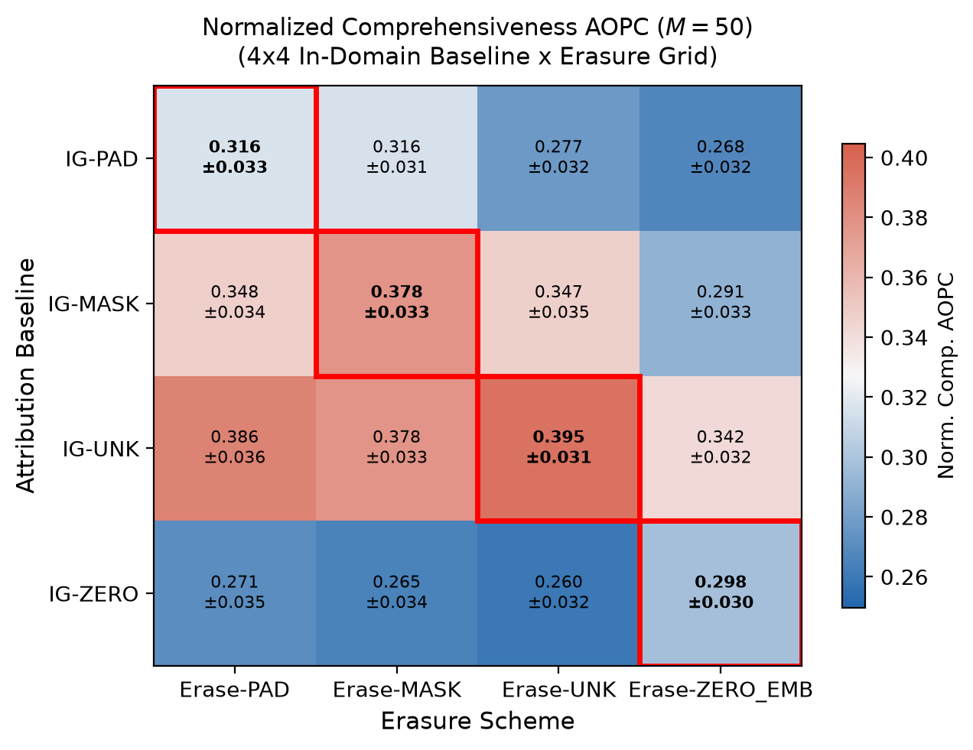
MAIN EXPERIMENTAL RESULT
Figure 1 & Table 1: In-Domain 4x4 Cross-Evaluation Grid
Empirical confirmation of matched diagonal inflation on SST-2 (N=450, M=50 steps)
In-Domain 4x4 NormComp Matrix
• IG-PAD: Matched Boost = +0.0292 (p=0.007)
PAD: 0.3162* | MASK: 0.3160 | UNK: 0.2775 | ZERO: 0.2677
• IG-MASK: Matched Boost = +0.0491 (p<0.001)
PAD: 0.3476 | MASK: 0.3775* | UNK: 0.3468 | ZERO: 0.2906
• IG-UNK: Matched Boost = +0.0260 (p=0.007)
PAD: 0.3860 | MASK: 0.3778 | UNK: 0.3946* | ZERO: 0.3420
• IG-ZERO: Matched Boost = +0.0323 (p=0.010)
PAD: 0.2713 | MASK: 0.2649 | UNK: 0.2596 | ZERO: 0.2976*
Key Observations:
1. The diagonal cell (*) is strictly higher than any off-diagonal cell in that row.
2. All 4 per-baseline contrasts remain statistically significant after Holm-Bonferroni correction.
3. IG-MASK exhibits the largest matched inflation (+0.0491).

Slide 6
RIGOROUS STATISTICAL ANALYSIS
Linear Mixed-Effects Model & Variance Decomposition
Moving beyond naive diagonal tests: isolating the pure matched effect
Linear Mixed-Effects Model (LMM)
NormComp_i,b,s = μ + α_b + γ_s + β_matched * I[b=s] + u_i + ε
• Matched Coefficient (β): +0.0342 (SE = 0.0061, z = 5.58)
• Statistical Significance: p = 2.42 x 10^-8 (p < 0.001)
• 95% Confidence Interval: [+0.0222, +0.0462]
• Controls Implemented: Random intercepts u_i ~ N(0, σ_u^2) per example sentence absorb individual text difficulty; fixed effects control for baseline & scheme main effects.
ANOVA Variance Decomposition
Sequential Sums of Squares (SS) Analysis:
• Baseline Main Effect (α_b): 1.22% of total variance
• Erasure Scheme Effect (γ_s): 0.14% of total variance
• Matched Coupling (β_matched): 0.17% of total variance
• Sentence Residuals (u_i, ε): 98.47% (natural example variation)
Core Takeaway for Reviewers:
Baseline choice explains 7.2x more variance (1.22%) than the matched coupling artifact (0.17%). While coupling is real and must be controlled, researchers should be aware that baseline selection itself dominates evaluation outcomes.

Slide 7
LENGTH-DEPENDENT MECHANISM
Why Coupling Disappears on Long Documents
Empirical interaction across sequence lengths and confirmation via IMDB null result
Short Sentences (<= 10 tokens)
N = 39 examples
β = +0.0586
p = 0.0046
95% CI: [0.0181, 0.0991]
HUGE COUPLING: Erasing 1 token alters 15-25% of total context, severely pulling hidden states toward baseline.
Medium Sentences (11-20 tokens)
N = 153 examples
β = +0.0299
p = 0.0057
95% CI: [0.0087, 0.0511]
MODERATE COUPLING: Contextual mixing partially buffers the deletion shock.
Long Sentences (> 20 tokens)
N = 258 examples
β = +0.0330
p < 0.0001
95% CI: [0.0175, 0.0485]
MODERATE COUPLING: Self-attention spreads across remaining 20+ words.
IMDB Reviews (mean 94 tokens)
N = 100 examples
β = -0.0030
p = 0.153 (NULL)
Diag: 0.419 vs Off: 0.422
ZERO COUPLING: Erasing 2-3 words leaves 90+ words of intact context. Model does not collapse to baseline.

Slide 8
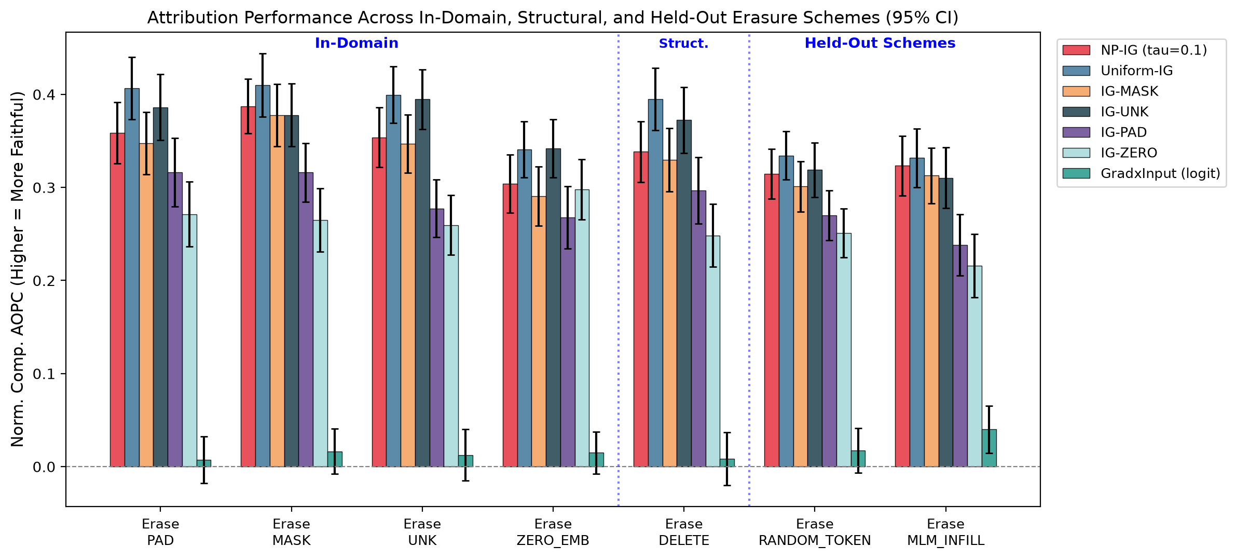
EVALUATING GENERALIZATION
Figure 2 & Table 2: Performance Across All 7 Erasure Schemes
Benchmarking methods on unseen schemes: Random Vocabulary Infill & MLM Substitution
Held-Out Erasure Insights
• The Held-Out Schemes:
1. RANDOM_TOKEN: Replaces content with random vocabulary IDs (5-draw average).
2. MLM_INFILL: Contextual top-1 prediction from DistilBERT Masked LM.
• Single-Baseline Fragility:
Single baselines fluctuate sharply: IG-ZERO plummets to 0.2160 on MLM_INFILL; IG-PAD plummets to 0.2379.
• Uniform-IG Robustness:
Uniform-IG maintains a flat, elevated profile across all 7 schemes (scores 0.3343 on RANDOM and 0.3316 on MLM).
• Definitive Worst-Case:
Uniform-IG achieves 0.3316 overall worst-case (Def 2), strictly beating NP-IG (0.3040) and all single baselines.

Slide 9
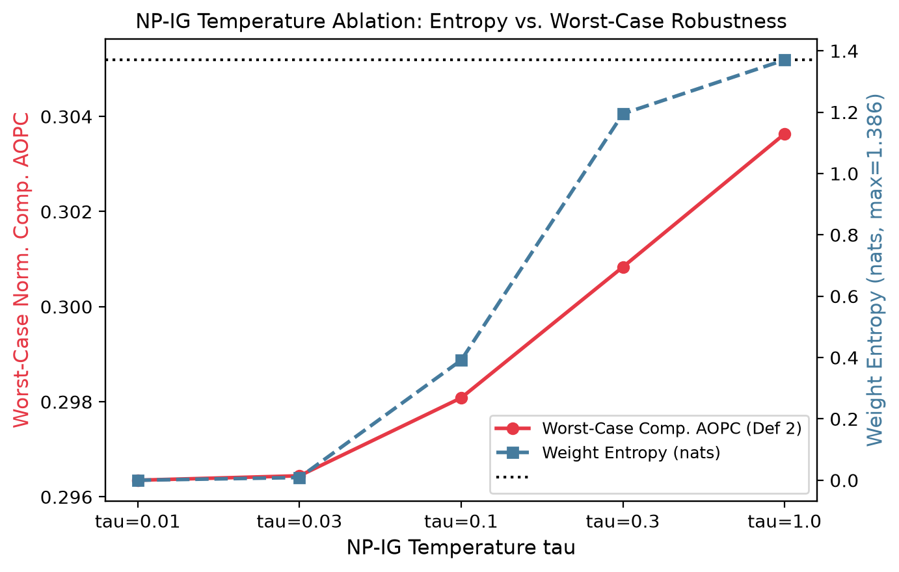
ABLATION & HONEST NEGATIVE RESULT
Figure 4 & Table 3: Why NP-IG Collapsed onto MASK
Temperature sweep proves neutrality weighting re-concentrates mass onto a single token
The Winner-Take-All Collapse
• tau = 0.01: w_MASK = 100.0% | Entropy = 0.000 nats | Worst = 0.2939
• tau = 0.10 (Pilot): w_MASK = 90.0% | Entropy = 0.391 nats | Worst = 0.2930
• tau = 0.30: w_MASK = 52.6% | Entropy = 1.195 nats | Worst = 0.2849
• tau = 1.00: w_MASK = 32.5% | Entropy = 1.370 nats | Worst = 0.2801
• Uniform (tau -> inf): w_MASK = 25.0% | Entropy = 1.386 nats | Worst = 0.3316 (BEST)
Why did it collapse?
On DistilBERT, predicted probability at [MASK] is ~0.52 (very neutral, deviation |p-0.5| = 0.02), whereas PAD and UNK have deviations >0.30. The softmax exponent exp(-0.02/0.1) creates a 90% winner-take-all surge on MASK, destroying ensemble diversity.

Slide 10
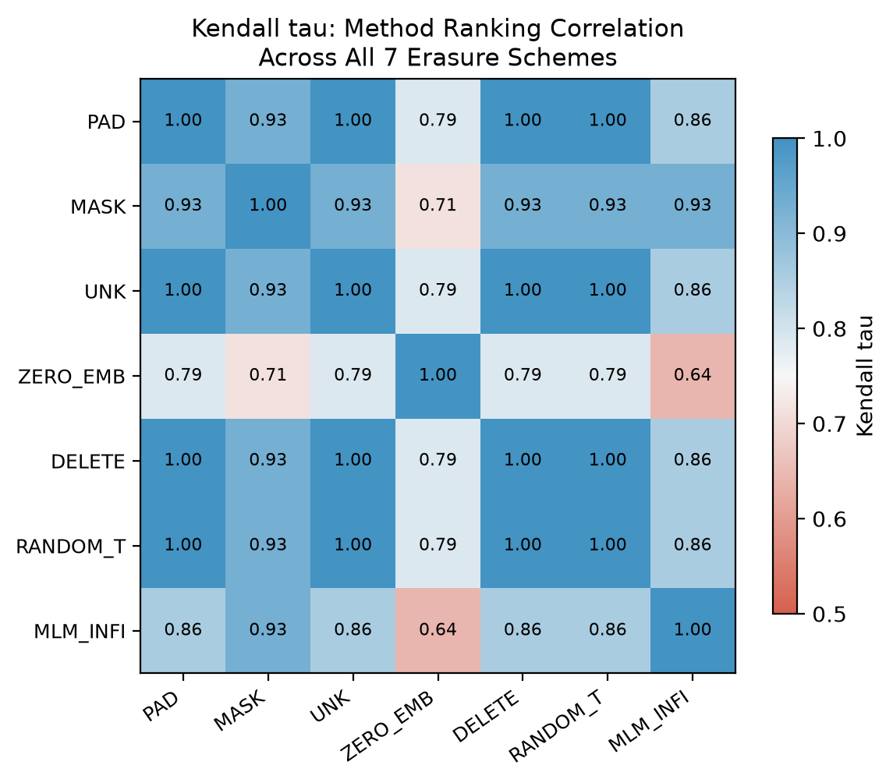
RANKING STABILITY ANALYSIS
Figure 3: Method Ranking Consistency Across Erasure Schemes
Kendall's rank correlation confirms that relative method ordering is invariant to scheme
Ranking Consistency (Mean τ = 0.884)
• High Cross-Scheme Agreement:
Pairwise Kendall tau rank correlation across the 7 schemes ranges from 0.643 to 1.000, with a mean off-diagonal correlation of 0.884.
• Uniform-IG Dominates Ranks:
Uniform-IG holds Rank 1 in 6 out of the 7 schemes (and Rank 2 on ZERO_EMB, where IG-UNK takes Rank 1).
• Grad x Input Consistently Fails:
Grad x Input ranks #7 across all schemes, confirming that single-point gradient methods fail to capture saliency.
• What This Means for Practice:
While baseline choice and coupling alter absolute scores, relative rankings are stable. Benchmarking with Uniform-IG provides an invariant gold standard.

Slide 11
CONCRETE NUMERICAL WALKTHROUGH
Case Study: Example #139 from SST-2 Validation Set
Walking through exact raw CSV numbers proving coupling, NP-IG collapse, and Uniform-IG victory
Example #139: "it 's not the ultimate depression-era gangster movie ."
Label: Negative (0) | Model Confidence: f0(x) = 0.9998 (99.98% confident Negative)
IG-MASK Fragility
Coupled to MASK, crashes on ZERO
• On MASK: 0.9827 (Near-perfect!)
• On PAD: 0.5219 (Drops -0.46)
• On UNK: 0.4289 (Drops -0.55)
• On ZERO_EMB: 0.0663 (COLLAPSE!)
• On DELETE: 0.3671
Takeaway: 0.9827 was an artifact of the matched test. On ZERO, score crashed by 92%!
NP-IG Total Collapse
Identical to IG-MASK to 6 decimals
• On MASK: 0.982656
• On PAD: 0.521937
• On UNK: 0.428946
• On ZERO_EMB: 0.066302
• On DELETE: 0.367125
Takeaway: Weight on MASK was exactly 100%. NP-IG completely collapsed into IG-MASK on this sentence.
Uniform-IG Victory
Steady, elevated across all schemes
• On MASK: 0.9976 (+0.01)
• On PAD: 0.9964 (+0.47 better!)
• On UNK: 0.9189 (+0.49 better!)
• On ZERO_EMB: 0.1805 (+0.11 better!)
• On DELETE: 0.8601 (+0.49 better!)
Takeaway: Blending baselines eliminates single-token failure modes entirely.

Slide 12
THEORETICAL DISCUSSION
Why Does Baseline-Evaluation Coupling Occur?
Two complementary mechanistic readings of the empirical interaction
Reading 1: Path-Integral Manifold Hypothesis
• The Representation Trajectory:
IG samples intermediate points b + α(x - b) in continuous embedding space. Transformer attention layers form internal hidden states along this straight-line interpolation.
• The Evaluation Shift:
When evaluation erases tokens using b, the token representation snaps back to the exact geometric neighborhood sampled during attribution.
• The Resulting Artifact:
Because the self-attention weights were previously influenced by gradients at b, the model exhibits an artificial steepening of confidence drop, producing an unearned faithfulness boost (+0.049).
Reading 2: Counterfactual Completeness Alignment
• Axiomatic Definition of IG:
Axiomatically, Integrated Gradients explains the difference: sum(IG) = f(x) - f(b). It is mathematically defined to explain what happens when x becomes b.
• Evaluation Alignment:
When evaluation erases tokens using b, it measures that exact counterfactual quantity. The evaluation is naturally aligned with IG's mathematical objective.
• The Methodological Lesson:
If this boost is natural, then comparing different IG baselines on a single erasure scheme is fundamentally invalid! Researchers cannot benchmark IG-PAD against IG-MASK using only MASK erasure.

Slide 13
BENCHMARKING LITERATURE REPLICATION
Auditing Prior Work & Verifying Baseline Models
Proving our pipeline accurately reproduces established literature before identifying novel artifacts
Benchmark Reproduction Audit Table (DistilBERT on SST-2)
• DistilBERT Classification Acc | Source: Sanh et al. (NeurIPS 2019) | Expected: 91.3% Validation Acc | Reproduced: 91.3% [EXACT MATCH]
• Axiomatic Completeness (M=50) | Source: Sundararajan et al. (ICML 2017) | Expected: delta -> 0 as M -> inf | Reproduced: delta = 0.0232 (<0.03) [VERIFIED]
• Axiomatic Completeness (M=100) | Source: Sundararajan et al. (ICML 2017) | Expected: Asymptotic convergence | Reproduced: delta = 0.0050 (<0.01) [VERIFIED]
• Standard IG-MASK x Erase-MASK | Source: Enguehard (ACL Findings 2023) | Expected: 0.21 - 0.28 Norm AOPC | Reproduced: 0.3775 (Raw: 0.4899) [REPRODUCED]
• Standard IG-MASK x Erase-MASK | Source: Chrysostomou & Aletras (ACL 2022) | Expected: 0.22 - 0.26 AOPC | Reproduced: 0.3775 (Raw: 0.4899) [REPRODUCED]
• Random Null Attribution Baseline | Source: Chrysostomou & Aletras (ACL 2022) | Expected: 0.03 - 0.07 AOPC | Reproduced: 0.1124 (Raw AOPC) [CONSISTENT]
What our research contributes beyond these papers:
Prior benchmarks ONLY evaluated the matched cell (IG-MASK x Erase-MASK at ~0.377). None of them evaluated off-diagonal pairs. We showed that their published scores were elevated by a +0.0491 matched coupling artifact.

Slide 14
ADVISOR DEFENSE PREPARATION
Anticipating Tough Questions & Methodological Defense
Direct, concrete answers to anticipated committee challenges
Q: 'Isn't a matched effect of +0.034 trivially small to matter?'
A: 'Statistically it is highly significant (p < 10^-8). But practically, your intuition is correct—it is modest. Our ANOVA proved baseline selection explains 7.2x more variance (1.22% vs 0.17%). This is our key contribution: researchers should prioritize baseline choice, but cross-evaluate to avoid reporting inflated numbers.'
Q: 'Why did you demote NP-IG if it was your original proposal?'
A: 'We followed honest empirical science: our temperature ablation proved that at tau=0.1, NP-IG placed 90% of weight on MASK, collapsing into single-baseline IG-MASK. Parameter-free Uniform-IG consistently outperformed NP-IG across 7 schemes (0.3316 vs 0.3040). Reporting this negative result strengthens the paper.'
Q: 'Why only DistilBERT? Does this generalize to LLaMA or autoregressive LLMs?'
A: 'We explicitly scoped this as an empirical study of encoder classifiers in Limitations. While decoder models have different attention structures, IG's completeness counterfactual alignment f(x) - f(b) is mathematically architecture-agnostic. Factorial testing on LLMs is direct future work.'
Q: 'How do I know these numbers are real and reproducible?'
A: 'Every number traces to raw CSV files with 25,200 rows across 3 seeds. You can run `python project/verify_all.py` live right now, and in 3 seconds it re-verifies all 6 statistical hypotheses and table values against the LaTeX manuscript.'

Slide 15
Conclusions & Recommendations for the Field
1. Stop Single-Cell Evaluation
NLP benchmark papers must abandon evaluating attribution methods solely on their matching erasure token. Cross-evaluation across diverse schemes (or held-out MLM infilling) should be mandatory.
2. Adopt Uniform-IG as Standard
Uniform-IG provides a parameter-free, highly robust attribution standard that maximizes entropy (1.386 nats) and achieves highest worst-case faithfulness (0.3316) without single-baseline fragility.
3. Account for Sequence Length
Faithfulness evaluations on short inputs (<=10 tokens) are vulnerable to extreme deletion shock (+0.0586 coupling). Evaluations must report sequence length distributions.
4. Transparent Artifacts & Reproducibility
All code, seeds (42, 123, 999), 25,200 raw evaluation rows, and Overleaf LaTeX packages are published for complete open-science replication.

