Slide 1

“FOOD DELIVERY WEBSITE AND APPLICATION”
TASK 1:

Slide 2
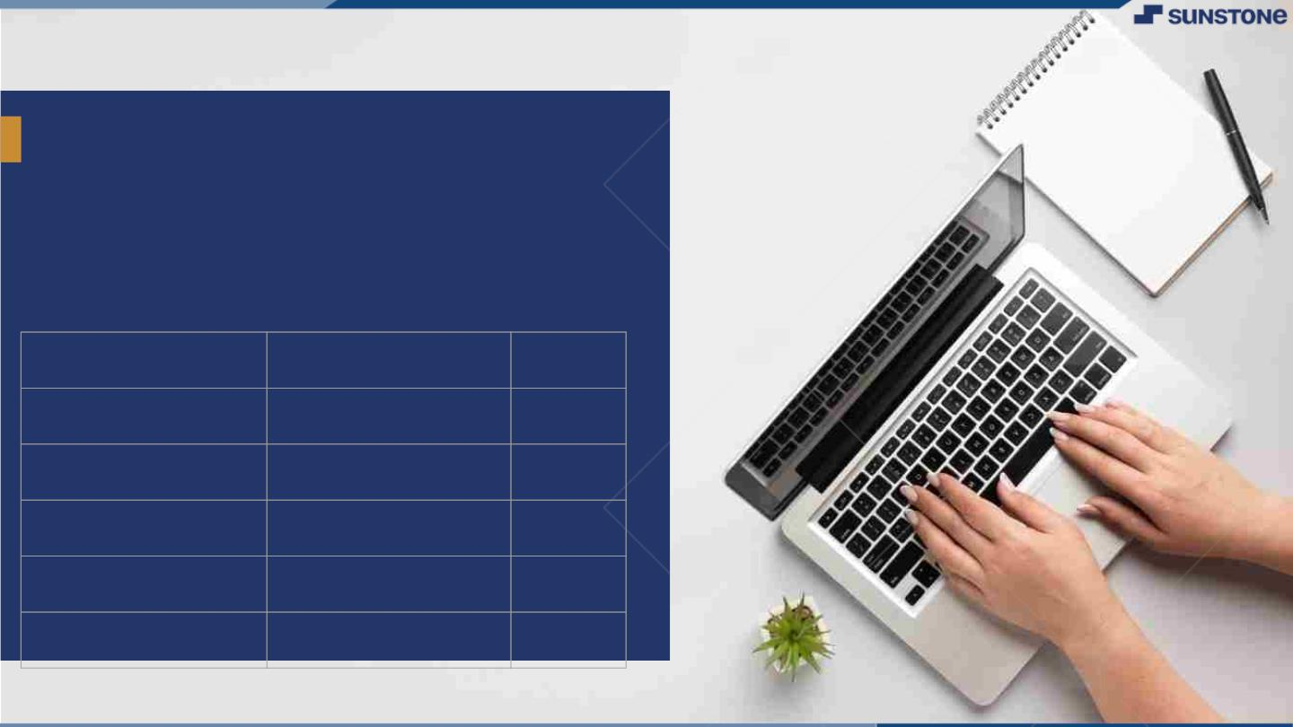
FOOD DELIVERY WEBSITE AND APPLICATION
Introduction:
An online food ordering system allows your business to accept and manage orders placed online for delivery or takeaway.
LMS Username
Name
Batch
MANIMEGAN T
02
DINESH KUMAR B
02
KAMALESH R 02
SIVAKUMAR M 02

Slide 3


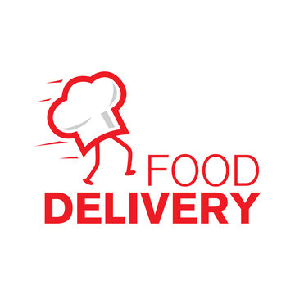
Introduction
Welcome to the world of convenient and delightful dining! In today's fast-paced world, food delivery has become an essential part of our lives. We are excited to introduce . a game-changing food delivery solution designed to make your culinary experiences easier, tastier, and more enjoyable.
Examples
DelightBites offers secure payment options, real-time order tracking, and timely deliveries, ensuring a hassle-free experience. Whether you're craving comfort food, exotic dishes, or healthy options, we've got you covered. Join the DelightBites community today and savor the freedom of enjoying restaurant-quality meals in the comfort of your own home."

Slide 4
Steps Involved in Development
1. Project Planning and Design:
Define the application's scope, features, and target audience.
Create a detailed system design, including data models, user interfaces, and architecture.
2. Front-End Development:
Develop the user interface using HTML, CSS, and JavaScript.
Implement user registration, login, and account management screens.
Integrate with APIs or libraries for user interactions.

Slide 5
3. Back-End Development:
Set up a server-side environment using Java.
Use a framework like Spring Boot for rapid development.
Implement user authentication, authorization, and session management.
Create RESTful APIs for handling money transfers, balance checking, and transaction history.
4. Database Setup:
Choose a database system (e.g., MySQL, PostgreSQL) and set it up.
Create database schemas and tables to store user data, account balances, and transaction records.
Implement database connectivity in your Java application using JDBC or an ORM (Object-Relational Mapping) framework.

Slide 6
5. Security Implementation:
Prioritize security with encryption for sensitive data (e.g., passwords, transaction details).
Implement secure communication protocols (HTTPS).
Apply input validation to prevent common security vulnerabilities.
6. Testing:
Perform unit testing to validate individual components and functions.
Conduct integration testing to ensure seamless interactions between front-end and back-end.
Perform user acceptance testing to verify the application's usability.

Slide 7
7. Deployment:
Deploy the application on a web server or cloud platform.
Configure domain settings and ensure scalability and availability.
Set up monitoring and error logging for maintenance.
8. User Documentation:
Create user guides or documentation to help users understand how to use the application effectively.

Slide 8
SUMMARY
A food delivery website and application serve as a dynamic and essential bridge between customers and their favorite restaurants. These platforms offer a streamlined and convenient way for users to access a wide variety of culinary options from the comfort of their homes. Key features include user-friendly interfaces for easy ordering, real-time delivery tracking, and secure payment processing. For businesses, they present opportunities for growth and reaching a broader audience. Food delivery websites and applications have redefined the dining experience, providing unparalleled convenience, choice, and efficiency in today's fast-paced world.

Slide 9

AssessmentꢀParameter
Gatherꢀrequirementsꢀforꢀtheꢀ
project
addꢀReadme.mdꢀfileꢀwithꢀ
descriptionꢀofꢀtheꢀproject
Prepareꢀdatabaseꢀdesignꢀ
schemas
Check-List
Commitꢀallꢀchangesꢀwithꢀ"firstꢀ
commit"
Getꢀyourꢀinitialꢀprojectꢀ
Structureꢀready
createꢀaꢀrepositoryꢀonꢀgithubꢀ
realtedꢀtoꢀproject
Initiateꢀaꢀgitꢀrepository
Pushꢀyourꢀchangesꢀtoꢀgithub

Slide 10

Submission Github
https://github.com/kamaleshsmart01/NM-APEC-IT-GROUP2

Slide 11


