Slide 1
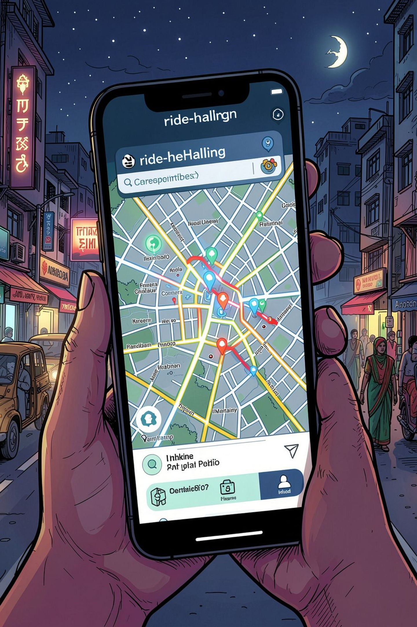
OLA Ride Booking Analysis
100,000 bookings · 20 columns · SQL + Power BI insights
DATA ANALYTICS PROJECT

Slide 2


Dataset at a Glance
Booking details: Date, Time, Status, Customer ID
Ride details: Vehicle Type, Pickup & Drop Location, Distance
Performance: TAT, Driver & Customer Ratings
Cancellations: Customer & Driver reasons
Revenue: Booking Value, Incomplete Rides
Missing values in TAT, cancellation reason, incomplete ride reason, and rating columns
100K
20
Booking rows
Columns

Slide 3
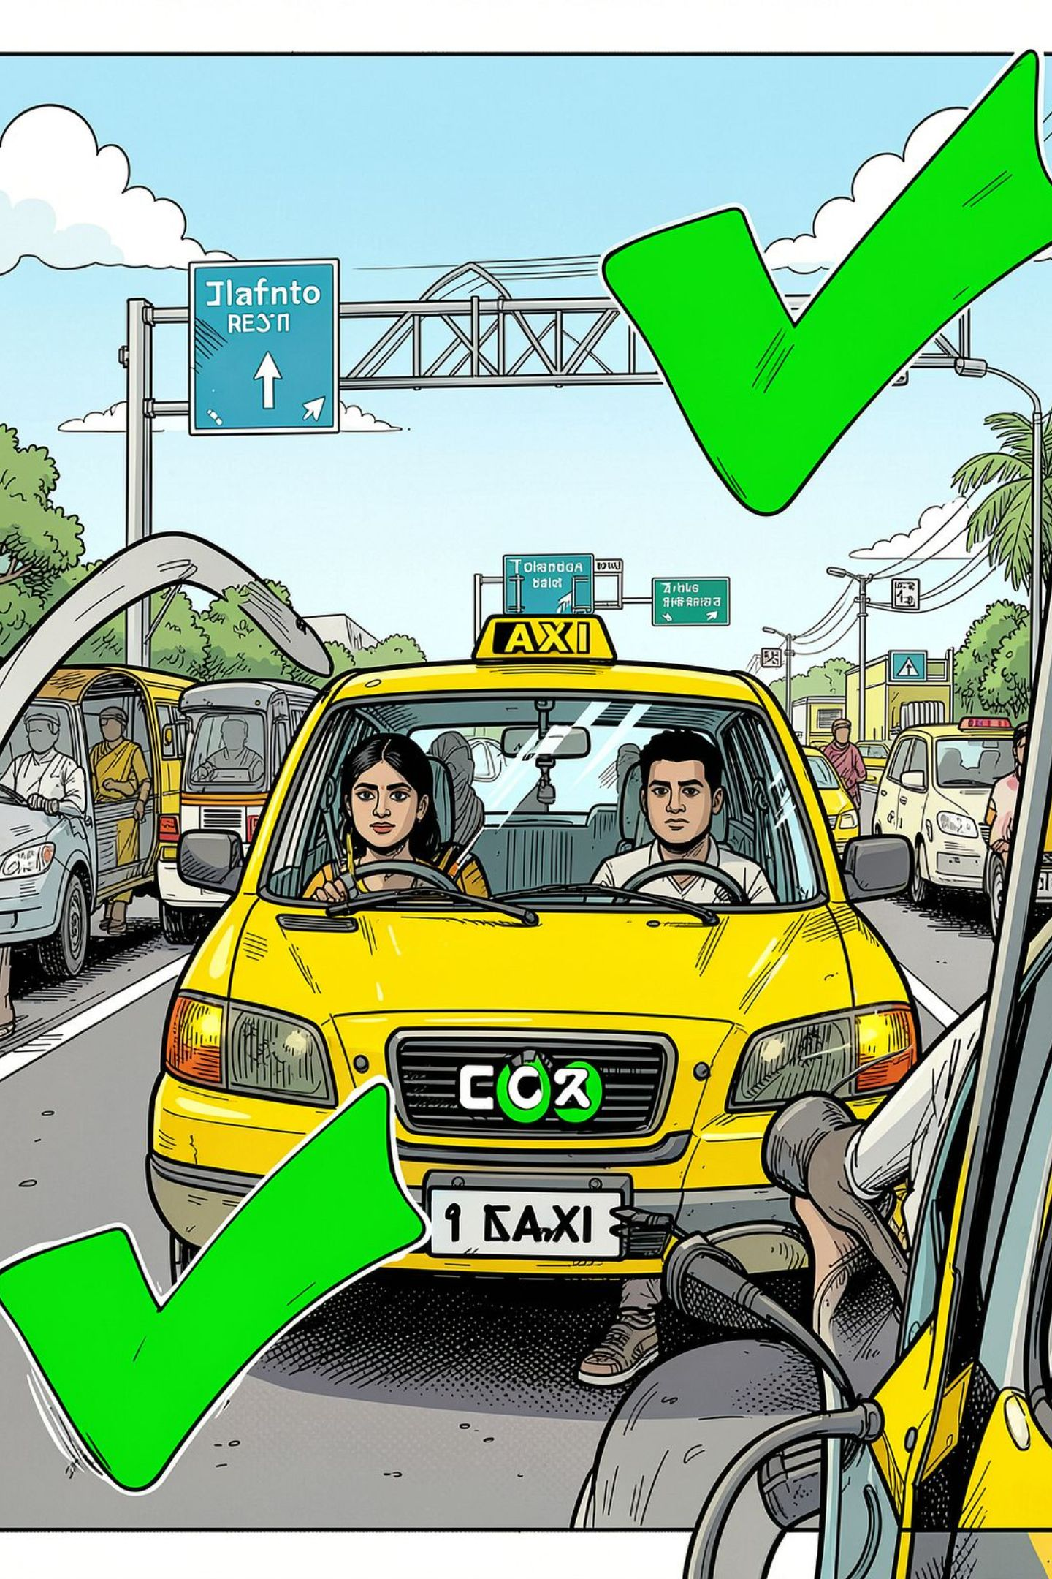
Booking Performance
10,499
6,542
Customer Cancellations
Driver Cancellations
35M
Successful Ride Value

Slide 4
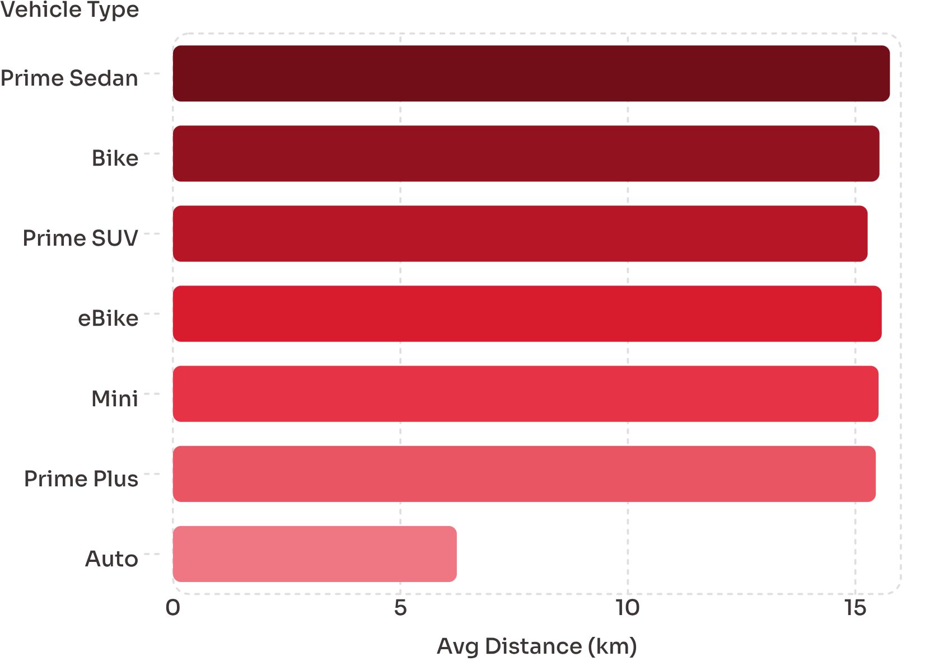
Ride Distance by Vehicle Type
Key Insight
Autos average just 6.24 km — less than half of all other vehicle types, which cluster tightly around 15–16 km.

Slide 5
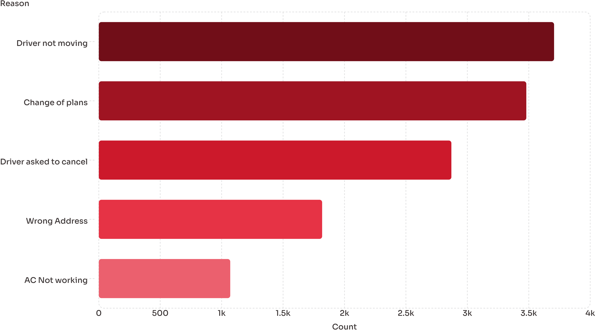
Customer Cancellation Reasons

Slide 6
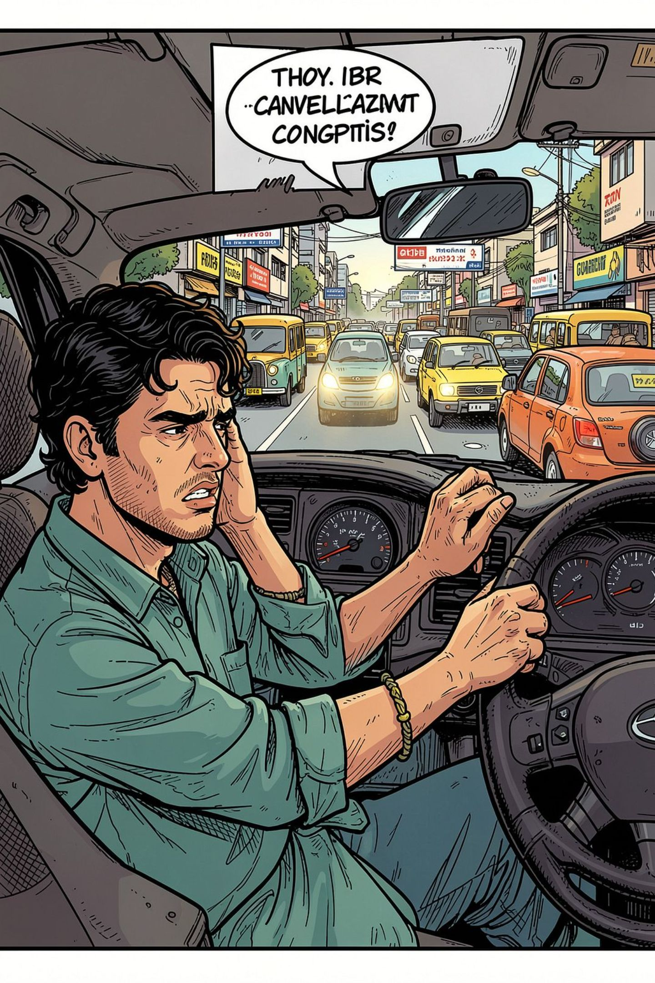
Driver Cancellation Reasons
Personal & Car Issues
8,540 · 25.48%
Customer Related
3,410 · 25.34%
Customer Double-Booking
3,830 · 25.32%
Over Passenger Limit
3,050 · 19.82%

Slide 7
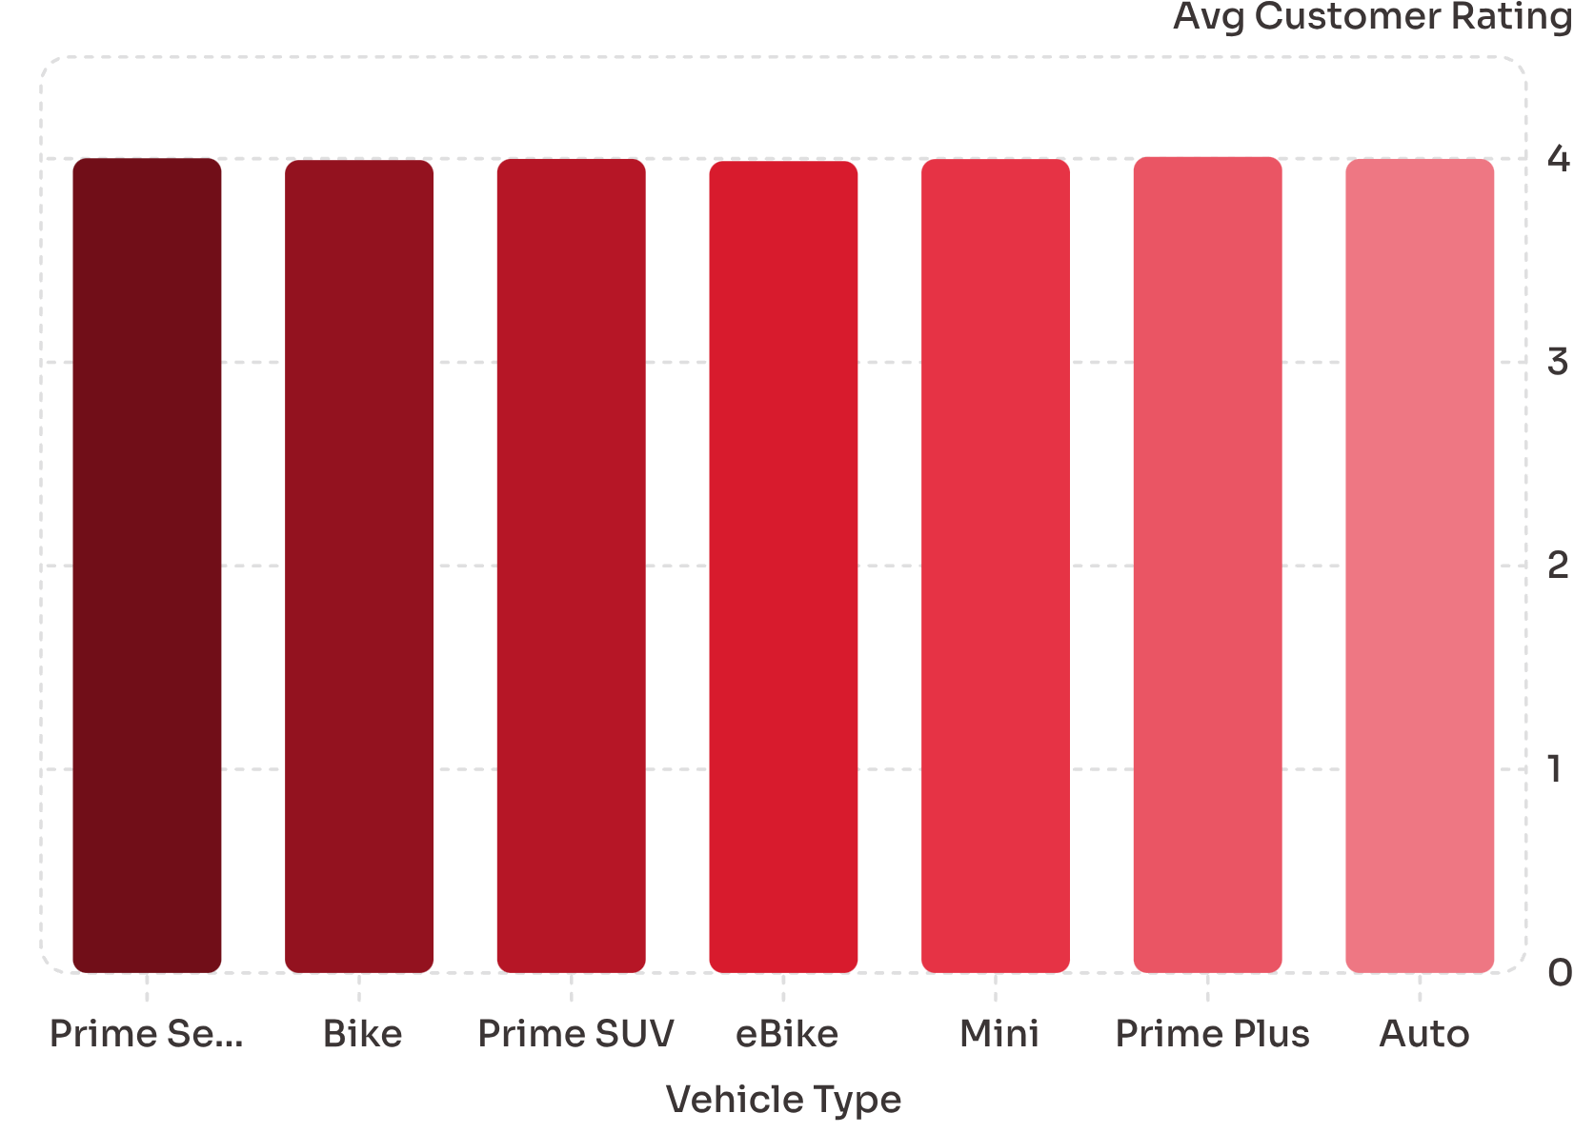
Customer Ratings by Vehicle Type
Driver Rating Range
Max: 5
Min: 3
All vehicle types cluster tightly around 4.0 — Prime Plus leads at 4.009.

Slide 8
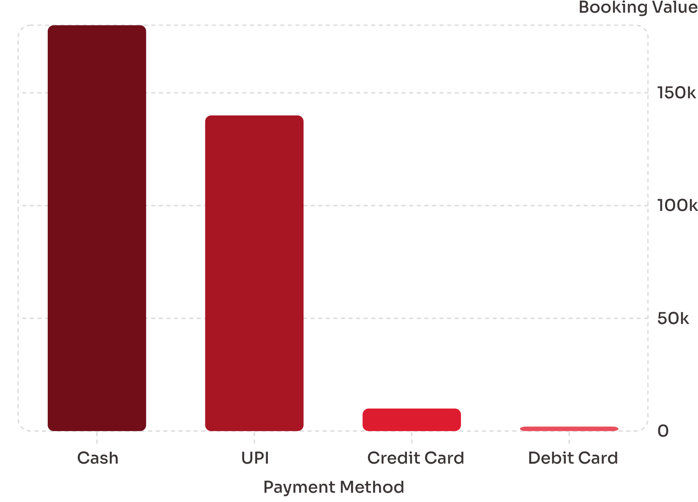
UPI Payment Adoption
Digital Payments Lead
UPI is the dominant digital payment method, second only to Cash overall.
Cash
UPI
~₹180K
~₹140K
Credit Card
Debit Card
~₹10K
~₹2K

Slide 9
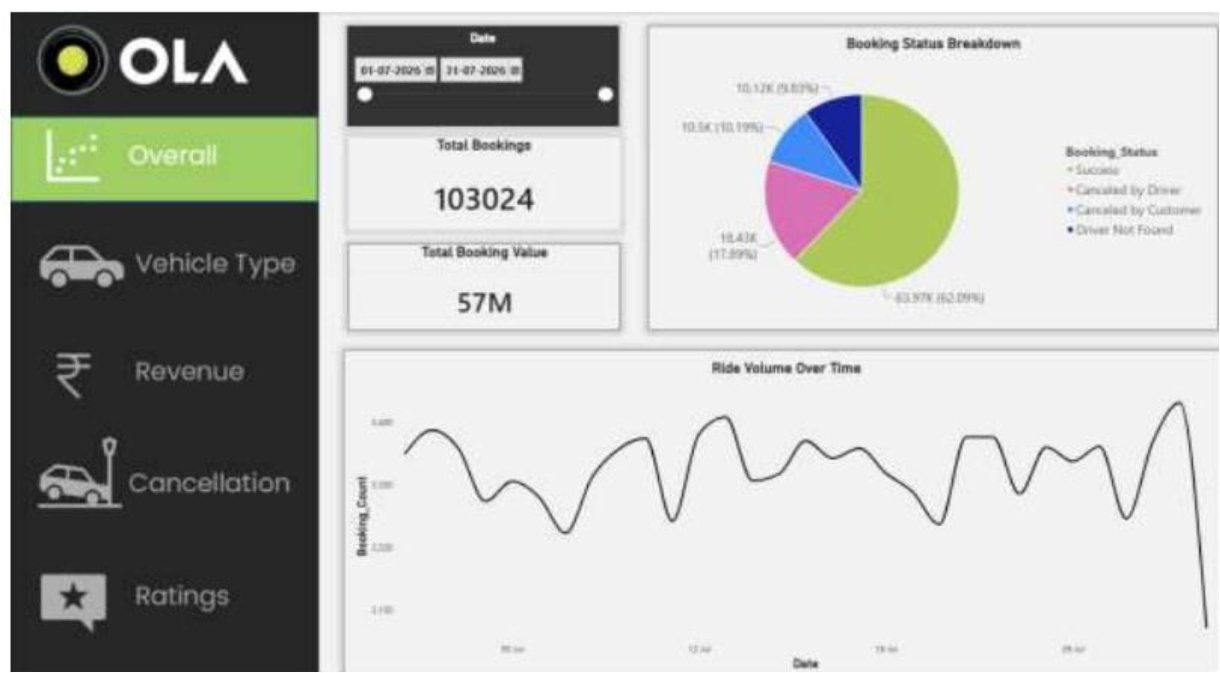
Power BI Dashboard
Overall Snapshot
103,024
Total Bookings
₹57M
Total Booking Value
62.09%
Success Rate
28.08%
Cancellation Rate
Peak booking volumes on July 12 and July 28.

Slide 10
Business Recommendations
Reduce Cancellations
Improve Ride Completion
Optimize Vehicles
Address top driver & customer cancellation reasons
Fix incomplete-ride issues: breakdowns, customer demand
Focus on high-demand, high-rating vehicle types
Customer Experience
Optimize Revenue
Use ratings & wait times to improve service quality
Target high-value rides, popular locations & vehicle types

