Slide 1


Telecom Customer Churn Analysis
Identifying churn patterns across 7,043 customers to support better retention strategies

Slide 2

Dataset at a Glance
7,043
21
Customers
Features
0
Missing Values
Demographics, tenure, services, contract, billing — all clean and ready for analysis

Slide 3
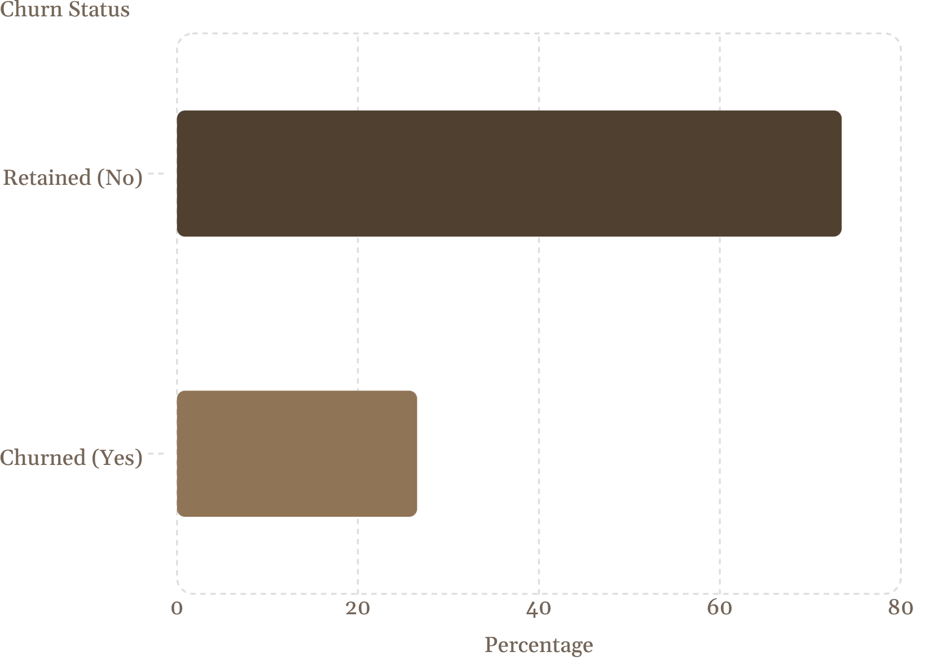
Overall Churn Rate
Key Finding
26.54% of customers have churned
Gender shows no significant difference in churn rates between male and female customers

Slide 4
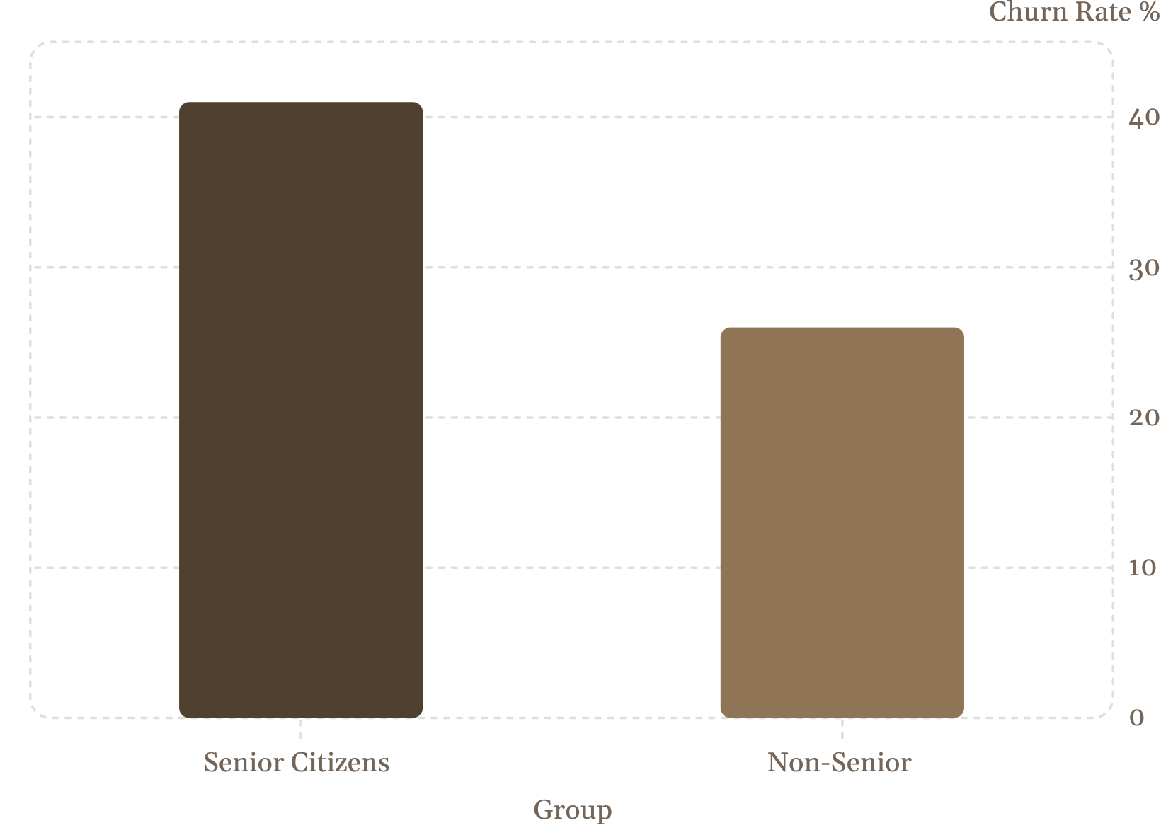

Senior Citizens Churn at Higher Rates
Insight
Senior citizens churn at 41% vs. 26% for non-seniors
Targeted retention programs for seniors may reduce attrition

Slide 5
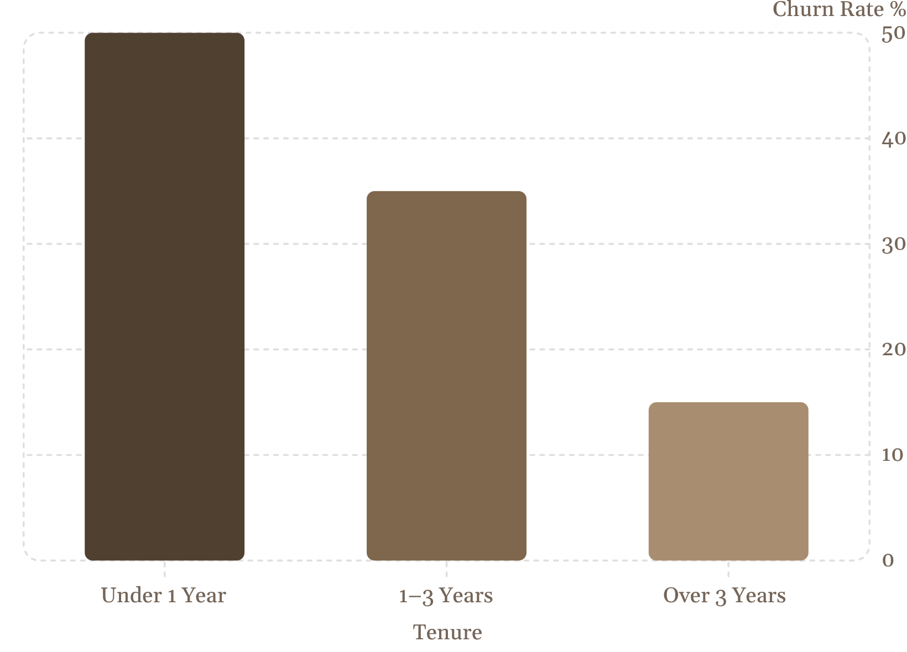
Tenure: The Longer, The Loyal
Key Insight
Customers with less than 1 year tenure have a 50% churn rate
Retention drops sharply after year one — early engagement is critical

Slide 6
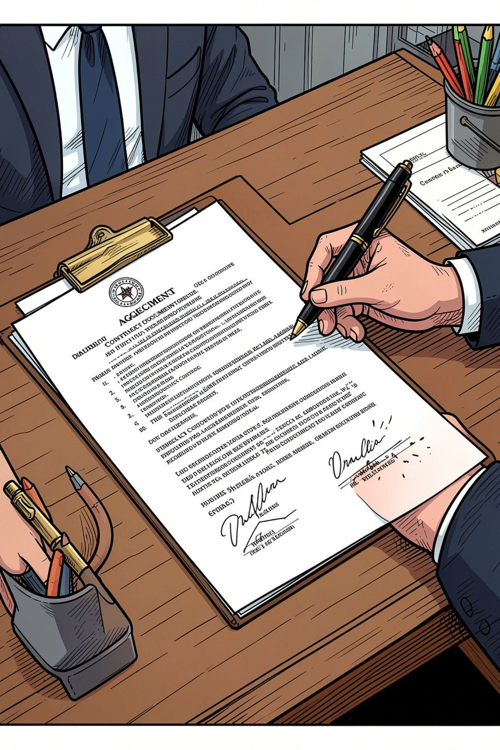
Contract Type Is the Strongest Predictor
Month-to-Month
One Year
42% churn rate
11% churn rate
Two Year
3% churn rate

Slide 7
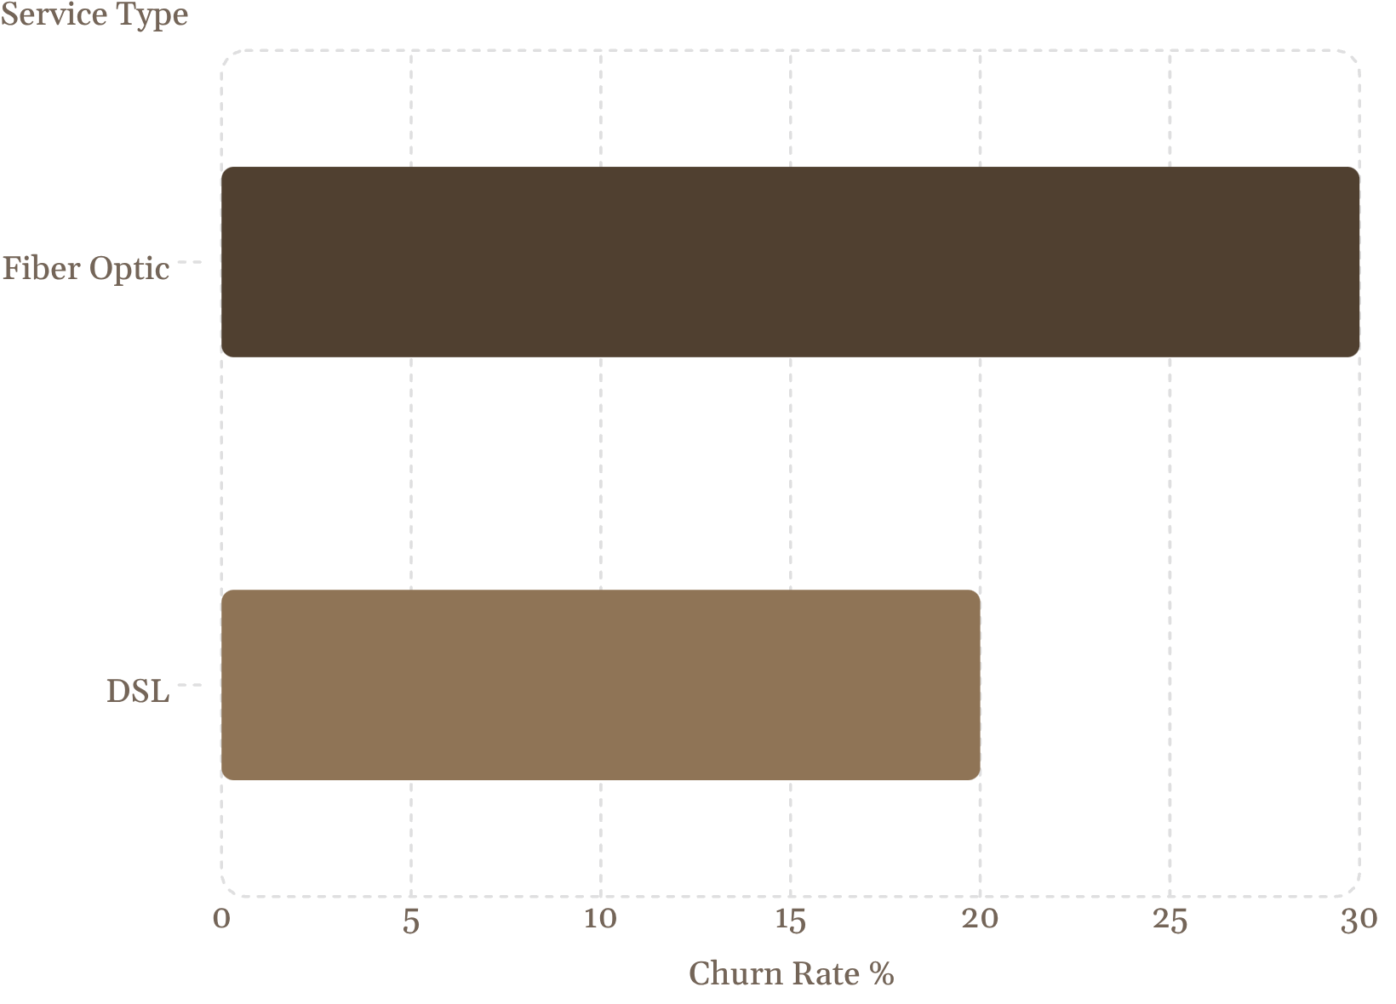
Internet Service Type Matters
Insight
Fiber Optic customers churn at 30% vs. 20% for DSL
Competition or service quality dissatisfaction may drive fiber users away

Slide 8
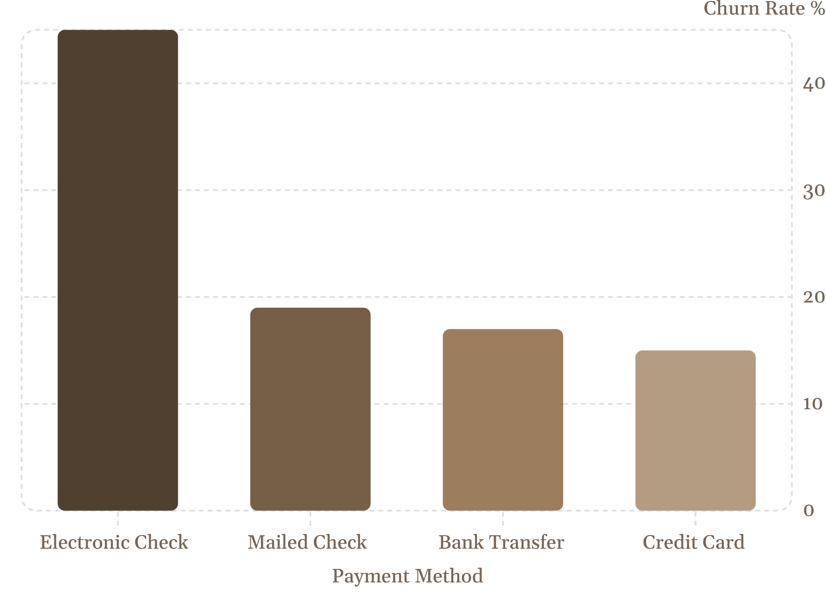
Payment Method: Electronic Check Risk
Key Finding
Electronic check users churn at 45% — nearly 3× higher than auto-pay methods
Convenience and trust issues may drive this behavior

Slide 9

Key Insights Summary
Contract Length
Month-to-month: 42% churn vs. two-year: 3%
Early Tenure Risk
Under 1 year: 50% churn rate
Payment Method
Electronic check: 45% churn
Senior Citizens
41% churn vs. 26% non-seniors

Slide 10
Recommendations
Promote Long-Term Contracts
Shift Payment Methods
Incentivize 1–2 year commitments
Encourage auto-pay over electronic checks
Engage Early Tenure
Senior Retention Programs
Focus on first-year customer experience
Personalized offers for senior customers

