Slide 1
Intelligent Document Extraction,
Validation & API Platform
AI Engineer Internship — Technical Case Study
Candidate: [Your Name] | Submission date: [Date]

Slide 2
Problem Statement
Financial teams receive invoices and statements as native or scanned PDF/JPG/PNG in wildly varying layouts.
Manual extraction is slow, inconsistent, and error-prone.
Goal: a reusable Document Intelligence service that extracts complete information, validates financial relationships, and exposes results via dashboard + REST API.
In scope: Invoice, Balance Sheet, Profit & Loss, Cash Flow Statement — up to 3 pages, PDF/JPG/PNG only.

Slide 3
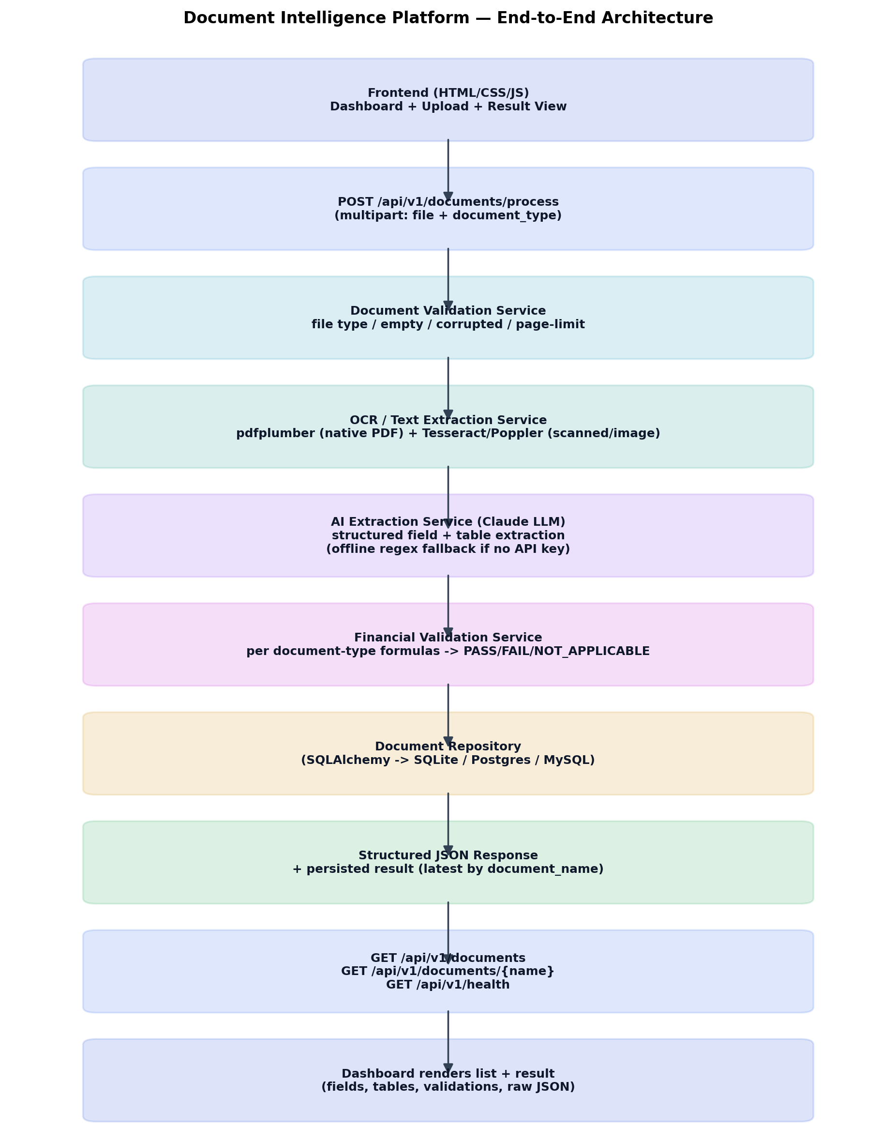
System Architecture
Single FastAPI service
serves REST API + HTML/CSS/JS frontend.
Validation → OCR → AI Extraction → Financial Validation → Persist → JSON, in that order.
Every stage fails gracefully with a controlled error response.

Slide 4
Technology Stack & Rationale
Backend: FastAPI (async, auto Swagger/OpenAPI docs, strong Pydantic validation).
OCR/Parsing: pdfplumber for native PDF text + tables; Tesseract + Poppler (pdf2image) for scanned PDFs and JPG/PNG — free, local, no API quota risk.
AI Extraction: Anthropic Claude (LLM) for layout-agnostic structured field & table extraction, with a deterministic offline regex fallback if no API key is configured.
Persistence: SQLAlchemy ORM over SQLite by default (swap to Postgres/MySQL via one env var).
Frontend: server-rendered HTML/CSS + vanilla JS calling the same-origin REST API — no separate frontend deploy needed.

Slide 5
Extraction Approach
Why an LLM, not fixed regex: real invoices/statements vary too much in layout for hand-written rules to hit “all meaningful fields.”
OCR/parsed text is page-tagged and sent to Claude with a document-type-specific instruction listing the minimum required fields.
Strict prompt rules: never invent values — missing data returns null; numbers must be plain JSON; bracketed numbers parsed as negative.
Every extracted field carries page_number + a short verbatim evidence snippet for traceability back to the source.
Line items (invoices) / statement_items (financial statements) capture every visible row, not just the minimum fields.

Slide 6
Financial Validation Rules
Invoice: subtotal + tax − discount ≈ total; cash paid − total ≈ change (when present).
Balance Sheet: total liabilities + total equity ≈ total assets.
Profit & Loss: revenue − COGS ≈ gross profit ≈ (operating profit + opex) ≈ (net profit + tax).
Cash Flow: operating + investing + financing ≈ net change; opening + net change ≈ closing.
Tolerance: max(1 currency unit, 1% of reported value) — configurable via env vars.
Every check returns formula, operands, calculated value, reported value, variance, and PASS / FAIL / NOT_APPLICABLE.

Slide 7
REST API Design
POST /api/v1/documents/process — multipart upload (file + document_type) → structured JSON result.
GET /api/v1/documents/{document_name} — latest stored result for a document.
GET /api/v1/documents — list for the dashboard.
GET /api/v1/health — health check for the deployed service.
Swagger/OpenAPI docs auto-published at /docs. Consistent {"error":{"code","message"}} shape on every failure — no stack traces or secrets ever returned to the client.

Slide 8
Frontend & Persistence
Dashboard: upload control (document type + file), processed-documents table with status/validation/OCR flag/time.
Result page: file validation, extracted key-value fields (missing fields highlighted), line items / statement items table, financial validation results, raw JSON viewer.
All processed results persist in a database (SQLite by default) so the dashboard survives restarts during evaluation.
Re-processing the same file name updates the existing record (“latest result” semantics), per spec.

Slide 9
Reliability, Security & Observability
Every pipeline stage wrapped in a typed exception hierarchy (AppError subclasses) → controlled JSON errors, correct HTTP status codes.
No secrets in source — all config/API keys read from environment variables (.env.example provided, real .env gitignored).
Structured logging at every stage (validation failures, OCR fallback triggers, LLM calls, exceptions) to stdout for platform log capture.
Uploaded files are sanitized, size/page/type limited, and deleted from disk after processing.
Global exception handler guarantees the service never returns a raw stack trace to the client.

Slide 10
Known Limitations & Production Improvements
Validation runs on the current/most-recent reporting period only; comparative-period figures are captured but not independently re-validated (documented assumption).
OCR accuracy on low-quality scans is inherently limited by Tesseract vs. paid Document AI services.
Synchronous processing suits 3-page documents; a production system would move to an async job queue for larger volumes.
No authentication/authorization layer — would add API keys / OAuth for production multi-tenant use.
Would add confidence calibration, per-period validation, and a managed Postgres instance for production deployment.

Slide 11
AI Tool Usage Declaration
Claude (Anthropic) was used as a coding assistant to help design and implement the backend services, frontend, tests, and this presentation, under my direction and review.
Claude (Claude 3.5 Sonnet or later) is also used at runtime as the document field/table extraction engine — this is a core, disclosed part of the architecture, not just a build-time aid.
All architecture decisions, validation formulas, and final code were reviewed and understood before submission.
I am prepared to explain, modify, and debug any part of this solution during the technical discussion.

