Slide 1

Python Project
Hotel Management System
Submitted By :
Kamaljeet Kaur(2210990470)
Submitted To :
Mr.Tushar

Slide 2
Table of Contents
Introduction
Problem and Solution Statement
Technical Details
Key Features
Conclusion
References/Links used

Slide 3
Introduction
This project is an automated solution designed to streamline the reservation process for hotels. Our system enhances operational efficiency and improves customer satisfaction by simplifying bookings, payments, and record management. Aimed at modernizing hospitality services, it offers an intuitive user experience for both hotel staff and guests.

Slide 4


Problem and Solution Statement
Problem: Traditional booking processes are often time-consuming, prone to errors, and inconvenient for both hotel staff and guests.
Solution: The Hotel Booking System automates reservations, payments, and record management, ensuring a smooth and reliable booking experience

Slide 5

Technical Details
The Hotel Booking System is crafted with Python, known for its efficiency and readability, ensuring a user-friendly and robust platform . Random and Datetime library is used.

Slide 6
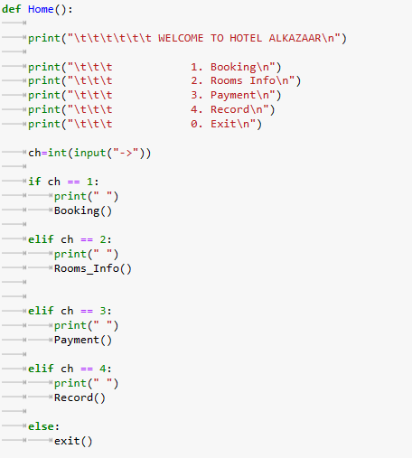
Code Snippets :
This is the Home() function which contains all other functions which work according to user input

Slide 7
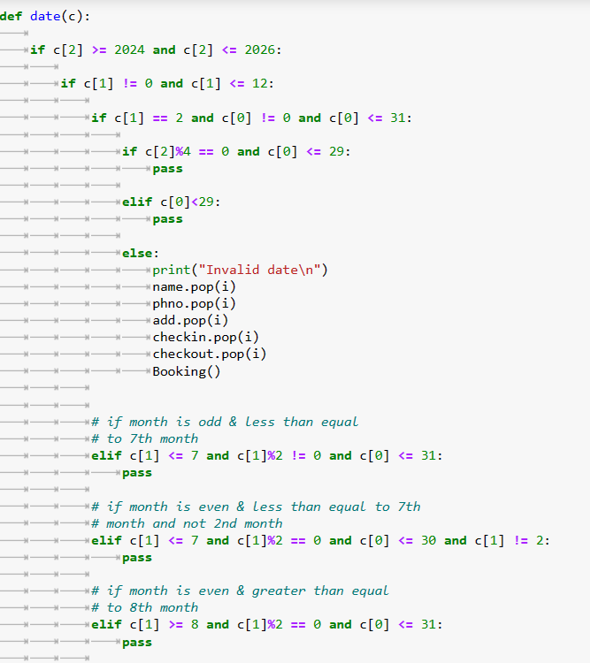
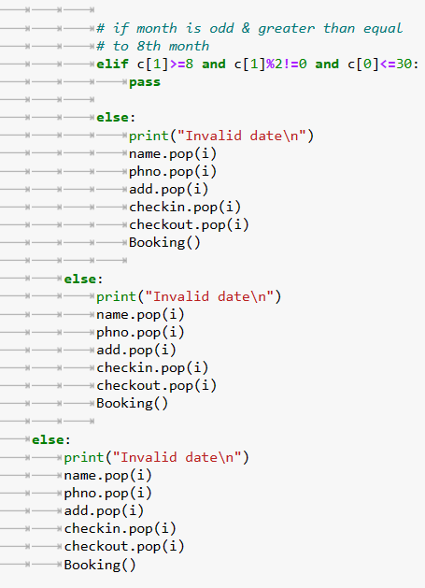
Date() function is used to check whether the data entered is valid or invalid

Slide 8
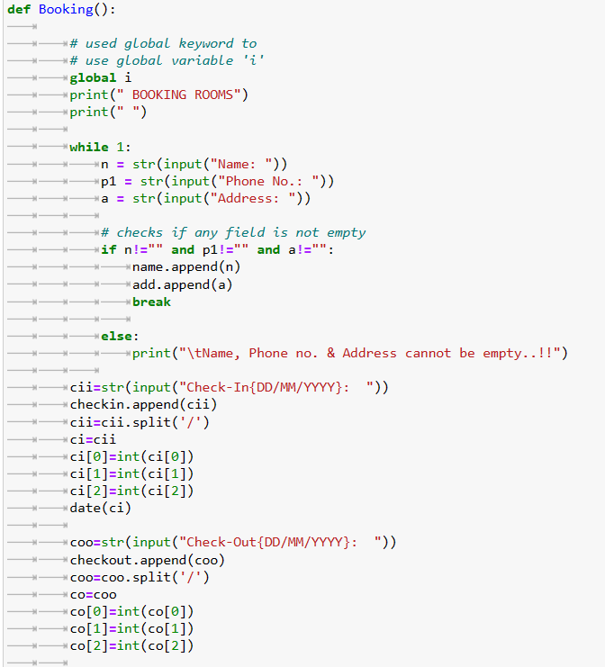
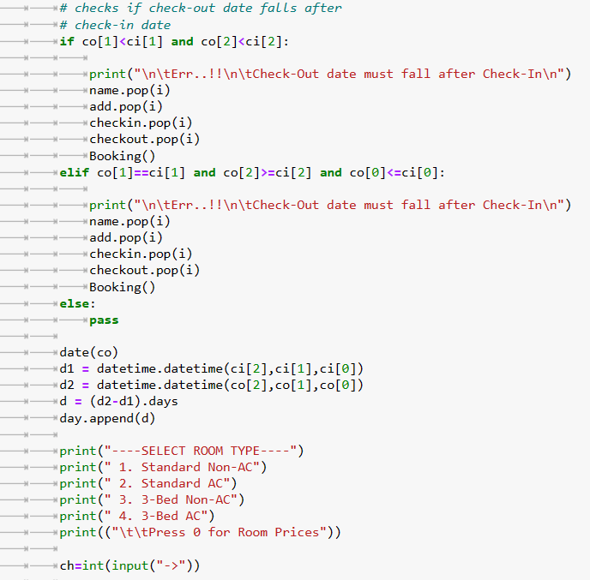
Booking() function is used for booking rooms after filling valid checkin and checkout dates,room
type

Slide 9
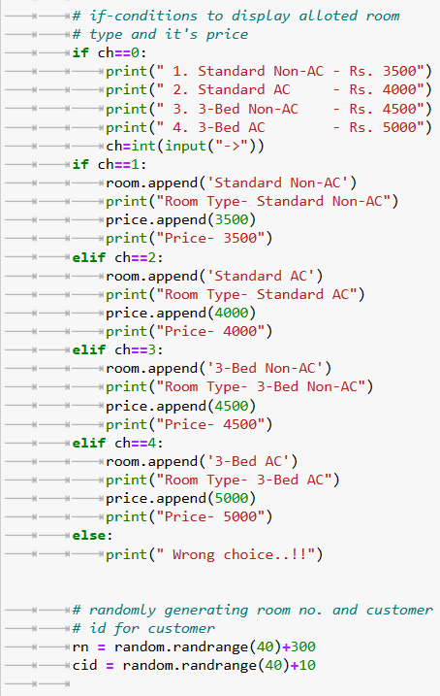
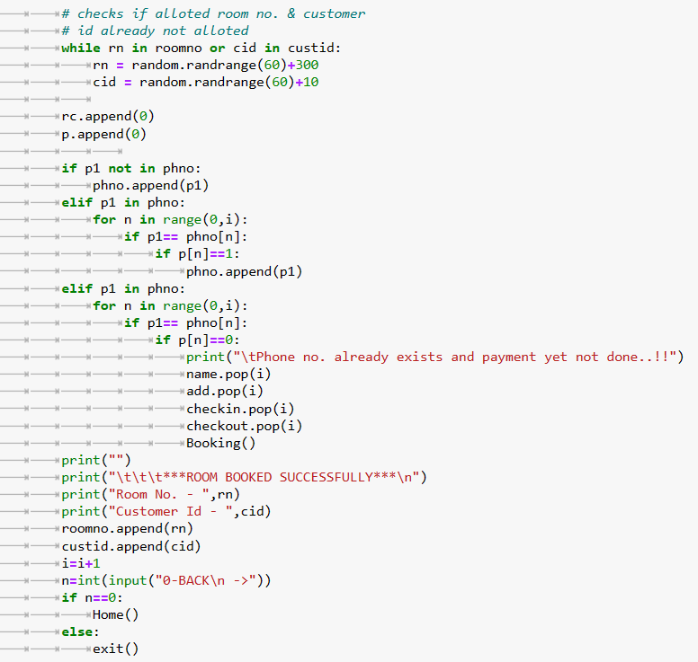
Continued Booking() function used for generating room number and customer id

Slide 10
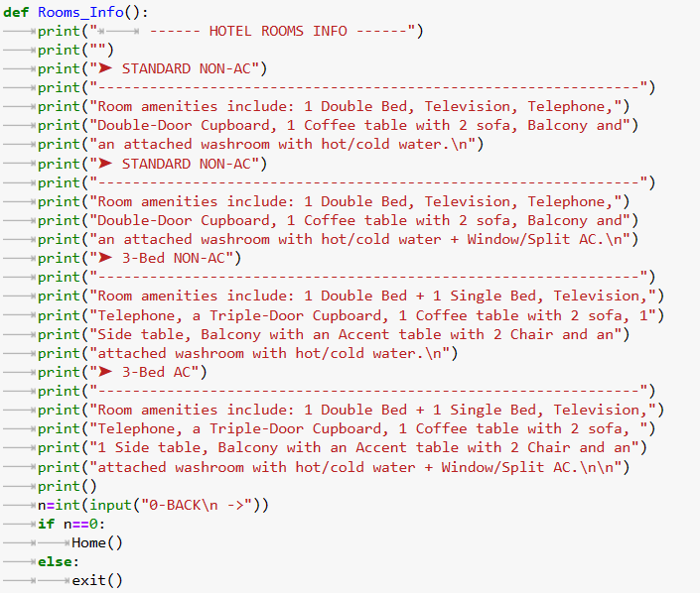
Rooms_Info() function used to display info about the rooms according to prices .

Slide 11
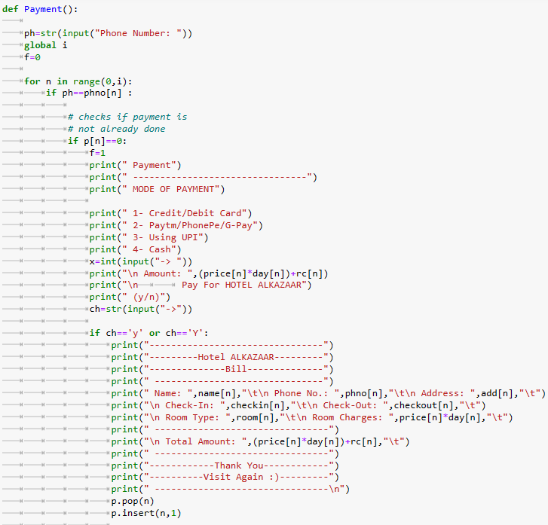
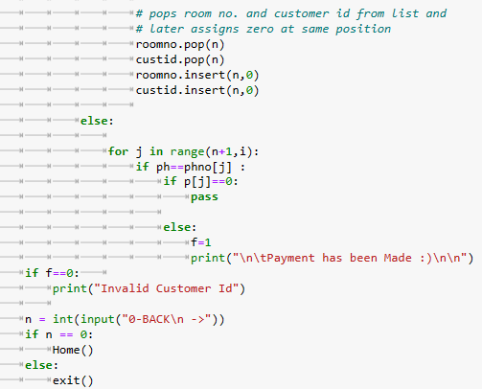
Payment() function used to print the bill according to phone number and if that phone number
doesn’t exist in records , means if it is not used while booking,then “invalid customer id” is shown

Slide 12
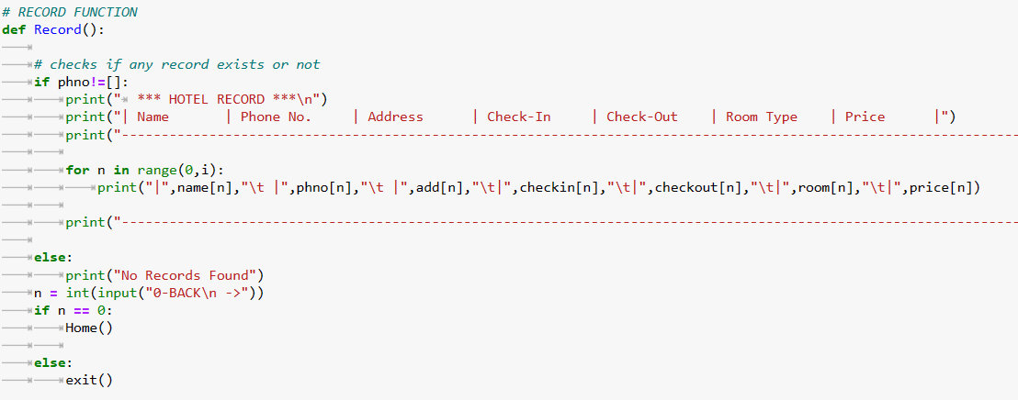
Record() function :

Slide 13
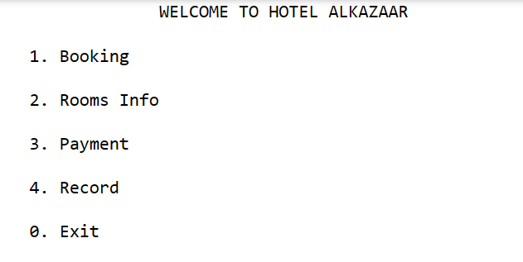
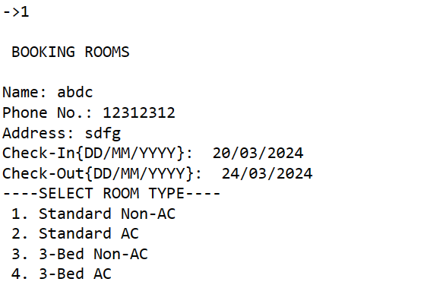

Some Key Features and outputs :
User will be able to book the room by filling all the details and selecting room type from option 1 , if the user enters invalid date , then error is shown .

Slide 14
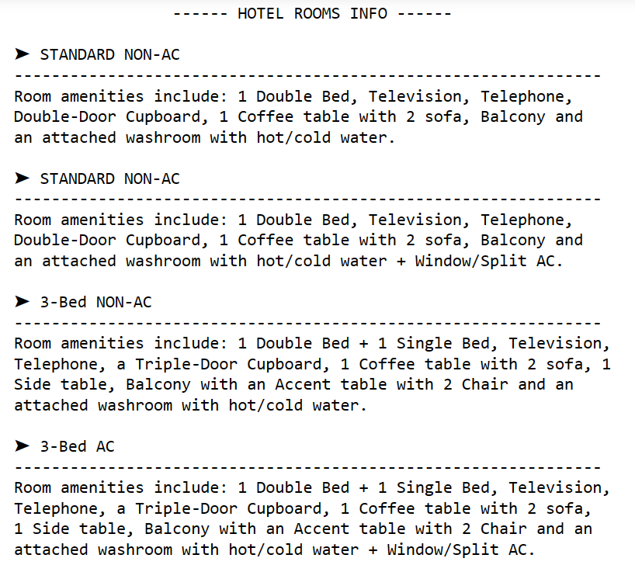
By option 2, detail of rooms is shown :

Slide 15
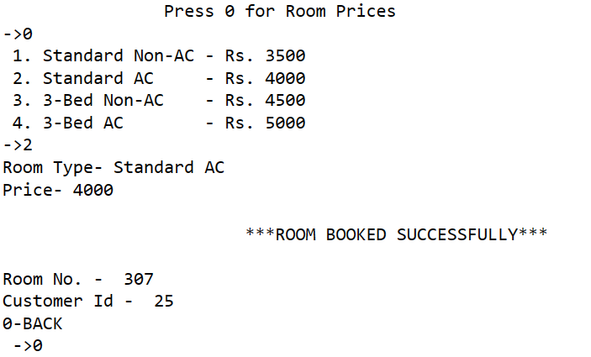
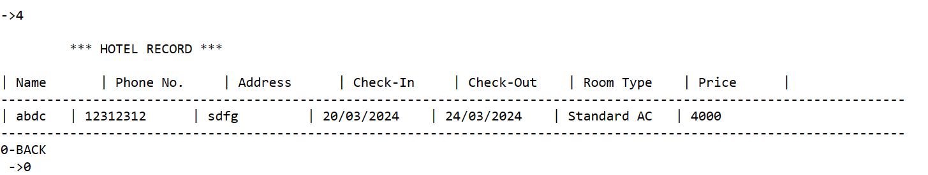
By option 2, user will be able to see room prices and then random room number and customer id is assigned to the user.
Record of all users is shown by option 4:

Slide 16
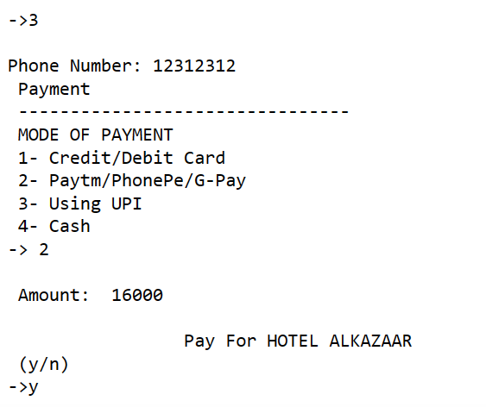
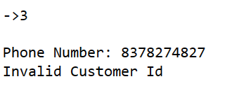
User will be able to pay by option 3 , then mode of payment is selected and then by clicking on y , bill will be shown .
If user fills the phone number that is not present in records , then “Invalid Customer Id” is shown.

Slide 17
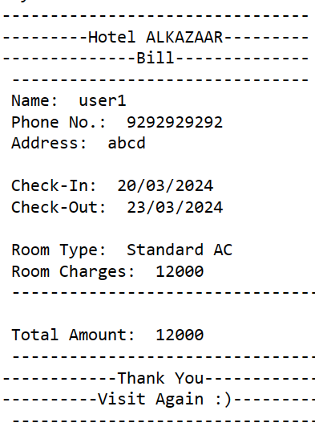
Bill after selecting payment mode :

Slide 18
Conclusion
In conclusion, our Hotel Booking System represents a significant leap forward in the management and operational efficiency of hospitality services. By integrating advanced technical solutions with user-centered design, we provide a seamless, secure, and enjoyable booking experience for guests while streamlining administrative processes for hotel staff. This system not only addresses the current challenges faced by the hospitality industry but also offers scalability and adaptability to meet future demands. We are committed to continuous improvement and innovation to ensure our system remains at the forefront of hotel management solutions.

Slide 19
References/Links used
https://takelessons.com/en-in/python
Python Tutorial (w3schools.com)
Learn Python Programming (programiz.com)

Slide 20


