Slide 1
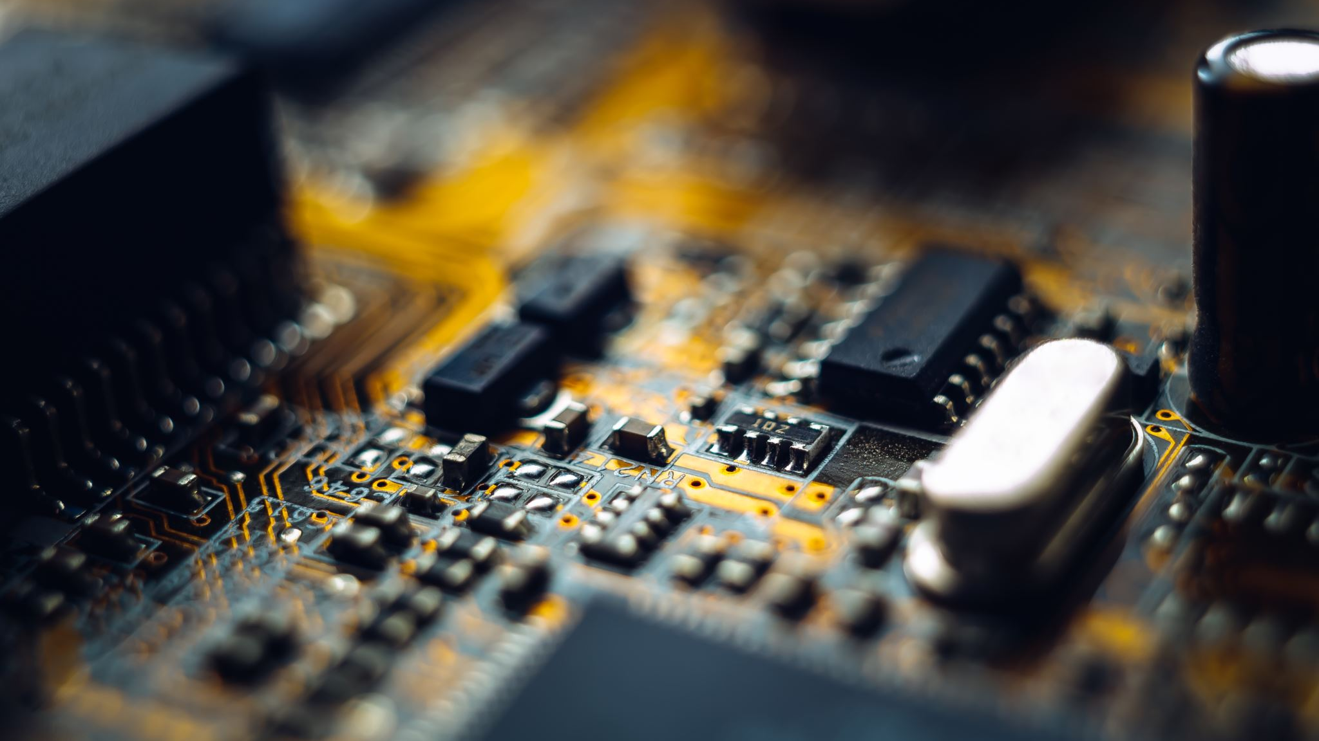
Smart farming by group no.1
1.PIYUSH JHA 17IT1027
2.ISHA GUJAR 17IT2042
3.KAMALJIT KAUR 17IT2039
Under the guidance of,
Ms. Nikita Kulkarni

Slide 2
OUTLINE
Introduction
Literature Survey
Problem statement
Proposed Methodology
Hardware and Software requirement
Advantages/benefits
Conclusion
References

Slide 3
INTRODUCTION
IoT (Internet of things) in an agricultural context refers to the use of sensors, cameras, and other devices to turn every element and action involved in farming into data
Eg: GPS technology on tractors and other equipment helps farmers with field mapping, soil sampling and crop scouting.
A large portion of farming and agricultural activities are based on the predictions, which at times fail.
The Features are: 1) SMS Notifications 2) Valuable information collection. 3) Detailed Data analysis 4) Easy to implement

Slide 4
Literature survey
SR.NO | NAME | AUTHOR | ADVANTAGES | DRAWBACKS
1. | Affordable Smart Farming Using IoT and Machine Learning | Reuben Varghese Smarita Sharma | Automate the monitoring of crops thereby reducing human intervention | Limitation to uneducated farmers.
2. | Providing Smart Agricultural solutions to farmers for better yielding using IoT | M.K Gayatri, J Jayashakhti G.S.Anandha Mala | Uses the combination of IoT and cloud computing | Active internet connection at the rural areas to connect to the cloud
3. | Big Data in Smart Farming | Marc-Jeroen Bogaardt | Real-time assisting reconfiguration features | Trained professions required to make any chances
4. | Smart Farming and solar technology | Anand Nayyar , Dr. Vikram Puri | Eco-friendly solution | Solar installations is expensive
5. | Smart Farming and Food Safety | AIOTI- ALLIANCE FOR INTERNET OF THINGS INNOVATION | Promoting healthy and safer livestock and agricultural products | Educating the farmers to reduce the use of chemical.

Slide 5
Problem Statement
Agriculture is the broadest economic sector and plays an important role in the overall economic development of a nation.
In traditional farming, farmers grow crops and spray fertilizers without knowing soil health & its composition. This results in severe decrease in soil health.
Usually in farming, irrigation is done manually so specifically, it results in huge manpower and increasing cost.
There is no effective use of weather predication data in traditional farming.
Fire in farms is the one of most important problem in world and there is no sufficient system to tackle it.

Slide 6
Proposed Methodology
Our smart farming system will be advanced than other ordinary systems,in case of fire in farm.
The notification will be sent to the owner of the house for security and an email will be immediately sent to the owner.
Due to which help will reach quickly and situation can be handled immediately.
It shares the information related pH, temperature & humidity etc by machine learning prediction algorithms and will help analyse the situation in future .
Any intruder tries to enter the farm, buzzer will get onand notifications will be sent to the farmer.

Slide 7
Hardware & Software requirement
HARDWARE:
Raspberry Pi
Jumping wires
Soil & Moisture sensor
Temperature sensor(DHT 11)
Smoke sensor
Webcam
Water pump motor
SOFTWARE:
Raspbian OS
PyCharm
Pushetta app
Thinkspeak

Slide 8
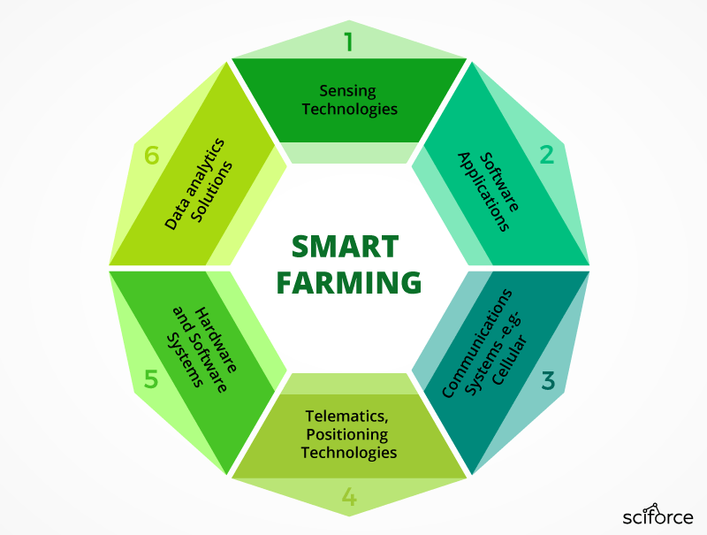
ADVANTAGES OF SMART FARMING
Increased Production
Water Conservation
Real-Time Data and Production Insight
Lowered Operation Costs
Accurate Farm and Field Evaluation
Improved Livestock Farming
Remote Monitoring
Equipment Monitoring

Slide 9
CONCLUSION
We believe that our concept will be a benchmark in the agribusiness due to its reliability and remote monitoring.
This concept will surely accelerate their business to reach new heights and also be more profitable. For future use, we can interface LCD screen in order to display the current status of the soil moisture content levels, percentage of water utilized to water the plant, duration of time for which the water pump is ON, etc.
We can also show the graphical representation of the moisture content levels in the soil. To improve the efficiency and effectiveness system, the following recommendations can be put into consideration.
We are looking forward to alternatively develop more applications and include features which are easy to implement in day-to-day life.

Slide 10
REFERENCES
[Patil, V. C., Al-Gaadi, K. A., Biradar, D. P., & Rangaswamy, M. (2012). Internet of things (Iot) and cloud computing for agriculture: An overview.Proceedings of Agro-Informatics and Precision Agriculture (AIPA 2012), India, 292-296]1
[ C. Peng, "Development strategy research based on the internet of things in smart agriculture", Journal of Xi'an University of Post and telecommunications, vol. 17, no. 2, pp. 94-98, 2012.]2
[Dr. V .Vidya Devi,G. Meena Kumari, “Real- Time Automation and Monitoring System for Modernized Agriculture” ,International Journal of Review and Research in Applied Sciences and Engineering (IJRRASE) Vol3 No.1. PP 7-12, 2013]3
[Chetan Dwarkani M, Ganesh Ram R, Jagannathan S, R.Priyatharshini, “Smart Farming System Using Sensors for Agricultural Task Automation”, IEEE International Conference on Technological Innovations in ICT for Agricultureand Rural Development (TIAR 2015).]4
[https://www.geeksforgeeks.org/crop-monitoring-smart-farming-using-iot/]5

Slide 11
THANK YOU

