Slide 1
Software platform for AUV waypoint navigation
Capstone project presentation by Kamal Shah
Committee: Taskin Padir and Gennert Michael

Slide 2
Problem Statement
Develop a software platform to test control algorithms for different AUV models for waypoint navigation.

Slide 3
Why AUVs
Marine exploration
Surveillance
Construction
Inspection
Maneuvering
Notes:
Explain why we need AUVs and why the research is important.

Slide 4
UNDERWATER VEHICLE
u (surge)
X₀
BOW PLANE(s)
p (roll)
BOW/ FORE
STERN PLANE(s)
PORT SIDE
+ ve
BODY-FIXED
STAR BOARD
X (azimuth)
Ф phi
+ ve
r₀
- ve
EARTH-FIXED
v (sway)
AFT/ STERN
q (pitch)
w (heave)
r (yaw)
Y (elevation)
Θ theta
PROPELLER
- ve
Y₀
Z₀
Z (spin)
Ψ psi
Notes:
Explain 6 DOF, Body-Fixed and Earth-Fixed coordinate frames

Slide 5
Notation in SNAME
Society of NAVAL Architects and Marine Engineers
Notes:
SNAME : Society of NAVAL Architects and Marine Engineers

Slide 6
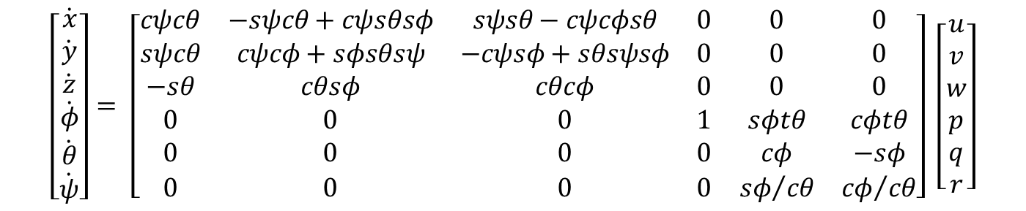
Vehicle Kinematics
Convert body-fixed velocities to earth-fixed velocities.
Kinematic Equations
$$\left[\begin{matrix}\dot{x} \\ \dot{y} \\ \dot{z} \\ \dot{φ} \\ \dot{θ} \\ \dot{ψ}\end{matrix}\right]= \left[\begin{matrix}cψcθ & −sψcθ+cψsθsφ & sψsθ−cψcφsθ & 0 & 0 & 0 \\ sψcθ & cψcφ+sφsθsψ & −cψsφ+sθsψsφ & 0 & 0 & 0 \\ −sθ & cθsφ & cθcφ & 0 & 0 & 0 \\ 0 & 0 & 0 & 1 & sφtθ & cφtθ \\ 0 & 0 & 0 & 0 & cφ & −sφ \\ 0 & 0 & 0 & 0 & {sφ}/{cθ} & {cφ}/{cθ}\end{matrix}\right] \left[\begin{matrix}u \\ v \\ w \\ p \\ q \\ r\end{matrix}\right]$$
Notes:
Explain the transformation matrices. Linear translation and rotational translation
Integrating the earth-fixed velocities w.r.t time gives position and orientation
6 X 6 matrix

Slide 7
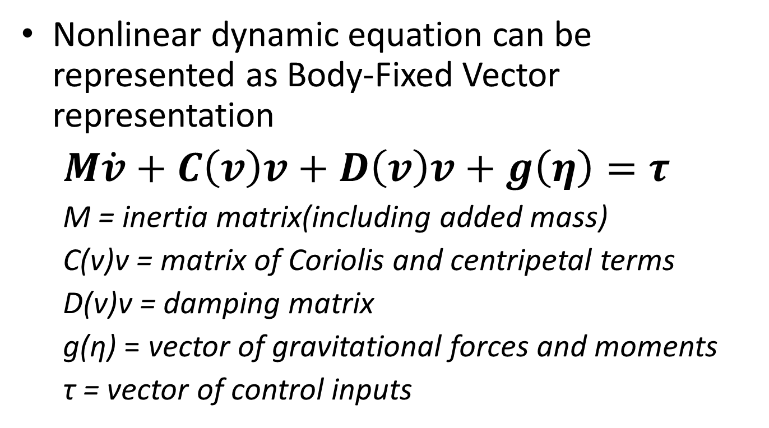
Dynamic Equations of motion
Nonlinear dynamic equation can be represented as Body-Fixed Vector representation
$M\dot{v}+C\left(v\right)v+D\left(v\right)v+g\left(η\right)=τ$
M = inertia matrix(including added mass)
C(v)v = matrix of Coriolis and centripetal terms
D(v)v = damping matrix
g(η) = vector of gravitational forces and moments
τ = vector of control inputs
Notes:
M = inertia matrix (including added mass)
C (v) v = matrix of coriolis and centripetal terms (including added mass)
D(v) = damping matrix
g(𝜂) = vector of gravitational forces and moments
Τ = vector of control inputs
$v$ is the body-fixed velocity vector

Slide 8
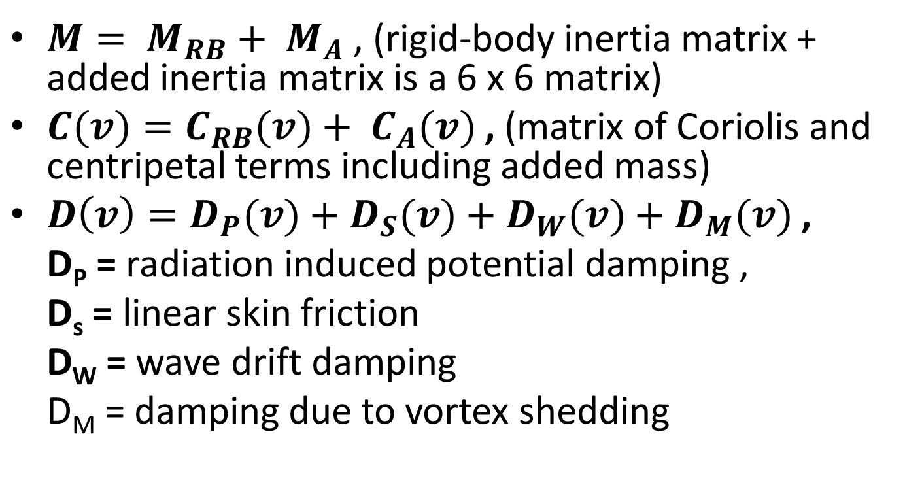
Matrix
$M= M_{RB}+ M_{A}$ , (rigid-body inertia matrix + added inertia matrix is a 6 x 6 matrix)
$C(v)=C_{RB}(v)+ C_{A}(v)$ , (matrix of Coriolis and centripetal terms including added mass)
$D\left(v\right)=D_{P}(v)+D_{S}(v)+D_{W}(v)+D_{M}(v)$ ,
D_{P} = radiation induced potential damping ,
D_{s} = linear skin friction
D_{W} = wave drift damping
D_{M} = damping due to vortex shedding
Notes:
Dp = radiation induced potential damping due to forced body oscillations
Ds = linear skin friction due to laminar boundary layers and quadratic skin friction
Dw = wave drift damping
Dm = damping due to vortex shedding (morison’s equation)

Slide 9
Buoyancy and Gravity
CG – center of gravity, first moment of centroid of vehicle’s mass.
CB – first centroid of volumetric displacement.
Notes:
CB do not lie generally at the origin of the body fixed frame.
All forces and moments acting on the vehicle are assumed to be applied to the center of gravity location.
Origin of body fixed frame is exactly the same as center of buoyancy.

Slide 10
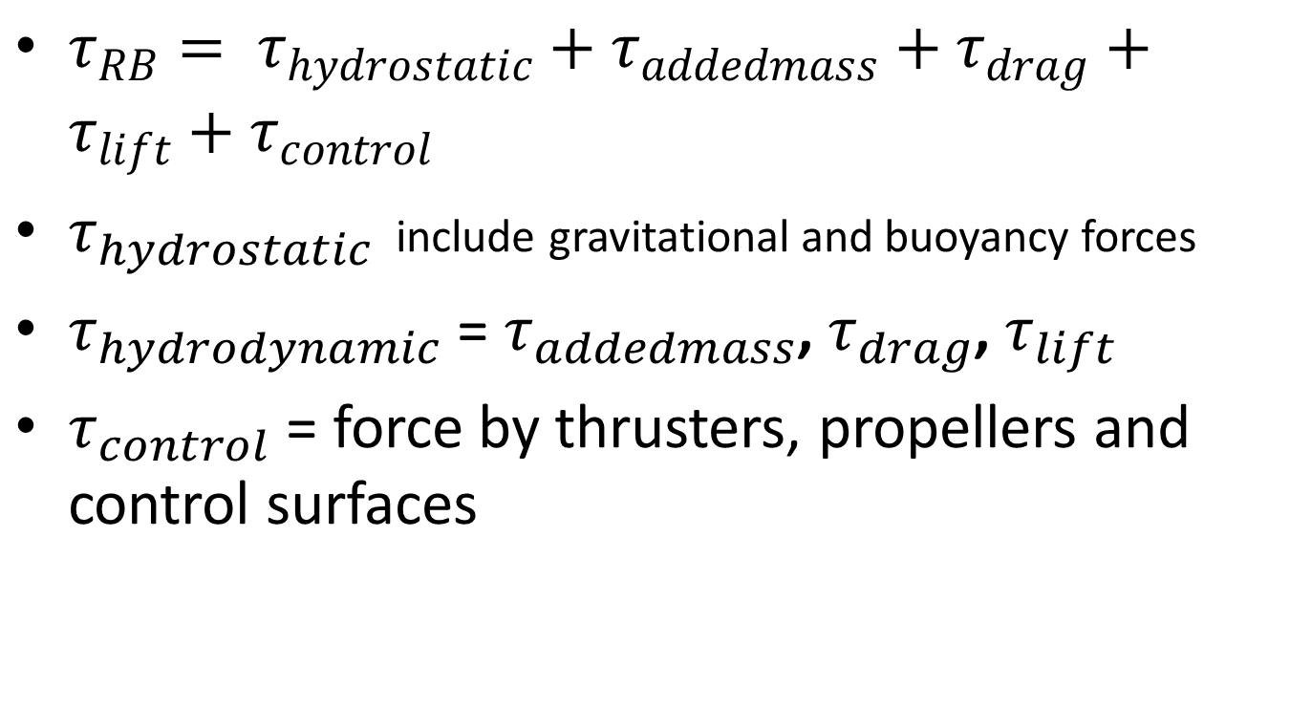
Forces and Moments on AUV
$τ_{RB}= τ_{hydrostatic}+τ_{addedmass}+τ_{drag}+τ_{lift}+τ_{control}$
$τ_{hydrostatic}$ include gravitational and buoyancy forces
$τ_{hydrodynamic}$ = $τ_{addedmass}$, $τ_{drag}$, $τ_{lift}$
$τ_{control}$ = force by thrusters, propellers and control surfaces
Notes:
Hydrostatic forces are also called restoring forces including the gravitational and buoyant forces.
Hydrodynamic forces include the force vector components tau(hydrostatic),tau(drag) and tau(lift)

Slide 11

Forces on AUV (Newton’s second law)
$\left[\begin{matrix}Mass \\ Inertia \\ Added Mass\end{matrix}\right]\left[\begin{matrix}Body fixed \\ accelerations\end{matrix}\right]= \left[\begin{matrix}Hydrostatic \\ + \\ Hydrodynamic \\ + \\ thruster and control surfaces \end{matrix}\right]$ ,

Slide 12
MSS toolbox
Marine Systems Simulator
NPS AUV known as “PHOENIX AUV” is part of the toolbox.

Slide 13
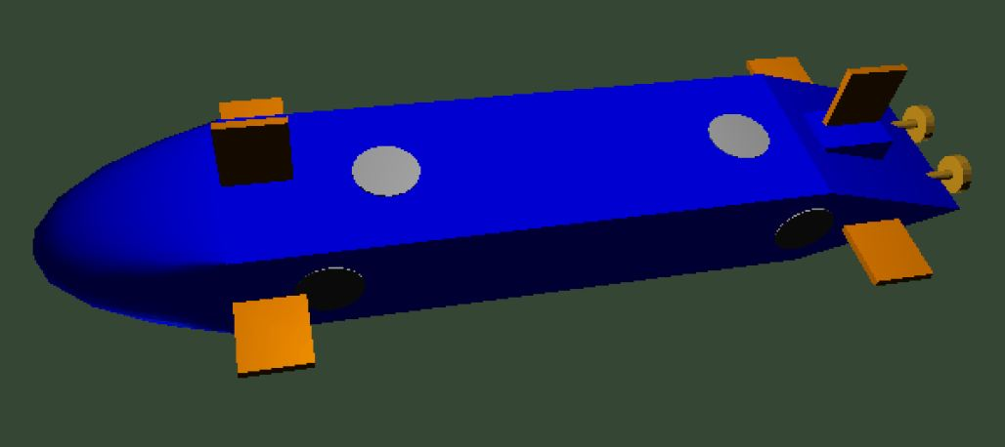
Exterior view of NPS AUV
Ref: Donald P. Brutzman, A virtual world for an Autonomous Underwater Vehicle

Slide 14
PHOENIX AUV in toolbox
[xdot,U] = npsauv(x,u)
x = [u,v,w,p,q,r,xpos,ypos,zpos,phi,theta,psi]’ , (state vector)
u = [δr,δs,δb,δbp,δbs,n]’ , (control input vector)
Notes:
NPS AUV 11 or PHOENIX is a very well studied and researched AUV in the industry.
u = surge velocity in body fixed frame
v = sway velocity in the body fixed frame
w = heave velocity in the body fixed frame
p = roll velocity , q = pitch velocity, r = yaw velocity

Slide 15
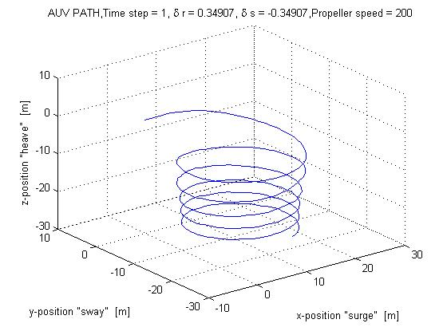
AUV Simulation
Notes:
The above simulation represents the AUV with rudder angle of 20 degrees and a stern plane deflection of 20 degrees the speed of the propeller is 200 m/s

Slide 16
demo of the above simulation
Run SimDemo3.m

Slide 17
Software Architecture
Control Algorithm
User Interface
Output functions
AUV Model
Spline Function

Slide 18
Functions used in the simulation
random_normalize(angle) normalizes to (0 to pi)
random_normalize2(angle) normalizes to (-pi/2..pi/2)
atan2(y,x) returns the angle to a point in the proper quadrant

Slide 19
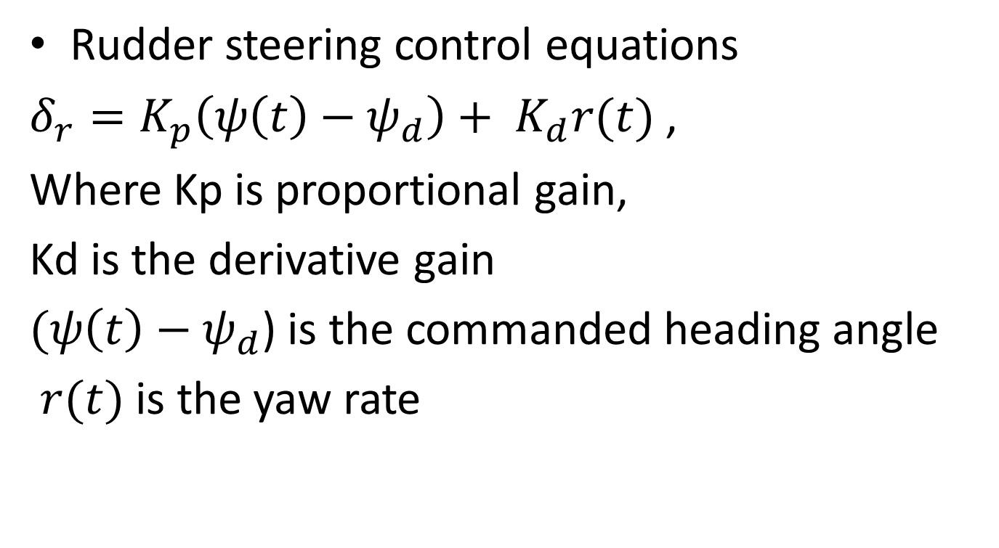
Steering Control equations
Rudder steering control equations
$δ_{r}=K_{p}\left(ψ\left(t\right)−ψ_{d}\right)+ K_{d}r(t)$ ,
Where Kp is proportional gain,
Kd is the derivative gain
$(ψ\left(t\right)−ψ_{d}$) is the commanded heading angle
$r(t)$ is the yaw rate

Slide 20
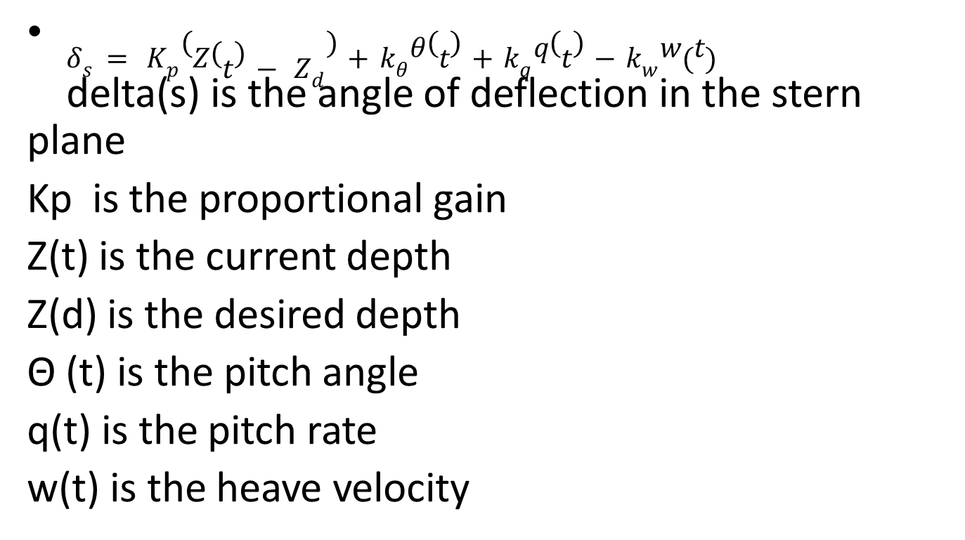
Pitch and depth control equations
$δ_{s}= K_{p}\left(Z\left(t\right)− Z_{d}\right)+k_{θ}θ\left(t\right)+k_{q}q\left(t\right)−k_{w}w(t)$
delta(s) is the angle of deflection in the stern plane
Kp is the proportional gain
Z(t) is the current depth
Z(d) is the desired depth
Θ (t) is the pitch angle
q(t) is the pitch rate
w(t) is the heave velocity

Slide 21
Demo
Run WayPointFinal9.m
Notes:
Open MATLAB and go for a live demo , explain the spline function, waypoint interface and initial and final orientation
Walk through the software and the control algorithm.

Slide 22
Conclusion and future work
Use different AUV models to test the control algorithm
Compare results of the simulation with a real system.
Develop a 3D visualization package for visualizing the results. VRML platform is a good choice

Slide 23
Acknowledgements
Prof. Padir, Taskin
Prof. Gennert, Michael
Riverlab
Tanay and Aaron

Slide 24
Questions??

