Slide 1
The opportunity at a glance
Mainframe
Modernisation
with AI Agents
$3T
70%
daily commerce
runs on COBOL
of IT budgets spent
on legacy maintenance
70%
~60
A Practical Approach
modernisation
projects fail
average age of
COBOL programmers
No procurement. No new tooling. Start next week.
Infosys × UBS · Mainframe Modernisation Programme · 2026

Slide 2
The Problem
The COBOL estate is real, urgent, and getting worse — and every tool on the market adds to the delay
THE SITUATION
COBOL is not going away — and the people who understand it are.
$3 trillion
75%
avg. age 60
70%
in daily commerce runs on COBOL systems
of financial services IT budgets go on keeping legacy systems alive
of COBOL programmers — a third retire by 2030
of modernisation projects fail using standard approaches
WHY EXISTING TOOLS DON'T HELP
IBM watsonx · AWS · Micro Focus · all the same story
⏳
💸
🔒
You wait 3–12 months before anything starts
You spend millions on setup, not delivery
You're stuck with their AI, not the best AI
Every tool on the market — IBM, AWS, Micro Focus — needs a procurement cycle first. In a regulated bank, vendor approval alone takes months. By the time you're approved, you haven't written a line yet.
A full modernisation programme runs $2M–$15M+. Most of that goes on licences, infrastructure, and getting the tool to work — not on actually modernising your code. The vendor sells you tooling. The work is still yours.
IBM watsonx runs on Mistral and IBM Granite — locked in. You can't swap the model. Claude Opus 4.6 scores 80.9% on real software engineering tasks vs these models' significantly lower numbers. You pay premium prices for yesterday's performance.
3–12 months wasted before day one
$2M–$15M+ and most of it is before the real work
Locked model · can't upgrade · can't switch
The Problem · IBM, MarketsAndMarkets, Deloitte, SoftwareModernizationServices.com, Anthropic
Infosys × UBS | Confidential

Slide 3
What You Already Have
No new procurement required — the technical prerequisites are already in place
The organisation already licenses everything needed to begin modernisation this sprint
ALREADY LICENSED
ZERO SETUP
ALREADY DEPLOYED
GitHub Copilot
GitHub Copilot Agent Mode
GitLab
Frontier models, continuously updated
Full agentic framework, already installed
End-to-end lifecycle platform, already deployed
42% market share · 20M users · 90% of Fortune 100
Copilot Business and Pro subscribers now have direct access to Claude Opus 4.6 and GPT-5.3-Codex — the same frontier models that IBM's platform cannot reach. Deprecated models are replaced within days.
Plans · builds · reviews · delegates across sessions
Custom agents are defined via simple markdown files. MCP servers connect without any additional infrastructure. No new tool to learn — most developers are already using Copilot.
CI/CD · issue tracking · code review · audit trails
Every stage of modernisation — analysis, architecture, development, QA — tracks natively in GitLab with zero additional tooling. Maps directly to regulated environment traceability requirements.
Existing Assets · GitHub Copilot stats: secondtalent.com, github.blog, docs.github.com
Infosys × UBS | Confidential

Slide 4
The Solution
A complete, repeatable mainframe modernisation factory — built on existing infrastructure
Documentation, business rules, and audit artefacts are structural outputs of the pipeline — not a separate workstream
⚡
🔄
🧠
Starts This Sprint
Full SDLC Coverage
Frontier AI, Updated Continuously
No procurement cycle. No security review. No new infrastructure. The pipeline runs on tooling already licensed and deployed.
Structural analysis · dependency mapping · business rule extraction · migration architecture · code generation · QA validation.
Claude Opus 4.6 + GPT-5.3-Codex via GitHub Copilot. Models refresh continuously — not locked to a vendor's fixed stack.
📋
♻️
Documentation as Output
One Process, All Applications
Every analysed program is documented. Business rules in plain English, dependency maps, and a queryable spec layer — produced automatically.
The first engagement establishes the template. Every subsequent application in the estate follows the identical process without modification.
The Solution · Runs on GitHub Copilot + GitLab + BMAD agentic methodology
Infosys × UBS | Confidential

Slide 5
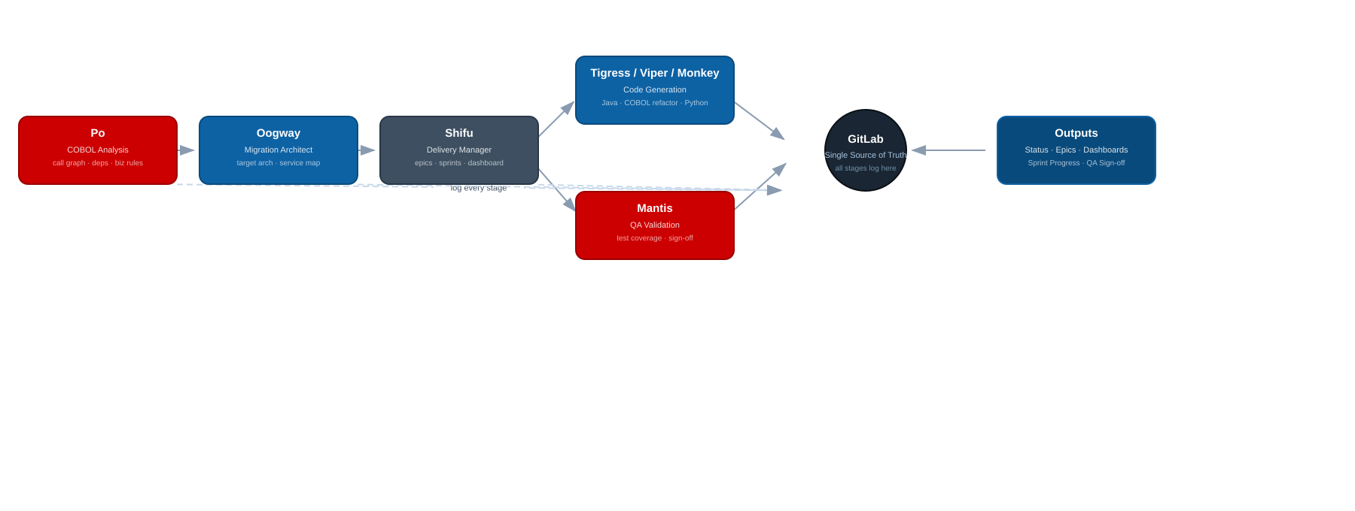
The Agent Squad
7 purpose-built agents, each scoped to a single pipeline stage — together covering full COBOL modernisation
Institutional knowledge captured once in agent configuration — reused across every application in the estate
Analysis · QA
Architecture · Delivery · Code Gen
GitLab · Outputs
Agent Squad · Named after Kung Fu Panda characters · 4 MCP servers: cobol-parser · specdb · delta-macros · gitlab
Infosys × UBS | Confidential
Po, Mantis
Oogway, Shifu, Tigress, Monkey
All stages log here

Slide 6
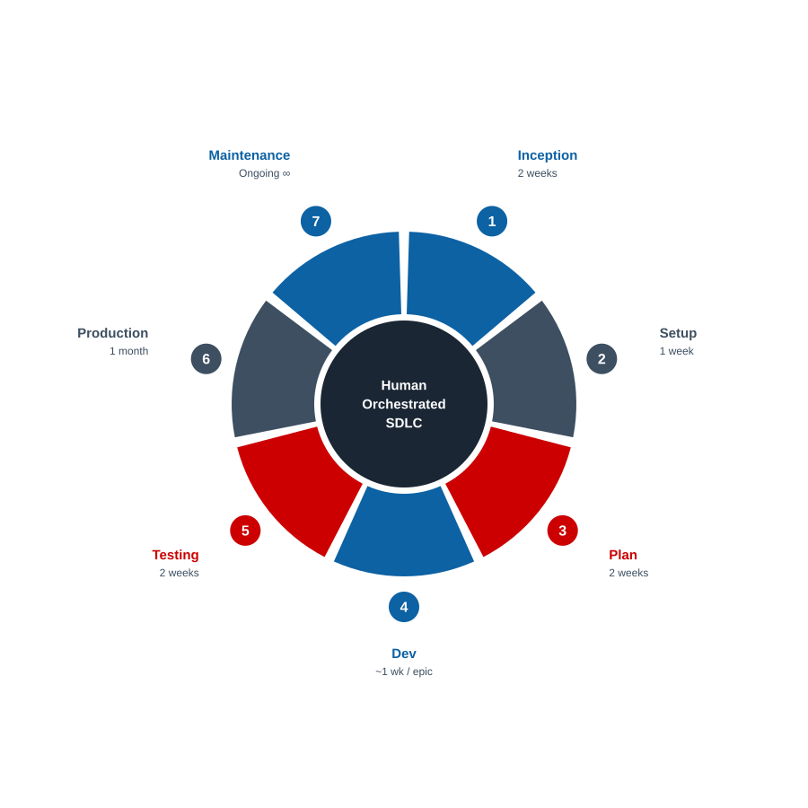
The Process
Human-orchestrated SDLC — every stage gate is a human review in GitLab before the pipeline advances
Every workflow logs to GitLab. Every stage closes with human sign-off. Nothing moves without approval.
STAGE
DUR.
AGENTS
SIGN-OFF
1
Inception
2 wks
Shifu
✅ App Owner + EA
2
Setup
1 wk
Shifu · Po
✅ Tech Lead
3
Plan
2 wks
Po · Oogway · Shifu
✅ App Owner + EA + Domain Expert
4
Dev
~1 wk/epic
Po · Tigress · Viper · Monkey · Shifu
✅ BA + App Tech Lead
5
Testing
2 wks
Mantis · Shifu
✅ App Owner + Tech Lead
6
Production
1 month
Shifu
✅ App Owner
7
Maintenance
Ongoing
Group Mode (all 7)
✅ Incident Owner
🔁 Same process, repeated identically for every application in the estate — the template is defined once, applied without modification to every subsequent program.
The Process · All reviews and approvals handled natively in GitLab — no email chains, no separate tools
Infosys × UBS | Confidential

Slide 7
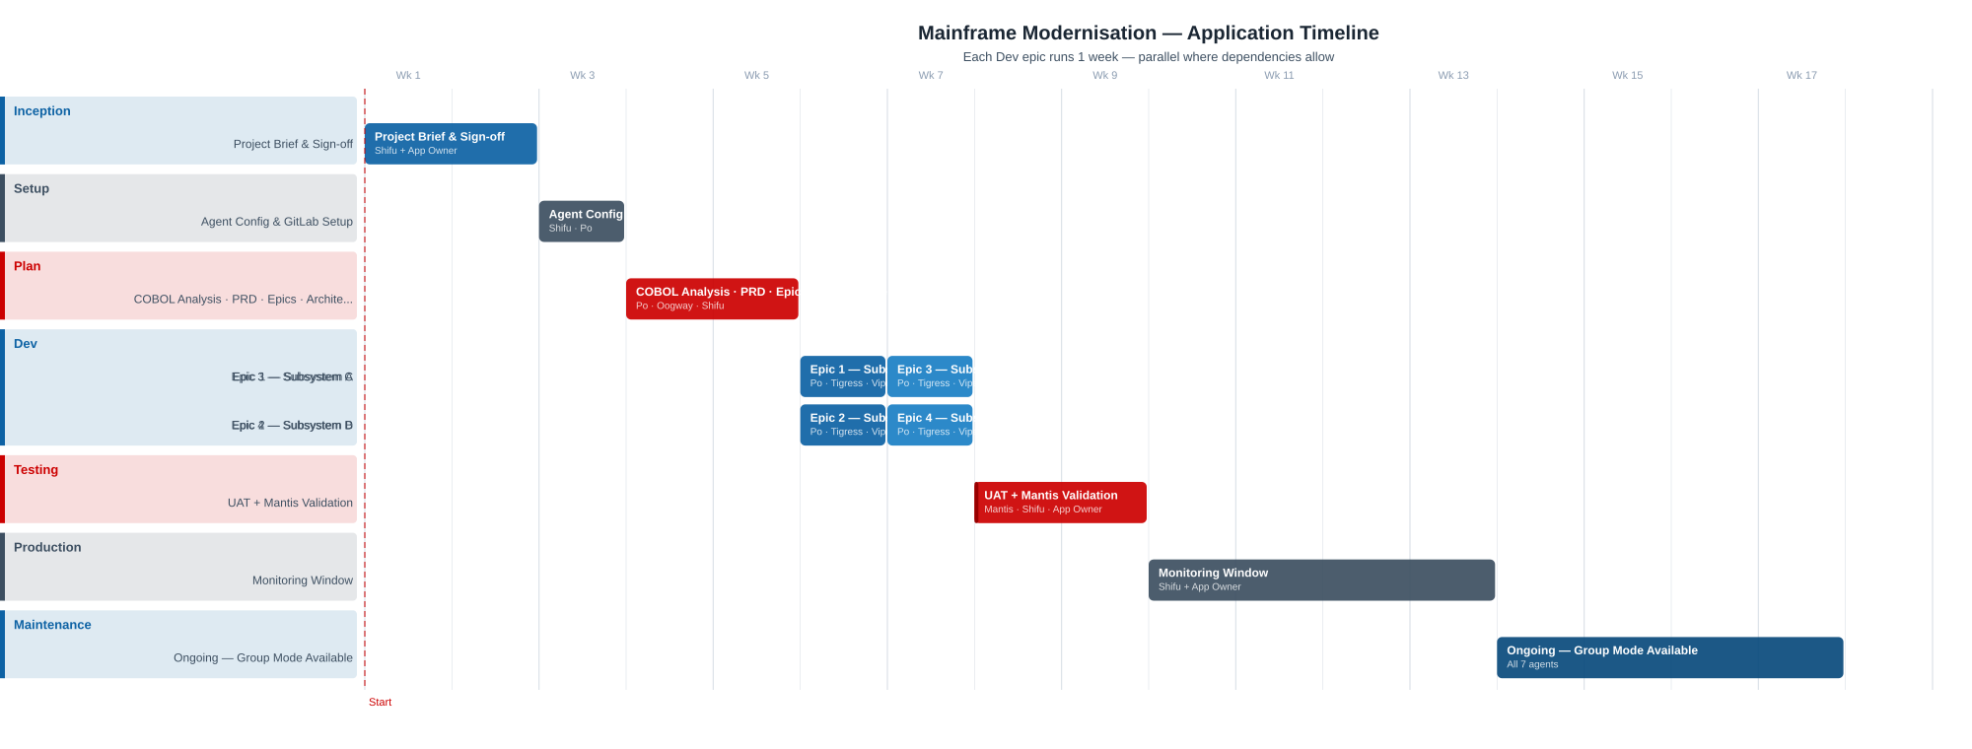
Timeline
End-to-end application delivery — 7 stages, parallel Dev epics, agent assignments per stage
Pilot duration: ~18 weeks for one application end-to-end · Factory model repeats from Stage 3 for each subsequent application
Timeline · Indicative schedule — actual dates set at Inception · All approvals in GitLab
Infosys × UBS | Confidential
Analysis / Plan / Code / Maintenance (Infosys-led)
Setup / Production (Shifu + App Owner)
Testing — critical gate (Mantis + App Owner sign-off)

Slide 8
People & Governance
Existing roles, no new headcount — agents work under human supervision at every stage
The COBOL expert's role changes, not disappears — their institutional knowledge becomes a reusable input to the system
Role
Party
Mode
Responsibility
Active Stages
App Owner
🏦 Bank
✅ Approve
Signs off all stage gates; holds final accountability
All
App Team Tech Lead
🏦 Bank
✅ Approve
Reviews and approves dev epics and testing results
Setup · Dev · Testing
Business Domain Expert
🏦 Bank
🤝 Support
Provides business context; validates extracted business rules
Plan · Dev
Delivery Lead
🔵 Infosys
⚙️ Execute
Runs engagement end-to-end; operates Shifu; manages GitLab sprints
All
COBOL Analyst
🔵 Infosys
⚙️ Execute
Drives all Po workflows; reviews and corrects analysis output
Setup · Dev
Business Analyst
🔵 Infosys
⚙️ Execute
Produces user stories from extracted business rules; manages epic backlog
Dev
Developers
🔵 Infosys
⚙️ Execute
Review, refine, and own all generated code
Dev
Enterprise Architect
🔵 Infosys
⚙️ + ✅
Produces migration architecture; approves technical design
Inception · Plan
Project Manager
🔵 Infosys
⚙️ Execute
Owns project governance, risk, budget, and stakeholder communication
All
Estimated Infosys team: 3–5 annualised headcount for a ~700-module / 500,000 LOC application · Red accent = Bank sign-off required
People & Governance · All approvals recorded natively in GitLab — full audit trail for regulated environments
Infosys × UBS | Confidential

Slide 9
Building the Factory
Three stages — each delivers working output while establishing the capability for the next
Stage 1 proves the pipeline. Stage 2 validates it end-to-end. Stage 3 scales it — at 2.5 HC per application per year.
Stage 1 6 months · 6 HC
Stage 2 7 months · 6 HC
Stage 3 Ongoing · scaled by volume
Pilot
First Full Application
Modernisation Factory
› First version of agent squad built and configured
› Full target application through complete pipeline
› Steady-state operation at 2.5 HC per application per annum
› End-to-end process aligned to org environment
› All epics, full testing, production monitoring
› Covers analysis, development, QA, and delivery management
› One full epic completed on a real application
› Agent v2 refined with real application patterns
› Applications run concurrently through the pipeline
› Pipeline validated against actual COBOL codebase
› Factory process proven end to end
› Process identical for every subsequent application
OUTPUT: Working pipeline + trained team
OUTPUT: 1 app modernised + proven factory
OUTPUT: 2.5 HC per app/year steady state
Factory Build · Pilot begins immediately on existing tooling — no procurement, no delay
Infosys × UBS | Confidential

Slide 10
Market Context & Competitive Landscape
The modernisation market is growing — and every existing tool has the same critical gaps
IBM lost $31B in market cap in a single day when Anthropic announced COBOL capabilities — the market has already decided
$8.4B
$13.3B
9.7%
-13%
global market
size (2025)
projected size
(2030)
market
CAGR
IBM stock drop
on Anthropic COBOL
Tool / Approach
Procurement
AI Model
Biz Rules
Spec IR
E2E
IBM watsonx Code Assistant for Z
Months
Mistral / Granite (fixed)
✗
✗
✗
AWS Mainframe Modernisation
Months
AWS-hosted (fixed)
✗
✗
✗
Micro Focus / OpenText
Months
Proprietary (fixed)
✗
✗
✗
Microsoft / Bankdata (open source)
Setup req.
Open source (fixed)
✗
✗
✗
This Proposal
Zero — start next week
Claude Opus 4.6 + GPT-5.3-Codex
✅
✅
✅
Market Context · MarketsAndMarkets, IBM, Deloitte, CNBC/Bloomberg, Anthropic
Infosys × UBS | Confidential

