Slide 1
Mainframe Modernisation with AI Agents
A Practical Approach — Powered by Tools You Already Have
Infosys · Confidential · 2026

Slide 2
Executive Summary
▸ COBOL estates consume 70–75% of IT budgets. 70% of modernisation projects fail with standard agile.
▸ Existing AI tools require 3–12 months procurement before work begins — and leave implementation to the client.
▸ This proposal uses GitHub Copilot, GitLab and BMAD — already licensed. Zero new software. Work begins next sprint.
▸ 3-stage engagement: 6-month pilot → 7-month full application → ongoing factory at 2.5 HC per app/year.

Slide 3
The Problem
Why existing tools don't work for a regulated bank
▸ Months before work begins — vendor approval in regulated IT takes 3–12 months before technical setup even starts.
▸ $2M–$15M+ absorbed by licensing, server infrastructure, and LLM hosting — before delivery begins.
▸ Locked to yesterday's models — IBM WCA for Z runs Mistral / Granite (fixed). Cannot access frontier models without rebuilding infrastructure.
▸ Products deliver tooling, not outcomes — end-to-end implementation left entirely to the client.
▸ 70% of projects fail — standard agile assumes you understand what you're building. COBOL breaks that assumption.

Slide 4
What You Already Have
The tools for this solution are already licensed and running
GitHub Copilot
GitHub Copilot Agent Mode
GitLab
42% market share · 20M users · 90% of Fortune 100 Claude Opus 4.6 + GPT-5.3-Codex available today Models refreshed continuously — deprecated within days, not years No additional cost to any licensed developer
Full agentic framework — plans, builds, reviews, delegates Custom agents via markdown files MCP servers connect without additional infrastructure Developers already using it — zero learning curve
End-to-end software lifecycle platform Native AI: CI/CD, issue generation, test creation, code review Maps directly to audit and traceability requirements Every pipeline stage tracks in GitLab — zero additional tooling

Slide 5
Solution — A Mainframe Modernisation Factory
▸ Zero procurement — built on GitHub Copilot, GitLab, and BMAD. Technical prerequisites already in place. Work begins this sprint.
▸ Complete SDLC — structural analysis → dependency mapping → business rule extraction → architecture → code generation → QA.
▸ Frontier AI — Claude Opus 4.6 + GPT-5.3-Codex via GitHub Copilot, refreshed continuously. Customised to org-specific macros and glossary.
▸ Documentation by design — every workflow produces business rules, dependency maps, and a queryable spec layer as direct output.
▸ Maintenance-ready — analysis workflows apply to impact assessment, developer onboarding, and pre-release verification.
▸ Tool agnostic — compatible with any MCP-supported coding assistant. Not locked to any single model or provider.

Slide 6
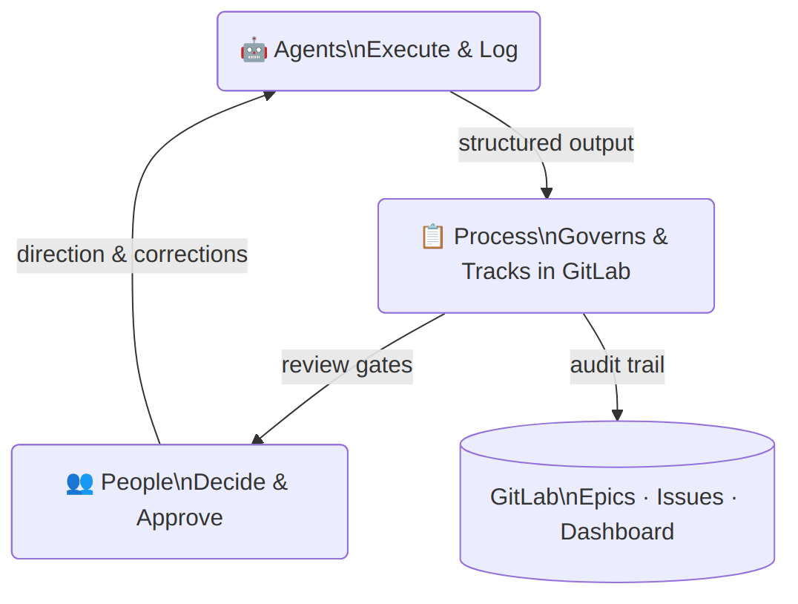
How It Works — Three Pillars
▸ Agents execute — specialised AI for each stage: analysis, architecture, delivery, code generation, QA.
▸ Process governs — every stage is a defined workflow with explicit inputs, outputs, and a GitLab review gate.
▸ People decide — analyst, architect, domain expert, tech lead and developers approve every output before it moves downstream.
▸ Spec layer (SQLite) is the shared backbone — the only shared state between agents. No direct agent-to-agent communication.

Slide 7
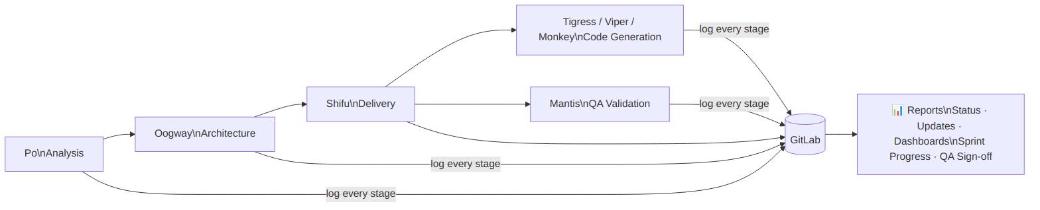
The Agent Squad
Each agent has one role. Every action is logged to GitLab.
▸ Po COBOL analysis: structure, dependencies, business rules → spec layer. Most critical agent. Standalone-capable.
▸ Oogway Migration architect — reads spec layer, produces target architecture and migration sequence.
▸ Shifu Delivery manager — GitLab project, sprints, milestones, live dashboard.
▸ Tigress / Viper / Monkey Code generation — Java, COBOL refactor, Python. Target language set by Oogway.
▸ Mantis QA validation — generated code vs spec layer business rules. Manages GitLab epic sign-off.
▸ Group Mode All agents active simultaneously — for production incidents, critical decisions, or unblocking sessions.

Slide 8
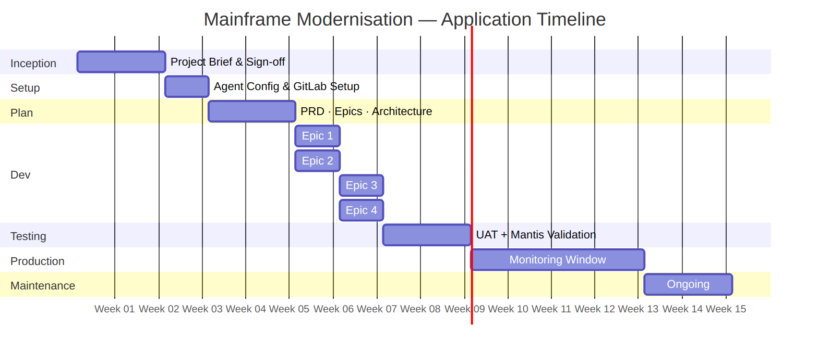
The Process
Every review gate is handled directly in GitLab
Stage | Sign-off | Output
Inception (2w) | App Owner + Architect | Project brief, tech stack, success criteria
Setup (1w) | Technical Lead | Agent config, GitLab init, spec layer setup
Plan (2w) | App Owner + Architect + Domain Expert | PRD, epics, architecture, testing strategy
Dev (~1w/epic) | BA + App Team Tech Lead | Business rules → user stories → code. Parallel epics.
Testing | App Owner + App Team Tech Lead | Mantis validation + UAT. Behaviour must match or deviation documented.
Production (1m) | App Owner | Monitored against Inception success criteria
Maintenance | Incident Owner | Group Mode or targeted agents. Same GitLab-tracked pattern.

Slide 9
People
Agents execute. People decide. No new headcount required.
Role | By | Mode | Responsibility | Stages
App Owner | 🏦 Bank | ✅ Approve | Final accountability · all sign-offs | All
App Team Tech Lead | 🏦 Bank | ✅ Approve | Technical quality gate · dev + test sign-off | Setup, Dev, Testing
Business Domain Expert | 🏦 Bank | 🤝 Support | Business context · validates extracted business rules | Plan, Dev
Delivery Lead | 🔵 Infosys | ⚙️ Execute | Runs engagement · operates Shifu · GitLab sprints | All
COBOL Analyst | 🔵 Infosys | ⚙️ Execute | Drives Po workflows · reviews analysis output | Setup, Dev
Business Analyst | 🔵 Infosys | ⚙️ Execute | User stories from business rules · epic backlog | Dev
Developers | 🔵 Infosys | ⚙️ Execute | Review, refine, and own all generated code | Dev
Enterprise Architect | 🔵 Infosys | ⚙️ Execute + ✅ Approve | Produces + approves migration architecture | Inception, Plan
Project Manager | 🔵 Infosys | ⚙️ Execute | Governance · risk · budget · stakeholder comms | All
For ~700 modules / 500,000 LOC: estimated 3–5 annualised Infosys HC for full engagement

Slide 10
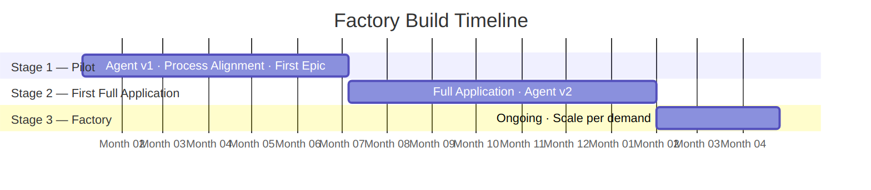
Building the Factory
Incrementally — each stage delivers output and builds capability
Stage 1 — Pilot
6 months · 6 HC (3 EU + 3 India)
Build agent v1 · align process · prove pipeline on one epic
Stage 2 — First App
7 months · 6 HC (same team)
Full application modernised · agent v2 refined from real-world data
Stage 3 — Factory
Ongoing · 2.5 HC per app/year
Repeatable at scale · team sized by annual application throughput

Slide 11
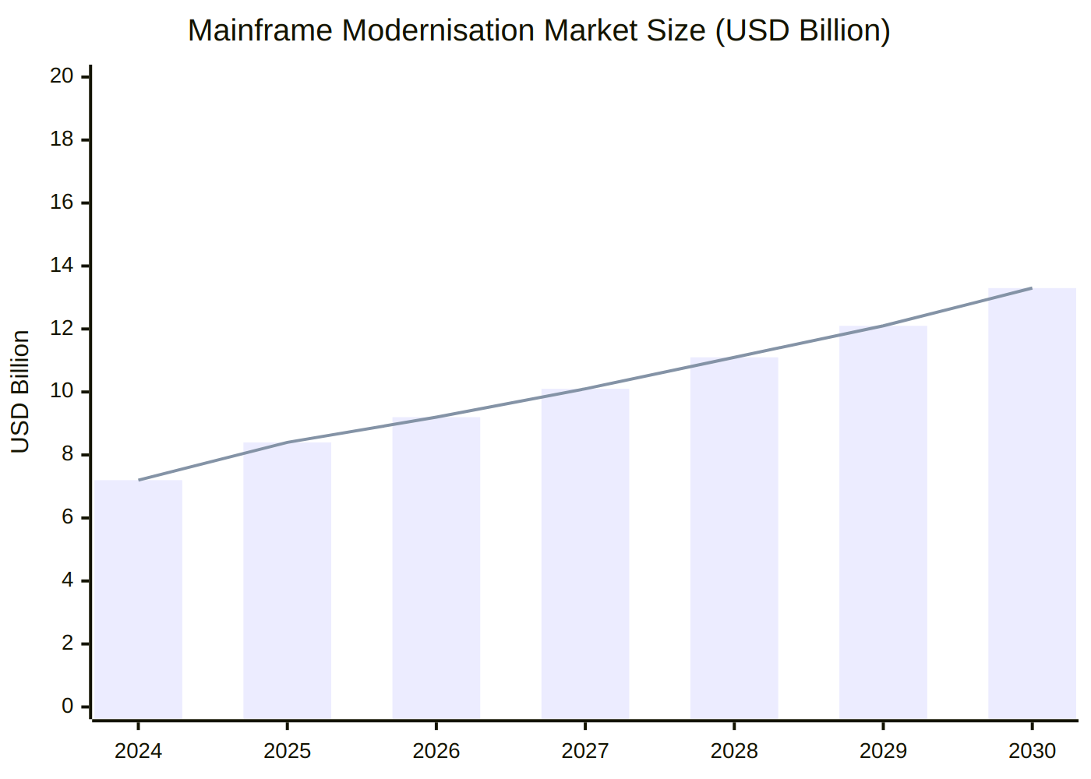
Appendix A — Market Context
Statistic | Figure
Market size 2025 | $8.4B (mainframe modernisation)
Projected 2030 | $13.3B · CAGR 9.7%
Daily commerce on COBOL | $3 trillion
Avg COBOL programmer age | ~60 years · one-third retiring by 2030
IT budget on legacy maintenance | 70–75% (financial services)
Project failure rate | 70% with standard agile
IBM stock drop (Feb 2026) | –13% in one day on Anthropic COBOL announcement
IBM market cap lost | $31 billion in one day

Slide 12
Appendix B — Competitive Comparison
Tool | Procurement | AI Model | Business Rules | Structured IR | End-to-End
IBM WCA for Z | Months + licensing | Mistral / Granite (fixed) | ✗ | ✗ | ✗
AWS Mainframe Mod. | Months + cloud setup | AWS-hosted (fixed) | ✗ | ✗ | ✗
Micro Focus / OpenText | Months + licensing | Proprietary (fixed) | ✗ | ✗ | ✗
Microsoft / Bankdata | Setup required | Open source (fixed) | ✗ | ✗ | ✗
This proposal | Zero — start next sprint | Claude Opus 4.6 + GPT-5.3-Codex (live) | ✅ | ✅ | ✅

Slide 13
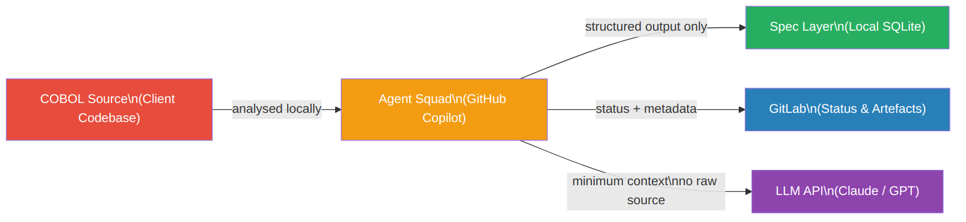
Appendix C — Security & Data Privacy
Designed local-first for regulated environments
Principle | Implementation
Source code stays local | All MCP servers run locally via STDIO — no source transmitted externally
Spec layer stays local | SQLite on local machine · configurable path · gitignored
LLM context is scoped | Only the specific paragraph cluster under analysis — no full program dumps
GitLab receives metadata only | Stage labels, status comments, summaries — not raw COBOL source
Credentials via env vars | GITLAB_TOKEN in environment — never written to config files

Slide 14
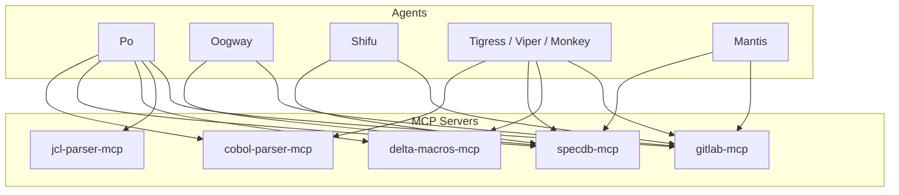
Appendix D — Agent Capabilities Matrix
Agent | cobol-parser | specdb | delta-macros | jcl-parser | gitlab
Po | ✅ | ✅ | ✅ | ✅ | ✅
Oogway | — | ✅ | — | — | ✅
Shifu | — | ✅ | — | — | ✅
Tigress / Viper / Monkey | ✅ | ✅ | ✅ | — | ✅
Mantis | — | ✅ | — | — | ✅

