Slide 1



PROPOSAL
Mainframe Modernization Factory
for Z-Abacus
Setting Up an AI-Powered Modernization Engine — Together
3x Faster
4 Years
High Quality
One-third the usual effort
Complete estate retirement
Fully traceable, audit-ready
Infosys
Confidential | February 2026

Slide 2
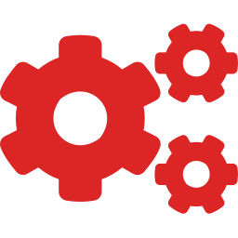




THE SITUATION
Built Solid 30 Years Ago. Every Year Since Has Added Risk.
30 years ago
Solid
Outdated Technology
Core systems on aging platforms that fewer people understand each year
Dead Programs
Code no one knows is still in use — but no one dares remove
Wrong or Missing Documentation
What exists is often outdated, incomplete, or simply incorrect
Critical Knowledge Gaps
The people who built these systems have moved on. What they knew left with them.
Today
This isn't stable. And it compounds every quarter.
Infosys
Confidential | February 2026

Slide 3


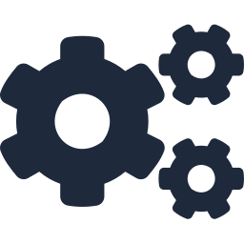

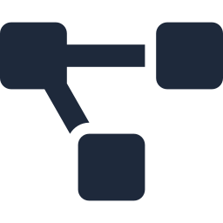

THE CHALLENGE
Every Past Attempt Stalled. Here's Why.
Sheer Scale
120+ applications, ~60 million lines of code. This isn't a project — it's an estate.
Criticality
Live banking operations. If this tower falls, it's reputational damage.
Deep Customization
600+ delta macros layered over decades. Nothing is standard anymore.
Interconnected Systems
Dare to touch?
Pulling one piece risks destabilizing others. Every change has a blast radius.
No Documentation to Rely On
You can't safely transform what you don't fully understand.
You can't brute-force this. You need a fundamentally different approach.
Infosys
Confidential | February 2026

Slide 4





THE SOLUTION
A Factory That Puts Every Piece Back in Place
BEFORE
Modern Architecture
Simpler, efficient implementation. Built for today, ready for tomorrow.
AFTER
Easier to Manage
THE FACTORY
Clean systems that teams can understand, maintain, and extend.
Dead Weight Removed
Unwanted programs identified and retired. No more untouchable code.
Knowledge Captured Permanently
Fragile. Undocumented.
Risk compounding.
Smaller. Balanced.
Ready to build on.
Business logic and decisions extracted from heads and locked in forever.
A foundation you can finally build on.
Infosys
Confidential | February 2026

Slide 5
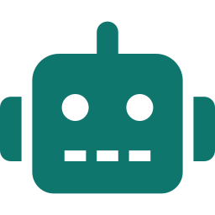




WHY NOW
The Tools Exist. The Missing Piece Was the Engine.
What AI Agents Can Now Do
What You Already Have
What Was Missing
Comprehend millions of lines of legacy code in hours
Watson Code Assistant
A framework connecting tools into a single pipeline
Legacy code comprehension
Extract business rules from undocumented programs
GitHub Copilot
A methodology turning AI into repeatable output
Code generation
Generate transformation code and test cases
GitLab Duo
People who understand mainframe AND AI workflows
CI/CD, orchestration, traceability
Validate changes across interconnected systems
Backstage
This is what Infosys brings.
Documentation & app catalog
You don't need more tools. You need the engine that makes them work together.
Infosys
Confidential | February 2026

Slide 6




THE ENGINE
AI Agents. 2-Day Sprints. One Application at a Time.
PRE-SPRINT
DAY 1
DAY 2
Discovery
Create & Review
Execute & Validate
AI Analyst scans legacy code
AI Architect generates target design
AI agents execute transformation
Extracts business rules
AI Developer produces code
Automated testing runs
Maps dependencies
Test cases auto-generated
Docs generated in Backstage
Human SME validates
Human team reviews & approves
All actions logged in GitLab
YOUR TOOLS
Watson | Copilot | GitLab Duo | Backstage
OUR ENGINE
BMAD Framework | Infosys Team
Every application enters legacy. Every application exits modern. Fully documented. Fully traceable.
Infosys
Confidential | February 2026

