Slide 1
The Agent Squad
7 agents · 5 pipeline stages · Analyst in the expert seat at every gate
SETUP Phase 0
›
DISCOVER Phases 1–3 · Viper + Crane
›
UNDERSTAND Phases 4–6 · Shifu
›
DESIGN Phases 7–8 · Oogway
›
DELIVER Phases 9–10 · Po + Tai Lung + Tigress
PHASE 0
VIPER
DISCOVER
CRANE
DISCOVER
SHIFU
UNDERSTAND
OOGWAY
DESIGN
PO
Setup
Target Code Generator
COBOL Structural Analyst
Cross-Module Dependency Mapper
Business Logic Extractor
Migration Architect
1
WORKFLOW
WORKFLOW
WORKFLOW
WORKFLOW
1
Read SM-enriched story spec
1
Parse COBOL — call graph + paragraph map
1
Consume Viper static dependency tables
1
Extract business rules per module paragraph
1
Read business function catalogue from spec layer
2
Generate Java/Python from spec layer
config.yaml
Flag low-conf rules as TODO stubs
Project settings
DB + GitLab paths
3
2
Score complexity: Low / Medium / High
2
Parse JCL job step sequences (runtime)
2
Expand Delta macros inline into rule text
2
Define service boundaries per business capability
▶ Clean target-language code per module
2
3
Detect anti-patterns: GOTOs, ALTERs, REDEFINES
3
Merge static + runtime into full dep. graph
3
Score confidence 0.0–1.0 per rule/operation
3
Design API contracts + target data model
TAI LUNG
Init Schema
4
Resolve Delta macros via delta-macros-mcp
4
Detect circular dependencies + dead code
4
Cluster modules into named business capabilities
4
Flag low-confidence areas — block if <0.70
QA Validator & Sign-off
specdb-mcp creates
all spec tables
1
Load spec_rules for the module
5
Flag unknown constructs — never silently ignored
5
Produce topological migration order
5
Ask Agent [AQ]: NL queries across spec layer
5
Produce capability-first architecture document
2
Validate code vs business rules
3
3
High-conf=must-pass · Low=advisory
KEY INPUT
KEY INPUT
KEY INPUT
KEY INPUT
Delta Macros
Raw .cbl modules + copybooks
Viper outputs + JCL step data in specdb
Viper + Crane outputs in specdb
Shifu business function catalogue (specdb)
▶ QA report + Epic sign-off in GitLab
Load macro library
markdown files
KEY OUTPUT
KEY OUTPUT
KEY OUTPUT
KEY OUTPUT
Call graph + complexity report in specdb
Mermaid dep. graph + migration order in specdb
Populated spec layer + business function catalogue
Target architecture → feeds PM Epic generation
TIGRESS
4
Delivery Manager
BUILT ON
BUILT ON
BUILT ON
BUILT ON
1
Epics per capability · Issues per module
Glossary
cobol-parser-mcp · specdb-mcp · delta-macros-mcp
specdb-mcp · cobol-parser-mcp
specdb-mcp · delta-macros-mcp
specdb-mcp
2
Sprint milestones from migration order
Map COBOL fields
to business terms
3
Live README dashboard — auto-updated
▶ Sprint-ready GitLab project

Slide 2
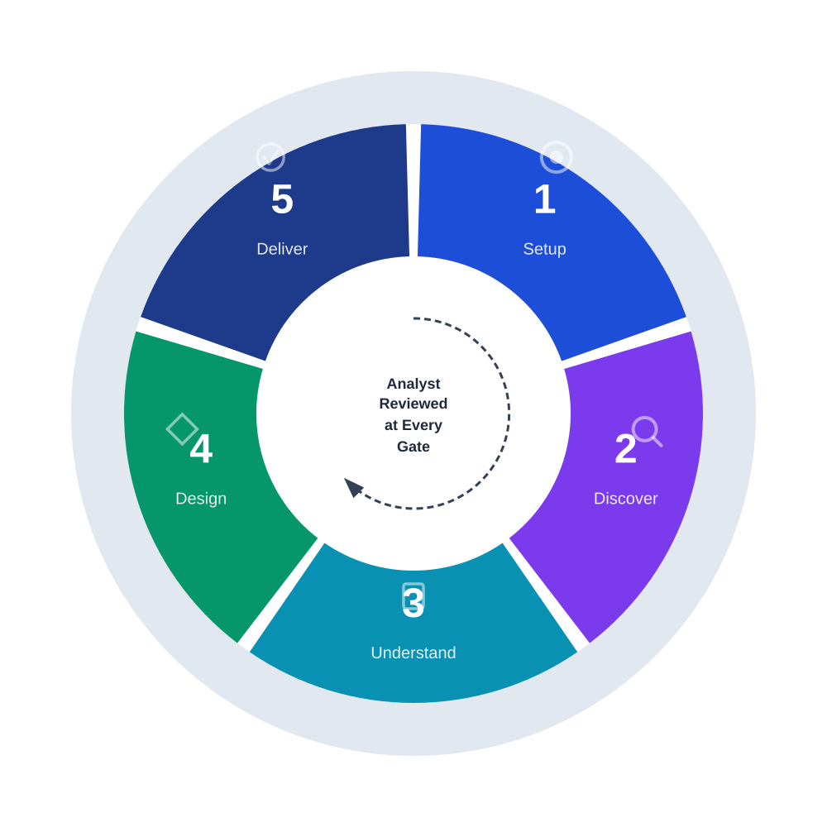
The Modernisation Process
5 Phases · AI-Assisted Discovery & Understanding · Analyst Gate at Every Stage
5. Deliver
1. Setup
1
Po: generate code from spec layer
1
Config yaml · init spec database
▼
▼
2
Tai Lung: QA vs spec_rules (conf-weighted)
2
Load Delta macro library files
▼
▼
3
Tigress: GitLab Epics + sprint milestones
3
Map COBOL fields via glossary file
▼
2. Discover
4
Sign-off closes Epic — all rules verified
4. Design
1
Viper: parse modules, call graphs, complexity
▼
1
Oogway: capability-first target architecture
2
JCL parser: job boundaries + dataset flows
▼
▼
2
Define service boundaries + API contracts
3
Crane: cross-module dependency graph
▼
▼
3
PM Agent: BMAD Epics per business function
4
Migration order via topological sort
▼
3. Understand
4
SM: enrich stories with spec layer context
1
Shifu: extract business rules per paragraph
▼
2
Expand Delta macros inline into rules
▼
3
Cluster modules into business capabilities
▼
4
Ask Agent [AQ]: NL queries on logic
"Understand first — convert later" is the architecture, not a team norm

